Slide 1
Smart Pointers
Course: Rust Basics
Author: Aleksandr Kugushev

Slide 2
Null
struct User { first_name: String, second_name: String, middle_name: String, }
fn print(user: &User) { println!("{} {} {}", user.first_name, user.second_name, user.middle_name); }

Slide 3
Null in Rust aka Option
let mut var: Option<i32> = Option::None;
assert_eq!(true, var.is_none());
var = Option::Some(42);
assert_eq!(true, var.is_some());
print!("{}", var.unwrap());
let reference: &i32 = var.as_ref().unwrap();

Slide 4
Option in struct
struct User { first_name: String, second_name: String, middle_name: Option<String>, }

Slide 5
Stack vs Heap
Let’s draw

Slide 6
How to move data to heap?
unsafe {
let layout = Layout::new::<u16>();
let ptr = alloc(layout);
if ptr.is_null() { handle_alloc_error(layout); }
*(ptr as *mut u16) = 42;
assert_eq!(*(ptr as *mut u16), 42);
dealloc(ptr, layout);
}
Problems?

Slide 7





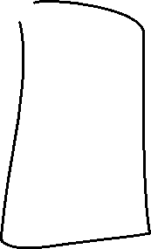



Ownership Based Resource Management (OBRM)

Slide 8
MyObrm
struct MyObrm<T> { ptr: *mut T, }
impl<T> MyObrm<T> { fn new(val: T) -> Self { unsafe { let layout = Layout::new::<T>(); let ptr = alloc(layout) as *mut T; if ptr.is_null() { handle_alloc_error(layout); } *ptr = val; MyObrm { ptr } } } }

Slide 9
MyObrm usage
fn obrm_usage() { let user = MyObrm::new(MyStruct { my_value: 42 }); println!("Print: {}", user.my_value); drop(user); }

Slide 10
Deref and DerefMut traits
impl<T> Deref for MyObrm<T> {
type Target = T;
fn deref(&self) -> &Self::Target {
unsafe { &*self.ptr } } }
println!("Print: {}", user.my_value);

Slide 11
Drop trait
impl<T> Drop for MyObrm<T> {
fn drop(&mut self) {
unsafe { let layout = Layout::new::<T>(); dealloc(self.ptr as *mut u8, layout); } } }

Slide 12
Box
Former ~T syntax
Now it is just a Rust structure Box<>
let smart_ptr: Box<i32> = Box::new(42);
struct Box<T>{ pointer: *const T }

Slide 13
Reference to Boxed value
let mut boxed = Box::new(MyStruct { my_value: 42 });
let reference: &MyStruct = &boxed;
println!("{}", reference.my_value);
let mut_reference: &mut MyStruct = &mut boxed;
mut_reference.my_value = 123;
let reference: &Box<MyStruct> = &boxed;
println!("{}", reference.my_value);

Slide 14
Box is special
let mut boxed = Box::new(MyStruct { my_value: 42 });
let mut x: MyStruct = *boxed;
x.my_value = 123;
println!("{}", x.my_value);
let reference = &x;
println!("{}", boxed.my_value)
error[E0382]: borrow of moved value: `*boxed`

Slide 15
Practice: Linked List

Slide 16
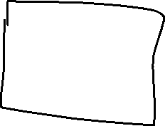


Linked List and Borrowing
struct Node { value: i32, next: Option<Node>, }
error[E0072]: recursive type `Node` has infinite size
struct Node<'a> { value: i32, next: Option<&'a Node<'a>>, }

Slide 17
Linked List and Borrowing
let mut node1 = Node { value: 1, next: None }; let mut node2 = Node { value: 2, next: None }; let mut node3 = Node { value: 3, next: None };
node1.next = Some(&node2); node2.next = Some(&node3);
^^^^^^^ `node2.next` is assigned to here but it was already borrowed
println!("{}", node1.next.unwrap().next.unwrap().value);

Slide 18
Linked List and Borrowing
let mut node1 = Node { value: 1, next: None }; { let mut node2 = Node { value: 2, next: None }; let mut node3 = Node { value: 3, next: None }; node2.next = Some(&node3); node1.next = Some(&node2); node1.next = None; } println!("{}", node1.value)
<- borrowed value does not live long enough
<- borrowed value does not live long enough

Slide 19
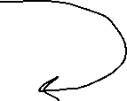








Linked List and Borrowing
Expectation
Reality

Slide 20

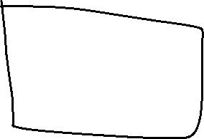






Practice: Previous in linked list

Slide 21
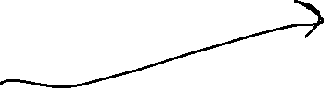


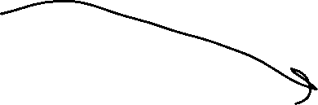
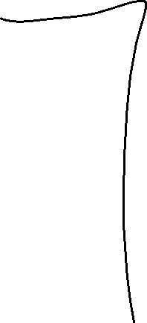
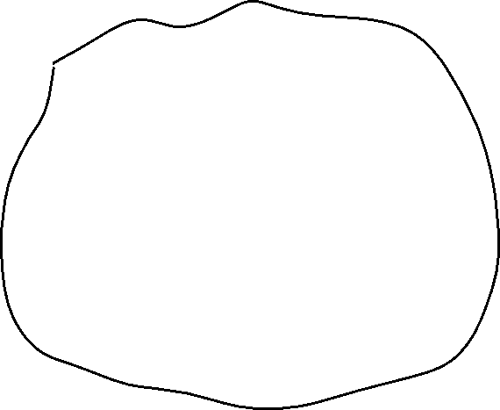


RC – shared ownership

Slide 22
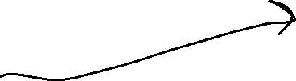


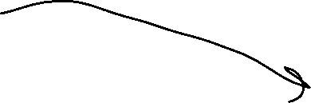
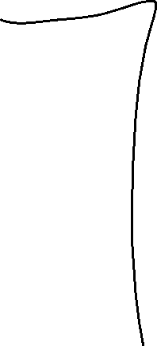
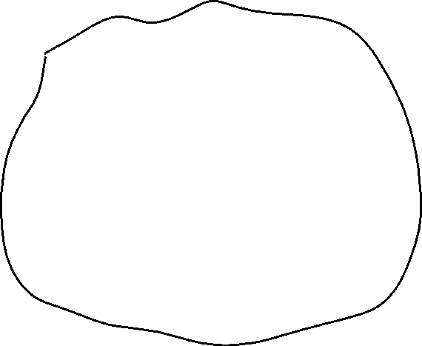


RC – shared ownership

Slide 23

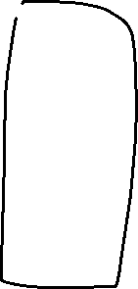





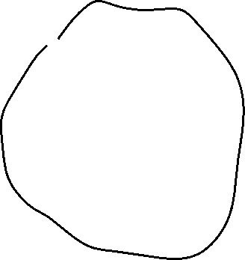


RC vs Box
RC
&Box

Slide 24
Rc
let owner1 = Rc::new(MyStruct { my_value: 42 });
let owner2: Rc<MyStruct> = owner1.clone();
let owner3: Rc<MyStruct> = owner2.clone();
println!("{}", owner3.my_value);
println!("{}", owner1.my_value);
println!("{}", owner2.my_value);
let reference: &MyStruct = &owner1;
println!("{}", reference.my_value);

Slide 25
Edit Rc value
let owner1 = Rc::new(MyStruct { value1: 42, value2: true });
owner1.value1 = 123;
error[E0594]: cannot assign to data in an `Rc`

Slide 26
Interior Mutability
let cell = Cell::new(42);
let reference1: &Cell<i32> = &cell;
let reference2: &Cell<i32> = &cell;
println!("{}", reference1.get()); // > 42
reference1.replace(123);
println!("{}", reference2.get()); // > 123

Slide 27
Cell – Alias Safe
pub fn replace(&self, val: T) -> T { mem::replace(unsafe { &mut *self.value.get() }, val) // wrapped assignment }
pub const fn replace<T>(dest: &mut T, src: T) -> T { // SAFETY: We read from `dest` but directly write `src` into it afterwards, // such that the old value is not duplicated. Nothing is dropped and // nothing here can panic. unsafe { let result = ptr::read(dest); ptr::write(dest, src); result } }

Slide 28
How to get data from Cell
get() – returns copy!
take() – return value and replace with Default
replace() – return value and replace

Slide 29
RefCell
let cell = RefCell::new(MyStruct { my_value: 42 });
{ let reference1: Ref<MyStruct> = cell.borrow(); println!("{}", reference1.my_value); // > 42 }
{ let mut borrowed: RefMut<MyStruct> = cell.borrow_mut(); borrowed.my_value = 123; }
let reference2: Ref<MyStruct> = cell.borrow(); println!("{}", reference2.my_value); // > 123

Slide 30
RefCell
let cell = RefCell::new(MyStruct { my_value: 42 }); let reference1: Ref<MyStruct> = cell.borrow(); println!("{}", reference1.my_value); // > 42 { let mut borrowed: RefMut<MyStruct> = cell.borrow_mut(); borrowed.my_value = 123; } let reference2: Ref<MyStruct> = cell.borrow(); println!("{}", reference2.my_value); // > 123
Ref != &
PANIC: already borrowed: BorrowMutError

Slide 31
Practice: Previous in linked list

Slide 32






Circular references
struct NodeLeft { right: Cell<Option<Rc<NodeRight>>>, } struct NodeRight { left: Cell<Option<Rc<NodeLeft>>>, }
let node_left = Rc::new(NodeLeft { right: Cell::new(None) });
let node_right = Rc::new(NodeRight { left: Cell::new(Some(node_left.clone())) });
let e = node_left.right.replace(Some(node_right.clone()));

Slide 33


Rc::downgrade()
struct NodeLeft { right: Cell<Option<Rc<NodeRight>>>, }
struct NodeRight { left: Cell<Option<Weak<NodeLeft>>>, }
let node_left = Rc::new(NodeLeft { right: Cell::new(None) });
let node_right = Rc::new(NodeRight { left: Cell::new(Some(Rc::downgrade(&node_left))) });
let e = node_left.right.replace(Some(node_right.clone()));

Slide 34
upgrade()
let five = Rc::new(5);
let weak_five = Rc::downgrade(&five);
let strong_five: Option<Rc<_>> = weak_five.upgrade();
assert!(strong_five.is_some());
drop(strong_five);
drop(five);
assert!(weak_five.upgrade().is_none());

Slide 35
Why Rc::downgrade(), but not rc1. downgrade()?
Deref

Slide 36
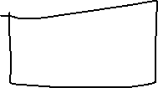


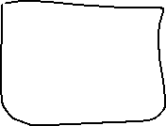
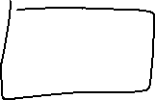

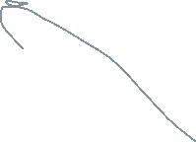






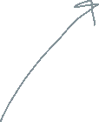

Practice: Tree

Slide 37
Vec
pub struct Vec<T> { pointer: *const T, len: usize, }
let mut vec: Vec<i32> = Vec::new();
vec.push(42);
let last: Option<i32> = vec.pop();

Slide 38
Vec
let mut vec = vec![1, 2, 3];
let count = vec.len();
let first:i32 = vec[0];
let mut vec = vec![String::from("Hi")]; let first: String = vec[0];
error[E0507]: cannot move out of index of `Vec<String>`

Slide 39
Get by reference
let mut vec = vec![String::from("Hi")];
let first: &String = &vec[0];
let first: Option<&String> = vec.get(0);

Slide 40
Borrow element, borrow whole vector
let mut vec = vec![String::from("Hi")];
let first: &String = &vec[0];
vec.push(String::from("World"));
println!("{}", first);
error[E0502]: cannot borrow `vec` as mutable because it is also borrowed as immutable

Slide 41
Set vec element
let first_mut: &mut String = &mut vec[0]; *first_mut = String::from("Hello");
vec[0] = String::from("World");

Slide 42
Box internals
pub struct Box<T: ?Sized,A: Allocator = Global>(Unique<T>, A);
pub struct Unique<T: ?Sized> { pointer: NonNull<T>, // NOTE: this marker has no consequences for variance, but is necessary // for dropck to understand that we logically own a `T`. _marker: PhantomData<T>, }
pub struct PhantomData<T: ?Sized>;

Slide 43
NonNull
pub struct NonNull<T: ?Sized> { pointer: *const T, }
*mut T but non-zero and covariant

Slide 44
Clone
fn clone(&self) -> Rc<T> { unsafe { self.inner().inc_strong(); Self::from_inner(self.ptr) } }

Slide 45
Rc internals
pub struct Rc<T: ?Sized,A: Allocator = Global> { ptr: NonNull<RcBox<T>>, phantom: PhantomData<RcBox<T>>, alloc: A, }
struct RcBox<T: ?Sized> { strong: Cell<usize>, weak: Cell<usize>, value: T, }

Slide 46
Rc::clone()
fn clone(&self) -> Self { unsafe { self.inner().inc_strong(); Self::from_inner_in(self.ptr, self.alloc.clone()) } }
fn inner(&self) -> &RcBox<T> { // This unsafety is ok because while this Rc is alive we're guaranteed // that the inner pointer is valid. unsafe { self.ptr.as_ref() } }

Slide 47
Rc::drop()
unsafe impl<T: ?Sized, A: Allocator> Drop for Rc<T, A> { fn drop(&mut self) { unsafe { self.inner().dec_strong(); if self.inner().strong() == 0 { // destroy the contained object ptr::drop_in_place(Self::get_mut_unchecked(self)); // remove the implicit "strong weak" pointer now that we've // destroyed the contents. self.inner().dec_weak(); if self.inner().weak() == 0 { self.alloc.deallocate(self.ptr.cast(), Layout::for_value(self.ptr.as_ref())); } } } } }

Slide 48
upgrade()
pub fn upgrade(&self) -> Option<Rc<T, A>> where A: Clone, { let inner = self.inner()?; if inner.strong() == 0 { None } else { unsafe { inner.inc_strong(); Some(Rc::from_inner_in(self.ptr, self.alloc.clone())) } } }

Slide 49
Cell internals
pub struct Cell<T: ?Sized> { value: UnsafeCell<T>, }
pub struct UnsafeCell<T: ?Sized> { value: T, }

Slide 50
Cell get()
Cell
UnsafeCell
impl<T: Copy> Cell<T> { pub fn get(&self) -> T { unsafe { *self.value.get() } } }
impl<T: ?Sized> UnsafeCell<T> { pub const fn get(&self) -> *mut T { self as *const UnsafeCell<T> as *const T as *mut T } }

Slide 51
Cell replace()
pub fn replace(&self, val: T) -> T { mem::replace(unsafe { &mut *self.value.get() }, val) }
pub const fn replace<T>(dest: &mut T, src: T) -> T { unsafe { let result = ptr::read(dest); ptr::write(dest, src); result } }

Slide 52
RefCell internals
struct RefCell<T: ?Sized> { borrow: Cell<BorrowFlag>, borrowed_at: Cell<Option<&'static crate::panic::Location<'static>>>, value: UnsafeCell<T>, }
type BorrowFlag = isize;

Slide 53
borrow()
pub fn borrow(&self) -> Ref<'_, T> { self.try_borrow().expect("already mutably borrowed") }

Slide 54
try_borrow()
pub fn try_borrow(&self) -> Result<Ref<'_, T>, BorrowError> { match BorrowRef::new(&self.borrow) { Some(b) => { { // `borrowed_at` is always the *first* active borrow if b.borrow.get() == 1 { self.borrowed_at.set(Some(crate::panic::Location::caller())); } } // SAFETY: `BorrowRef` ensures that there is only immutable access // to the value while borrowed. let value = unsafe { NonNull::new_unchecked(self.value.get()) }; Ok(Ref { value, borrow: b }) } None => Err(BorrowError { // If a borrow occurred, then we must already have an outstanding borrow, // so `borrowed_at` will be `Some` location: self.borrowed_at.get().unwrap(), }), } }

Slide 55
BorrowRef
impl<'b> BorrowRef<'b> { fn new(borrow: &'b Cell<BorrowFlag>) -> Option<BorrowRef<'b>> { let b = borrow.get().wrapping_add(1); if !is_reading(b) { // Incrementing borrow can result in a non-reading value (<= 0) in these cases: // 1. It was < 0, i.e. there are writing borrows, so we can't allow a read borrow // due to Rust's reference aliasing rules // 2. It was isize::MAX (the max amount of reading borrows) and it overflowed // into isize::MIN (the max amount of writing borrows) so we can't allow // an additional read borrow because isize can't represent so many read borrows // (this can only happen if you mem::forget more than a small constant amount of // `Ref`s, which is not good practice) None } else { // Incrementing borrow can result in a reading value (> 0) in these cases: // 1. It was = 0, i.e. it wasn't borrowed, and we are taking the first read borrow // 2. It was > 0 and < isize::MAX, i.e. there were read borrows, and isize // is large enough to represent having one more read borrow borrow.set(b); Some(BorrowRef { borrow }) } } }
fn is_reading(x: BorrowFlag) -> bool { x > UNUSED }
const UNUSED: BorrowFlag = 0;

Slide 56
Ref
pub struct Ref<'b, T: ?Sized + 'b> { value: NonNull<T>, borrow: BorrowRef<'b>, }
pub struct NonNull<T: ?Sized> { pointer: *const T, }
struct BorrowRef<'b> { borrow: &'b Cell<BorrowFlag>, }
type BorrowFlag = isize;
Notes:
// NB: we use a pointer instead of `&'b T` to avoid `noalias` violations, because a // `Ref` argument doesn't hold immutability for its whole scope, only until it drops. // `NonNull` is also covariant over `T`, just like we would have with `&T`.
// Positive values represent the number of `Ref` active. Negative values // represent the number of `RefMut` active. Multiple `RefMut`s can only be // active at a time if they refer to distinct, nonoverlapping components of a // `RefCell` (e.g., different ranges of a slice). // // `Ref` and `RefMut` are both two words in size, and so there will likely never // be enough `Ref`s or `RefMut`s in existence to overflow half of the `usize` // range. Thus, a `BorrowFlag` will probably never overflow or underflow. // However, this is not a guarantee, as a pathological program could repeatedly // create and then mem::forget `Ref`s or `RefMut`s. Thus, all code must // explicitly check for overflow and underflow in order to avoid unsafety, or at // least behave correctly in the event that overflow or underflow happens (e.g., // see BorrowRef::new).

Slide 57
try_borrow_mut()
pub fn try_borrow_mut(&self) -> Result<RefMut<'_, T>, BorrowMutError> { match BorrowRefMut::new(&self.borrow) { Some(b) => { { self.borrowed_at.set(Some(crate::panic::Location::caller())); } // SAFETY: `BorrowRefMut` guarantees unique access. let value = unsafe { NonNull::new_unchecked(self.value.get()) }; Ok(RefMut { value, borrow: b, marker: PhantomData }) } None => Err(BorrowMutError { // If a borrow occurred, then we must already have an outstanding borrow, // so `borrowed_at` will be `Some` location: self.borrowed_at.get().unwrap(), }), } }

Slide 58
BorrowRefMut
impl<'b> BorrowRefMut<'b> { fn new(borrow: &'b Cell<BorrowFlag>) -> Option<BorrowRefMut<'b>> { // NOTE: Unlike BorrowRefMut::clone, new is called to create the initial // mutable reference, and so there must currently be no existing // references. Thus, while clone increments the mutable refcount, here // we explicitly only allow going from UNUSED to UNUSED - 1. match borrow.get() { UNUSED => { borrow.set(UNUSED - 1); Some(BorrowRefMut { borrow }) } _ => None, } }
}

Slide 59
BorrowRef vs BorrowRefMut
impl<'b> BorrowRef<'b> {
fn new(borrow: &'b Cell<BorrowFlag>) -> Option<BorrowRef<'b>> {
let b = borrow.get().wrapping_add(1); if !is_reading(b) { None } else { borrow.set(b); Some(BorrowRef { borrow }) } } }
fn is_reading(x: BorrowFlag) -> bool { x > UNUSED }
impl<'b> BorrowRefMut<'b> {
fn new(borrow: &'b Cell<BorrowFlag>) -> Option<BorrowRefMut<'b>> { match borrow.get() { UNUSED => { borrow.set(UNUSED - 1); Some(BorrowRefMut { borrow }) } _ => None, } }
}

Slide 60
RefMut
pub struct RefMut<'b, T: ?Sized + 'b> { value: NonNull<T>, borrow: BorrowRefMut<'b>, marker: PhantomData<&'b mut T>, }
Notes:
Why PhantomData? `NonNull` is covariant over `T`, so we need to reintroduce invariance.

Slide 61
Homework
Rustlings
smart_pointers
vecs
Strings
Courseware
New feature: sorting. Key --sort: output should be sorted by file name
cargo run -- c:/Projects --find main.rs –sort
> abra.rs
> folder/cadabra.rs
> shwabra.txt
Save folders/files to memory
Sorting algorithm: implement on your own

