Slide 1
Intro
Course: Rust Basics
Author: Aleksandr Kugushev

Slide 2
Course Structure
2 lectures: 150 min
Homework
Main: Github Classroom
Main: Coursework
Optional: Rustlings
Use telegram for questions

Slide 3
Rust is not…
Competitor to Go
Substitution of C#/Java/Python
C/C++ killer

Slide 4
Rust usage (rustjobs.dev)
Cryptocurrency
Big-tech
High-Load Backend
GameDev
C++ legacy
Cross Platform Libraries (Android/IOS)
…

Slide 5
Rust characteristics
No Undefined Behaviors, except unsafe
Zero Cost Abstractions
Memory Safety
LLVM
Functional Programming Language
Performance (why is it the last one?)

Slide 6
No Undefined Behaviors
fn compute(input: &u32, output: &mut u32) {
if *input > 10 {
*output = 1;
}
if *input > 5 {
*output *= 2;
}
// remember that `output` will be `2` if `input > 10`
}
fn compute(input: &u32, output: &mut u32) {
let cached_input = *input; // keep `*input` in a register
if cached_input > 10 {
*output = 2;
} else if cached_input > 5 {
*output *= 2;
}
}

Slide 7
No Undefined Behaviors
fn compute(input: &u32, output: &mut u32) {
if *input > 10 {
*output = 1;
}
if *input > 5 {
*output *= 2;
}
// remember that `output` will be `2` if `input > 10`
}
fn compute(input: &u32, output: &mut u32)
// let's draw

Slide 8
No Undefined Behaviors!!!
fn compute(input: &u32, output: &mut u32)
fn compute(input: &u32, output: &mut u32)

Slide 9
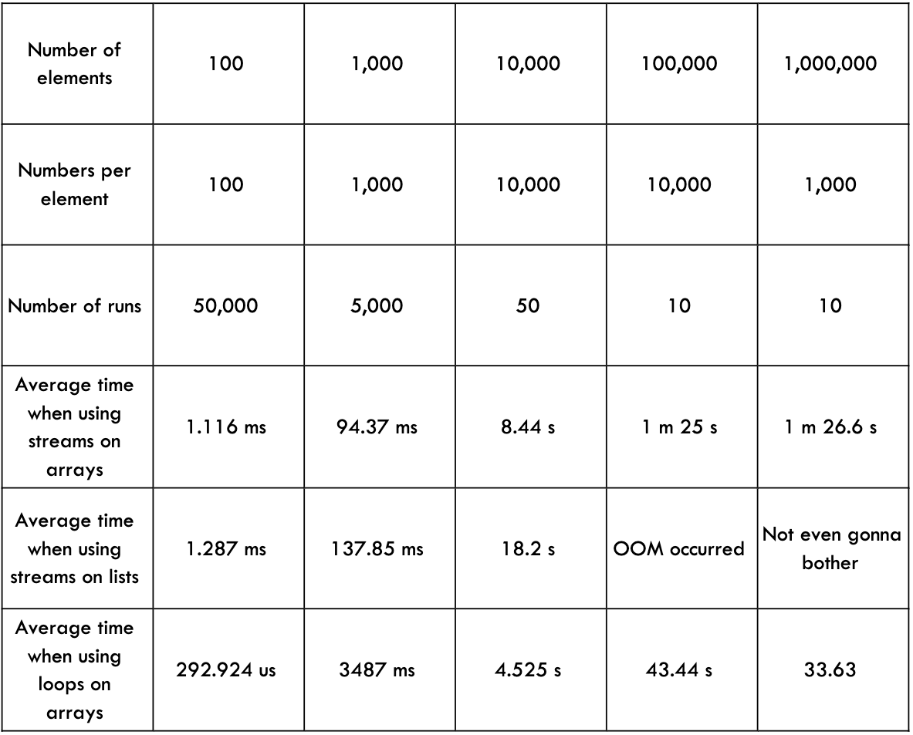
Zero Cost Abstractions: Iterator
Java
Rust
test bench_search_for ... bench: 19,620,300 ns/iter (+/- 915,700)
test bench_search_iter ... bench: 19,234,900 ns/iter (+/- 657,200)
https://doc.rust-lang.org/book/ch13-04-performance.html

Slide 10
Zero Cost Abstractions: Class
C#/Java/Python/etc.
Rust
// let's draw
// let's draw

Slide 11
Zero Cost Abstractions: Monomorphization
C#/Java/Python/etc.
Rust
myClass.MyIterfaceMethod()
// let's draw
myClass.MyTraitMethod()
// let's draw

Slide 12
Memory Safety
let raw_ptr: *const MyStruct = …
let reference: &MyStruct = unsafe { &*raw_ptr };

Slide 13
Memory Safety
pub const fn split_at_mut(&mut self, mid: usize) -> (&mut [T], &mut [T]) {
assert!(mid <= self.len());
// SAFETY: `[ptr; mid]` and `[mid; len]` are inside `self`, which
// fulfills the requirements of `from_raw_parts_mut`.
unsafe { self.split_at_mut_unchecked(mid) }
}
pub const unsafe fn split_at_mut_unchecked(&mut self, mid: usize) -> (&mut [T], &mut [T]) {
let len = self.len();
let ptr = self.as_mut_ptr();
unsafe {
(from_raw_parts_mut(ptr, mid),
from_raw_parts_mut(ptr.add(mid), len - mid)
)
}
}

Slide 14
Memory Safety
// let's draw
Contract
Prerequisites
Parameters Validation
Etc.

Slide 15
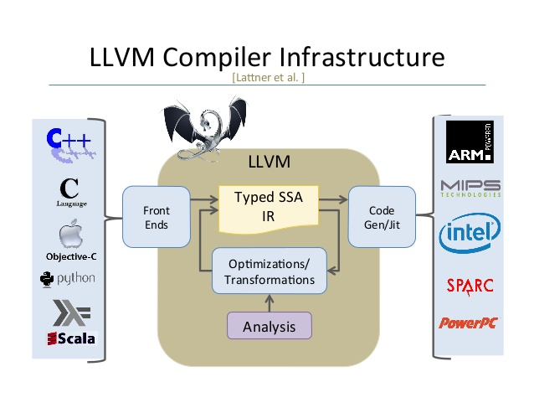
LLVM

Slide 16
LLVM
HIR
THIR
MIR
LLVM IR
Machine Code
Parsing
Desugaring
Etc.
Exhaustiveness Checking
Borrow Checking
Optimization
Optimization
Platform Specific

Slide 17
Functional Programming Language
High level functions
Tuples
Algebraic data type
Iterators
Pattern Matching
Immutability
Pure Functions
Etc.

Slide 18
Functional Programming Language
C++
Rust
C with classes
OOP
Backward Compatibility
OCaml with performance
FP
Breaking Changes

Slide 19
Performance (why is it the last one?)
No Undefined Behaviors, except unsafe
Zero Cost Abstractions
Memory Safety
LLVM
Functional Programming Language

Slide 20
Modern Approach
https://doc.rust-lang.org/book/title-page.html
https://doc.rust-lang.org/reference/
https://github.com/rust-lang/rust-clippy
https://github.com/rust-lang/rustfmt
…

Slide 21
Setup

Slide 22
Tools: rustup
https://rust-lang.github.io/rustup/installation
> rustc --version
rustc 1.65.0 (897e37553 2022-11-02)
> rustup update
….
stable-x86_64-pc-windows-msvc updated - rustc 1.67.0 (fc594f156 2023-01-24) (from rustc 1.65.0 (897e37553 2022-11-02))
> rustc --version
rustc 1.67.0 (fc594f156 2023-01-24)

Slide 23
Tools: rustc
https://doc.rust-lang.org/stable/rustc/
> rustc main.rs

Slide 24
Hello World
main.rs
fn main() { println!("Hello, world!"); }
> rustc main.rs
Hello, world!

Slide 25

Tools: cargo
Package manager
Templates
CLI: Run, Test, etc.
…

Slide 26
Crate
A Rust crate is either a library or an executable program, referred to as either a library crate or a binary crate, respectively.
Every target defined for a Cargo package is a crate.
Library
Executable program
Cargo Package

Slide 27
Hello World, Cargo edition
> cargo new hello-world
.gitignore
Cargo.lock
Cargo.toml
src
main.rs
target

Slide 28
Hello World, Cargo edition
> cargo new hello-world
.gitignore
Cargo.lock
Cargo.toml
src
main.rs
target
/target

Slide 29
Hello World, Cargo edition
> cargo new hello-world
.gitignore
Cargo.lock
Cargo.toml
src
main.rs
target
[package] name = "hello-world" version = "0.1.0" edition = "2021" [dependencies]

Slide 30
Hello World, Cargo edition
> cargo new hello-world
.gitignore
Cargo.lock
Cargo.toml
src
main.rs
target
[package] name = "hello-world" version = "0.1.0" edition = "2021" [dependencies] time = "0.1.12" regex = "0.1.41"

Slide 31
Hello World, Cargo edition
> cargo new hello-world
.gitignore
Cargo.lock
Cargo.toml
src
main.rs
target
# This file is automatically @generated by Cargo. # It is not intended for manual editing. version = 3 [[package]] name = "time" version = "0.1.45" source = "registry+https://github.com/rust-lang/crates.io-index" checksum = "1b797afad3f312d1c66a56d11d0316f916356d11bd158fbc6ca6389ff6bf805a" dependencies = [ "libc", "wasi", "winapi 0.3.9", ] …..

Slide 32
Tools: cargo
build
run
check
test
doc
fix
…

Slide 33
Rust Syntax

Slide 34
Functions
fn my_function(parameter1: String, parameter2: String) -> String {
return format!("{} {}", parameter1, parameter2);
}
fn my_function_no_return(parameter1: String, parameter2: String) {
println!("{} {}", parameter1, parameter2);
}

Slide 35
Variables
let variable: String = parameter1;
let variable2 = parameter1;
let mut variable_mut = parameter1;
fn my_function(parameter1: String, mut parameter2: String)

Slide 36
Return
fn my_function(parameter1: String, parameter2: String) -> String {
return format!("{} {}", parameter1, parameter2);
}
fn my_function(parameter1: String, parameter2: String) -> String {
format!("{} {}", parameter1, parameter2)
}

Slide 37
Macro
format!("{} {}", parameter1, parameter2)
macro_rules! format {
($($arg:tt)*) => {{
let res = $crate::fmt::format($crate::__export::format_args!($($arg)*));
res
}}
}

Slide 38
panic!
panic!(“It’s over");

Slide 39
Data Types
Numeric: +-*/%
i8, u8, i16, u16 …. u128, isize, usize: 42, 98_222, 0xff, etc.
Overflow Rules: panic on debug, overflow on release
f32, f64: 2.1, 0.1
bool: true, false
char 32bit: 'a’
array
tuple
…

Slide 40
If
if a > 0 { // do something positive } else { // do something negative }
let b = if a > 0 { 1 } else { 2 };

Slide 41
Loop
loop { println!("Oh no, it's dizzy") }
let mut counter = 1; loop { println!("Oh no, it's dizzy"); counter += 1; if counter > 42 { break } }

Slide 42
Loop as expression
let mut counter = 1; let b= loop { println!("Oh no, it's dizzy"); counter += 1; if counter > 42 { break counter * 2 } };

Slide 43
Break to label
let b = 'main_loop: loop { loop { loop { counter += 1; if counter > 42 { break 'main_loop counter * 2; } } } };

Slide 44
While/For
let mut counter = 0; while counter < 42 { println!("Oh no, it's dizzy"); counter += 1; }
for _ in 0..42 { println!("Oh no, it's dizzy"); }

Slide 45
Structs
struct MyStruct { value1: i32, value2: bool, }
let my_struct = MyStruct { value1: 42, value2: true, };

Slide 46
&str
"Foo"

Slide 47
String
pub struct String { vec: Vec<u8>, }
String::from("Foo")

Slide 48
Std lib
use std::env; fn main() { let args: Vec<String> = env::args().collect(); dbg!(args); }

Slide 49
Result
pub enum Result<T, E> { /// Contains the success value Ok(T), /// Contains the error value Err(E), }
let file: Result<File> = File::open("foo.txt");
let f: File = file.unwrap();

Slide 50
Homework
Setup your Text Editor/IDE for Rust
GitHubClassroom (TBD)
Rustlings
https://github.com/rust-lang/rustlings
rustlings run <name_of_file>
exercises/variables
exercises/functions
exercises/if
exercises/primitive_types

Slide 51
Coursework
Get all files in the directory (not recursive)
Example:
> cargo run -- c:\Projects
file1.txt
code2.rs

