Slide 1
Collections
Course: Rust Basics
Author: Aleksandr Kugushev

Slide 2
Vec
struct Vec<T,A: Allocator = Global> { buf: RawVec<T, A>, len: usize, } struct RawVec<T, A: Allocator = Global> { ptr: Unique<T>, cap: usize, alloc: A, } struct Unique<T: ?Sized> { pointer: NonNull<T>, _marker: PhantomData<T>, }
struct NonNull<T: ?Sized> { pointer: *const T, }
struct PhantomData<T: ?Sized>;

Slide 3
Vec
let mut vec: Vec<i32> = Vec::new();
vec.push(42);
let last: Option<i32> = vec.pop();

Slide 4
Vec
let mut vec = vec![1, 2, 3];
let count = vec.len();
let first:i32 = vec[0];
let mut vec = vec![String::from("Hi")]; let first: String = vec[0];
error[E0507]: cannot move out of index of `Vec<String>`

Slide 5
Get by reference
let mut vec = vec![String::from("Hi")];
let first: &String = &vec[0];
let first: Option<&String> = vec.get(0);

Slide 6
Borrow element, borrow whole vector
let mut vec = vec![String::from("Hi")];
let first: &String = &vec[0];
vec.push(String::from("World"));
println!("{}", first);
error[E0502]: cannot borrow `vec` as mutable because it is also borrowed as immutable

Slide 7
Set vec element
let first_mut: &mut String = &mut vec[0]; *first_mut = String::from("Hello");
vec[0] = String::from("World");

Slide 8
Drain
let mut vec = vec![1, 2, 3, 4, 5, 6, 7];
let drained: Drain<i32> = vec.drain(2..5);
drop(drained);
println!("{}", vec.len()) // 4

Slide 9
Range
let arr = [0, 1, 2, 3, 4];
assert_eq!(arr[ .. ], [0, 1, 2, 3, 4]); assert_eq!(arr[ .. 3], [0, 1, 2 ]); assert_eq!(arr[ ..=3], [0, 1, 2, 3 ]); assert_eq!(arr[1.. ], [ 1, 2, 3, 4]); assert_eq!(arr[1.. 3], [ 1, 2 ]); // This is a `Range` assert_eq!(arr[1..=3], [ 1, 2, 3 ]);
for i in 0..42 { println!("{}", i) }

Slide 10
Range
pub struct Range<Idx> { /// The lower bound of the range (inclusive). pub start: Idx, /// The upper bound of the range (exclusive). pub end: Idx, }

Slide 11
Apply Range on array
let arr = [0, 1, 2, 3, 4]; let s: [i32] = arr[..];
let i = 1; let b = arr[i..];
error[E0277]: the size for values of type `[i32]` cannot be known at compilation time

Slide 12
Slice
let mut vec = vec![1, 2, 3, 4, 5, 6, 7];
let slice: &[i32] = &vec[2..5];

Slide 13
Slice is ref
let mut vec = vec![1, 2, 3, 4, 5, 6, 7]; let slice: &[i32] = &vec[2..5]; // 3 drop(vec); println!("{:?}", slice);
error[E0505]: cannot move out of `vec` because it is borrowed

Slide 14
Slice
let mut vec = vec![1, 2, 3, 4, 5, 6, 7];
let slice: &[i32] = &vec[2..5];
let count = slice.len(); // 3
println!("{}",count);
let item: &i32 = &slice[1]; // 4
let item: Option<&i32> = slice.get(1);

Slide 15
Slice mut
let mut vec = vec![1, 2, 3, 4, 5, 6, 7];
let mut slice_mut: &mut [i32] = &mut vec[2..5];
slice_mut[0] = 42;
println!("{}", vec[2]) // 42

Slide 16
Slice without &
let arr = [0, 1, 2, 3, 4]; let s: [i32] = arr[..];
error[E0277]: the size for values of type `[{integer}]` cannot be known at compilation time

Slide 17
Boxed slice
let vec = vec![1, 2, 3, 4, 5, 6, 7]; let boxed: Box<[i32]> = vec.into_boxed_slice(); let slice = &boxed[2..5]; println!("{:?}", slice);

Slide 18
Split at
let vec = vec![1, 2, 3, 4, 5, 6, 7]; let (left, right): (&[i32], &[i32]) = vec.split_at(3); println!("{:?} {:?}", left, right);

Slide 19
Practice: Slice
let vec = vec!['h', 'e', 'l', 'l', 'o', ' ', 'w', 'o', 'r', 'l', 'd’];
Get Slice with “world” and print it
Get 2 slices: “hello” and “world”
Replace “world” with “space”
Replace with: let mut vec = String::from("hello world");
Replace "hello world" with "привет мир"

Slide 20
String
pub struct String { vec: Vec<u8>, }
let string_eng = String::from("Hello!!");
let string_china = String::from("读写汉字学中文");
println!("{}", string_eng.len()); // 7
println!("{}", string_china.len()); // 21

Slide 21
String slice aka &str
let string = String::from("Hello World");
let slice: &str = &string[..];
let other_slice = "Hello World";

Slide 22
Slice UTF-8
let string_china = String::from("读写汉字学中文");
let slice_china = &string_china[1..2]; println!("{}", slice_china);
panic: byte index 1 is not a char boundary; it is inside '读' (bytes 0..3) of `读写汉字学中文`
let slice_chars: Vec<char> = string_china.chars().collect();
let chars_china: &[char] = &slice_chars[1..2];
println!("{}", chars_china[0]); // 写

Slide 23
Replace char at index
let mut string = String::from("Hello World");
let slice_mut: &mut str = &mut string[1..2]; *slice_mut[0..1] = "00";
error[E0614]: type `str` cannot be dereferenced
string.replace_range(1..2, "00");
println!("{}", string); // H00llo World

Slide 24
HashMap
let mut scores = HashMap::new();
scores.insert(String::from("Blue"), 10);
scores.insert(String::from("Yellow"), 50);
scores.remove("Blue");
let contains: bool = scores.contains_key("Yellow");
let score: Option<&i32> = scores.get("Yellow");

Slide 25
HashMap Entry API
scores.entry(String::from("Yellow")).or_insert(42);
match scores.entry(String::from("Yellow")) { Entry::Occupied(x) => { println!("{} {}", x.key(), x.get()) // Yellow 50 } Entry::Vacant(x) => { println!("{}", x.key()) } }

Slide 26
For
let vector = vec![1, 2, 3, 4, 5, 6, 7, 8, 9];
for x in vector { println!("{}", x); }
for x in vector { println!("{}", x); }
error[E0382]: use of moved value: `vector`
consider iterating over a slice of the `Vec<i32>`'s content to avoid moving into the `for` loop

Slide 27


For
let vector = vec![1, 2, 3, 4, 5, 6, 7, 8, 9]; for x in &vector { println!("{}", x); } for x in &vector { println!("{}", x); }

Slide 28
Iterators
let vector = vec![1, 2, 3, 4, 5, 6, 7, 8, 9];
let mut result = Vec::<String>::new();
for i in 0..vector.len() {
if vector[i] > 5 {
result.push(i.to_string()) } }
let result: Vec<String> = vector
.iter()
.filter(|x| { **x > 5 })
.map(|x| { x.to_string() })
.collect();

Slide 29
Iterator
trait Iterator { type Item; fn next(&mut self) -> Option<Self::Item>; }

Slide 30
Iterator
let vector = vec![1, 2, 3, 4, 5, 6, 7, 8, 9];
let mut iter = vector.iter();
loop {
let option: Option<&i32> = iter.next();
match option {
None => { break; }
Some(x) => { println!("{}", x); } } }

Slide 31
Iterator
let vector = vec![1, 2, 3, 4, 5, 6, 7, 8, 9];
let mut iter = vector.iter()
.filter(|x| { **x > 5 })
.map(|x| { x.to_string() });
loop { let option: Option<String> = iter.next(); match option { None => { break; } Some(x) => { println!("{}", x); } } }

Slide 32
For
let mut iter = vector.iter();
loop {
let option = iter.next();
match option {
None => { break; }
Some(x) => { println!("{}", x); } } }
for x in vector.iter() { println!("{}", x); }

Slide 33
For and IntoIterator trait
for x in vector.iter() { println!("{}", x); }
for x in vector { println!("{}", x); }
trait IntoIterator { type Item; type IntoIter: Iterator<Item = Self::Item>; fn into_iter(self) -> Self::IntoIter; }

Slide 34
Iter vs IterMut vs IntoInterator
impl<T> [T] {
pub fn iter(&self) -> Iter<'_, T> { Iter::new(self) }
pub fn iter_mut(&mut self) -> IterMut<'_, T> { IterMut::new(self) }
pub trait IntoIterator { type Item; type IntoIter: Iterator<Item = Self::Item>; fn into_iter(self) -> Self::IntoIter; }

Slide 35
Why into_iter requires trait?
/// Creates a consuming iterator, that is, one that moves each value out of /// the vector (from start to end). The vector cannot be used after calling /// this. fn into_iter(self) -> Self::IntoIter { unsafe { let mut me = ManuallyDrop::new(self); let alloc = ManuallyDrop::new(ptr::read(me.allocator())); let begin = me.as_mut_ptr(); let end = if T::IS_ZST { begin.wrapping_byte_add(me.len()) } else { begin.add(me.len()) as *const T }; let cap = me.buf.capacity(); IntoIter { buf: NonNull::new_unchecked(begin), phantom: PhantomData, cap, alloc, ptr: begin, end, } } }

Slide 36
Iterator functions
https://danielkeep.github.io/itercheat_baked.html
Generators: once, repeat, etc.
Sequences: map, filter, flat_map, etc.
Collectors: collect, find, max, sum, any, etc.

Slide 37
Generators
my_vec.iter()
iter::once(1)
iter::repeat(4) // repeat forever
iter::empty::<i32>()

Slide 38
Sequences
map , filter , flat_map , flatten , zip , unzip , chain , take , skip , enumerate, filter_map, cloned …

Slide 39
Map
let vector = vec![1, 2, 3, 4, 5, 6, 7, 8, 9];
let map_result = vector.iter().map(|x| x.to_string());
fn map<B, F>(self, f: F) -> Map<Self, F> where Self: Sized, F: FnMut(Self::Item) -> B, { Map::new(self, f) }

Slide 40
Map
fn map<B, F>(self, f: F) -> Map<Self, F> where Self: Sized, F: FnMut(Self::Item) -> B, { Map::new(self, f) }
pub struct Map<I, F> { iter: I, f: F, }
impl<B, I: Iterator, F> Iterator for Map<I, F> where F: FnMut(I::Item) -> B, { type Item = B; #[inline] fn next(&mut self) -> Option<B> { match self.iter.next() { Some(x) => Some(self.f(x)), None => None, } } }

Slide 41
Filter
let vector = vec![1, 2, 3, 4, 5, 6, 7, 8, 9];
let result = vector.iter() .filter(|x| **x > 5) .map(|x| x.to_string());

Slide 42
Filter
fn filter<P>(self, predicate: P) -> Filter<Self, P> where Self: Sized, P: FnMut(&Self::Item) -> bool, { Filter::new(self, predicate) }
pub struct Filter<I, P> { iter: I, predicate: P, }
impl<I: Iterator, P> Iterator for Filter<I, P> where P: FnMut(&I::Item) -> bool, { type Item = I::Item; #[inline] fn next(&mut self) -> Option<I::Item> { self.iter.find(&mut self.predicate) } }

Slide 43




Iterators are lazy
let vector = vec![1, 2, 3, 4, 5, 6, 7, 8, 9];
vector.iter() .filter(|x| **x > 5) .map(|x| x.to_string());
fn next(&mut self) -> Option<I::Item> { self.iter.find(&mut self.predicate) }
fn next(&mut self) -> Option<B> { match self.iter.next() { Some(x) => Some(self.f(x)), None => None, } }

Slide 44

Iterators are lazy
let result: Map<Filter<Iter<i32>, fn(&&i32) -> bool>, fn(&i32) -> String> = vector.iter() .filter(|x| **x > 5) .map(|x| x.to_string());
for item in result { println!("{}", item) }
fn next(&mut self) -> Option<I::Item> { self.iter.find(&mut self.predicate) }
fn next(&mut self) -> Option<B> { match self.iter.next() { Some(x) => Some(self.f(x)), None => None, } }

Slide 45
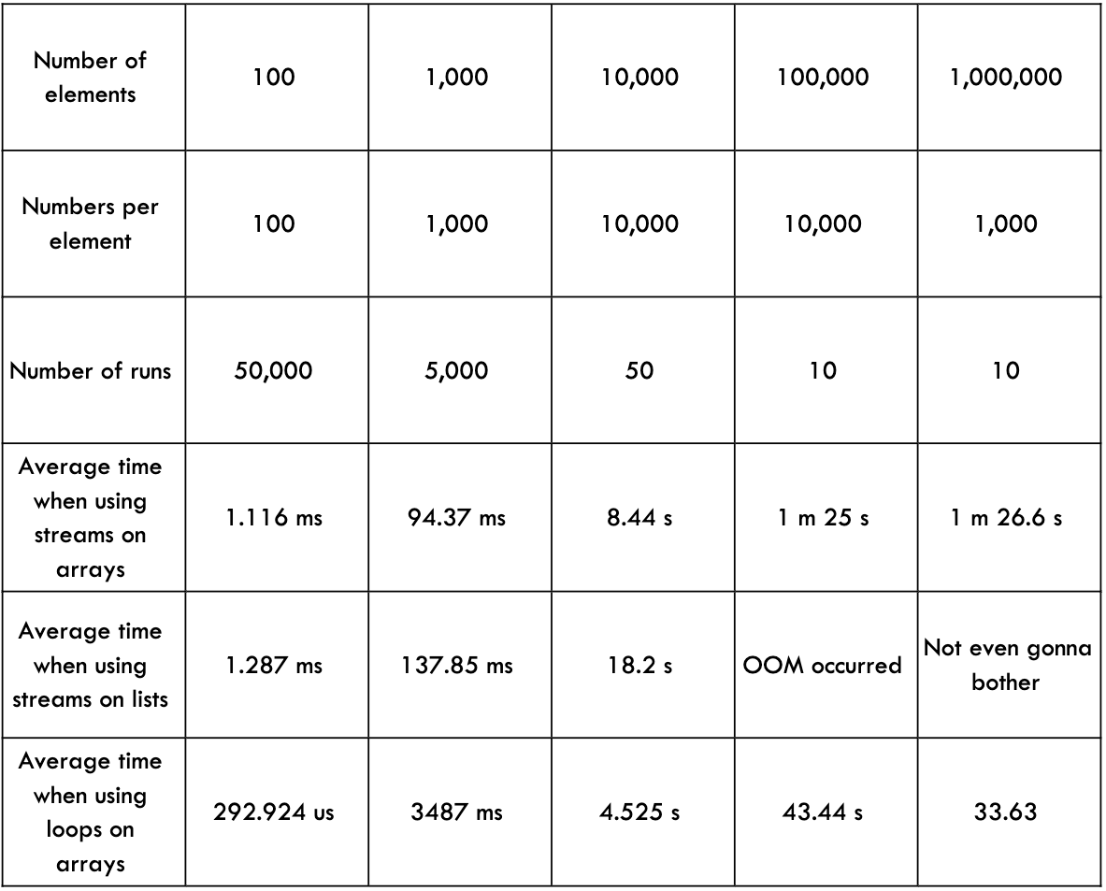
Zero Cost Abstractions: Iterator
Java
Rust
test bench_search_for ... bench: 19,620,300 ns/iter (+/- 915,700)
test bench_search_iter ... bench: 19,234,900 ns/iter (+/- 657,200)
https://doc.rust-lang.org/book/ch13-04-performance.html

Slide 46
Sequences
flat_map
zip
take , skip
filter_map
cloned

Slide 47
Sorting 0_o?
https://crates.io/crates/itertools
fn sorted_by<F>(self, cmp: F) -> VecIntoIter<Self::Item> where Self: Sized, F: FnMut(&Self::Item, &Self::Item) -> Ordering, { let mut v = Vec::from_iter(self); v.sort_by(cmp); v.into_iter() }

Slide 48
Iterators and ownership
iter()
iter_mut()
into_iter()

Slide 49
iter_mut()
let mut vector = vec![1, 2, 3, 4];
let result = vector.iter_mut() .filter(|x| **x > 2);
for item in result { *item = *item + 10; }
for x in vector { println!("{}", x) // 1 2 13 14 }

Slide 50
into_iter()
let vector = vec![1, 2, 3, 4, 5, 6, 7, 8, 9];
let result = vector.into_iter() .filter(|x| *x > 5) .map(|x| x.to_string());
for item in result { println!("{}", item) }
for x in vector { println!("{}", x) }
error[E0382]: use of moved value: `vector`

Slide 51
Collectors
let vector = vec![1, 2, 3, 4, 5, 6, 7, 8, 9]; let result: Vec<String> = vector.iter() .filter(|x| **x > 5) .map(|x| x.to_string()) .collect();

Slide 52
collect()
let vector = vec![1, 2, 3, 4, 5, 6, 7, 8, 9]; let result = vector.iter() .filter(|x| **x > 5) .map(|x| x.to_string()) .collect();
error[E0282]: type annotations needed

Slide 53
collect()
fn collect<B: FromIterator<Self::Item>>(self) -> B where Self: Sized, { FromIterator::from_iter(self) }
pub trait FromIterator<A>: Sized { fn from_iter<T: IntoIterator<Item = A>>(iter: T) -> Self; }

Slide 54
Practice: interators
fn create_nums(range: Range<i32>) -> impl Iterator<Item=i32> { // you should implement generator of iterator from range }
let nums0to10 = create_nums(0..10); let nums100to110 = create_nums(100..110); let even_numbers: Vec<String> = // get even numbers in both ranges assert_eq!(even_numbers, vec!["2", "4", "6", "8", "100", "102", "104", "106", "108"]); let chars_not_0: String = even_numbers. // get chars of even_numbers without 0 assert_eq!(chars_not_0, String::from("2468112141618")); let nums0to10 = create_nums(0..10); let nums100to110 = create_nums(100..110); let summ: i32 = // calculate the following expression using nums0to10 and nums100to110 iterators assert_eq!(summ, (3 * 103) + (4 * 104))

Slide 55
Iterator
pub trait Iterator { /// The type of the elements being iterated over. type Item; /// Advances the iterator and returns the next value. fn next(&mut self) -> Option<Self::Item>; }

Slide 56
Iterator for Fibonacci
impl Iterator for Fibonacci { type Item = u32; fn next(&mut self) -> Option<Self::Item> { let current = self.curr; self.curr = self.next; self.next = current + self.next; Some(current) } }

Slide 57
Practice: custom iterator
struct BufferOf32<T>([Option<T>; 32]);
let buffer = BufferOf8([Some(1), Some(2), Some(3), None, None, None, None, None]); buffer.iter().filter(|i| **i >= 2).map(|i| i.to_string()).collect(); // 2 3
impl<T> BufferOf8<T>{ pub fn iter(&self) -> BufferOf8Iter<T>{ BufferOf8Iter { reference: self, next: 0 } } }

Slide 58
Homework
Rustlings:
iterators
vecs
strings
Hashmaps
Courseware
Refactoring: use iterators

