Slide 1
Smart Pointers
Course: Rust Basics
Author: Aleksandr Kugushev

Slide 2
Why copy is not a default behavior?
Smart Pointers
Optimizations
Missing Updates
fn update_int(mut str: MyStruct){ str.integer = 123; }
let str = MyStruct { integer: 42 }; update_int(str); println!("{}", str.integer);
#[derive(Copy, Clone)] struct MyStruct { integer: i32, }
let str = MyStruct { integer: 42 }; update_int(str); println!("{}", str.integer); // 42
<- value borrowed here after move

Slide 3




HW Feedback
fn get_passport(&self) -> PassportNumber { self.passport.clone() }
fn gdpr(&mut self) { self.id = 0; self.age_if_specified = (false, 0); self.name = String::new(); self.passport = PassportNumber(0, 0); }

Slide 4
HW Feedback
struct PassportNumber { serial: i32, number: i32, }
fn get_passport(&self) -> PassportNumber { PassportNumber(self.passport.0, self.passport.1) }
fn retrieve_passport<T: GetPassport>(obj: &T) -> &PassportNumber { obj.get_passport() }

Slide 5
HW Feedback
fn gdpr(&mut self) { *self = T::default(); }
#[derive(Debug)] struct PassportNumber(i32, i32);
type PassportNumber = (i32, i32);
#[allow(non_snake_case)] fn PassportNumber(serie: i32, num: i32) -> PassportNumber { (serie, num) }

Slide 6
Null in Rust aka Option
let mut var: Option<i32> = Option::None;
assert_eq!(true, var.is_none());
var = Option::Some(42);
assert_eq!(true, var.is_some());
print!("{}", var.unwrap());
let reference: &i32 = var.as_ref().unwrap();

Slide 7



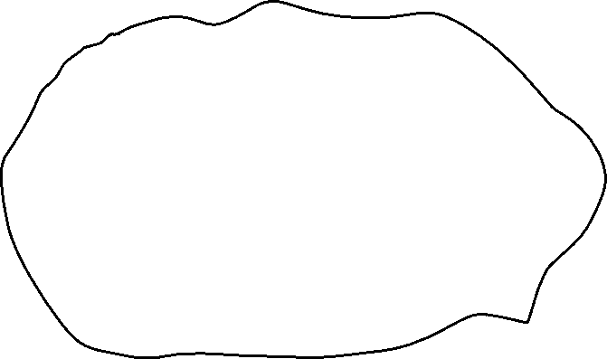





Stack vs Heap

Slide 8
How to move data to heap?
unsafe {
let layout = Layout::new::<u16>();
let ptr = alloc(layout);
if ptr.is_null() { handle_alloc_error(layout); }
*(ptr as *mut u16) = 42;
assert_eq!(*(ptr as *mut u16), 42);
dealloc(ptr, layout);
}
Problems?

Slide 9

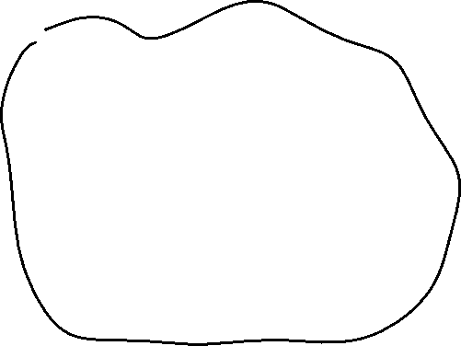



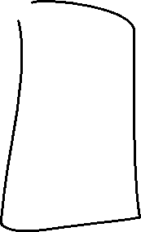



Ownership Based Resource Management (OBRM)

Slide 10
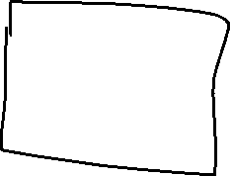


Linked List
struct Node { value: i32, next: Node, }
error[E0072]: recursive type `Node` has infinite size
struct Node<'a> { value: i32, next: &'a Node<'a> }

Slide 11




Linked List
let mut node1 = Node { value: 1, next: None }; {
let mut node2 = Node { value: 2, next: None };
{
let mut node3 = Node { value: 3, next: None }; node2.next = Some(&node3);
node1.next = Some(&node2);
println!("{}", node1.next.unwrap().next.unwrap().value);
node1.next = None; }
println!("{}", node1.value) }
struct Node<'a> { value: i32, next: &'a Node<'a> }
Borrowing ^
error[E0597]: `node3` does not live long enough

Slide 12
Box
Former ~T syntax
Now it is just a Rust structure Box<>
let smart_ptr: Box<i32> = Box::new(42);
struct Box<T>{ pointer: *const T }

Slide 13








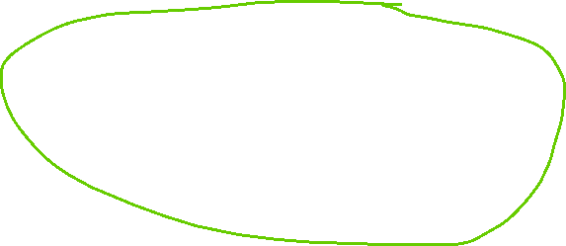

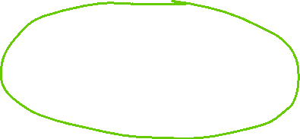
Linked List
struct Node { value: i32, next: Option<Box<Node>>, }
Ownership ^
struct Node<'a> { value: i32, next: &'a Node<'a> }
Borrowing ^

Slide 14
Linked List
struct Node { value: i32, next: Option<Box<Node>>, }
Ownership ^
let mut root = Box::new(Node { value: 1, next: Some( Box::new( Node { value: 2, next: Some(Box::new(Node { value: 3, next: None, })), })), });
println!("{}", root.next.unwrap().next.unwrap().value);
root.next = None;
println!("{}", root.value);

Slide 15
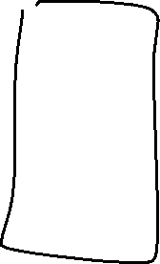



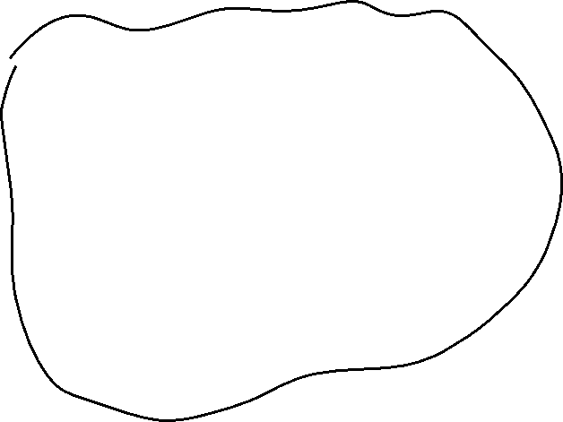

Java-Style

Slide 16
Java-style
struct JavaStyleStruct { reference: Option<Box<MyStruct>>, }
let boxed_struct = Box::new(MyStruct { value1: 42, value2: true });
let java_style = JavaStyleStruct { reference: Some(boxed_struct) };
println!("{}", java_style.reference.unwrap().value1)

Slide 17
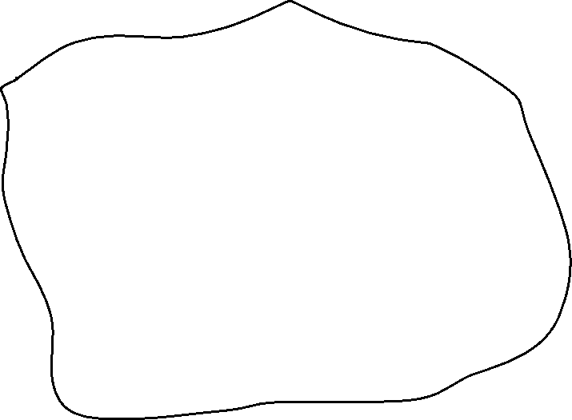






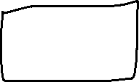
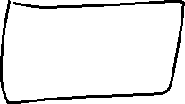
Rust-Style

Slide 18
Reference to Boxed value
let mut boxed = Box::new(MyStruct { value1: 42, value2: true });
let reference: &MyStruct = boxed.borrow();
println!("{}", reference.value1);
let mut_reference: &mut MyStruct = boxed.borrow_mut();
mut_reference.value1 = 123;
let reference: &MyStruct = boxed.borrow();
println!("{}", reference.value1);

Slide 19
Reference to Boxed value
let mut boxed = Box::new(MyStruct { value1: 42, value2: true });
let reference: &MyStruct = boxed.borrow();
println!("{}", reference.value1);
let mut_reference: &mut MyStruct = boxed.borrow_mut();
mut_reference.value1 = 123;
let reference = boxed.borrow();
println!("{}", reference.value1);
error[E0282]: type annotations needed for `&Borrowed`

Slide 20
Box is special
let b = Box::new(MyStruct { value1: 42, value2: true });
let mut x: MyStruct = *b;
x.value1 = 123;
println!("{}", x.value1);
let reference = &x;
println!("{}", b.value1)
error[E0382]: borrow of moved value: `*b`

Slide 21









Previous in linked list

Slide 22
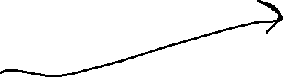


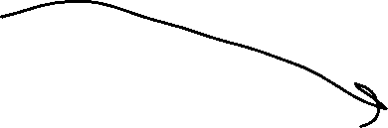
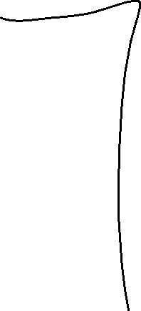
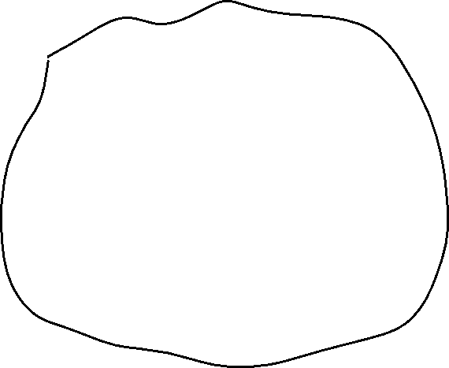


RC – shared ownership

Slide 23
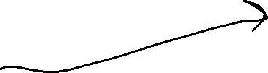


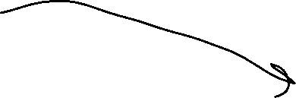
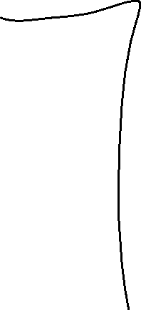
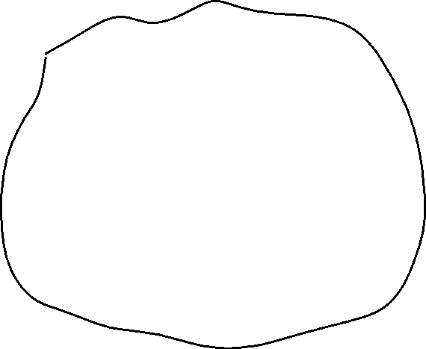


RC – shared ownership

Slide 24







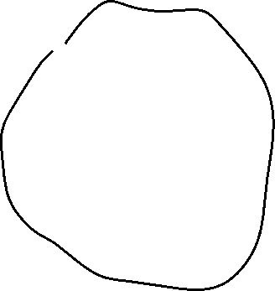


RC vs Box
RC
Box.borrow()

Slide 25
Rc
let owner1 = Rc::new(MyStruct { value1: 42, value2: true });
let owner2: Rc<MyStruct> = owner1.clone();
let owner3: Rc<MyStruct> = owner2.clone();
println!("{}", owner3.value1);
println!("{}", owner1.value1);
println!("{}", owner2.value1);
let reference: &MyStruct = owner1.borrow();
println!("{}", reference.value1);

Slide 26
Clone
fn clone(&self) -> Rc<T> { unsafe { self.inner().inc_strong(); Self::from_inner(self.ptr) } }

Slide 27
Edit Rc value
let owner1 = Rc::new(MyStruct { value1: 42, value2: true });
owner1.value1 = 123;
error[E0594]: cannot assign to data in an `Rc`

Slide 28
Interior Mutability
let cell = Cell::new(42);
let reference1: &Cell<i32> = cell.borrow();
let reference2: &Cell<i32> = cell.borrow();
println!("{}", reference1.get()); // > 42
reference1.replace(123);
println!("{}", reference2.get()); // > 123

Slide 29
Cell – Alias Safe
pub fn replace(&self, val: T) -> T { mem::replace(unsafe { &mut *self.value.get() }, val) // wrapped assignment }
pub const fn replace<T>(dest: &mut T, src: T) -> T { // SAFETY: We read from `dest` but directly write `src` into it afterwards, // such that the old value is not duplicated. Nothing is dropped and // nothing here can panic. unsafe { let result = ptr::read(dest); ptr::write(dest, src); result } }

Slide 30
How to get data from Cell
get() – returns copy!
take() – return value and replace with Default
replace() – return value and replace

Slide 31
RefCell
let cell = RefCell::new(MyStruct { value1: 42, value2: true });
{ let reference1: Ref<MyStruct> = cell.borrow(); println!("{}", reference1.borrow().value1); // > 42 }
{ let mut borrowed: RefMut<MyStruct> = cell.borrow_mut(); borrowed.value1 = 123; }
let reference2: Ref<MyStruct> = cell.borrow();
println!("{}", reference2.borrow().value1); // > 123

Slide 32
RefCell
let cell = RefCell::new(MyStruct { value1: 42, value2: true });
let reference1: Ref<MyStruct> = cell.borrow(); println!("{}", reference1.borrow().value1); // > 42 { let mut borrowed: RefMut<MyStruct> = cell.borrow_mut(); borrowed.value1 = 123; }
let reference2: Ref<MyStruct> = cell.borrow();
println!("{}", reference2.borrow().value1); // > 123
PANIC: already borrowed: BorrowMutError
Ref != &

Slide 33






Circular references
struct NodeLeft { right: Cell<Option<Rc<NodeRight>>>, } struct NodeRight { left: Cell<Option<Rc<NodeLeft>>>, }
let node_left = Rc::new(NodeLeft { right: Cell::new(None) });
let node_right = Rc::new(NodeRight { left: Cell::new(Some(node_left.clone())) });
let e = node_left.right.replace(Some(node_right.clone()));

Slide 34


Rc::downgrade()
struct NodeLeft { right: Cell<Option<Rc<NodeRight>>>, }
struct NodeRight { left: Cell<Option<Weak<NodeLeft>>>, }
let node_left = Rc::new(NodeLeft { right: Cell::new(None) });
let node_right = Rc::new(NodeRight { left: Cell::new(Some(Rc::downgrade(&node_left))) });
let e = node_left.right.replace(Some(node_right.clone()));

Slide 35
Rc::upgrade()
let five = Rc::new(5);
let weak_five = Rc::downgrade(&five);
let strong_five: Option<Rc<_>> = weak_five.upgrade();
assert!(strong_five.is_some());
drop(strong_five);
drop(five);
assert!(weak_five.upgrade().is_none());

Slide 36
Custom Smart Pointer
struct MySmartPtr { value: i32, }
let ptr = MySmartPtr { value: 42 };
let integer: i32 = *ptr;
error[E0614]: type `MySmartPtr` cannot be dereferenced

Slide 37
Deref Trait
impl Deref for MySmartPtr{ type Target = i32; fn deref(&self) -> &Self::Target { &self.value } }
let integer: i32 = *ptr;
let integer: i32 = *(ptr.deref());

Slide 38
Vec
pub struct Vec<T> { pointer: *const T, len: usize, }
let mut vec: Vec<i32> = Vec::new();
vec.push(42);
let last: Option<i32> = vec.pop();

Slide 39
Vec
let mut vec = vec![1, 2, 3];
let count = vec.len();
let first:i32 = vec[0];
let mut vec = vec![String::from("Hi")]; let first: String = vec[0];
error[E0507]: cannot move out of index of `Vec<String>`

Slide 40
Get by reference
let mut vec = vec![String::from("Hi")];
let first: &String = &vec[0];
let first: Option<&String> = vec.get(0);

Slide 41
Borrow element, borrow whole vector
let mut vec = vec![String::from("Hi")];
let first: &String = &vec[0];
vec.push(String::from("World"));
println!("{}", first);
error[E0502]: cannot borrow `vec` as mutable because it is also borrowed as immutable

Slide 42
Set vec element
let first_mut: &mut String = &mut vec[0]; *first_mut = String::from("Hello");
vec[0] = String::from("World");

Slide 43
Drain
let mut vec = vec![1, 2, 3, 4, 5, 6, 7];
let drained: Drain<i32> = vec.drain(2..5);
drop(drained);
println!("{}", vec.len()) // 4

Slide 44
Range
let arr = [0, 1, 2, 3, 4];
assert_eq!(arr[ .. ], [0, 1, 2, 3, 4]); assert_eq!(arr[ .. 3], [0, 1, 2 ]); assert_eq!(arr[ ..=3], [0, 1, 2, 3 ]); assert_eq!(arr[1.. ], [ 1, 2, 3, 4]); assert_eq!(arr[1.. 3], [ 1, 2 ]); // This is a `Range` assert_eq!(arr[1..=3], [ 1, 2, 3 ]);
for i in 0..42 { println!("{}", i) }

Slide 45
Slice
let mut vec = vec![1, 2, 3, 4, 5, 6, 7];
let slice: &[i32] = &vec[2..5];
let count = slice.len(); // 3
println!("{}",count);
let item: &i32 = &slice[1]; // 4
let item: Option<&i32> = slice.get(1);

Slide 46
Slice mut
let mut vec = vec![1, 2, 3, 4, 5, 6, 7];
let mut slice_mut: &mut [i32] = &mut vec[2..5];
slice_mut[0] = 42;
println!("{}", vec[2]) // 42

Slide 47
For
let vector = vec![1, 2, 3, 4, 5, 6, 7, 8, 9];
for x in vector { println!("{}", x); }
for x in vector { println!("{}", x); }
error[E0382]: use of moved value: `vector`
consider iterating over a slice of the `Vec<i32>`'s content to avoid moving into the `for` loop

Slide 48


For
let vector = vec![1, 2, 3, 4, 5, 6, 7, 8, 9]; for x in &vector { println!("{}", x); } for x in &vector { println!("{}", x); }

Slide 49
String
pub struct String { vec: Vec<u8>, }
let string_eng = String::from("Hello!!");
let string_china = String::from("读写汉字学中文");
println!("{}", string_eng.len()); // 7
println!("{}", string_china.len()); // 21

Slide 50
String slice aka &str
let string = String::from("Hello World");
let slice: &str = &string[..];
let other_slice = "Hello World";

Slide 51
Slice UTF-8
let string_china = String::from("读写汉字学中文");
let slice_china = &string_china[1..2]; println!("{}", slice_china);
panic: byte index 1 is not a char boundary; it is inside '读' (bytes 0..3) of `读写汉字学中文`
let slice_chars: Vec<char> = string_china.chars().collect();
let chars_china: &[char] = &slice_chars[1..2];
println!("{}", chars_china[0]); // 写

Slide 52
Replace char at index
let mut string = String::from("Hello World");
let slice_mut: &mut str = &mut string[1..2]; *slice_mut[0..1] = "00";
error[E0614]: type `str` cannot be dereferenced
string.replace_range(1..2, "00");
println!("{}", string); // H00llo World

Slide 53
Homework
struct Node { value: String, #[allow(dead_code)] parent: // weak reference to parent left: // strong reference right: // strong reference }

Slide 54
Homework
let zero_parent: Option<Weak<RefCell<Node>>> = None; let root: Rc<RefCell<Node>> = Node::create(String::from("Root"), zero_parent); { let mut root_ref = RefCell::borrow_mut(root.borrow()); let weak_root: Option<Weak<RefCell<Node>>> = my_get_weak(&root); root_ref.add_left(weak_root, String::from("Left")); root_ref.add_right(my_get_weak(&root), String::from("Right")); { let mut left_node: RefMut<Node> = root_ref.unwrap_left_mut(); left_node.add_left(my_get_weak(&root), String::from("Leaf")); } let chars: &str = root_ref.get_first_characters(3); assert_eq!("Roo", chars); let mut values: Vec<String> = vec![]; // fill this collection with clones: node.value.clone() root_ref.traverse(&mut values); // use recursive algorithm assert_eq!(vec![String::from("Root"), String::from("Left"), String::from("Leaf"), String::from("Right")], values); } my_destroy_all(root);

Slide 55
Homework
https://classroom.github.com/a/-AOwDP2m
Rustlings
smart_pointers

