Slide 1
Daily Needs: iterators, modules, tests, errors, etc.
Course: Rust Basics
Author: Aleksandr Kugushev

Slide 2
Fun with collections
let vector = vec![1, 2, 3, 4, 5, 6, 7, 8, 9];
let mut result = Vec::<String>::new();
for i in 0..vector.len() {
if vector[i] > 5 {
result.push(i.to_string()) } }
let result: Vec<String> = vector
.iter()
.filter(|x| { **x > 5 })
.map(|x| { x.to_string() })
.collect();

Slide 3
Iterator
trait Iterator { type Item; fn next(&mut self) -> Option<Self::Item>; }

Slide 4
Iterator
let vector = vec![1, 2, 3, 4, 5, 6, 7, 8, 9];
let mut iter = vector.iter();
loop {
let option: Option<&i32> = iter.next();
match option {
None => { break; }
Some(x) => { println!("{}", x); } } }

Slide 5
Iterator
let vector = vec![1, 2, 3, 4, 5, 6, 7, 8, 9];
let mut iter = vector.iter()
.filter(|x| { **x > 5 })
.map(|x| { x.to_string() });
loop { let option: Option<String> = iter.next(); match option { None => { break; } Some(x) => { println!("{}", x); } } }

Slide 6
For
let mut iter = vector.iter();
loop {
let option = iter.next();
match option {
None => { break; }
Some(x) => { println!("{}", x); } } }
for x in vector.iter() { println!("{}", x); }

Slide 7
For and IntoIterator trait
for x in vector.iter() { println!("{}", x); }
for x in vector { println!("{}", x); }
trait IntoIterator { type Item; type IntoIter: Iterator<Item = Self::Item>; fn into_iter(self) -> Self::IntoIter; }

Slide 8
Iterator functions
map
map(|x| { x.to_string() })
Return and Iter types may be different
filter
filter(|x| **x > 1)
filter(|&x| *x > 1)
filter(|&&x| x > 1)
flat_map: one to many

Slide 9
Iterator functions
https://danielkeep.github.io/itercheat_baked.html
Generators: once, repeat, etc.
Sequences: map, filter, etc.
Values: max, sum, any, etc.

Slide 10
Sorting
TODO: compare with C#/Java/etc.

Slide 11
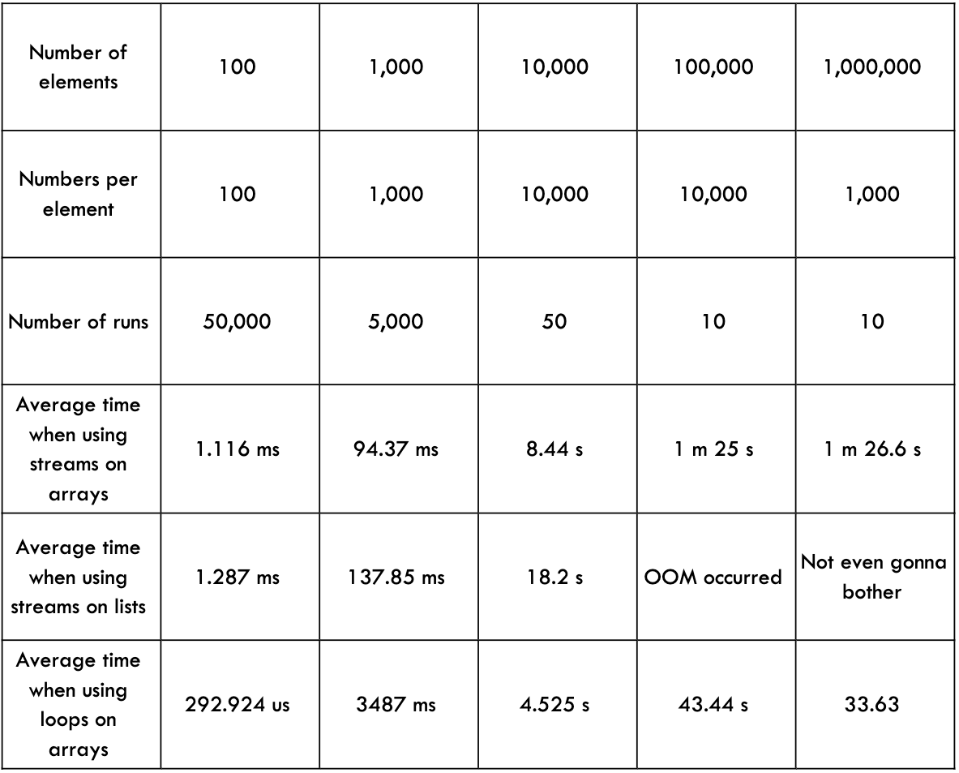
Zero Cost Abstractions: Iterator
Java
Rust
test bench_search_for ... bench: 19,620,300 ns/iter (+/- 915,700)
test bench_search_iter ... bench: 19,234,900 ns/iter (+/- 657,200)
https://doc.rust-lang.org/book/ch13-04-performance.html

Slide 12
Homework

