Slide 1
Lifetime and Smart Pointers
Course: Rust Basics
Author: Aleksandr Kugushev

Slide 2
Hw
fn extract_count(request: &Request, val: &mut i32) { *val = request.count.clone(); }
fn create_builder() -> RequestBuilder { RequestBuilder{ count: 0, name: String::from(""), } }

Slide 3
Questions?

Slide 4
mut or not to mut
fn func(mut mutable: &i32, immutable: &i32, mut_ref: &mut i32){
mutable = &42;
immutable = &42;
*mut_ref = 42; }
error[E0384]: cannot assign to immutable argument `immutable`

Slide 5
Variable/Field State
 | Can Move | Can Borrow | Can Borrow Mut | Can Reassign
let mut str = MyStruct { int: 42 }; | True | True | True | True
let shared_ref = &str; | False | True | False | False
let mut_ref = &mut str; | False | False | False | False
drop(str); | False | False | False | True

Slide 6
What happens with variable after move
let mut str = StrWithInt { int1: 42 };
let ptr: *const StrWithInt = &str as *const StrWithInt;
unsafe { println!("{}", (*ptr).int1); } // 42
drop(str);
unsafe { println!("{}", (*ptr).int1); } // 42
str = StrWithInt { int1: 1 };
unsafe { println!("{}", (*ptr).int1); } // 1

Slide 7
Lifetimes
Compile Time
Annotation
Drop Check relies on Lifetimes

Slide 8
Lifetimes
{ // lifetime: 'a let var1: i32 = 42; { // lifetime: 'b let var2: &'b i32 = &'b var1; } }
let var1: i32 = 42; let var2: &i32 = &var1;

Slide 9
Lifetimes
{ // lifetime: 'a let var1: i32 = 42; { // lifetime: 'b let var2: &'b i32 = &'b var1; { // lifetime: 'c let var3: &'c &'b i32 = &'c var2; } } }
let var1: i32 = 42; let var2: &i32 = &var1; let var3: &&i32 = &var2;

Slide 10








Lifetimes
{ // lifetime: 'a let var1: i32 = 42; { // lifetime: 'b let var2: &'b i32 = &'b var1; { // lifetime: 'c let var3: &'c &'b i32 = &'c var2; } } }

Slide 11


Lifetimes
{ // lifetime: 'a let var: &i32; { // lifetime: 'b let var1: i32 = 42; { // lifetime: 'c let var2: &’a i32 = &’a var1; var = var2; } } }
let var: &i32; let var1: i32 = 42; let var2: &i32 = &var1; let var3: &&i32 = &var2; var = var2;

Slide 12
Lifetimes and Dangling Pointer
fn create_and_return_ref<'x>() -> &'x String { { // lifetime 'b let s = String::from("Hi"); &'x s } }
fn caller_dangling_string(){ { // lifetime 'x let string_ref: &'x String = create_and_return_ref(); } }

Slide 13





Lifetimes and Dangling Pointer
fn caller_dangling_string() { { // lifetime 'x let string_ref: &'x String; { // lifetime 'b let s = String::from("Hi"); string_ref = &'x s } } }

Slide 14
Lifetimes and Dangling Pointer
fn create_and_return_ref(my_struct: &mut MyStruct) -> &String { my_struct.str = String::from("Hi"); &my_struct.str } fn caller_non_dangling_string() { let mut my_struct = MyStruct { str: String::default() }; let string_ref: &String = create_and_return_ref(&mut my_struct); print!("{}", string_ref) }

Slide 15
Lifetimes and Dangling Pointer
fn create_and_return_ref(my_struct: &mut MyStruct) -> &String { my_struct.str = String::from("Hi"); &my_struct.str } fn caller_non_dangling_string() { let mut my_struct = MyStruct { str: String::default() }; let string_ref: &String = create_and_return_ref(&mut my_struct); print!("{}", string_ref) }

Slide 16






How to avoid Dangling Pointer
{// lifetime 'a let mut my_struct = MyStruct { str: String::default() }; { // lifetime 'b let string_ref: &'b String; my_struct.str = String::from("Hi"); string_ref = &'b my_struct.str; print!("{}", string_ref) } }

Slide 17
How to avoid Dangling Pointer and LEAK
fn create_and_return_ref() -> &'static String { let s = Box::leak(Box::new(String::from("Hi"))); s }

Slide 18
Static livetime: Lives forever
fn static_instance() { let val = String::from("Hi"); let reference: &'static String = &val; }
error[E0597]: `val` does not live long enough
let reference: &'static String = &val;
^^^^ borrowed value does not live long enough
}
- `val` dropped here while still borrowed

Slide 19
Compiler POV
fn caller_non_dangling_string() { let mut my_struct = MyStruct { str: String::default() }; let string_ref: &'a String = create_and_return_ref(&'a mut my_struct); print!("{}", string_ref) }
fn create_and_return_ref<'a>(my_struct: &'a mut MyStruct) -> &'a String

Slide 20
Compiler POV
fn caller_non_dangling_string() { let mut my_struct = MyStruct { str: String::default() }; let string_ref: &'a String = create_and_return_ref(&'a mut my_struct); print!("{}", string_ref) }
fn create_and_return_ref<'a>(my_struct: &'a mut MyStruct) -> &'a String

Slide 21


How mut check works
{ // lifetime 'a let mut var: String = String::from("Hello"); { // lifetime 'b let reference: &'b String = &'b var; { // lifetime 'c let mut_reference: &'c mut String = &'b mut var; mut_reference.push_str("World"); } println!("{}", reference) } }
let mut var = String::from("Hello"); let reference = &var; let mut_reference = &mut var; mut_reference.push_str("World"); println!("{}", reference)

Slide 22
Lifetimes that you have to specify
fn create (s1: &mut MyStruct, s2: &mut MyStruct) -> &String { s1.str = String::from("Hi"); &s1.str }
error[E0106]: missing lifetime specifier
fn create(s1: &mut MyStruct, s2: &mut MyStruct) -> &String {
expected named lifetime parameter ^

Slide 23



Lifetimes that you have to specify
fn create<'a>(s1: &'a mut MyStruct, s2: &mut MyStruct) -> &'a String { s1.str = String::from("Hi"); &s1.str }

Slide 24
Structs with References
struct MyStructWithRef<'a, 'b> { reference1: &'a String, reference2: &'b String, }
let val1 = String::from("Foo"); let val2 = String::from("Bar"); let str = MyStructWithRef { reference1: &val1, reference2: &val2, };

Slide 25
Structs with References
struct MyStructWithRef<'a, 'b> { reference1: &'a String, reference2: &'b String, } fn create_struct_with_ref() -> MyStructWithRef { let val1 = String::from("Foo"); let val2 = String::from("Bar"); let str = MyStructWithRef { reference1: &val1, reference2: &val2, }; return str; }

Slide 26
Structs with References
fn create_struct_with_ref<'a>() -> MyStructWithRef<'a, 'a> { let val1 = String::from("Foo"); let val2 = String::from("Bar"); let str = MyStructWithRef { reference1: &val1, reference2: &val2, }; return str; }
^^^ returns a value referencing data owned by the current function

Slide 27
Structs with References
fn main() { let mut val1 = String::new(); let mut val2 = String::new(); let str = create_struct_from_strings(&mut val1, &mut val2); } fn create_struct_from_strings<'a>(val1: &'a mut String, val2: &'a mut String) -> MyStructWithRef<'a, 'a> { *val1 = String::from("Foo"); *val2 = String::from("Bar"); let str = MyStructWithRef { reference1: val1, reference2: val2, }; return str; }

Slide 28
Return Structs with References vs &
fn create<'a>(s1: &'a mut MyStruct, s2: &mut MyStruct) -> &'a String
vs
fn create_struct_from_strings<'a>(val1: &'a mut String, val2: &'a mut String) -> MyStructWithRef<'a, 'a>
struct MyStructWithRef<'a, 'b> { reference1: &'a String, reference2: &'b String, }

Slide 29
Multiple lifetimes in structs
struct MyStructWithRef<'a> { reference1: &'a String, reference2: &'a String, }
let val1 = String::from("Foo"); let reference2: &'static mut String = Box::leak(Box::new(String::from("Hi"))); let str = MyStructWithRef { reference1: &val1, reference2: reference2, }; let r: &'static String = str.reference2;
← borrowed value does not live long enough

Slide 30
Multiple lifetimes in structs
struct MyStructWithRef<'a, 'b> { reference1: &'a String, reference2: &'b String, }
let val1 = String::from("Foo"); let reference2: &'static mut String = Box::leak(Box::new(String::from("Hi"))); let str = MyStructWithRef { reference1: &val1, reference2: reference2, }; let r: &'static String = str.reference2;

Slide 31
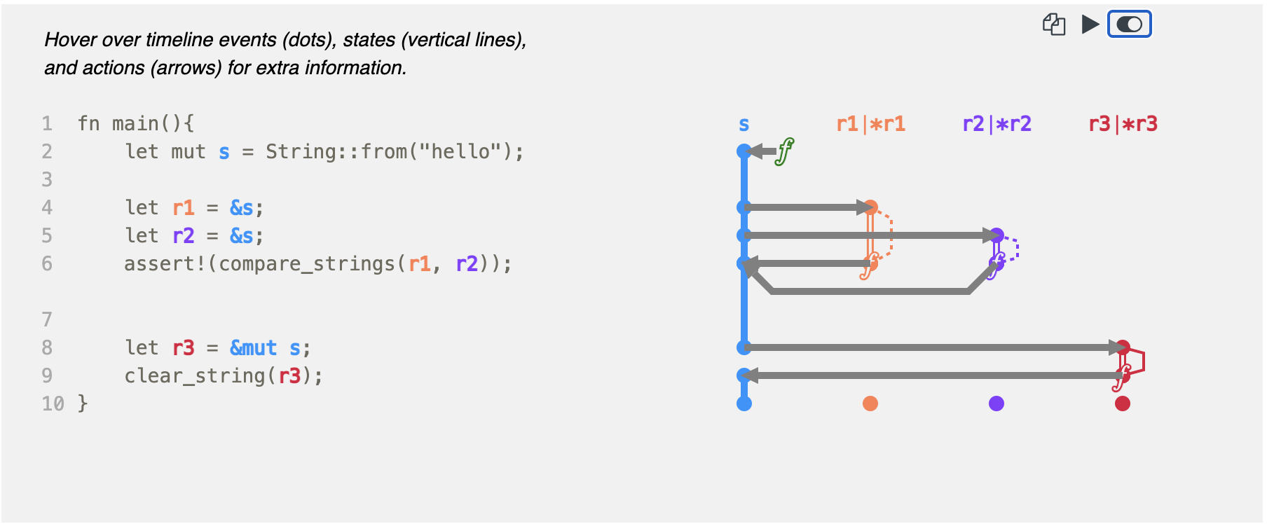
https://github.com/rustviz/rustviz

Slide 32
Homework
TBD (telegram)
Rustlings
lifetimes
smart_pointers

