Slide 1
Daily Needs
Course: Rust Basics
Author: Aleksandr Kugushev

Slide 2
Fun with collections
let vector = vec![1, 2, 3, 4, 5, 6, 7, 8, 9];
let mut result = Vec::<String>::new();
for i in 0..vector.len() {
if vector[i] > 5 {
result.push(i.to_string()) } }
let result: Vec<String> = vector
.iter()
.filter(|x| { **x > 5 })
.map(|x| { x.to_string() })
.collect();

Slide 3
Iterator
trait Iterator { type Item; fn next(&mut self) -> Option<Self::Item>; }

Slide 4
Iterator
let vector = vec![1, 2, 3, 4, 5, 6, 7, 8, 9];
let mut iter = vector.iter();
loop {
let option: Option<&i32> = iter.next();
match option {
None => { break; }
Some(x) => { println!("{}", x); } } }

Slide 5
Iterator
let vector = vec![1, 2, 3, 4, 5, 6, 7, 8, 9];
let mut iter = vector.iter()
.filter(|x| { **x > 5 })
.map(|x| { x.to_string() });
loop { let option: Option<String> = iter.next(); match option { None => { break; } Some(x) => { println!("{}", x); } } }

Slide 6
For
let mut iter = vector.iter();
loop {
let option = iter.next();
match option {
None => { break; }
Some(x) => { println!("{}", x); } } }
for x in vector.iter() { println!("{}", x); }

Slide 7
For and IntoIterator trait
for x in vector.iter() { println!("{}", x); }
for x in vector { println!("{}", x); }
trait IntoIterator { type Item; type IntoIter: Iterator<Item = Self::Item>; fn into_iter(self) -> Self::IntoIter; }

Slide 8
Iterator functions
https://danielkeep.github.io/itercheat_baked.html
Generators: once, repeat, etc.
Sequences: map, filter, flat_map, etc.
Collectors: collect, find, max, sum, any, etc.

Slide 9
Generators
my_vec.iter()
iter::once(1)
iter::repeat(4) // repeat forever
iter::empty::<i32>()

Slide 10
Sequences
map , filter , flat_map , flatten , zip , unzip , chain , take , skip , enumerate, filter_map, cloned …

Slide 11
Map
let vector = vec![1, 2, 3, 4, 5, 6, 7, 8, 9];
let map_result = vector.iter().map(|x| x.to_string());
fn map<B, F>(self, f: F) -> Map<Self, F> where Self: Sized, F: FnMut(Self::Item) -> B, { Map::new(self, f) }

Slide 12
Map
fn map<B, F>(self, f: F) -> Map<Self, F> where Self: Sized, F: FnMut(Self::Item) -> B, { Map::new(self, f) }
pub struct Map<I, F> { iter: I, f: F, }
impl<B, I: Iterator, F> Iterator for Map<I, F> where F: FnMut(I::Item) -> B, { type Item = B; #[inline] fn next(&mut self) -> Option<B> { match self.iter.next() { Some(x) => Some(self.f(x)), None => None, } } }

Slide 13
Filter
let vector = vec![1, 2, 3, 4, 5, 6, 7, 8, 9];
let result = vector.iter() .filter(|x| **x > 5) .map(|x| x.to_string());

Slide 14
Filter
fn filter<P>(self, predicate: P) -> Filter<Self, P> where Self: Sized, P: FnMut(&Self::Item) -> bool, { Filter::new(self, predicate) }
pub struct Filter<I, P> { iter: I, predicate: P, }
impl<I: Iterator, P> Iterator for Filter<I, P> where P: FnMut(&I::Item) -> bool, { type Item = I::Item; #[inline] fn next(&mut self) -> Option<I::Item> { self.iter.find(&mut self.predicate) } }

Slide 15




Iterators are lazy
let vector = vec![1, 2, 3, 4, 5, 6, 7, 8, 9];
let result = vector.iter() .filter(|x| **x > 5) .map(|x| x.to_string());
fn next(&mut self) -> Option<I::Item> { self.iter.find(&mut self.predicate) }
fn next(&mut self) -> Option<B> { match self.iter.next() { Some(x) => Some(self.f(x)), None => None, } }

Slide 16

Iterators are lazy
let result: Map<Filter<Iter<i32>, fn(&&i32) -> bool>, fn(&i32) -> String> = vector.iter() .filter(|x| **x > 5) .map(|x| x.to_string());
for item in result { println!("{}", item) }
fn next(&mut self) -> Option<I::Item> { self.iter.find(&mut self.predicate) }
fn next(&mut self) -> Option<B> { match self.iter.next() { Some(x) => Some(self.f(x)), None => None, } }

Slide 17
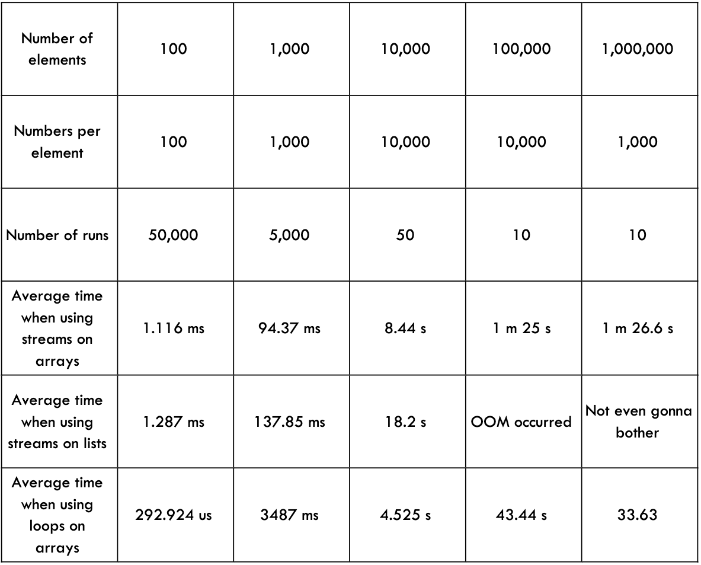
Zero Cost Abstractions: Iterator
Java
Rust
test bench_search_for ... bench: 19,620,300 ns/iter (+/- 915,700)
test bench_search_iter ... bench: 19,234,900 ns/iter (+/- 657,200)
https://doc.rust-lang.org/book/ch13-04-performance.html

Slide 18
Sequences
flat_map
zip
take , skip
filter_map
cloned

Slide 19
Sorting 0_o?
https://crates.io/crates/itertools
fn sorted_by<F>(self, cmp: F) -> VecIntoIter<Self::Item> where Self: Sized, F: FnMut(&Self::Item, &Self::Item) -> Ordering, { let mut v = Vec::from_iter(self); v.sort_by(cmp); v.into_iter() }

Slide 20
Iterators and ownership
iter()
iter_mut()
into_iter()

Slide 21
iter_mut()
let mut vector = vec![1, 2, 3, 4];
let result = vector.iter_mut() .filter(|x| **x > 2);
for item in result { *item = *item + 10; }
for x in vector { println!("{}", x) // 1 2 13 14 }

Slide 22
into_iter()
let vector = vec![1, 2, 3, 4, 5, 6, 7, 8, 9];
let result = vector.into_iter() .filter(|x| *x > 5) .map(|x| x.to_string());
for item in result { println!("{}", item) }
for x in vector { println!("{}", x) }
error[E0382]: use of moved value: `vector`

Slide 23
Collectors
let vector = vec![1, 2, 3, 4, 5, 6, 7, 8, 9]; let result: Vec<String> = vector.iter() .filter(|x| **x > 5) .map(|x| x.to_string()) .collect();

Slide 24
collect()
let vector = vec![1, 2, 3, 4, 5, 6, 7, 8, 9]; let result = vector.iter() .filter(|x| **x > 5) .map(|x| x.to_string()) .collect();
error[E0282]: type annotations needed

Slide 25
collect()
fn collect<B: FromIterator<Self::Item>>(self) -> B where Self: Sized, { FromIterator::from_iter(self) }
pub trait FromIterator<A>: Sized { fn from_iter<T: IntoIterator<Item = A>>(iter: T) -> Self; }

Slide 26
Homework

