Slide 1
Smart Pointers
Course: Rust Basics
Author: Aleksandr Kugushev

Slide 2
Null
struct User { first_name: String, second_name: String, middle_name: String, }
fn print(user: &User) { println!("{} {} {}", user.first_name, user.second_name, user.middle_name); }

Slide 3
Null in Rust aka Option
let mut var: Option<i32> = Option::None;
assert_eq!(true, var.is_none());
var = Option::Some(42);
assert_eq!(true, var.is_some());
print!("{}", var.unwrap());
let reference: &i32 = var.as_ref().unwrap();

Slide 4
Option in struct
struct User { first_name: String, second_name: String, middle_name: Option<String>, }

Slide 5
Stack vs Heap
Let’s draw

Slide 6
How to move data to heap?
unsafe {
let layout = Layout::new::<u16>();
let ptr = alloc(layout);
if ptr.is_null() { handle_alloc_error(layout); }
*(ptr as *mut u16) = 42;
assert_eq!(*(ptr as *mut u16), 42);
dealloc(ptr, layout);
}
Problems?

Slide 7

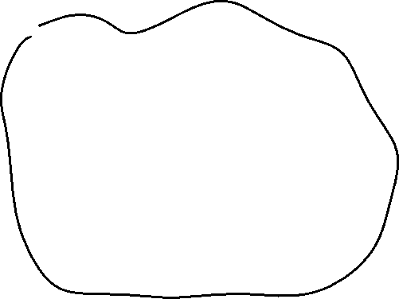

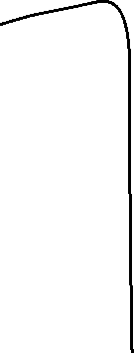

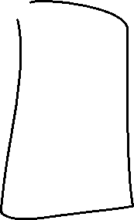



Ownership Based Resource Management (OBRM)

Slide 8
MyObrm
struct MyObrm<T> { ptr: *mut T, }
impl<T> MyObrm<T> { fn new(val: T) -> Self { unsafe { let layout = Layout::new::<T>(); let ptr = alloc(layout) as *mut T; if ptr.is_null() { handle_alloc_error(layout); } *ptr = val; MyObrm { ptr } } } }

Slide 9
MyObrm usage
fn obrm_usage() { let user = MyObrm::new(MyStruct { my_value: 42 }); println!("Print: {}", user.my_value); drop(user); }

Slide 10
Deref and DerefMut traits
impl<T> Deref for MyObrm<T> {
type Target = T;
fn deref(&self) -> &Self::Target {
unsafe { &*self.ptr } } }
println!("Print: {}", user.my_value);

Slide 11
Drop trait
impl<T> Drop for MyObrm<T> {
fn drop(&mut self) {
unsafe { let layout = Layout::new::<T>(); dealloc(self.ptr as *mut u8, layout); } } }

Slide 12
Box
Former ~T syntax
Now it is just a Rust structure Box<>
let smart_ptr: Box<i32> = Box::new(42);
struct Box<T>{ pointer: *const T }

Slide 13
Reference to Boxed value
let mut boxed = Box::new(MyStruct { my_value: 42 });
let reference: &MyStruct = &boxed;
println!("{}", reference.my_value);
let mut_reference: &mut MyStruct = &mut boxed;
mut_reference.my_value = 123;
let reference: &Box<MyStruct> = &boxed;
println!("{}", reference.my_value);

Slide 14
Box is special
let mut boxed = Box::new(MyStruct { my_value: 42 });
let mut x: MyStruct = *boxed;
x.my_value = 123;
println!("{}", x.my_value);
let reference = &x;
println!("{}", boxed.my_value)
error[E0382]: borrow of moved value: `*boxed`

Slide 15
Practice: Linked List

Slide 16
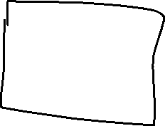


Linked List and Borrowing
struct Node { value: i32, next: Option<Node>, }
error[E0072]: recursive type `Node` has infinite size
struct Node<'a> { value: i32, next: Option<&'a Node<'a>>, }

Slide 17
Linked List and Borrowing
let mut node1 = Node { value: 1, next: None }; let mut node2 = Node { value: 2, next: None }; let mut node3 = Node { value: 3, next: None };
node1.next = Some(&node2); node2.next = Some(&node3);
^^^^^^^ `node2.next` is assigned to here but it was already borrowed
println!("{}", node1.next.unwrap().next.unwrap().value);

Slide 18
Linked List and Borrowing
let mut node1 = Node { value: 1, next: None }; { let mut node2 = Node { value: 2, next: None }; let mut node3 = Node { value: 3, next: None }; node2.next = Some(&node3); node1.next = Some(&node2); node1.next = None; } println!("{}", node1.value)
<- borrowed value does not live long enough
<- borrowed value does not live long enough

Slide 19
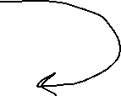








Linked List and Borrowing
Expectation
Reality

Slide 20

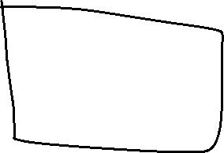



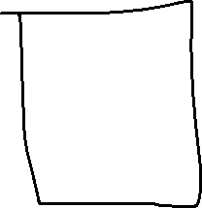


Previous in linked list

Slide 21
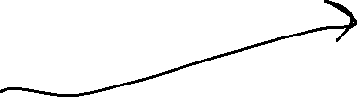

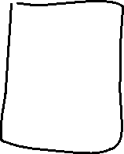
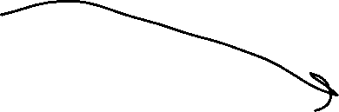
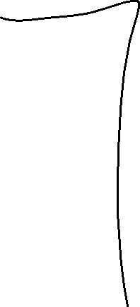
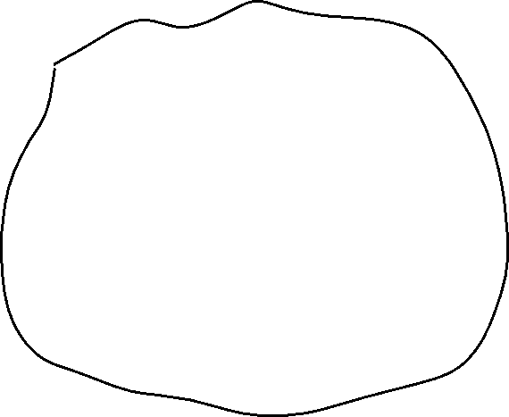


RC – shared ownership

Slide 22
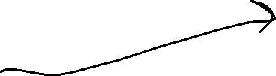

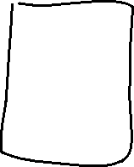
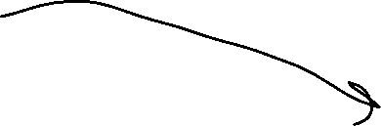
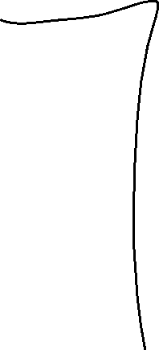
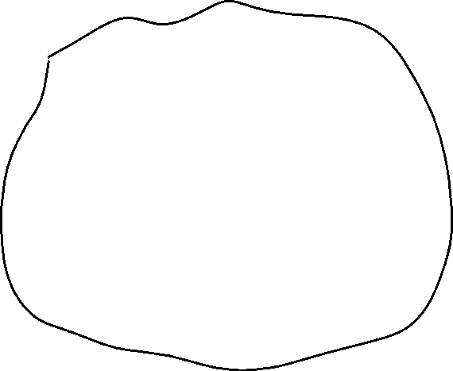


RC – shared ownership

Slide 23

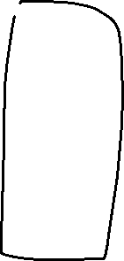



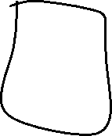

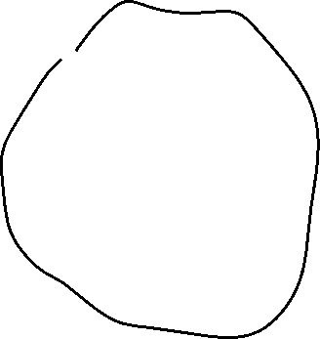


RC vs Box
RC
&Box

Slide 24
Rc
let owner1 = Rc::new(MyStruct { my_value: 42 });
let owner2: Rc<MyStruct> = owner1.clone();
let owner3: Rc<MyStruct> = owner2.clone();
println!("{}", owner3.my_value);
println!("{}", owner1.my_value);
println!("{}", owner2.my_value);
let reference: &MyStruct = &owner1;
println!("{}", reference.my_value);

Slide 25
Clone
fn clone(&self) -> Rc<T> { unsafe { self.inner().inc_strong(); Self::from_inner(self.ptr) } }

Slide 26
Edit Rc value
let owner1 = Rc::new(MyStruct { value1: 42, value2: true });
owner1.value1 = 123;
error[E0594]: cannot assign to data in an `Rc`

Slide 27
Interior Mutability
let cell = Cell::new(42);
let reference1: &Cell<i32> = &cell;
let reference2: &Cell<i32> = &cell;
println!("{}", reference1.get()); // > 42
reference1.replace(123);
println!("{}", reference2.get()); // > 123

Slide 28
Cell – Alias Safe
pub fn replace(&self, val: T) -> T { mem::replace(unsafe { &mut *self.value.get() }, val) // wrapped assignment }
pub const fn replace<T>(dest: &mut T, src: T) -> T { // SAFETY: We read from `dest` but directly write `src` into it afterwards, // such that the old value is not duplicated. Nothing is dropped and // nothing here can panic. unsafe { let result = ptr::read(dest); ptr::write(dest, src); result } }

Slide 29
How to get data from Cell
get() – returns copy!
take() – return value and replace with Default
replace() – return value and replace

Slide 30
Cell internals
pub struct Cell<T: ?Sized> { value: UnsafeCell<T>, }
pub struct UnsafeCell<T: ?Sized> { value: T, }

Slide 31
Cell get()
Cell
UnsafeCell
impl<T: Copy> Cell<T> { pub fn get(&self) -> T { unsafe { *self.value.get() } } }
impl<T: ?Sized> UnsafeCell<T> { pub const fn get(&self) -> *mut T { self as *const UnsafeCell<T> as *const T as *mut T } }

Slide 32
Cell replace()
pub fn replace(&self, val: T) -> T { mem::replace(unsafe { &mut *self.value.get() }, val) }
pub const fn replace<T>(dest: &mut T, src: T) -> T { unsafe { let result = ptr::read(dest); ptr::write(dest, src); result } }

Slide 33
RefCell
let cell = RefCell::new(MyStruct { my_value: 42 });
{ let reference1: Ref<MyStruct> = cell.borrow(); println!("{}", reference1.my_value); // > 42 }
{ let mut borrowed: RefMut<MyStruct> = cell.borrow_mut(); borrowed.my_value = 123; }
let reference2: Ref<MyStruct> = cell.borrow(); println!("{}", reference2.my_value); // > 123

Slide 34
RefCell
let cell = RefCell::new(MyStruct { my_value: 42 }); let reference1: Ref<MyStruct> = cell.borrow(); println!("{}", reference1.my_value); // > 42 { let mut borrowed: RefMut<MyStruct> = cell.borrow_mut(); borrowed.my_value = 123; } let reference2: Ref<MyStruct> = cell.borrow(); println!("{}", reference2.my_value); // > 123
Ref != &
PANIC: already borrowed: BorrowMutError

Slide 35
RefCell internals

Slide 36
Ref
pub struct Ref<'b, T: ?Sized + 'b> { value: NonNull<T>, borrow: BorrowRef<'b>, }
pub struct NonNull<T: ?Sized> { pointer: *const T, }
struct BorrowRef<'b> { borrow: &'b Cell<BorrowFlag>, }
type BorrowFlag = isize;
Notes:
// NB: we use a pointer instead of `&'b T` to avoid `noalias` violations, because a // `Ref` argument doesn't hold immutability for its whole scope, only until it drops. // `NonNull` is also covariant over `T`, just like we would have with `&T`.
// Positive values represent the number of `Ref` active. Negative values // represent the number of `RefMut` active. Multiple `RefMut`s can only be // active at a time if they refer to distinct, nonoverlapping components of a // `RefCell` (e.g., different ranges of a slice). // // `Ref` and `RefMut` are both two words in size, and so there will likely never // be enough `Ref`s or `RefMut`s in existence to overflow half of the `usize` // range. Thus, a `BorrowFlag` will probably never overflow or underflow. // However, this is not a guarantee, as a pathological program could repeatedly // create and then mem::forget `Ref`s or `RefMut`s. Thus, all code must // explicitly check for overflow and underflow in order to avoid unsafety, or at // least behave correctly in the event that overflow or underflow happens (e.g., // see BorrowRef::new).

Slide 37
RefMut

Slide 38






Circular references
struct NodeLeft { right: Cell<Option<Rc<NodeRight>>>, } struct NodeRight { left: Cell<Option<Rc<NodeLeft>>>, }
let node_left = Rc::new(NodeLeft { right: Cell::new(None) });
let node_right = Rc::new(NodeRight { left: Cell::new(Some(node_left.clone())) });
let e = node_left.right.replace(Some(node_right.clone()));

Slide 39


Rc::downgrade()
struct NodeLeft { right: Cell<Option<Rc<NodeRight>>>, }
struct NodeRight { left: Cell<Option<Weak<NodeLeft>>>, }
let node_left = Rc::new(NodeLeft { right: Cell::new(None) });
let node_right = Rc::new(NodeRight { left: Cell::new(Some(Rc::downgrade(&node_left))) });
let e = node_left.right.replace(Some(node_right.clone()));

Slide 40
Rc::upgrade()
let five = Rc::new(5);
let weak_five = Rc::downgrade(&five);
let strong_five: Option<Rc<_>> = weak_five.upgrade();
assert!(strong_five.is_some());
drop(strong_five);
drop(five);
assert!(weak_five.upgrade().is_none());

Slide 41
Homework
struct Node { value: String, #[allow(dead_code)] parent: // weak reference to parent left: // strong reference right: // strong reference }

Slide 42
Homework
let zero_parent: Option<Weak<RefCell<Node>>> = None; let root: Rc<RefCell<Node>> = Node::create(String::from("Root"), zero_parent); { let mut root_ref = RefCell::borrow_mut(root.borrow()); let weak_root: Option<Weak<RefCell<Node>>> = my_get_weak(&root); root_ref.add_left(weak_root, String::from("Left")); root_ref.add_right(my_get_weak(&root), String::from("Right")); { let mut left_node: RefMut<Node> = root_ref.unwrap_left_mut(); left_node.add_left(my_get_weak(&root), String::from("Leaf")); } let chars: &str = root_ref.get_first_characters(3); assert_eq!("Roo", chars); let mut values: Vec<String> = vec![]; // fill this collection with clones: node.value.clone() root_ref.traverse(&mut values); // use recursive algorithm assert_eq!(vec![String::from("Root"), String::from("Left"), String::from("Leaf"), String::from("Right")], values); } my_destroy_all(root);

Slide 43
Homework
https://classroom.github.com/a/-AOwDP2m
Rustlings
smart_pointers
vecs
strings

Slide 44




Linked List
struct Node { value: i32, next: Option<Box<Node>>, }
Ownership ^
struct Node<'a> { value: i32, next: Option<&'a Node<'a>>, }
Borrowing ^

Slide 45
Linked List
struct Node { value: i32, next: Option<Box<Node>>, }
let mut node1 = Node { value: 1, next: None }; { let mut node2 = Node { value: 2, next: None }; let mut node3 = Node { value: 3, next: None }; node2.next = Some(Box::new(node3)); node1.next = Some(Box::new(node2)); node1.next = None; } println!("{}", node1.value)

Slide 46
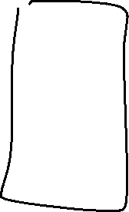
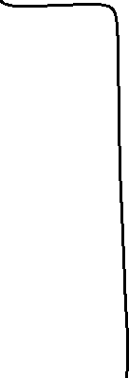


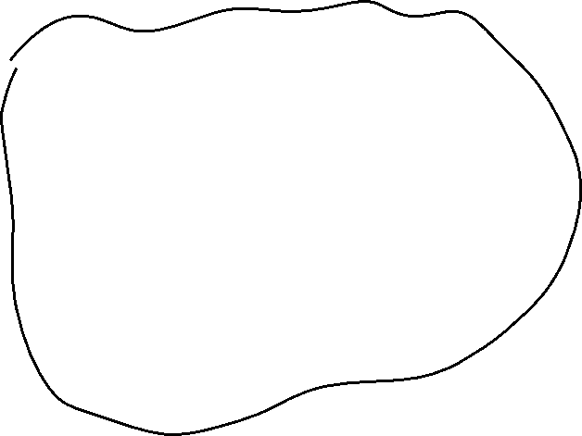

Java-Style

Slide 47
Java-style
struct JavaStyleStruct { reference: Option<Box<MyStruct>>, }
let boxed_struct = Box::new(MyStruct { value1: 42, value2: true });
let java_style = JavaStyleStruct { reference: Some(boxed_struct) };
println!("{}", java_style.reference.unwrap().value1)

Slide 48
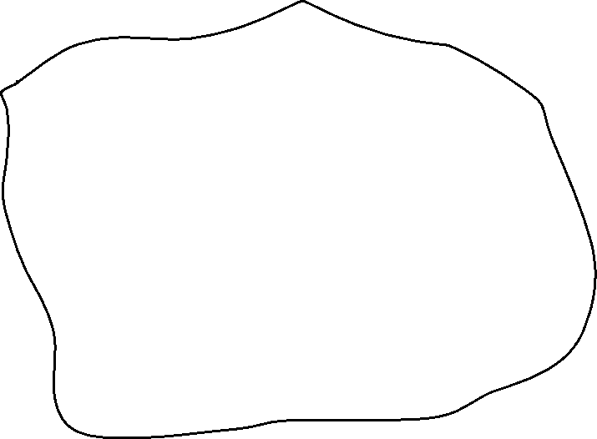


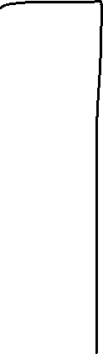
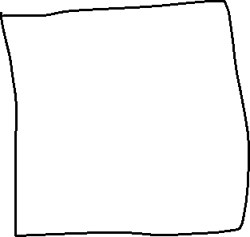


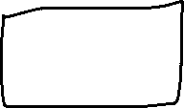
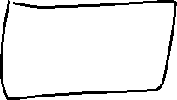
Rust-Style

