Slide 1
Lifetime and Smart Pointers
Course: Rust Basics
Author: Aleksandr Kugushev

Slide 2
Hw
fn extract_count(request: &Request, val: &mut i32) { *val = request.count.clone(); }
fn create_builder() -> RequestBuilder { RequestBuilder{ count: 0, name: String::from(""), } }

Slide 3
Questions?

Slide 4
mut or not to mut
fn func(mut mutable: &i32, immutable: &i32, mut_ref: &mut i32){
mutable = &42;
immutable = &42;
*mut_ref = 42; }
error[E0384]: cannot assign to immutable argument `immutable`

Slide 5
Variable/Field State
 | Can Move | Can Borrow | Can Borrow Mut | Can Reassign
let mut str = MyStruct { int: 42 }; | True | True | True | True
let shared_ref = &str; | False | True | False | False
let mut_ref = &mut str; | False | False | False | False
drop(str); | False | False | False | True

Slide 6
What happens with variable after move
let mut str = StrWithInt { int1: 42 };
let ptr: *const StrWithInt = &str as *const StrWithInt;
unsafe { println!("{}", (*ptr).int1); } // 42
drop(str);
unsafe { println!("{}", (*ptr).int1); } // 42
str = StrWithInt { int1: 1 };
unsafe { println!("{}", (*ptr).int1); } // 1

Slide 7
Lifetimes
Compile Time
Annotation
Drop Check relies on Lifetimes

Slide 8
Lifetimes
{ // lifetime: 'a let var1: i32 = 42; { // lifetime: 'b let var2: &'b i32 = &'b var1; } }
let var1: i32 = 42; let var2: &i32 = &var1;

Slide 9
Lifetimes
{ // lifetime: 'a let var1: i32 = 42; { // lifetime: 'b let var2: &'b i32 = &'b var1; { // lifetime: 'c let var3: &'c &'b i32 = &'c var2; } } }
let var1: i32 = 42; let var2: &i32 = &var1; let var3: &&i32 = &var2;

Slide 10





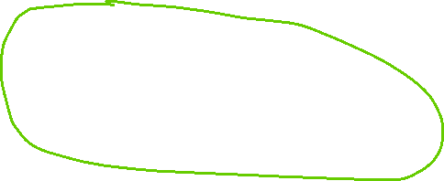
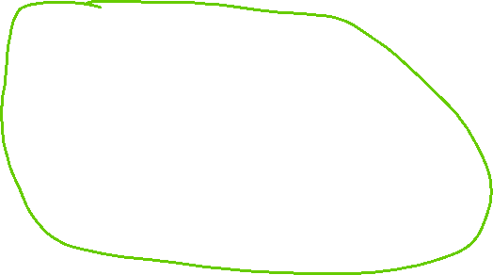

Lifetimes
{ // lifetime: 'a let var1: i32 = 42; { // lifetime: 'b let var2: &'b i32 = &'b var1; { // lifetime: 'c let var3: &'c &'b i32 = &'c var2; } } }

Slide 11


Lifetimes
{ // lifetime: 'a let var: &i32; { // lifetime: 'b let var1: i32 = 42; { // lifetime: 'c let var2: &’a i32 = &’a var1; var = var2; } } }
let var: &i32; let var1: i32 = 42; let var2: &i32 = &var1; let var3: &&i32 = &var2; var = var2;

Slide 12
Lifetimes and Dangling Pointer
fn create_and_return_ref<'x>() -> &'x String { { // lifetime 'b let s = String::from("Hi"); &'x s } }
fn caller_dangling_string(){ { // lifetime 'x let string_ref: &'x String = create_and_return_ref(); } }

Slide 13





Lifetimes and Dangling Pointer
fn caller_dangling_string() { { // lifetime 'x let string_ref: &'x String; { // lifetime 'b let s = String::from("Hi"); string_ref = &'x s } } }

Slide 14
Lifetimes and Dangling Pointer
fn create_and_return_ref(my_struct: &mut MyStruct) -> &String { my_struct.str = String::from("Hi"); &my_struct.str } fn caller_non_dangling_string() { let mut my_struct = MyStruct { str: String::default() }; let string_ref: &String = create_and_return_ref(&mut my_struct); print!("{}", string_ref) }

Slide 15
Lifetimes and Dangling Pointer
fn create_and_return_ref(my_struct: &mut MyStruct) -> &String { my_struct.str = String::from("Hi"); &my_struct.str } fn caller_non_dangling_string() { let mut my_struct = MyStruct { str: String::default() }; let string_ref: &String = create_and_return_ref(&mut my_struct); print!("{}", string_ref) }

Slide 16


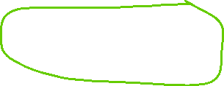
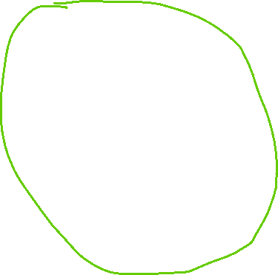


How to avoid Dangling Pointer
{// lifetime 'a let mut my_struct = MyStruct { str: String::default() }; { // lifetime 'b let string_ref: &'b String; my_struct.str = String::from("Hi"); string_ref = &'b my_struct.str; print!("{}", string_ref) } }

Slide 17
How to avoid Dangling Pointer and LEAK
fn create_and_return_ref() -> &'static String { let s = Box::leak(Box::new(String::from("Hi"))); s }

Slide 18
Static livetime: Lives forever
fn static_instance() { let val = String::from("Hi"); let reference: &'static String = &val; }
error[E0597]: `val` does not live long enough
let reference: &'static String = &val;
^^^^ borrowed value does not live long enough
}
- `val` dropped here while still borrowed

Slide 19
Compiler POV
fn caller_non_dangling_string() { let mut my_struct = MyStruct { str: String::default() }; let string_ref: &'a String = create_and_return_ref(&'a mut my_struct); print!("{}", string_ref) }
fn create_and_return_ref<'a>(my_struct: &'a mut MyStruct) -> &'a String

Slide 20
Compiler POV
fn caller_non_dangling_string() { let mut my_struct = MyStruct { str: String::default() }; let string_ref: &'a String = create_and_return_ref(&'a mut my_struct); print!("{}", string_ref) }
fn create_and_return_ref<'a>(my_struct: &'a mut MyStruct) -> &'a String

Slide 21
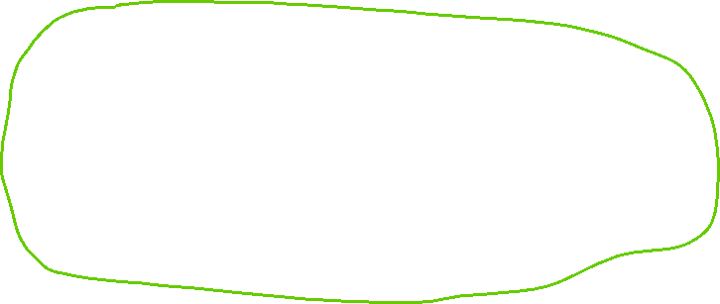
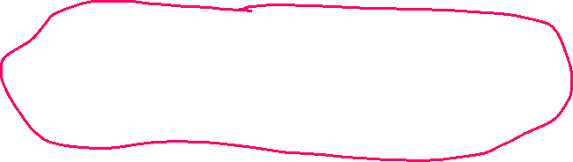
How mut check works
{ // lifetime 'a let mut var: String = String::from("Hello"); { // lifetime 'b let reference: &'b String = &'b var; { // lifetime 'c let mut_reference: &'c mut String = &'b mut var; mut_reference.push_str("World"); } println!("{}", reference) } }
let mut var = String::from("Hello"); let reference = &var; let mut_reference = &mut var; mut_reference.push_str("World"); println!("{}", reference)

Slide 22
Lifetimes that you have to specify
fn create (s1: &mut MyStruct, s2: &mut MyStruct) -> &String { s1.str = String::from("Hi"); &s1.str }
error[E0106]: missing lifetime specifier
fn create(s1: &mut MyStruct, s2: &mut MyStruct) -> &String {
expected named lifetime parameter ^

Slide 23



Lifetimes that you have to specify
fn create<'a>(s1: &'a mut MyStruct, s2: &mut MyStruct) -> &'a String { s1.str = String::from("Hi"); &s1.str }

Slide 24
Structs with References
struct MyStructWithRef<'a, 'b> { reference1: &'a String, reference2: &'b String, }
let val1 = String::from("Foo"); let val2 = String::from("Bar"); let str = MyStructWithRef { reference1: &val1, reference2: &val2, };

Slide 25
Structs with References
struct MyStructWithRef<'a, 'b> { reference1: &'a String, reference2: &'b String, } fn create_struct_with_ref() -> MyStructWithRef { let val1 = String::from("Foo"); let val2 = String::from("Bar"); let str = MyStructWithRef { reference1: &val1, reference2: &val2, }; return str; }

Slide 26
Structs with References
fn create_struct_with_ref<'a>() -> MyStructWithRef<'a, 'a> { let val1 = String::from("Foo"); let val2 = String::from("Bar"); let str = MyStructWithRef { reference1: &val1, reference2: &val2, }; return str; }
^^^ returns a value referencing data owned by the current function

Slide 27
Structs with References
fn main() { let mut val1 = String::new(); let mut val2 = String::new(); let str = create_struct_from_strings(&mut val1, &mut val2); } fn create_struct_from_strings<'a>(val1: &'a mut String, val2: &'a mut String) -> MyStructWithRef<'a, 'a> { *val1 = String::from("Foo"); *val2 = String::from("Bar"); let str = MyStructWithRef { reference1: val1, reference2: val2, }; return str; }

Slide 28
Return Structs with References vs &
fn create<'a>(s1: &'a mut MyStruct, s2: &mut MyStruct) -> &'a String
vs
fn create_struct_from_strings<'a>(val1: &'a mut String, val2: &'a mut String) -> MyStructWithRef<'a, 'a>
struct MyStructWithRef<'a, 'b> { reference1: &'a String, reference2: &'b String, }

Slide 29
Multiple lifetimes in structs
struct MyStructWithRef<'a> { reference1: &'a String, reference2: &'a String, }
let val1 = String::from("Foo"); let reference2: &'static mut String = Box::leak(Box::new(String::from("Hi"))); let str = MyStructWithRef { reference1: &val1, reference2: reference2, }; let r: &'static String = str.reference2;
← borrowed value does not live long enough

Slide 30
Multiple lifetimes in structs
struct MyStructWithRef<'a, 'b> { reference1: &'a String, reference2: &'b String, }
let val1 = String::from("Foo"); let reference2: &'static mut String = Box::leak(Box::new(String::from("Hi"))); let str = MyStructWithRef { reference1: &val1, reference2: reference2, }; let r: &'static String = str.reference2;

Slide 31
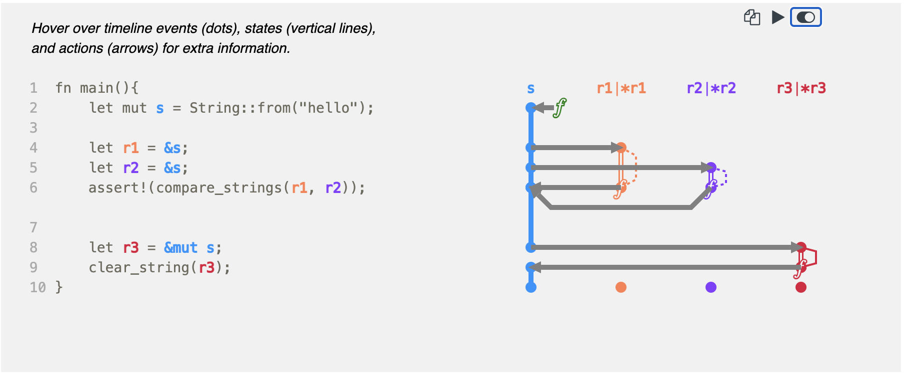
https://github.com/rustviz/rustviz

Slide 32



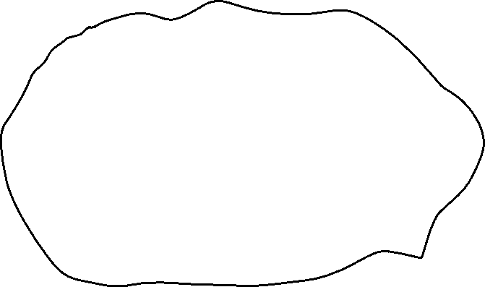





Stack vs Heap

Slide 33
How to move data to heap?
unsafe {
let layout = Layout::new::<u16>();
let ptr = alloc(layout);
if ptr.is_null() { handle_alloc_error(layout); }
*(ptr as *mut u16) = 42;
assert_eq!(*(ptr as *mut u16), 42);
dealloc(ptr, layout);
}
Problems?

Slide 34

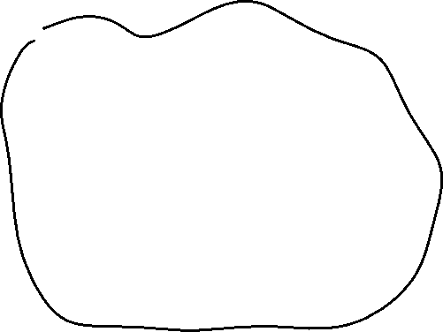

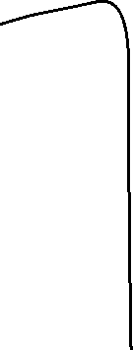

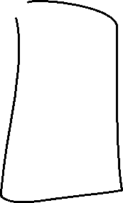



Ownership Based Resource Management (OBRM)

Slide 35
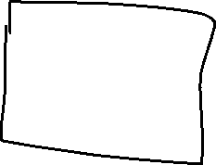


Linked List
struct Node { value: i32, next: Node, }
error[E0072]: recursive type `Node` has infinite size
struct Node<'a> { value: i32, next: &'a Node<'a> }

Slide 36




Linked List
let mut node1 = Node { value: 1, next: None }; {
let mut node2 = Node { value: 2, next: None };
{
let mut node3 = Node { value: 3, next: None }; node2.next = Some(&node3);
node1.next = Some(&node2);
println!("{}", node1.next.unwrap().next.unwrap().value);
node1.next = None; }
println!("{}", node1.value) }
struct Node<'a> { value: i32, next: &'a Node<'a> }
Borrowing ^
error[E0597]: `node3` does not live long enough

Slide 37
Box
Former ~T syntax
Now it is just a Rust structure Box<>
let smart_ptr: Box<i32> = Box::new(42);
struct Box<T>{ pointer: *const T }

Slide 38
What is <>?
let smart_ptr1 = Box::new(42); let smart_ptr2 = Box::new(true);
??? let smart_ptr1: BoxOfI32 = Box::new(42); ??? let smart_ptr2: BoxOfBool = Box::new(true);
Generics – like code generation
let smart_ptr1: Box<i32> = Box::new(42); let smart_ptr2: Box<bool> = Box::new(true);

Slide 39








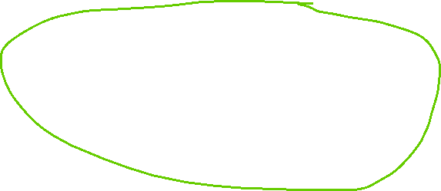

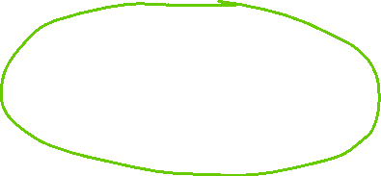
Linked List
struct Node { value: i32, next: Box<Node> }
Ownership ^
struct Node<'a> { value: i32, next: &'a Node<'a> }
Borrowing ^

Slide 40
Linked List
struct Node { value: i32, next: Box<Node> }
Ownership ^
let mut root = Box::new(Node { value: 1, next: Box::new(Node { value: 2, next: Box::new(Node { value: 3, next: empty_node(), }), }), });
println!("{}", root.next.next.value);
root.next = empty_node();
println!("{}", root.value);

Slide 41
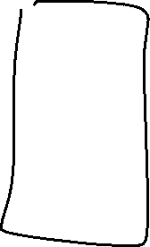
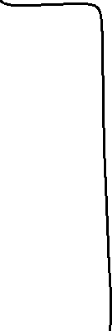


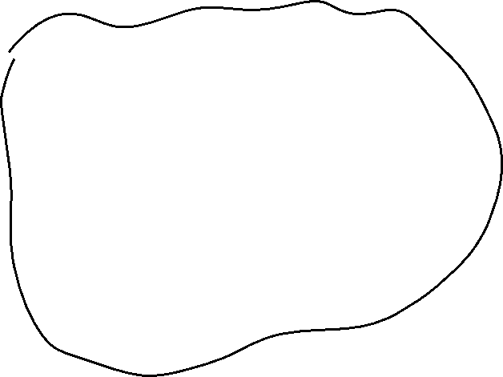

Java-Style

Slide 42
Java-style
struct JavaStyleStruct { reference: Box<MyStruct>, }
let boxed_struct = Box::new(MyStruct { value1: 42, value2: true });
let java_style = JavaStyleStruct { reference: boxed_struct };
println!("{}", java_style.reference.value1)

Slide 43
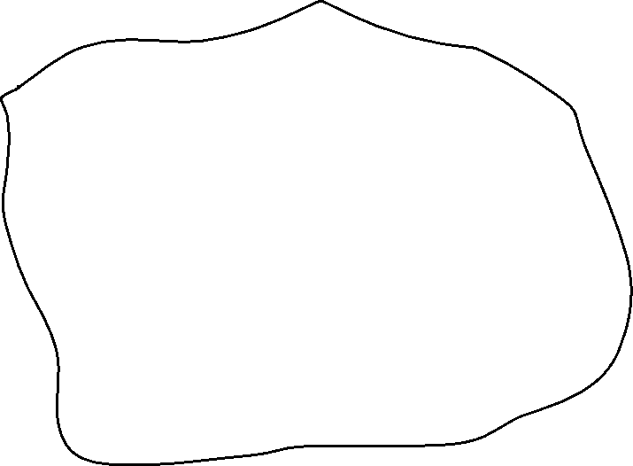


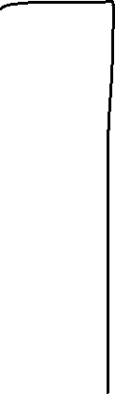



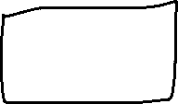
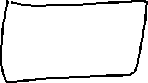
Rust-Style

Slide 44
Reference to Boxed value
let mut boxed = Box::new(MyStruct { value1: 42, value2: true });
let reference: &MyStruct = boxed.borrow();
println!("{}", reference.value1);
let mut_reference: &mut MyStruct = boxed.borrow_mut();
mut_reference.value1 = 123;
let reference: &MyStruct = boxed.borrow();
println!("{}", reference.value1);

Slide 45
Box is special
let b = Box::new(MyStruct { value1: 42, value2: true });
let mut x: MyStruct = *b;
x.value1 = 123;
println!("{}", x.value1);
let reference = &x;
println!("{}", b.value1)
error[E0382]: borrow of moved value: `*b`

Slide 46

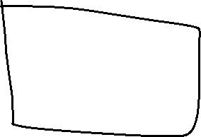







Previous in linked list

Slide 47
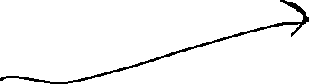

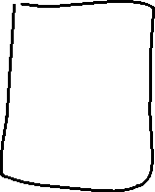
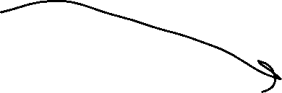
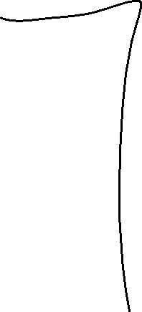
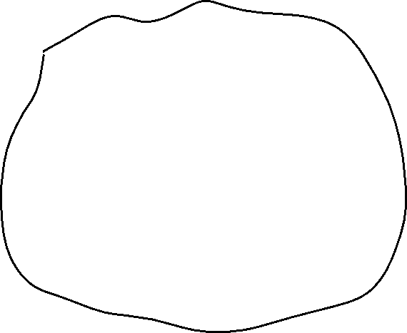


RC – shared ownership

Slide 48
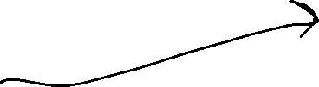

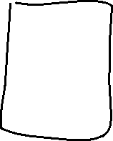
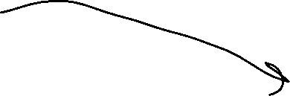
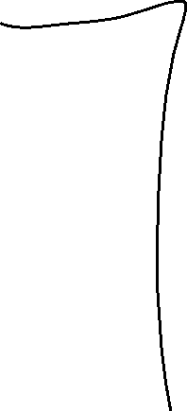
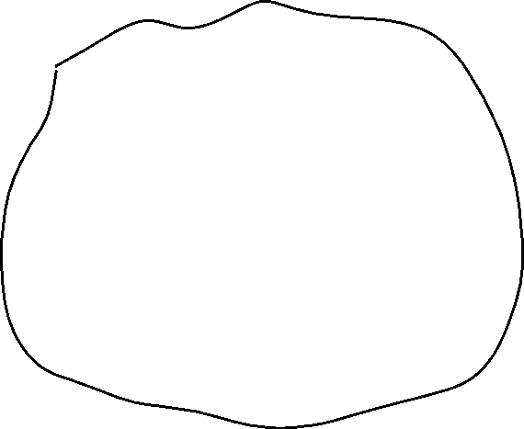


RC – shared ownership

Slide 49

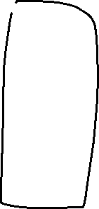



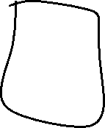

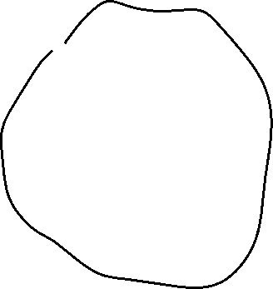


RC vs Box
RC
Box.borrow()

Slide 50
Rc
let owner1 = Rc::new(MyStruct { value1: 42, value2: true });
let owner2: Rc<MyStruct> = owner1.clone();
let owner3: Rc<MyStruct> = owner2.clone();
println!("{}", owner3.value1);
println!("{}", owner1.value1);
println!("{}", owner2.value1);
let reference: &MyStruct = owner1.borrow();
println!("{}", reference.value1);

Slide 51
Clone
fn clone(&self) -> Rc<T> { unsafe { self.inner().inc_strong(); Self::from_inner(self.ptr) } }

Slide 52
Edit Rc value
let owner1 = Rc::new(MyStruct { value1: 42, value2: true });
owner1.value1 = 123;
error[E0594]: cannot assign to data in an `Rc`

Slide 53
Interior Mutability
let cell = Cell::new(42);
let reference1: &Cell<i32> = cell.borrow();
let reference2: &Cell<i32> = cell.borrow();
println!("{}", reference1.get()); // > 42
reference1.replace(123);
println!("{}", reference2.get()); // > 123

Slide 54
Cell – Alias Safe
pub fn replace(&self, val: T) -> T { mem::replace(unsafe { &mut *self.value.get() }, val) // wrapped assignment }
pub const fn replace<T>(dest: &mut T, src: T) -> T { // SAFETY: We read from `dest` but directly write `src` into it afterwards, // such that the old value is not duplicated. Nothing is dropped and // nothing here can panic. unsafe { let result = ptr::read(dest); ptr::write(dest, src); result } }

Slide 55
How to get data from Cell
get() – returns copy
take() – return value and replace with Default
replace() – return value and replace

Slide 56
RefCell
let cell = RefCell::new(MyStruct { value1: 42, value2: true });
{ let reference1: Ref<MyStruct> = cell.borrow(); println!("{}", reference1.borrow().value1); // > 42 }
{ let mut borrowed: RefMut<MyStruct> = cell.borrow_mut(); borrowed.value1 = 123; }
let reference2: Ref<MyStruct> = cell.borrow();
println!("{}", reference2.borrow().value1); // > 123

Slide 57
RefCell
let cell = RefCell::new(MyStruct { value1: 42, value2: true });
let reference1: Ref<MyStruct> = cell.borrow(); println!("{}", reference1.borrow().value1); // > 42 { let mut borrowed: RefMut<MyStruct> = cell.borrow_mut(); borrowed.value1 = 123; }
let reference2: Ref<MyStruct> = cell.borrow();
println!("{}", reference2.borrow().value1); // > 123
PANIC: already borrowed: BorrowMutError
Ref != &

Slide 58






Circular references
struct NodeLeft { right: Cell<Rc<NodeRight>>, } struct NodeRight { left: Cell<Rc<NodeLeft>>, }
let node_left = Rc::new(NodeLeft { right: Cell::new(empty_rc()) });
let node_right = Rc::new(NodeRight { left: Cell::new(node_left.clone()) });
node_left.right.replace(node_right.clone());

Slide 59
Rc::downgrade()
struct NodeLeft { right: Cell<Rc<NodeRight>>, }
struct NodeRight { left: Cell<Weak<NodeLeft>>, }
let node_left = Rc::new(NodeLeft { right: Cell::new(empty_rc()) });
let node_right = Rc::new(NodeRight { left: Cell::new(Rc::downgrade(&node_left)) });
let e = node_left.right.replace(node_right.clone());

Slide 60
Homework
TBD (telegram)
Rustlings
lifetimes
smart_pointers

