Slide 1
Intro
Course: Rust Basics
Author: Aleksandr Kugushev

Slide 2
Course Structure
2 lectures: 150 min
Homework
Main: Github Classroom
Main: Coursework
Optional: Rustlings
Use telegram for questions

Slide 3
Rust is not…
Competitor to Go
Substitution of C#/Java/Python
C/C++ killer

Slide 4
Rust usage (rustjobs.dev)
Cryptocurrency
Big-tech
High-Load Backend
GameDev
C++ legacy
Cross Platform Libraries (Android/IOS)
…

Slide 5
Rust characteristics
No Undefined Behaviors, except unsafe
Zero Cost Abstractions
Memory Safety
LLVM
Functional Programming Language
Performance (why is it the last one?)

Slide 6
No Undefined Behaviors
fn main() { fn compute(input: &u32, output: &mut u32) { if *input > 10 { *output = 1; } if *input > 5 { *output *= 2; } // remember that `output` will be `2` if `input > 10` } }
fn main() { fn compute(input: &u32, output: &mut u32) { let cached_input = *input; // keep `*input` in a register if cached_input > 10 { *output = 2; } else if cached_input > 5 { *output *= 2; } } }

Slide 7
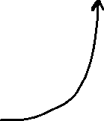


No Undefined Behaviors
fn main() { fn compute(input: &u32, output: &mut u32) { if *input > 10 { *output = 1; } if *input > 5 { *output *= 2; } // remember that `output` will be `2` if `input > 10` } }
fn compute(input: &u32, output: &mut u32)

Slide 8

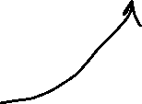
No Undefined Behaviors
fn main() { fn compute(input: &u32, output: &mut u32) { if *input > 10 { *output = 1; } if *input > 5 { *output *= 2; } // remember that `output` will be `2` if `input > 10` } }
fn compute(input: &u32, output: &mut u32)

Slide 9
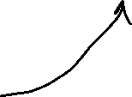
No Undefined Behaviors
fn main() { fn compute(input: &u32, output: &mut u32) { if *input > 10 { *output = 1; } if *input > 5 { *output *= 2; } // remember that `output` will be `2` if `input > 10` } }
fn compute(input: &u32, output: &mut u32)

Slide 10
No Undefined Behaviors
fn main() { fn compute(input: &u32, output: &mut u32) { let cached_input = *input; // keep `*input` in a register if cached_input > 10 { *output = 2; } else if cached_input > 5 { *output *= 2; } } }
fn compute(input: &u32, output: &mut u32)

Slide 11
No Undefined Behaviors?
fn compute(input: &u32, output: &mut u32)
fn compute(input: &u32, output: &mut u32)

Slide 12
No Undefined Behaviors!!!
fn compute(input: &u32, output: &mut u32)
fn compute(input: &u32, output: &mut u32)

Slide 13
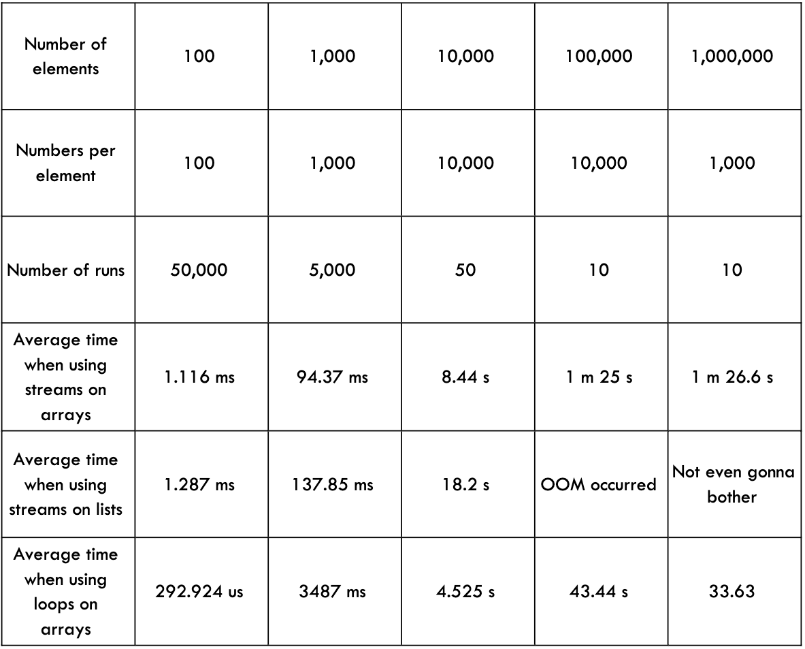

Zero Cost Abstractions: Iterator
Java
Rust
test bench_search_for ... bench: 19,620,300 ns/iter (+/- 915,700)
test bench_search_iter ... bench: 19,234,900 ns/iter (+/- 657,200)
https://doc.rust-lang.org/book/ch13-04-performance.html

Slide 14





Zero Cost Abstractions: Tuple(1, 2)
C#/Java/Python/etc.
Rust

Slide 15


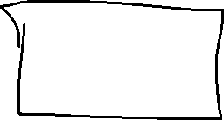





Zero Cost Abstractions: Monomorphization
C#/Java/Python/etc.
Rust
myClass.MyIterfaceMethod()
myClass.MyTraitMethod()

Slide 16






Memory Safety
let raw_ptr: *const MyStruct = …
let reference: &MyStruct = unsafe { &*raw_ptr };

Slide 17











Memory Safety
Contract
Prerequisites
Parameters Validation
Etc.

Slide 18








Memory Safety
pub const unsafe fn split_at_mut_unchecked(&mut self, mid: usize) -> (&mut [T], &mut [T])
pub const fn split_at_mut(&mut self, mid: usize) -> (&mut [T], &mut [T]) { assert!(mid <= self.len()); // SAFETY: `[ptr; mid]` and `[mid; len]` are inside `self`, which // fulfills the requirements of `from_raw_parts_mut`. unsafe { self.split_at_mut_unchecked(mid) } }
Contract

Slide 19
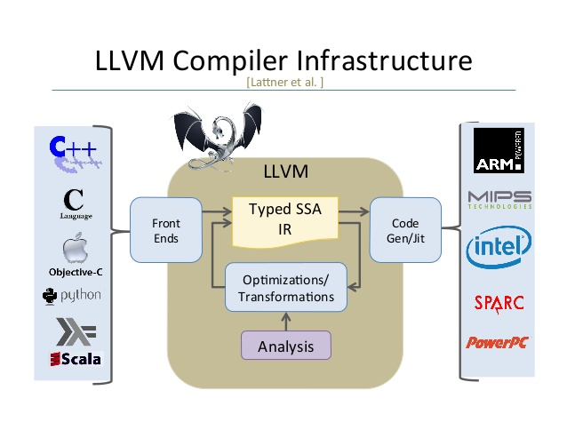
LLVM

Slide 20
LLVM
HIR
Desugaring
THIR
MIR
Borrow Checking
Parsing
Etc.
Optimization
LLVM IR
Machine Code
Optimization
Platform Specific
Exhaustiveness Checking

Slide 21
Functional Programming Language
High level functions
Tuples
Algebraic data type
Iterators
Pattern Matching
Immutability
Pure Functions
Etc.

Slide 22
Functional Programming Language
C++
Rust
C with classes
OOP
Backward Compatibility
OCaml with performance
FP
Breaking Changes

Slide 23
Performance (why is it the last one?)
No Undefined Behaviors, except unsafe
Zero Cost Abstractions
Memory Safety
LLVM
Functional Programming Language

Slide 24
Modern Approach
https://doc.rust-lang.org/book/title-page.html
https://doc.rust-lang.org/reference/
https://github.com/rust-lang/rust-clippy
https://github.com/rust-lang/rustfmt
…

Slide 25
Tools: rustup
https://rust-lang.github.io/rustup/installation
> rustc --version
rustc 1.65.0 (897e37553 2022-11-02)
> rustup update
….
stable-x86_64-pc-windows-msvc updated - rustc 1.67.0 (fc594f156 2023-01-24) (from rustc 1.65.0 (897e37553 2022-11-02))
> rustc --version
rustc 1.67.0 (fc594f156 2023-01-24)

Slide 26
Tools: rustc
https://doc.rust-lang.org/stable/rustc/
> rustc main.rs

Slide 27

Tools: cargo
Package manager
Templates
CLI: Run, Test, etc.
…

Slide 28
Crate
A Rust crate is either a library or an executable program, referred to as either a library crate or a binary crate, respectively.
Every target defined for a Cargo package is a crate.
Library
Executable program
Cargo Package

Slide 29
Hello World
main.rs
fn main() { println!("Hello, world!"); }
> rustc main.rs
Hello, world!

Slide 30
Hello World, Cargo edition
> cargo new hello-world
.gitignore
Cargo.lock
Cargo.toml
src
main.rs
target

Slide 31
Hello World, Cargo edition
> cargo new hello-world
.gitignore
Cargo.lock
Cargo.toml
src
main.rs
target
/target

Slide 32
Hello World, Cargo edition
> cargo new hello-world
.gitignore
Cargo.lock
Cargo.toml
src
main.rs
target
[package] name = "hello-world" version = "0.1.0" edition = "2021" [dependencies]

Slide 33
Hello World, Cargo edition
> cargo new hello-world
.gitignore
Cargo.lock
Cargo.toml
src
main.rs
target
[package] name = "hello-world" version = "0.1.0" edition = "2021" [dependencies] time = "0.1.12" regex = "0.1.41"

Slide 34
Hello World, Cargo edition
> cargo new hello-world
.gitignore
Cargo.lock
Cargo.toml
src
main.rs
target
# This file is automatically @generated by Cargo. # It is not intended for manual editing. version = 3 [[package]] name = "time" version = "0.1.45" source = "registry+https://github.com/rust-lang/crates.io-index" checksum = "1b797afad3f312d1c66a56d11d0316f916356d11bd158fbc6ca6389ff6bf805a" dependencies = [ "libc", "wasi", "winapi 0.3.9", ] …..

Slide 35
Tools: cargo
build
run
check
test
doc
fix
…

Slide 36
Functions
fn my_function(parameter1: String, parameter2: String) -> String { return format!("{} {}", parameter1, parameter2); }
fn my_function_no_return(parameter1: String, parameter2: String) { println!("{} {}", parameter1, parameter2); }

Slide 37
Variables
let variable: String = parameter1;
let variable2 = parameter1;
let mut variable_mut = parameter1;
fn my_function(parameter1: String, mut parameter2: String)

Slide 38
Return
fn my_function(parameter1: String, parameter2: String) -> String { return format!("{} {}", parameter1, parameter2); }
fn my_function(parameter1: String, parameter2: String) -> String { format!("{} {}", parameter1, parameter2) }

Slide 39
Macro
format!("{}", variable);
macro_rules! format { ($($arg:tt)*) => {{ let res = $crate::fmt::format($crate::__export::format_args!($($arg)*)); res }} }

Slide 40
panic!
panic!(“It’s over");

Slide 41
Data Types
Numeric: +-*/%
i8, u8, i16, u16 …. u128, isize, usize: 42, 98_222, 0xff, etc.
Overflow Rules: panic on debug, overflow on release
f32, f64: 2.1, 0.1
bool: true, false
char 32bit: 'a’
array
tuple
…

Slide 42
If
if a > 0 { // do something positive } else { // do something negative }
let b = if a > 0 { 1 } else { 2 };

Slide 43
Loop
loop { println!("Oh no, it's dizzy") }
let mut counter = 1; loop { println!("Oh no, it's dizzy"); counter += 1; if counter > 42 { break } }

Slide 44
Loop as expression
let mut counter = 1; let b= loop { println!("Oh no, it's dizzy"); counter += 1; if counter > 42 { break counter * 2 } };

Slide 45
Break to label
let b = 'main_loop: loop { loop { loop { counter += 1; if counter > 42 { break 'main_loop counter * 2; } } } };

Slide 46
While/For
let mut counter = 0; while counter < 42 { println!("Oh no, it's dizzy"); counter += 1; }
for _ in 0..42 { println!("Oh no, it's dizzy"); }

Slide 47


Structs
struct MyStruct { value1: i32, value2: bool, }
let my_struct = MyStruct { value1: 42, value2: true, };

Slide 48
&str
"Foo"

Slide 49
String
pub struct String { vec: Vec<u8>, }
String::from("Foo")

Slide 50
Homework
Setup Rust environment
Setup your Text Editor/IDE for Rust
Setup your Coursework
Rustlings
https://github.com/rust-lang/rustlings
rustlings run <name_of_file>
exercises/variables
exercises/functions
exercises/if
exercises/primitive_types

