Slide 1
Mutlithreading
Course: Rust Basics
Author: Aleksandr Kugushev

Slide 2
Homework
Err(CustomError(str)) – you SHOULD use ?;
Panic -> Err
[profile.dev]
panic = 'unwind’
struct CustomError(&'static str);
fn divide(left: i32, right: i32) -> Result<i32, CustomError<'static>>

Slide 3
Thread
thread::spawn(|| {
for _ in 0..5 { println!("Hello"); thread::sleep(Duration::from_millis(1)) } });
for _ in 0..5 { println!("World"); thread::sleep(Duration::from_millis(1)) }
World
Hello
Hello
World
Hello
World
Hello
World
World
Hello

Slide 4
Thread builder
thread::Builder::new() .name(String::from("My Thread")) .stack_size(32 * 1024) .spawn(|| { println!("Hello World") });

Slide 5
Threads are background
thread::spawn(|| { for _ in 0..5 { println!("Hello"); thread::sleep(Duration::from_millis(1)) } });
Hello

Slide 6
JoinHandle
let handle: JoinHandle<i32> = thread::spawn(|| {
for _ in 0..5 { println!("Hello"); thread::sleep(Duration::from_millis(1)) }
42 });
let result: Result<i32, Box<dyn Any + Send + 'static>> = handle.join(); assert_eq!(result.unwrap(), 42)

Slide 7
Handle error
let handle: JoinHandle<i32> = thread::spawn(|| { panic!("AAA!") });
let result: Result<i32, Box<dyn Any + Send + 'static>> = handle.join();
let error: Box<dyn Any + Send + 'static> = result.unwrap_err();
let downcast: Box<&str> = error.downcast::<&str>().unwrap();
assert_eq!(*downcast.deref(), "AAA!");

Slide 8
Closure
let int = 5;
let handle = thread::spawn(|| {
println!("Int background {int}"); });
handle.join().expect("The thread shouldn't panic 0_o");
println!("Int main {int}");
<- may outlive borrowed value `int`

Slide 9
thread::spawn
pub fn spawn<F, T>(f: F) -> JoinHandle<T> where F: FnOnce() -> T, F: Send + 'static, T: Send + 'static, { Builder::new().spawn(f).expect("failed to spawn thread") }

Slide 10

Move to spawn
let int = 5; let handle = thread::spawn(move || { println!("Int background {int}"); }); handle.join().expect("The thread shouldn't panic 0_o"); println!("Int main {int}");

Slide 11
Move to spawn ☹
let int = 5;
let text = String::from("Int");
let handle = thread::spawn(move || { println!("{text} background {int}"); });
handle.join().expect("The thread shouldn't panic 0_o");
println!("{text} main {int}");
^^^^ value borrowed here after move

Slide 12
thread::scope
let int = 5; let text = String::from("Int");
thread::scope(|s: &Scope| {
// main thread
s.spawn(|| { // background thread println!("{text} background {int}"); });
});
// main thread println!("{text} main {int}");

Slide 13
thread::scope
let int = 5; let text = String::from("Int"); thread::scope(|s: &Scope| { // main thread s.spawn(|| { // background thread println!("{text} background {int}"); }); s.spawn(|| { // background thread println!("{text} background {int}"); }); }); // main thread println!("{text} main {int}");

Slide 14
Race Condition
fn increment(counter: &mut i32){ let buffer = *counter + 1; *counter = buffer; }

Slide 15
Race Condition
Thread 1
Thread 2
// counter = 0 let buffer = *counter + 1; // 1
*counter = buffer; // 1
// counter = 0 let buffer = *counter + 1; // 1 *counter = buffer; // 1

Slide 16
Use & + &mut in scope
let mut int = 5;
thread::scope(|s: &Scope| {
s.spawn(|| {
int = int + 1;
println!("{text} background {int}");
});
s.spawn(|| {
int = int + 1;
println!("{text} background {int}");
});
});
println!("{text} main {int}");
-- first mutable borrow occurs here
<- second mutable borrow occurs here

Slide 17
Use & + &mut in scope
let mut int = 5; thread::scope(|s: &Scope| { s.spawn(|| { int = int + 1; println!("{text} background {int}"); }); s.spawn(|| { println!("{text} background {int}"); }); }); println!("{text} main {int}");
cannot borrow `int` as immutable because it is also borrowed as mutable

Slide 18
Scope::spawn
pub fn spawn<F, T>(&'scope self, f: F) -> ScopedJoinHandle<'scope, T> where F: FnOnce() -> T + Send + 'scope, T: Send + 'scope, { Builder::new().spawn_scoped(self, f).expect("failed to spawn thread") }

Slide 19
Scope::spawn
pub fn spawn<F, T>(&'scope self, f: F) -> ScopedJoinHandle<'scope, T> where F: FnOnce() -> T + Send + 'scope, T: Send + 'scope, { Builder::new().spawn_scoped(self, f).expect("failed to spawn thread") }

Slide 20
What about Rc?
let int = 5;
let text: Rc<String> = Rc::new(String::from("Int"));
let clone = text.clone();
let handle = thread::spawn(move || {
let txt: &String = clone.deref();
println!("{txt} background {int}"); });
handle.join().expect("The thread shouldn't panic 0_o");
println!("{text} main {int}");
`Rc<String>` cannot be sent between threads safely

Slide 21






Why Rc is not thread safe?

Slide 22
How the compiler found out? 0_o
let int = 5; let text: Rc<String> = Rc::new(String::from("Int")); let clone = text.clone(); let handle = thread::spawn(move || { let txt: &String = clone.deref(); println!("{txt} background {int}"); }); handle.join().expect("The thread shouldn't panic 0_o"); println!("{text} main {int}");

Slide 23
How the compiler found out? 0_o
impl<T: ?Sized> !Send for Rc<T> {}
impl<T: ?Sized> !Sync for Rc<T> {}

Slide 24
Send/Sync
pub unsafe auto trait Send { // empty. }
pub unsafe auto trait Sync { // Empty }

Slide 25
Auto trait
Auto traits, like Send or Sync in the standard library, are marker traits that are automatically implemented for every type, unless the type, or a type it contains, has explicitly opted out via a negative impl.
impl !Trait for Type {}
negative trait bounds are not yet fully implemented;
https://doc.rust-lang.org/beta/unstable-book/language-features/auto-traits.html

Slide 26
Send/Sync
Send
Sync
Can be moved
Can be referenced

Slide 27
Send/Sync
Send
Sync
let int = 5; thread::spawn(move || { println!("background {int}"); }); println!("main {int}");
let int = 5; thread::scope(|s: &Scope| { s.spawn(|| { println!("background {int}"); }); }); println!("main {int}");

Slide 28
Send/Sync
Send + Sync | String, i32, anything except below
Send + !Sync | Cell, RefCell, UnsafeCell, etc.
!Send + !Sync | Rc, raw pointers

Slide 29
Rust as awesome for multithreading because
&/&mut for most cases
Send/Sync for Interior Mutability/Unsafe

Slide 30
Arc
let arc1: Arc<String> = Arc::new(String::from("Shared ownership"));
let arc2: Arc<String> = arc1.clone();
let handle = thread::Builder::new().name(String::from("background")) .spawn(|| {
let moved_arc2: Arc<String> = arc2;
println!("{} from {}", moved_arc2, thread::current().name().unwrap())
});
println!("{} from {}", arc1, thread::current().name().unwrap());
handle.unwrap().join().expect("The thread shouldn't panic 0_o");
> Shared ownership from main
> Shared ownership from background

Slide 31
Arc<T> where T: Send & Sync
let arc1: Arc<RefCell<String>> = Arc::new( RefCell::new( String::from("Shared ownership")));
let arc2: Arc<RefCell<String>> = arc1.clone();
let handle = thread::Builder::new().name(String::from("background")) .spawn(|| {
let moved_arc2: Arc<RefCell<String>> = arc2;
let mut string = moved_arc2.borrow_mut();
string.push_str(" and updated")
});
println!("{} from {}", arc1.borrow(), thread::current().name().unwrap());
handle.unwrap().join().expect("The thread shouldn't panic 0_o");
<- `RefCell<String>` cannot be shared between threads safely

Slide 32
std::sync::atomic
AtomicBool
AtomicI8
AtomicI16
AtomicI32
AtomicI64
AtomicIsize
AtomicPtr
AtomicU8
AtomicU16
AtomicU32
AtomicU64
AtomicUsize
Interior Mutability
Prevents the compiler and CPU from reordering
Atomic operations

Slide 33
static MY_COUNTER: AtomicI32
static MY_COUNTER: AtomicI32 = AtomicI32::new(0);
let handle = thread::spawn(|| {
for _ in 0..100000 {
MY_COUNTER.fetch_add(1, Ordering::SeqCst); // increment
}
});
for _ in 0..100000 {
MY_COUNTER.fetch_add(1, Ordering::SeqCst); // increment
}
handle.join().expect("The thread shouldn't panic 0_o");
println!("Counter={}", MY_COUNTER.load(Ordering::SeqCst)); // 200000

Slide 34
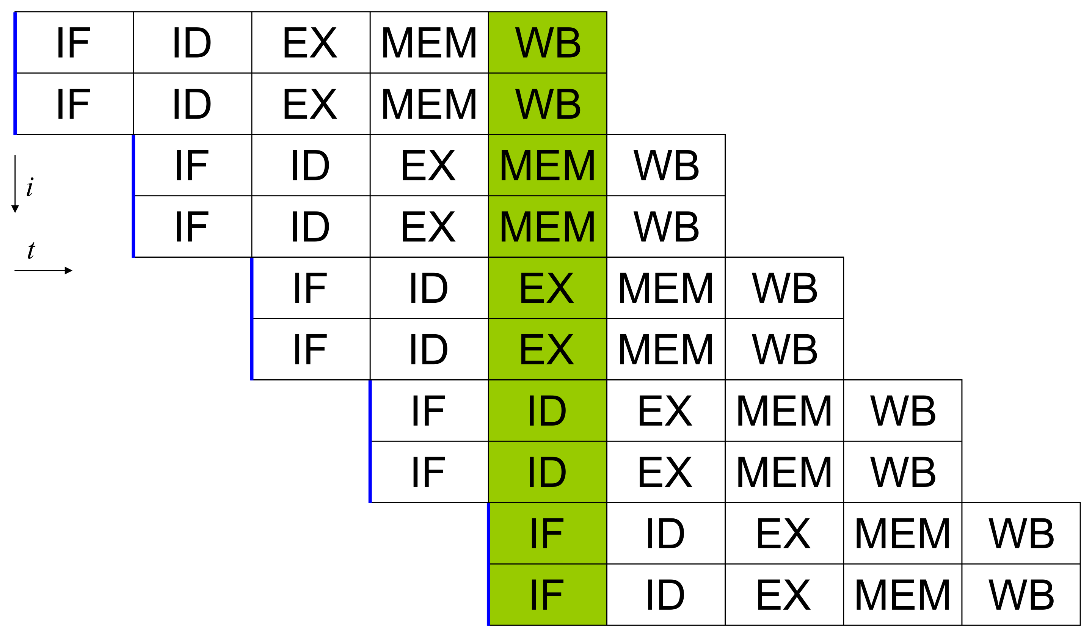
Reordering

Slide 35





std::sync::atomic::fence
fence(Ordering::Acquire);
let value: i32 = MY_COUNTER.load();
// do something
MY_COUNTER.store(value);
fence(Ordering::Release);

Slide 36
Ordering
Relaxed
Acquire – choose on read
Any memory operation written after the Acquire stays after it
Release – choose on write
Any memory operation written before the Release stays before it
AcqRel – choose for compare_exchange
SeqCst – choose if you’re not sure

Slide 37
Atomic operations
let handle = thread::spawn(|| { for _ in 0..1000 { timely_increment(&MY_COUNTER); } }); for _ in 0..1000 { timely_increment(&MY_COUNTER); } handle.join().expect("The thread shouldn't panic 0_o"); // fence inside println!("Counter={}", MY_COUNTER.load(Ordering::Relaxed)); // 2000

Slide 38
compare_exchange
fn timely_increment(value: &AtomicI32) {
loop {
let mut current = value.load(Ordering::Acquire);
let new = current + 1;
thread::sleep(Duration::from_millis(1));
let result = value.compare_exchange(current, new, Ordering::AcqRel, Ordering::Acquire);
if result.is_ok() {
return;
}
}
}

Slide 39
Send/Sync and Pointers
struct NoSendStruct{ cell: *const i32 }
…
let str = NoSendStruct { cell: &42 };
thread::spawn(move || { let moved = str; println!("{}", unsafe { *moved.cell }); });
error[E0277]: `*const i32` cannot be sent between threads safely

Slide 40
Send/Sync and Pointers
struct NoSendStruct{ cell: *const i32 }
unsafe impl Send for NoSendStruct {}
…
let str = NoSendStruct { cell: &42 };
thread::spawn(move || { let moved = str; println!("{}", unsafe { *moved.cell }); });

Slide 41
RAII based locks
Mutex
RwLock
…

Slide 42
Mutex
let mutex = Mutex::new(String::from("Hello"));
thread::scope(|s| { s.spawn(|| {
let mut guard: MutexGuard<String> = mutex.lock().unwrap();
guard.push_str(" World");
}); });
println!("{}", mutex.lock().unwrap())
> Hello World

Slide 43
Poisoning
let mutex = Mutex::new(String::from("Hello"));
thread::scope(|s| { let handle = s.spawn(|| {
let mut guard: MutexGuard<String> = mutex.lock().unwrap(); guard.push_str(" World");
panic!("Something went wrong!")
});
assert!(handle.join().is_err())
});
assert_eq!(mutex.is_poisoned(), true);
let result: LockResult<MutexGuard<String>> = mutex.lock();
assert!(result.is_err());
let guard: MutexGuard<String> = result.unwrap_err().into_inner(); println!("{}", guard)

Slide 44
Arc<Mutex<T>>
let arc1: Arc<Mutex<String>> = Arc::new(
Mutex::new( String::from("Shared ownership")));
let arc2: Arc<Mutex<String>> = arc1.clone();
let handle = thread::Builder::new().name(String::from("background")) .spawn(|| {
let moved_arc2: Arc<Mutex<String>> = arc2;
let mut guard: MutexGuard<String> = moved_arc2.lock().unwrap();
guard.push_str(" and updated")
});
while !handle.as_ref().unwrap().is_finished() {
let guard = arc1.lock().unwrap();
println!("{} from {}", guard, thread::current().name().unwrap());
}
> Shared ownership from main
> Shared ownership from main
> Shared ownership from main
> Shared ownership from main
> Shared ownership from main
> Shared ownership from main
> Shared ownership from main
> Shared ownership from main
> Shared ownership from main
> Shared ownership from main
> Shared ownership and updated from main

Slide 45
RwLock<T>
let arc1: Arc<RwLock<String>> = Arc::new(RwLock::new(String::from("0")));
let arc2: Arc<RwLock<String>> = arc1.clone();
let handle = thread::Builder::new().name(String::from("background")) .spawn(|| {
let moved_arc2: Arc<RwLock<String>> = arc2;
for i in 1..100 {
let mut guard: RwLockWriteGuard<String> = moved_arc2.write().unwrap();
let len = guard.len();
guard.replace_range(0..len, &i.to_string())
}
});
while !handle.as_ref().unwrap().is_finished() { let guard: RwLockReadGuard<String> = arc1.read().unwrap(); println!("{guard}"); }
> 0
> 0
> 0
> 0
> 26
> 26
> 26
> 26
> 77
> 77
> 77
> 77
> 77
> 77
> 99

Slide 46
RwLock<T>
let arc1: Arc<RwLock<String>> = Arc::new(RwLock::new(String::from("0"))); let arc2: Arc<RwLock<String>> = arc1.clone(); let handle = thread::Builder::new().name(String::from("background")) .spawn(|| { let moved_arc2: Arc<RwLock<String>> = arc2;
let mut guard: RwLockWriteGuard<String> = moved_arc2.write().unwrap();
for i in 1..100 { let len = guard.len(); guard.replace_range(0..len, &i.to_string()) }
});
while !handle.as_ref().unwrap().is_finished() { let guard: RwLockReadGuard<String> = arc1.read().unwrap(); println!("{guard}"); }
> 0
> 0
> 0
> 0
> 0
> 0
> 0
> 0
> 0
> 0
> 0
> 0
> 0
PAUSE!
> 99

Slide 47
Channels
let (tx, rx): (Sender<String>, Receiver<String>) = mpsc::channel();
let handle = thread::spawn(move || {
for i in 1..100 {
tx.send(i.to_string());
}
});
while !handle.is_finished() {
let next: Result<String, RecvError> = rx.recv();
println!("{}", next.unwrap());
}
> 0
> 1
> 2
> 3
> 4
> 5
> 6
> 7
> 8
> 9
> 10
> 12

Slide 48
Channels and ownership
pub fn send(&self, t: T) -> Result<(), SendError<T>> { self.inner.send(t) }
pub fn recv(&self) -> Result<T, RecvError> { self.inner.recv() }

Slide 49
Receiver<T> is iterator
let (tx, rx): (Sender<String>, Receiver<String>) = mpsc::channel();
let handle = thread::spawn(move || { for i in 1..100 { tx.send(i.to_string()); } });
for val in rx { println!("{val}"); }
> 0
> 1
> 2
> 3
> 4
…
> 98
> 99

Slide 50
Multiple Producer Single Consumer
let (tx, rx): (Sender<String>, Receiver<String>) = mpsc::channel();
let tx_clone = tx.clone();
thread::spawn(move || { for i in 1..100 { tx.send(i.to_string()); } });
thread::spawn(move || { for i in 100..10000 { tx_clone.send(i.to_string()); } });
for val in rx { println!("{val}"); }
100
1
101
2
102
3
103
4
104
5
6
105
…

Slide 51
Homework
Later in telegram
Rustlings:
threads

