Slide 1
Ownership
Course: Rust Basics
Author: Aleksandr Kugushev

Slide 2
Questions?

Slide 3


Structs
struct MyStruct { value1: i32, value2: bool, }
let my_struct = MyStruct { value1: 42, value2: true, };

Slide 4
String
pub struct String { vec: Vec<u8>, }
String::from("Foo")

Slide 5
Move/Copy/Borrow Semantics in Programming
Language | Move | Copy | Borrow | Default (Primitives) | Default (Complex Types) | Immutable Parameters
C | - | Y | - | Copy | - | Y (opt-in via 'const')
C# | - | Y | Y | Copy | Mutable Borrow | -
Java | - | Y | Y | Copy | Mutable Borrow | Y (opt-in via 'final')
Rust | Y | Y | Y | Copy | Move/Copy | Y (opt-out via 'mut')
https://gist.github.com/dubrowgn/c61372647160ae4a52f65ef91da99ddc

Slide 6


Copy
let var1 = 42; let var2 = var1;
pub trait Copy: Clone { // Empty. }

Slide 7





Copy is not Deep Copy
struct StructWithPtr { ref: &i32, }
let var1 = StructWithPtr { ref: &42 }; let var2 = var1;

Slide 8


Move
let var1 = my_struct; let var2 = var1;
memcpy (!)

Slide 9




Move
let var1 = my_struct; let var2 = var1;
println!("{}", var1);
error[E0382]: borrow of moved value: `var1`:
let var2 = var1;
---- value moved here
println!("{}", var1);
^^^^ value borrowed here after move

Slide 10
Move to method
let var1 = my_struct; my_fn(var1); println!("{}", var1);
error[E0382]:
my_fn(var1);
---- value moved here
println!("{}", var1);
^^^^ value borrowed here after moveborrow of moved value: `var1`

Slide 11
Drop
pub fn drop<T>(_x: T) {}

Slide 12


Drop on move out of scope
let var1 = my_struct1; { let var2 = my_struct2; }
let var1 = my_struct; { let var2 = var1; }

Slide 13
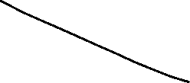



Drop on move out of scope
let var1 = my_struct1; { let var2 = my_struct2; }
let var1 = my_struct; { let var2 = var1; }

Slide 14
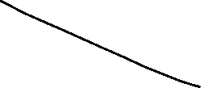






Drop on move out of scope
let var1 = my_struct1; { let var2 = my_struct2; }
let var1 = my_struct; { let var2 = var1; }

Slide 15




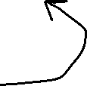


Borrowing aka Access via Reference
let var1 = my_struct; let var2 = &var1;
println!("{}", var2);

Slide 16




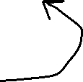


Borrowing aka Access via Reference
let var1 = my_struct; let var2 = &var1;
println!("{}", var2);

Slide 17
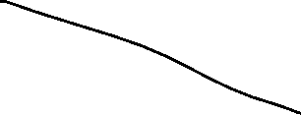



Borrowing aka Access via Reference
let var1 = my_struct; let var2 = &var1; my_move(var1); println!("{}", var2);
error[E0505]: cannot move out of `var1` because it is borrowed

Slide 18

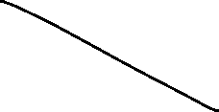



Dangling References
fn create_and_return_ref() -> & String { let s = String::from("Hi"); &s }
error[E0515]: cannot return reference to local variable `s`
&s
^^ returns a reference to data owned by the current function

Slide 19
Mutable References
let mut var = String::from("Hello"); var.push_str(" World!"); println!("{}", var)

Slide 20
Mutable References
let mut var = String::from("Hello"); append_world(&var); println!("{}", var)
fn append_world(str: &String){ str.push_str(" World!") }
error[E0596]: cannot borrow `*str` as mutable, as it is behind a `&` reference
fn append_world(str: &String){
------- help: consider changing this to be a mutable reference: `&mut String`
str.push_str(" World!")
`str` is a `&` reference, so the data it refers to cannot be borrowed as mutable

Slide 21
Mutable References
let mut var = String::from("Hello"); append_world(&var); println!("{}", var)
fn append_world(str: &mut String){ str.push_str(" World!") }
error[E0308]: mismatched types
append_world(&var);
------------ ^^^^ types differ in mutability

Slide 22
Mutable References
let mut var = String::from("Hello"); append_world(&mut var); println!("{}", var)
fn append_world(str: &mut String){ str.push_str(" World!") }

Slide 23
Mutable (Unique) vs Shared References
&mut – Mutable (Unique)
& - Shared
Single
No other Shared References
Allow using in &mut parameters
Allow using in & parameters
Multiple
No another Unique Reference
Allow using in & parameters

Slide 24
No Undefined Behaviors
fn main() { fn compute(input: &u32, output: &mut u32) { if *input > 10 { *output = 1; } if *input > 5 { *output *= 2; } // remember that `output` will be `2` if `input > 10` } }
fn main() { fn compute(input: &u32, output: &mut u32) { let cached_input = *input; // keep `*input` in a register if cached_input > 10 { *output = 2; } else if cached_input > 5 { *output *= 2; } } }

Slide 25



Mutable vs Shared References: Aliasing
fn main() { fn compute(input: &u32, output: &mut u32) { if *input > 10 { *output = 1; } if *input > 5 { *output *= 2; } // remember that `output` will be `2` if `input > 10` } }
fn compute(input: &u32, output: &mut u32)

Slide 26

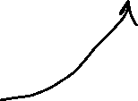
Mutable vs Shared References: Aliasing
fn main() { fn compute(input: &u32, output: &mut u32) { if *input > 10 { *output = 1; } if *input > 5 { *output *= 2; } // remember that `output` will be `2` if `input > 10` } }
fn compute(input: &u32, output: &mut u32)

Slide 27
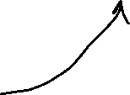
Mutable vs Shared References: Aliasing
fn main() { fn compute(input: &u32, output: &mut u32) { if *input > 10 { *output = 1; } if *input > 5 { *output *= 2; } // remember that `output` will be `2` if `input > 10` } }
fn compute(input: &u32, output: &mut u32)

Slide 28
Mutable vs Shared References: Aliasing
fn main() { fn compute(input: &u32, output: &mut u32) { let cached_input = *input; // keep `*input` in a register if cached_input > 10 { *output = 2; } else if cached_input > 5 { *output *= 2; } } }
fn compute(input: &u32, output: &mut u32)

Slide 29
Mutable vs Shared References: Aliasing
fn compute(input: &u32, output: &mut u32)
fn compute(input: &u32, output: &mut u32)
Variables and pointers alias if they refer to overlapping regions of memory.

Slide 30
Dereference via *
let x = 5; let y = &x; assert_eq!(5, x); assert_eq!(5, *y);

Slide 31





Stealing Prevention for Drop Check
let var = String::from("Hi"); let reference = &var; my_move(*reference);
fn my_move(my_struct: String) {}
error[E0507]: cannot move out of `*reference` which is behind a shared reference

Slide 32
Assignment
let mut var = String::from("Hi"); let reference = &mut var; *reference = String::from("Lol");
Why is it ok?

Slide 33




Dereference move
let moved = *reference;
*reference = new_value;

Slide 34



Dereference move
let moved = *reference;
*reference = new_value;

Slide 35


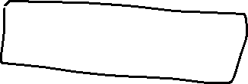
Dereference move
let moved = *reference;
*reference = new_value;

Slide 36

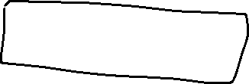


Dereference move
let mut var = String::from("Hi"); let reference = &mut var;
// stealing may happened anywhere let moved = *reference;
println!("{}", var)

Slide 37
Dereference * as out
fn try_create(condition: bool, out: &mut String) -> bool { if condition { *out = String::from("Success"); return true; } return false; }

Slide 38
Dereference via .
let mut var = String::from("Hi"); let reference = &mut var;
(*reference).push_str("Dude");
reference.push_str("Dude")

Slide 39
Stealing
let mut var = String::from("Hi"); let reference = &mut var; let bytes = reference.into_bytes();
pub fn into_bytes(self) -> Vec<u8> { self.vec }
error[E0507]: cannot move out of `*reference` which is behind a mutable reference

Slide 40
Copy vs Move
let var = String::from("Hi"); let reference = &var; let moved = var; println!("{}", reference)
error[E0505]: cannot move out of `var` because it is borrowed
let moved = var;
^^^ move out of `var` occurs here
println!("{}", reference)
--------- borrow later used here

Slide 41

Copy vs Move
let var = 42; let reference = &var; let moved = var; println!("{}", reference)

Slide 42
Copy vs Move
Copy
Move
let var = 42; let reference = &var; let copy = var; println!("{}", reference)
#[derive ! (Copy, Clone)] struct i32 { … }
let var = String::from("Hi"); let reference = &var; let moved = var; println!("{}", reference)
pub struct String { … }

Slide 43




Copy vs Move
Copy
let var = 42; let reference = &var; let copy = var; println!("{}", reference)
#[derive(Copy, Clone)] struct i32 { … }

Slide 44
Copy trait
Simple bit-wise copy
Not overloadable
Everything which is Copy must also implement Clone
Can’t implement Copy for &mut
Shouldn’t implement Copy for mutable structures

Slide 45
Lifetimes
Compile Time
Annotation
Drop Check relies on Lifetimes

Slide 46
Lifetimes
{ // lifetime: 'a let var1: i32 = 42; { // lifetime: 'b let var2: &'b i32 = &'b var1; } }
let var1: i32 = 42; let var2: &i32 = &var1;

Slide 47
Lifetimes
{ // lifetime: 'a let var1: i32 = 42; { // lifetime: 'b let var2: &'b i32 = &'b var1; { // lifetime: 'c let var3: &'c &'b i32 = &'c var2; } } }
let var1: i32 = 42; let var2: &i32 = &var1; let var3: &&i32 = &var2;

Slide 48








Lifetimes
{ // lifetime: 'a let var1: i32 = 42; { // lifetime: 'b let var2: &'b i32 = &'b var1; { // lifetime: 'c let var3: &'c &'b i32 = &'c var2; } } }

Slide 49


Lifetimes
{ // lifetime: 'a let var: &i32; { // lifetime: 'b let var1: i32 = 42; { // lifetime: 'c let var2: &’a i32 = &’a var1; var = var2; } } }
let var: &i32; let var1: i32 = 42; let var2: &i32 = &var1; let var3: &&i32 = &var2; var = var2;

Slide 50
Lifetimes and Dangling Pointer
fn create_and_return_ref<'x>() -> &'x String { { // lifetime 'b let s = String::from("Hi"); &'x s } }
fn caller_dangling_string(){ { // lifetime 'x let string_ref: &'x String = create_and_return_ref(); } }

Slide 51





Lifetimes and Dangling Pointer
fn caller_dangling_string() { { // lifetime 'x let string_ref: &'x String; { // lifetime 'b let s = String::from("Hi"); string_ref = &'x s } } }

Slide 52
Lifetimes and Dangling Pointer
fn create_and_return_ref(my_struct: &mut MyStruct) -> &String { my_struct.str = String::from("Hi"); &my_struct.str } fn caller_non_dangling_string() { let mut my_struct = MyStruct { str: String::default() }; let string_ref: &String = create_and_return_ref(&mut my_struct); print!("{}", string_ref) }

Slide 53
Lifetimes and Dangling Pointer
fn create_and_return_ref(my_struct: &mut MyStruct) -> &String { my_struct.str = String::from("Hi"); &my_struct.str } fn caller_non_dangling_string() { let mut my_struct = MyStruct { str: String::default() }; let string_ref: &String = create_and_return_ref(&mut my_struct); print!("{}", string_ref) }

Slide 54






How to avoid Dangling Pointer
{// lifetime 'a let mut my_struct = MyStruct { str: String::default() }; { // lifetime 'b let string_ref: &'b String; my_struct.str = String::from("Hi"); string_ref = &'b my_struct.str; print!("{}", string_ref) } }

Slide 55
How to avoid Dangling Pointer and LEAK
fn create_and_return_ref() -> &'static String { let s = Box::leak(Box::new(String::from("Hi"))); s }

Slide 56
Static livetime: Lives forever
fn static_instance() { let val = String::from("Hi"); let reference: &'static String = &val; }
error[E0597]: `val` does not live long enough
let reference: &'static String = &val;
^^^^ borrowed value does not live long enough
}
- `val` dropped here while still borrowed

Slide 57
Compiler POV
fn caller_non_dangling_string() { let mut my_struct = MyStruct { str: String::default() }; let string_ref: &'a String = create_and_return_ref(&'a mut my_struct); print!("{}", string_ref) }
fn create_and_return_ref<'a>(my_struct: &'a mut MyStruct) -> &'a String

Slide 58
Compiler POV
fn caller_non_dangling_string() { let mut my_struct = MyStruct { str: String::default() }; let string_ref: &'a String = create_and_return_ref(&'a mut my_struct); print!("{}", string_ref) }
fn create_and_return_ref<'a>(my_struct: &'a mut MyStruct) -> &'a String

Slide 59


How mut check works
{ // lifetime 'a let mut var: String = String::from("Hello"); { // lifetime 'b let reference: &'b String = &'b var; { // lifetime 'c let mut_reference: &'c mut String = &'b mut var; mut_reference.push_str("World"); } println!("{}", reference) } }
let mut var = String::from("Hello"); let reference = &var; let mut_reference = &mut var; mut_reference.push_str("World"); println!("{}", reference)

Slide 60
Lifetimes that you have to specify
fn create (s1: &mut MyStruct, s2: &mut MyStruct) -> &String { s1.str = String::from("Hi"); &s1.str }
error[E0106]: missing lifetime specifier
fn create(s1: &mut MyStruct, s2: &mut MyStruct) -> &String {
expected named lifetime parameter ^

Slide 61



Lifetimes that you have to specify
fn create<'a>(s1: &'a mut MyStruct, s2: &mut MyStruct) -> &'a String { s1.str = String::from("Hi"); &s1.str }

Slide 62
Structs with References
struct MyStructWithRef<'a, 'b> { reference1: &'a String, reference2: &'b String, }
let val1 = String::from("Foo"); let val2 = String::from("Bar"); let str = MyStructWithRef { reference1: &val1, reference2: &val2, };

Slide 63
Structs with References
struct MyStructWithRef<'a, 'b> { reference1: &'a String, reference2: &'b String, } fn create_struct_with_ref() -> MyStructWithRef { let val1 = String::from("Foo"); let val2 = String::from("Bar"); let str = MyStructWithRef { reference1: &val1, reference2: &val2, }; return str; }

Slide 64
Structs with References
fn create_struct_with_ref<'a>() -> MyStructWithRef<'a, 'a> { let val1 = String::from("Foo"); let val2 = String::from("Bar"); let str = MyStructWithRef { reference1: &val1, reference2: &val2, }; return str; }
^^^ returns a value referencing data owned by the current function

Slide 65
Structs with References
fn main() { let mut val1 = String::new(); let mut val2 = String::new(); let str = create_struct_from_strings(&mut val1, &mut val2); } fn create_struct_from_strings<'a>(val1: &'a mut String, val2: &'a mut String) -> MyStructWithRef<'a, 'a> { *val1 = String::from("Foo"); *val2 = String::from("Bar"); let str = MyStructWithRef { reference1: val1, reference2: val2, }; return str; }

Slide 66
Return Structs with References vs &
fn create<'a>(s1: &'a mut MyStruct, s2: &mut MyStruct) -> &'a String
vs
fn create_struct_from_strings<'a>(val1: &'a mut String, val2: &'a mut String) -> MyStructWithRef<'a, 'a>
struct MyStructWithRef<'a, 'b> { reference1: &'a String, reference2: &'b String, }

Slide 67
Multiple lifetimes in structs
struct MyStructWithRef<'a> { reference1: &'a String, reference2: &'a String, }
let val1 = String::from("Foo"); let reference2: &'static mut String = Box::leak(Box::new(String::from("Hi"))); let str = MyStructWithRef { reference1: &val1, reference2: reference2, }; let r: &'static String = str.reference2;
← borrowed value does not live long enough

Slide 68
Multiple lifetimes in structs
struct MyStructWithRef<'a, 'b> { reference1: &'a String, reference2: &'b String, }
let val1 = String::from("Foo"); let reference2: &'static mut String = Box::leak(Box::new(String::from("Hi"))); let str = MyStructWithRef { reference1: &val1, reference2: reference2, }; let r: &'static String = str.reference2;

Slide 69
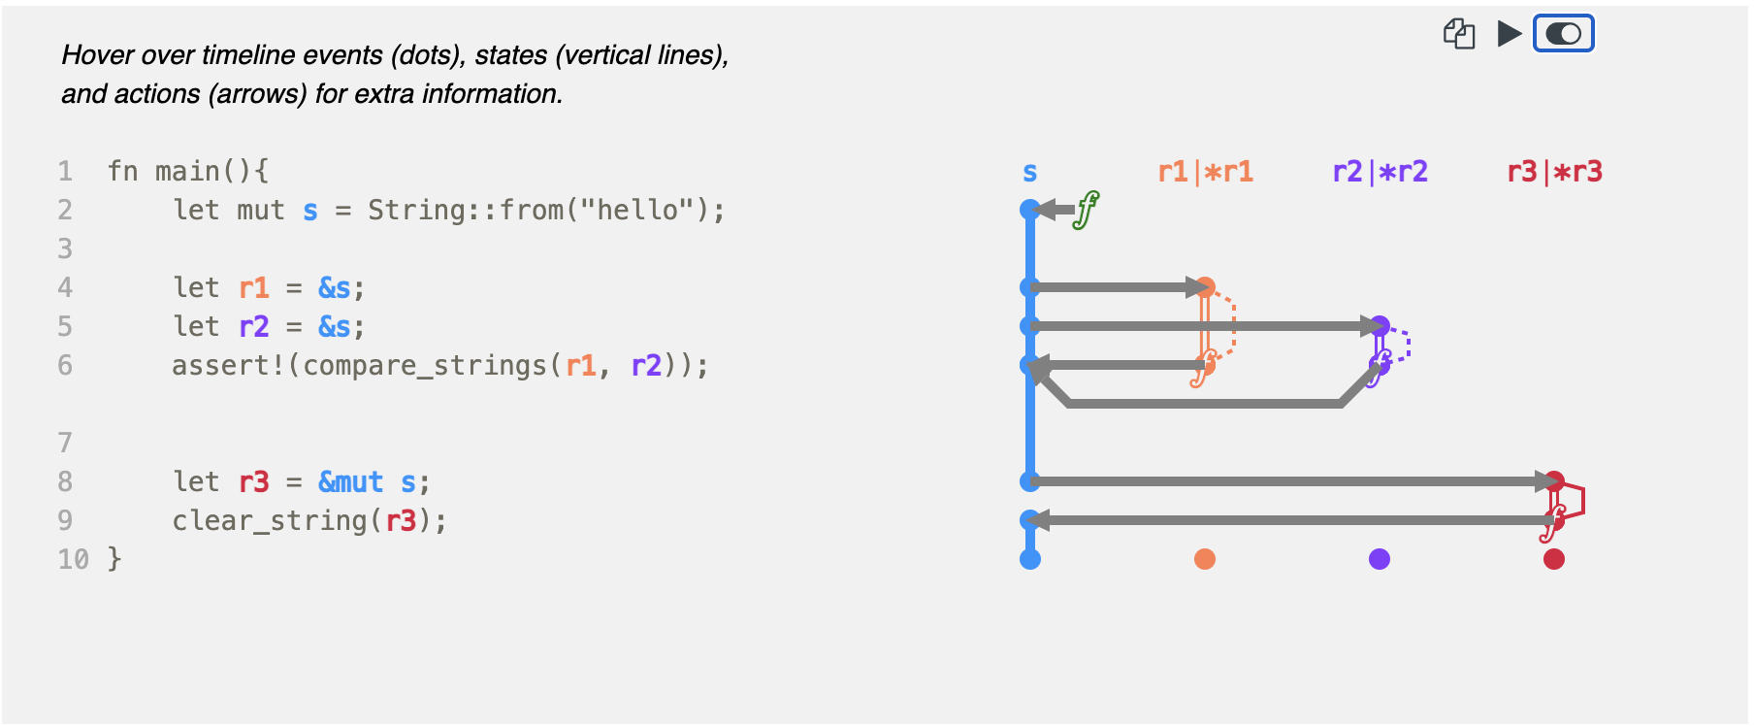
Conclusion: https://github.com/rustviz/rustviz

Slide 70
Homework
struct Request { count: i32, name: String, } struct RequestBuilder { count: i32, name: String, }
let mut builder = create_builder(); set_count(/* & or &mut or nothing */ builder, 42);
let name = String::from("Hello World"); set_name(/* & or &mut or nothing */ builder, name);
let mut request: Request = build(/* & or &mut or nothing */ builder); assert_eq!("Hello World", &request.name[..]); assert_eq!(42, request.count);

Slide 71
Homework
Main: https://classroom.github.com/a/qbAk09p1
Rustlings
move_semantics

