Slide 1




Slide 2




Free
Framework
Open-source

Slide 3
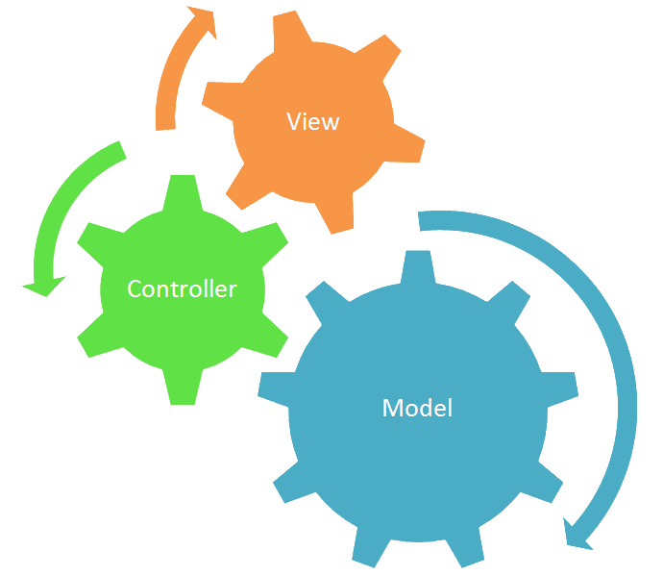
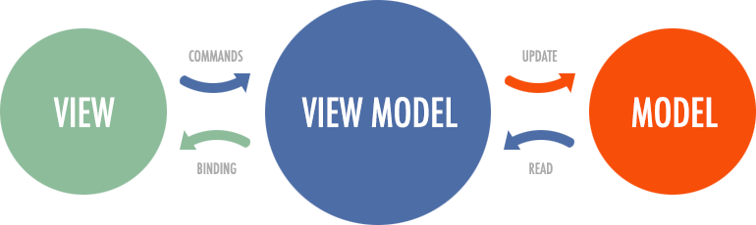

Slide 4
Version 2
Fall 2016
Version 6
May 2018
Version 9
Feb 2019
Version 15
Nov 2022
Base
Angular
CLI Implementation
Library support
Animations performances improvements
Angular Material Starters
Better debug
Improved type checking
Improved build errors and times
Standalone APIs

Slide 5


> npm install –g typescript
> npm install –g @angular/core
> npm install –g @angular/cli
> ng new gps-activity-mapper
> npm install bootstrap
> ng serve

Slide 6
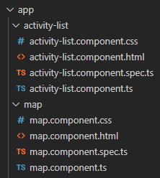
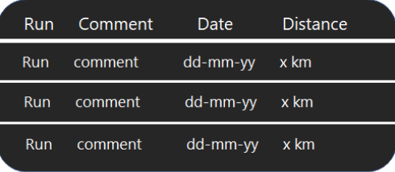

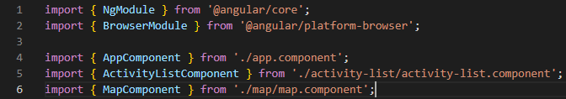
View 1
View 2
> ng generate component activty-list
> ng generate component map

Slide 7
import { Component, OnInit } from '@angular/core’;
@Component({
selector: 'app-activity-list',
templateUrl: './activity-list.component.html',
styleUrls: ['./activity-list.component.css']
})
constructor() {}
ngOnInit() {}
}
export interface IActivity{
id: number
name: string
date: Date
comments?: string
distance: number
gpxData: string
}
import { IActivity } from '../shared/activity.model';

Slide 8
import { IActivity } from "./activity.model";
export const SAVED_ACTIVITIES: IActivity[] = [
{
"id": 1,
"name": "Grand bassin",
"date": new Date('11/10/2022'),
"comments": "It was cold but i like it",
"gpxData": '../assets/gpx/1.gpx'
},
{
"id": 2,
"name": " Lalaa Setti ",
"date": new Date('12/06/2022'),
"comments": "The view is great up here",
"gpxData": '../assets/gpx/2.gpx'
}// and so on
]

Slide 9
import { Injectable } from '@angular/core';
import { IActivity } from '../shared/activity.model';
import { SAVED_ACTIVITIES } from '../shared/activities';
@Injectable()
export class ActivityService {
constructor() { }
getTotalDistance(allActivities: IActivity[])
{
var totalDistance = 0;
for(var i=0; i<allActivities.length; i++)
{totalDistance += allActivities[i].distance;}
return totalDistance;
}
getLastDate(allActivities: IActivity[])
{
var lastDate = new Date('01/01/1900');
for(var i=0; i<allActivities.length; i++)
{
if(allActivities[i].date>lastDate)
lastDate=allActivities[i].date;
}
return lastDate;
}
}
> ng generate service activity-list
getActivities(): IActivity[]{
return SAVED_ACTIVITIES.slice(0);
}
getTotalActivities(allActivities: IActivity[])
{
return allActivities.length;
}

Slide 10
import { Component, OnInit } from '@angular/core';
import { IActivity } from '../shared/activity.model';
import { ActivityService } from '../services/activity.service’;
@Component({
selector: 'app-activity-list',
templateUrl: './activity-list.component.html',
styleUrls: ['./activity-list.component.css']
})
export class ActivityListComponent {
constructor(private _activityService: ActivityService) {}
ngOnInit() {
this.activities = this._activityService.getActivities();
this.totalActivities = this._activityService.getTotalActivities(this.activities);
this.totalDistance = this._activityService.getTotalDistance(this.activities);
this.lastDate = this._activityService.getLastDate(this.activities);
}
}
activities: IActivity[];
totalActivities: number;
totalDistance: number;
lastDate: Date;

Slide 11
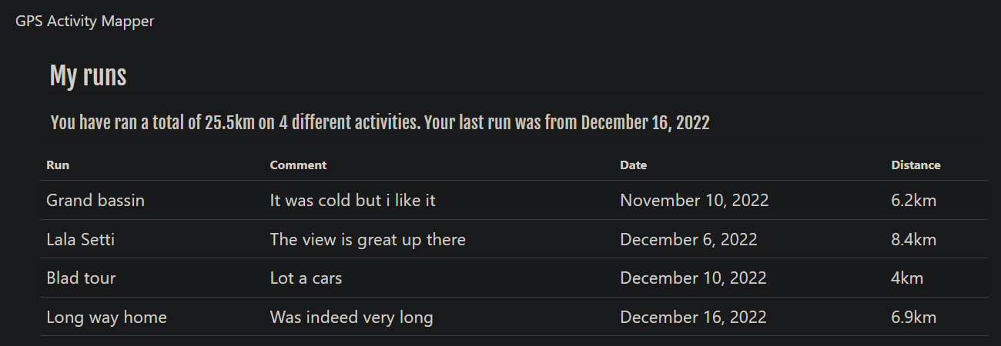
<table class="table table-hover table-striped">
<thead>
<tr>
<th>Run</th>
<th>Comment</th>
<th>Date</th>
<th>Distance</th>
</tr>
</thead>
<tbody>
<tr *ngFor="let activity of activities">
<td>{{ activity.name }}</td>
<td>{{ activity.comments }}</td>
<td>{{ activity.date | date: "longDate" }}</td>
<td>{{ activity.distance }}</td>
</tr>
</tbody>
</table>
</div>
<div class="row row-runs">
<h2 class="heading">My runs</h2>
<div class="summary">
<p class="totals">You have run a total of {{ totalDistance }}km</p>
<p class="totals"> On {{ totalActivities }} activities</p>
<p class="totals">Your last run was from {{ lastDate | date: 'MMMM dd, yyyy'}}</p>
</div>

Slide 12

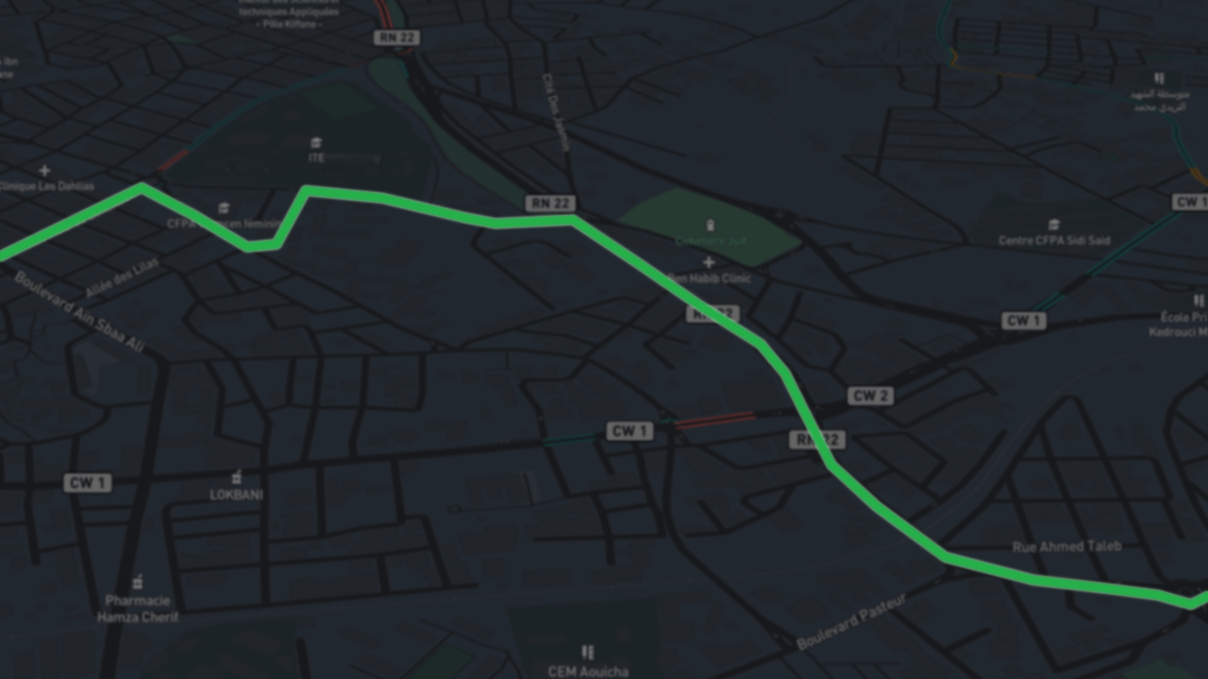



Slide 13
import { Routes } from "@angular/router";
import { ActivityListComponent } from "./app/activity-list/activity-list.component";
export const appRoutes: Routes = [
{ path:"activities", component: ActivityListComponent },
{ path:"", redirectTo:"/activities", pathMatch:'full’}
]
import { appRoutes } from 'src/routes';
import { RouterModule } from '@angular/router’;
@NgModule({
declarations: [
AppComponent,
ActivityListComponent,
MapComponent
],
imports: [
BrowserModule,
RouterModule.forRoot(appRoutes)
],
providers: [ActivityService, MapService],
bootstrap: [AppComponent]
})
export class AppModule { }
import { MapComponent } from "./app/map/map.component";
{ path:"activity/:id", component: MapComponent },

Slide 14
export class MapComponent {
constructor (private _mapService: MapService,
private _route: ActivatedRoute) {}
activity: any;
activityName : string;
activityComments : string;
activityDate: Date;
activityDistance: number;
gpx: any;
ngOnInit() {
this.activity=this._mapService.getActivity(+this._route.snapshot.params['id']);
}

Slide 15
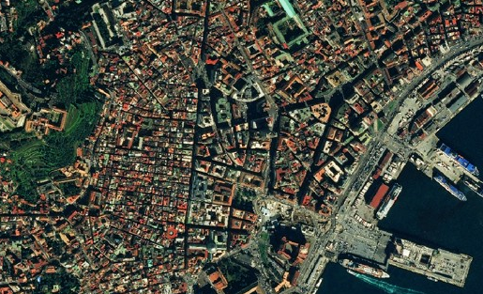
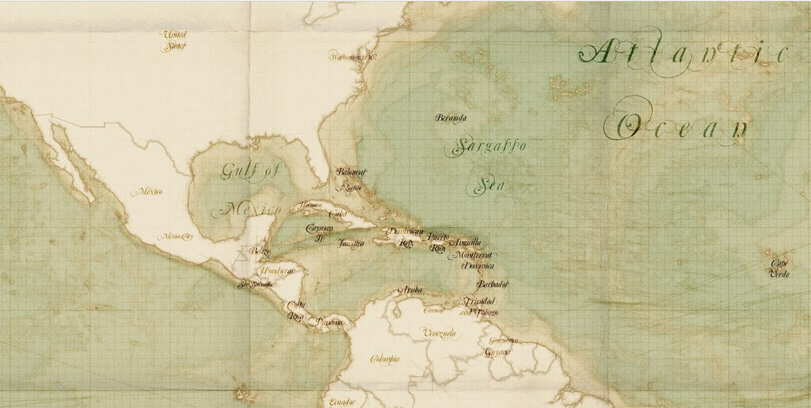
import { Injectable } from '@angular/core';
import { environment } from '../../environments/environment'
import { SAVED_ACTIVITIES } from '../shared/activities’;
@Injectable()
export class MapService {
constructor() { }
getActivity(id: number){
return SAVED_ACTIVITIES.slice(0).find(run => run.id == id)
}
plotActivity(id: number){
var Style = {
"color": "#25b04a",
"weight": 5,
"opacity": 0.90
};
declare var omnivore: any;
declare var L: any;
var map = L.map('map').setView(defaultCoords, defaultZoom);
L.tileLayer('https://api.mapbox.com/styles/v1/{id}/tiles/{tileSize}/{z}/{x}/{y}?access_token={accessToken}', {
id: 'mapbox/navigation-night-v1',
tileSize: 256,
accessToken: apiToken
}).addTo(map);
Satellite
Pirate

Slide 16
}).addTo(map);
var customLayer = L.geoJson(null, {
style: Style
});
var gpxLayer = omnivore.gpx(SAVED_ACTIVITIES.slice(0).find(run => run.id == id)?.gpxData, null, customLayer).on('ready', function() {
map.fitBounds(gpxLayer.getBounds());
}).addTo(map);
}
}

Slide 17
ngOnInit() {
this.activity=this._mapService.getActivity(+this._route.snapshot.params['id']);
}
ngAfterViewInit() {
this._mapService.plotActivity(+this._route.snapshot.params['id']);
this.activityName= this.activity.name;
this.activityComments=this.activity.comments;
this.activityDistance=this.activity.distance;
this.activityDate=this.activity.date;
this.gpx=this.activity.gpx;
}
}

Slide 18
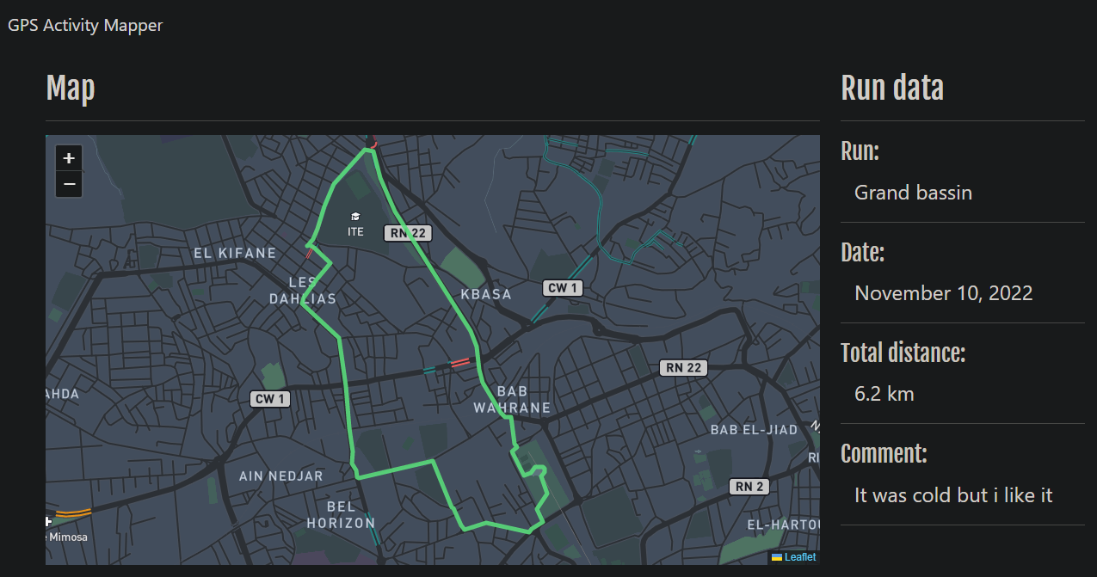
<div class="row row-map">
<div class="col-md-9">
<h2 class="heading">Map</h2>
<hr/>
<div id="map"></div>
</div>
<div class="col-md-3 info-container">
<div id="activity-info">
<h2 class="heading">Run data</h2>
<hr/>
<div class="data-heading">Run:</div>
<p class="data-entry">{{ activityName }}</p>
<hr/>
<div class="data-heading">Date:</div>
<p class="data-entry">{{ activityDate | date: "longDate" }} <p>
<hr/>
//...

Slide 19
<tbody>
<tr *ngFor="let activity of activities">
<td>{{ activity.comments }}</td>
<td>{{ activity.date | date: "longDate" }}</td>
<td>{{ activity.distance }}km</td>
</tr>
</tbody>
<td>{{ activity.name }}</td>
<td> <a [routerLink]="['/activity',activity.id]">{{ activity.name }}</a></td>

Slide 20
Thank you for you attention
This was
Presented to you by
OUAFI Mohammed Zakaria
And
MEZIANI Nadéra Chaimaa

