Slide 1


Quiz # 4
Write a function that reverses a queue using a temporary queue. Only use the queue functions (See the figure).
What’s the Big O of the function?
If you could use another temporary date structure to reverse the queue, what data structure would you use?
Before reversing
After reversing
Front
A
Front
D
B
C
C
B
Back
D
Back
A

Slide 2
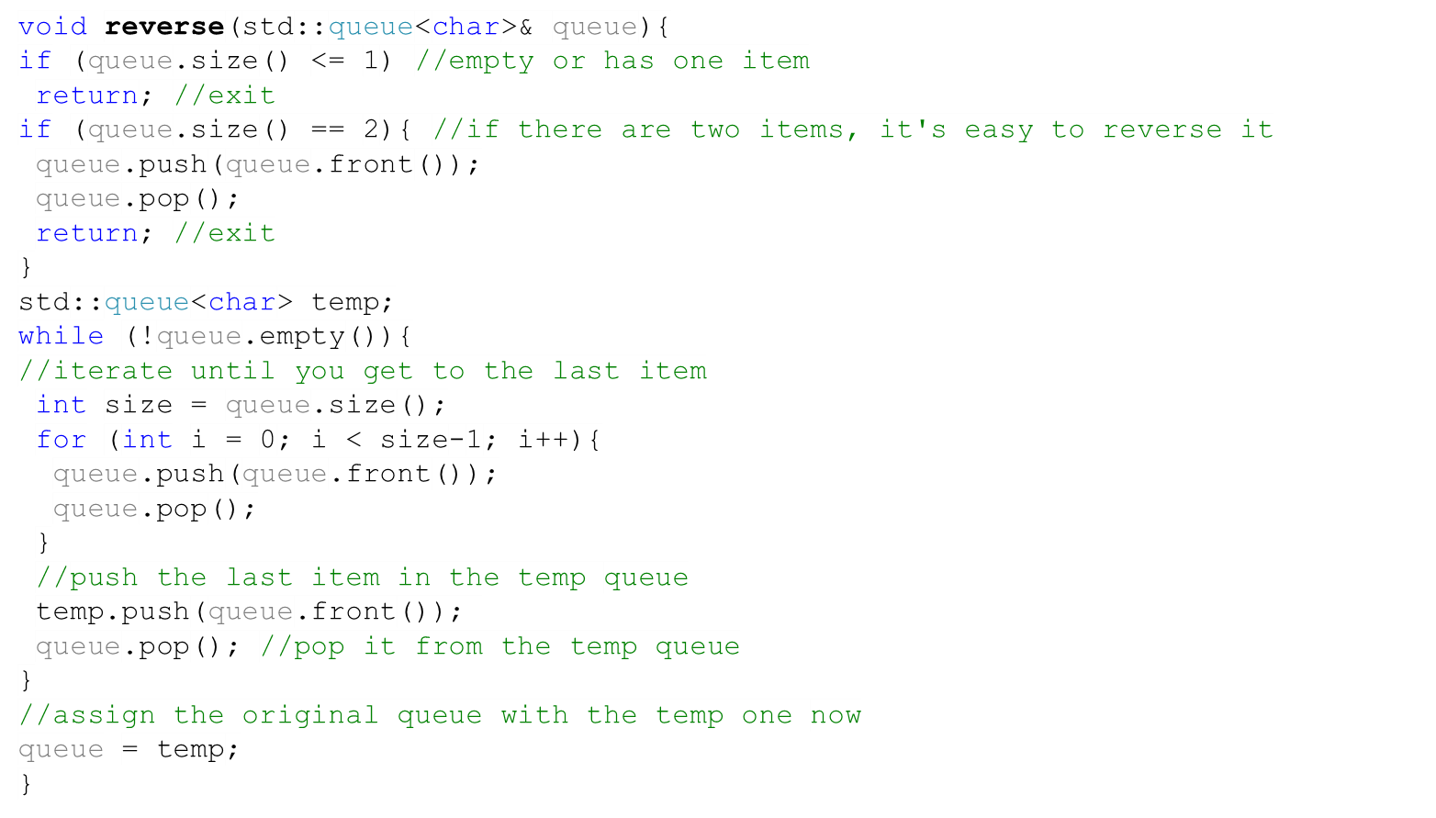

Quiz # 4 (Solution)
Queue
temp
Front, Back
Front
A
Front
D
Front
A
Front
A
C
Front
B
Back
Front
B
Back
Front
B
Front
C
Back
B
Back
C
Front
Back
A
Front, Back
Front
D
A
Back
A
Back
Back
Front
Back
A
Front
B
Back
Back
B
Back
C
It’s best to use an array to reverse the queue.

