Slide 1
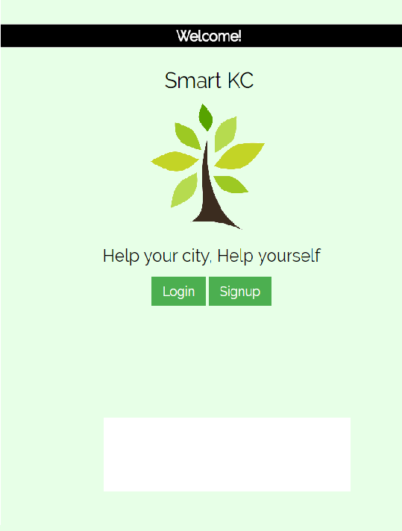
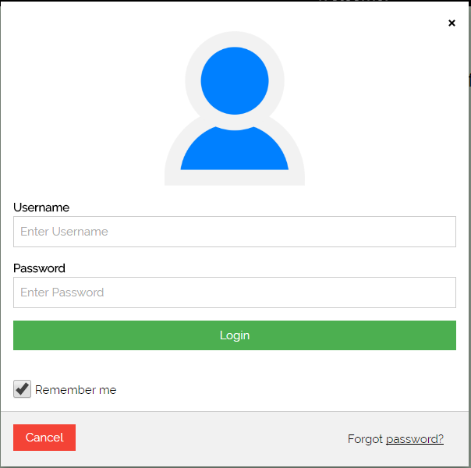
Initial screen → Login / Signup
Simple login screen

Slide 2
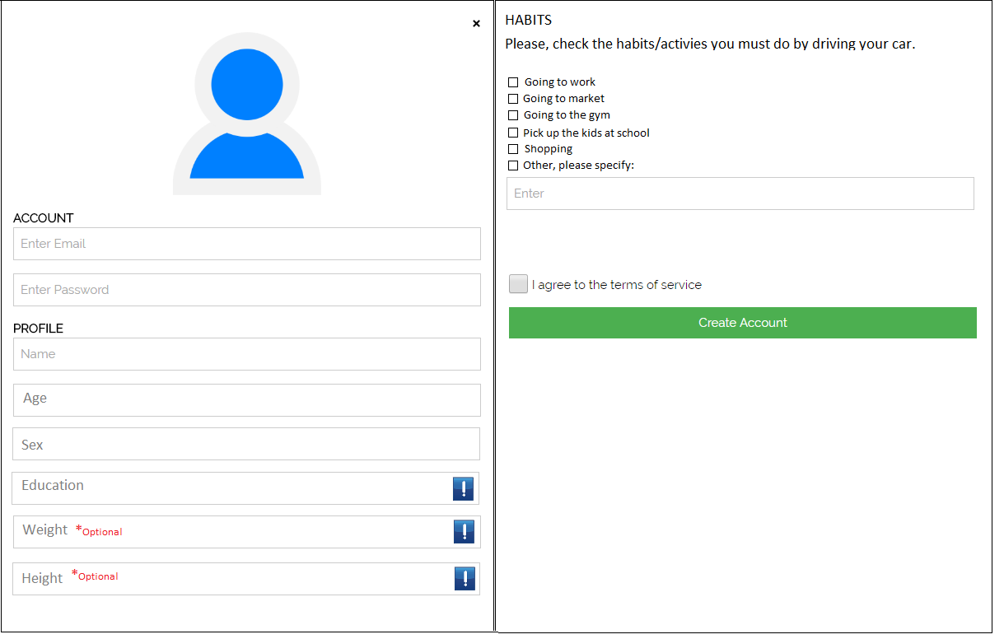
Creating account menu
After the user checks the box, we ask for the weekly frequency
More info on why we are asking that

Slide 3
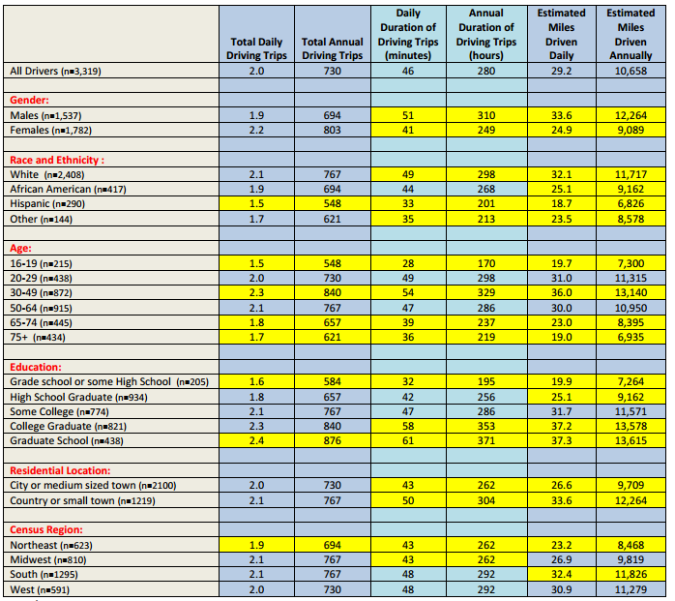

Slide 4
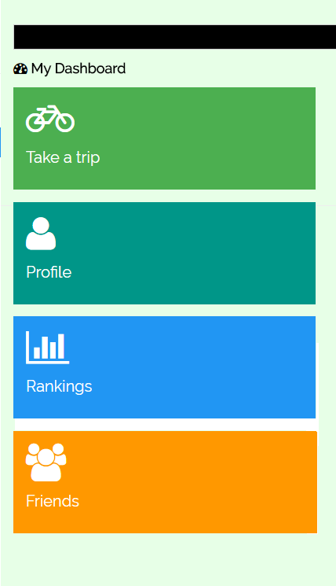
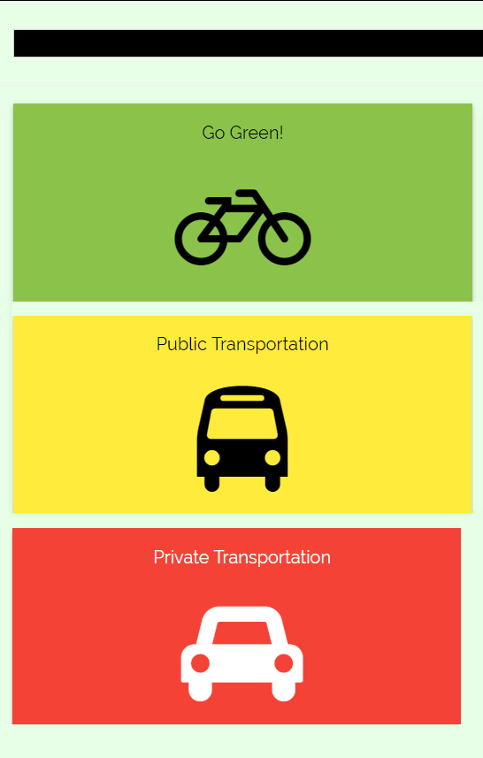
First screen after you login.
Profile contain:
-Accomplishments
-set auto-goals
-Stats
-Leader board

Slide 5
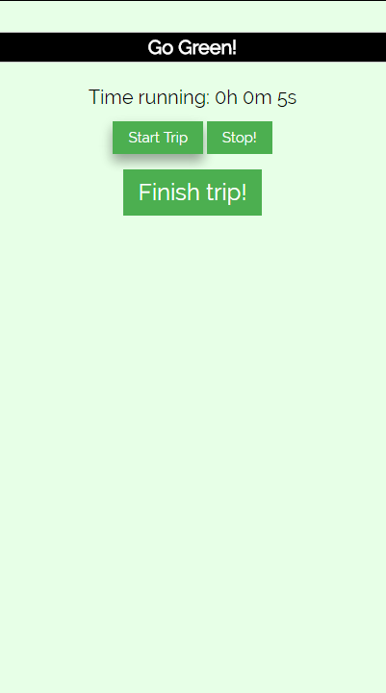
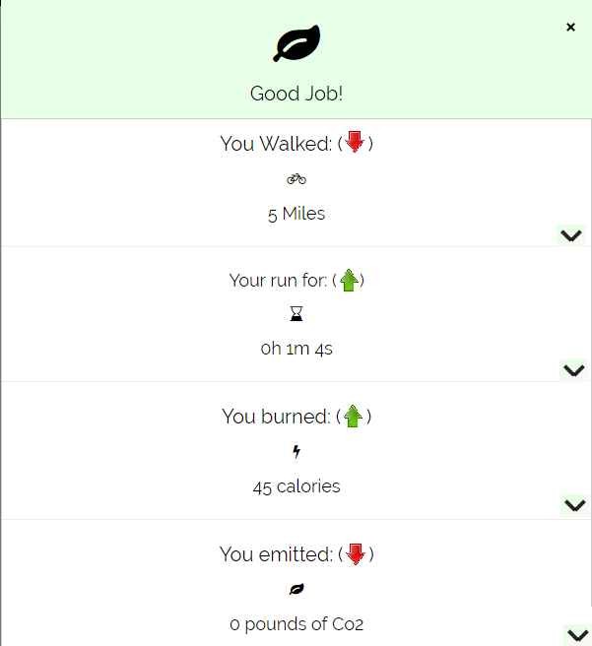
After you select the way you're going
Expand arrow for more detailed information/tips/curiosities
You ran for:
You've won X points for this trip.

Slide 6
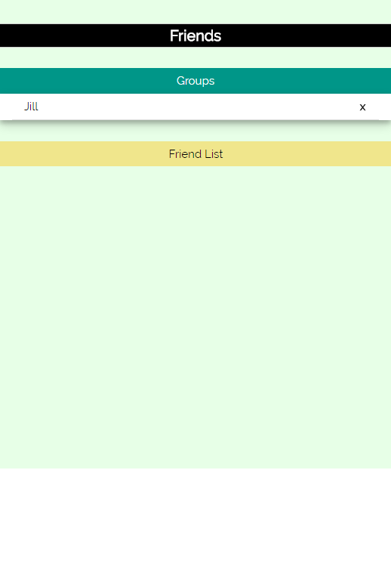
Friends menu
-Friend list
-Add/Remove friend
-Create group
-Manage group

Slide 7
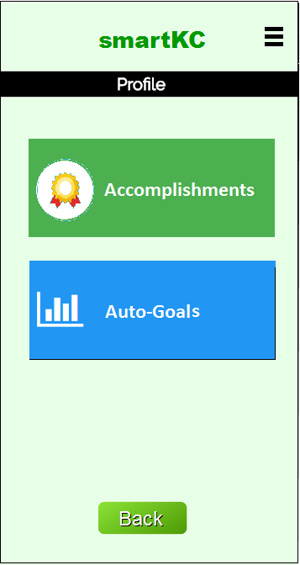
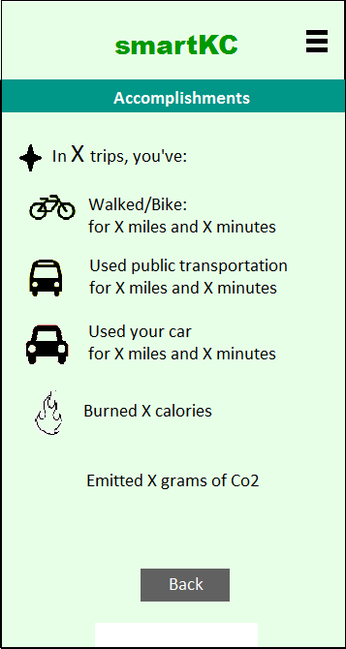
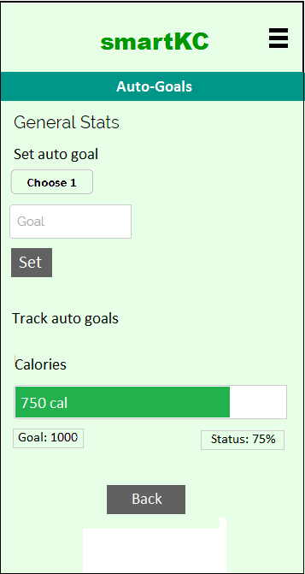


Main Menu → Profile → Accomplishments or Auto-goals
X points

Slide 8

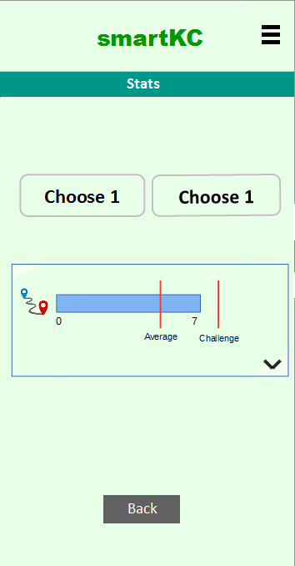
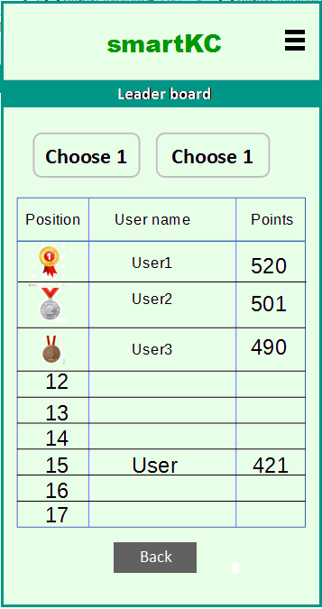

Main menu→ Rankings → Stats or Leader board
-Time walking
-Percentage of gas emissions
-Burned calories
-Distance walking
Options:
-Weekly,
- Monthly
-Average
(3 last months)
The ranking graph will 4 elements: the user auto-set goal, user data, average from other people data and the challenge set by us.
Expand arrow for more details
Show the top 3 and the range near user

