Slide 1
Seamless Indoor Outdoor Navigation for Smartphone Users
Using GPS, WI-FI and Android Sensors
by
Kuheli Manna
Date-11/8/23
Exam. Roll No.-MCA2360041
MASTER OF COMPUTER APPLICATION
Department Of Computer Science and Engineering
Jadavpur University,Kolkata-700032

Slide 2
Contents
Introduction
Navigation Challenges
Timeline
Outdoor positing with GPS
Wi-Fi-based Indoor Navigation
Android Sensors for Navigation
Hybrid Navigation System
Experiment Result
Conclusion
Reference

Slide 3
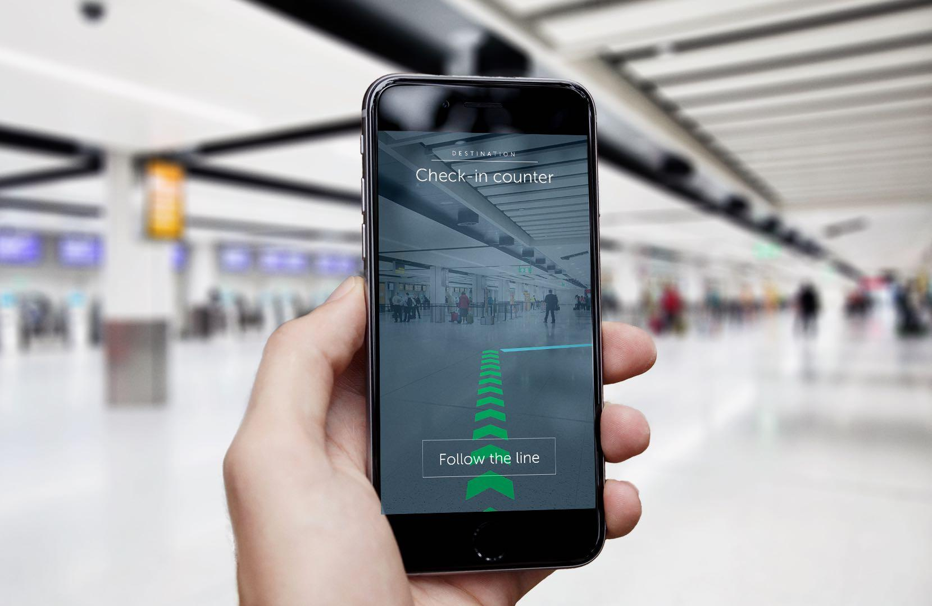
Introduction
In today's fast-paced world, we rely heavily on our smartphones for navigation and location-based services. However, transitioning between indoor and outdoor environments often poses challenges for smartphone users.
Importance of navigation apps for smartphone users.
Highlight the challenges of transitioning between indoor and outdoor navigation.

Slide 4
Navigation Challenges
Limitations of GPS in indoor environments.
Highlight the need for alternative indoor positioning technologies using Wi-Fi.
Advantages of combining Wi-Fi and GPS.
Role of Android sensors in navigation.

Slide 5
Timeline
START
END
Phase 1: Literature Review
Phase 2: Data Collection and Analysis
Phase 3: Application Development
Phase 4: User Testing and Evaluation
This was Conducted a thorough review of existing literature on indoor and outdoor navigation systems. Identify gaps and opportunities.
Data sets were Collected through surveys and
interviews. Analyzed the collected data using qualitative and quantitative methods.
An Android application has been Developed for seamless integration of indoor and outdoor navigation systems based on research findings.
It was Conducted user testing and evaluation of the prototype to validate its effectiveness and gather feedback.

Slide 6
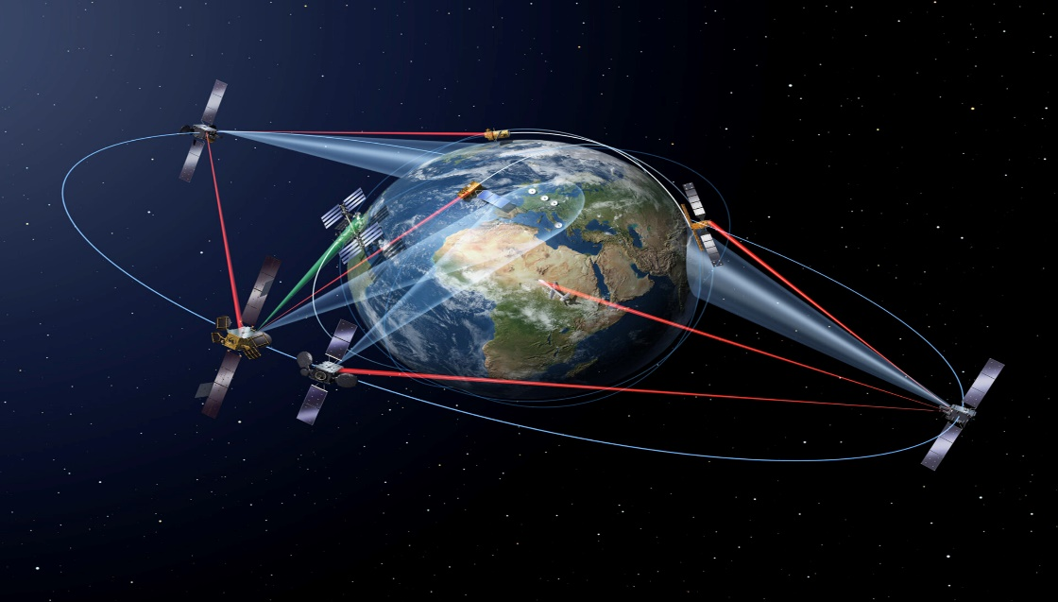
Outdoor positing with GPS
GPS is a satellite-based navigation system that provides location and time information in all weather conditions. It enables users to navigate from one point to another by providing real-time location information and directions. GPS is widely used in outdoor navigation applications.
Invention
Satellites
Strong signal
How GPS work?

Slide 7
How does it differentiate between indoor outdoor?
Satellite Visibility: Multiple satellites seen outdoors, limited indoors, impacting triangulation.
Signal Strength: Stronger outdoors, weak indoors due to obstructions.

Slide 8
How does it detect Semi-outdoor environment?
In this semi-outdoor environment, the average value of SNR is around 19–22 dBm.
Similarly. the average value of Number of available satellite is around 2-5.
Outdoor semi-outdoor indoor

Slide 9
Why GPS does not work in indoor?
Weak Signals: GPS signals weaken significantly when passing through walls and structures, making them insufficient for accurate positioning indoors.
Obstructions: Walls and ceilings block GPS signals, leading to inaccuracies and signal reflections (multipath interference) that distort the signal.
Limited Satellite View: Indoors, there's often limited visibility of the sky, resulting in fewer satellites in view, reducing accuracy.
Receiver Design: GPS receivers in mobile devices are optimized for outdoor use, making them less sensitive to weak indoor signals.

Slide 10
Why GPS does not work in indoor?

Slide 11
Benefits and Limitations of GPS
Benefits of GPS:
Accurate Positioning for navigation and location-based services.
Emergency Response with precise location data for quicker assistance.
Versatile Scientific Research tool for climate, wildlife, and more.
Limitations of GPS:
Signal Blockage in urban areas, dense forests, and indoors.
Limited Satellite Availability affects accuracy.
Power Consumption impacts device battery life.
Weather Interference during adverse conditions.
To achieve indoor positioning, alternative technologies or sensor combinations are needed due to these challenges.

Slide 12
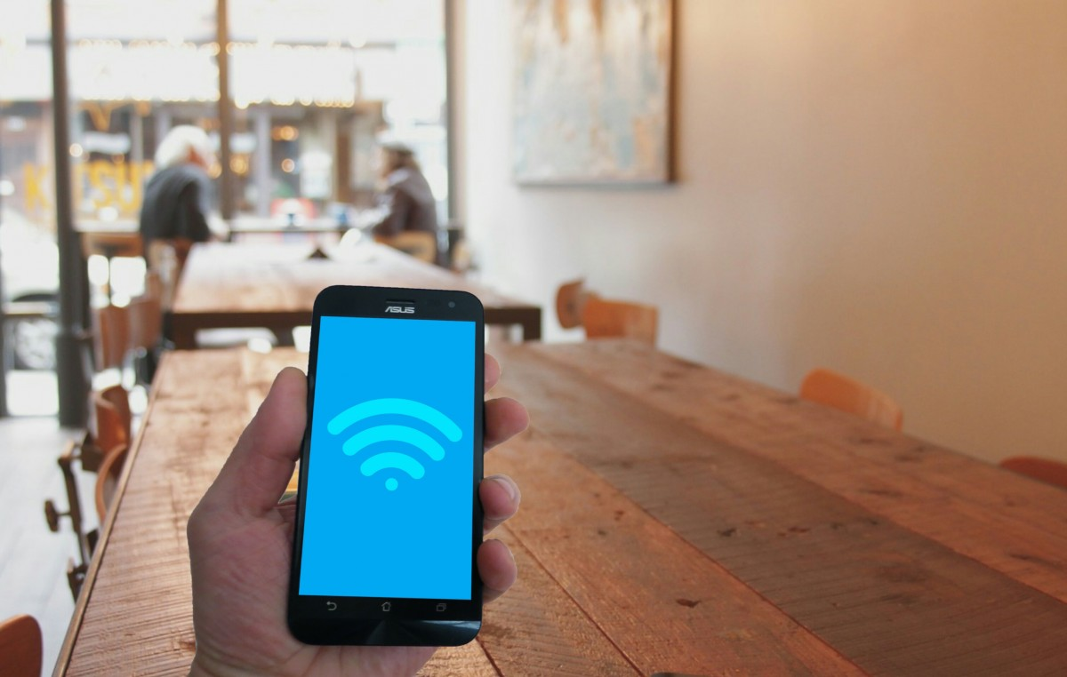
Wi-Fi-based Indoor Navigation
WIFI navigation uses WIFI access points to determine the location of a smartphone. It is commonly used in indoor navigation applications where GPS signals are weak or unavailable. WIFI navigation provides accurate location information and can be used to navigate within a building or a campus.
Fingerprinting techniques.
Wi-Fi access points and signal strength.
How Wi-Fi-based positioning works indoors.

Slide 13
Wi-Fi-based Indoor Navigation
This Wi-Fi module does a Wi-Fi scan every second and lists all the access points detected. Every list row shows the access point’s SSID, BSSID, RSSI, and frequency. The number of Wi-Fi APs makes a significant difference between indoor and outdoor environments. Our primary approach involves a combination of the following factors:
The count of Wi-Fi Access Points (APs) detected.
The highest Received Signal Strength Indicator (RSSI) value.
The average RSSI value.

Slide 14
Wi-Fi AP Density
In our experiments, we conducted scans in various indoor and outdoor locations with different mobility scenarios. We counted the number of detected Wi-Fi nodes based on their unique MAC addresses (BSSID). Bellow Figure shows that outdoor areas consistently have Wi-Fi AP density within the range of thresholds α1 and α2, occasionally exceeding α1 and reaching up to 39 APs. In contrast, indoor sites typically have lower Wi-Fi AP density, sometimes even below 5 APs, falling below threshold α2.

Slide 15
Impact of Maximum RSSI
This Wi-Fi module records RSSI values and calculates the maximum RSSI. Indoors, APs have higher RSSI value because users inside the building will be nearby and in line of sight with many of the indoor nodes, accuracy varies with user mobility. Outdoors, weak RSSI records still reach client devices in narrow spaces. But using this maximum RSSI, we cannot reach any decision because sometimes, when the Wi-Fi router is close to the outdoor scene, the maximum RSSI range falls under -55 dB to -69 dB.

Slide 16
Analysis of Average RSSI
This Wi-Fi module also calculates the average RSSI. We observe that the most commonly collected average values of all visible Wi-Fi APs RSSI in indoor sites are higher than the β1 threshold. This is seen as logical because the majority of these nodes should provide strong RSSI readings to meet connectivity considerations. Unlike average values collected at outdoor sites, most of them are lower than β2 because most detected signals are weak signals that can still be heard due to buildings' structure and distance considerations.

Slide 17
Limitations of Wi-Fi Indoor positioning
Signal Variability: Wi-Fi signals can be affected by obstacles, walls, and interference, leading to inaccuracies in indoor positioning.
Infrastructure Dependency: Wi-Fi positioning relies on the availability and density of Wi-Fi access points, limiting its effectiveness in areas with poor Wi-Fi coverage.
Privacy Concerns: The use of Wi-Fi for indoor positioning may raise privacy issues, as it involves tracking devices based on their connection to Wi-Fi networks, potentially leading to user privacy concerns.

Slide 18

Android Sensors for Navigation
Android Sensors can be used to provide additional information about the user's location and movement. These sensors can be used to detect the orientation of the smartphone, the direction of movement, and the speed of movement. Android Sensors can enhance the accuracy of GPS and WIFI navigation.
Types of sensors available in Android smartphones.
Accelerometer, gyroscope, magnetometer, barometer, etc.
Sensor fusion for accurate positioning.

Slide 19
Light Sensor
The primary source of light for light detection is the Sun. Light sensor is designed to capture and measure the intensity of light, and it can detect sunlight as well as other sources of light( Artificial light). Indoors, artificial light sources play a crucial role in light detection. There may be Additional information is needed to make the light information more useful
The phone might be in the pocket of the user, which would mean the light sensor is obstructed and no light measurement is available.
Lastly, the sun is not available 24 hours a day. This changes depending on the time and place the user is. To further improve the possibility of inferring information from the light sensor, information about the part of the day was collected. Even though a simple approach would be to divide the day into 2, daytime and nighttime.

Slide 20
Light intensity at daytime
In the daytime, outdoors, light intensity is above 2000 Lux.
The illumination of the general indoor fluorescent lamp is about 20-800 lux.

Slide 21
Light intensity at nighttime
In the nighttime, the outdoor streetlight is about 1-5 lux.
The brightness of the full moon is about 0.01- 0.1 lux.
Indoor
Light not available in outdoor at night

Slide 22
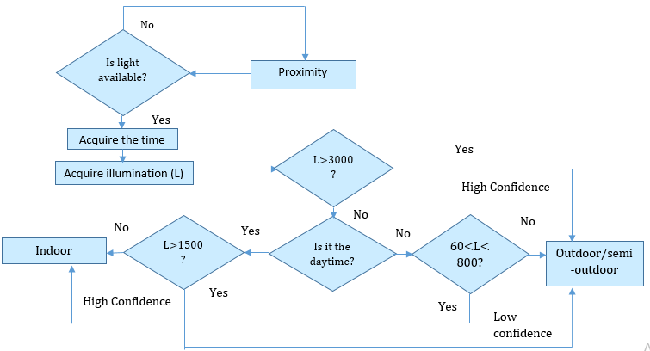
Light intensity sense module flowchart

Slide 23
Challenges in Estimating Light Intensity near Dawn and Nightfall
During experiments, we collected 24-hour light intensity readings from mobile devices to monitor indoor/outdoor light signatures. Even when the light sensor is back to the sun, the light intensity is relatively high as well (e.g., around 3,000Lux). During the daytime, outdoor illumination exceeds indoor illumination, while at night, indoor illumination surpasses outdoor illumination. The estimation by brightness is unreliable near dawn and nightfall due to factors such as the influence of shadows from buildings, the orientation of the device, and the presence of clouds, which cause significant fluctuations in outdoor light levels during these periods.

Slide 24
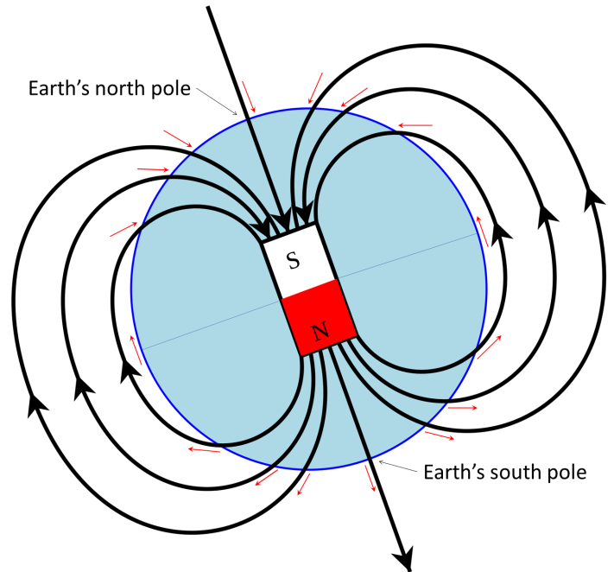
Magnetometer Sensor
Magnetic field is an invisible for created by magnetic objects. Earth itself has a magnetic field which play a crucial role in various aspect. The disturbance of the earth’s magnetic field inside buildings can be utilized as fingerprints for indoor localization. The quantity of magnetism is easy to use for the estimation because there is a large change in the quantity of magnetism indoors.

Slide 25
Magnetic field intensity
A magnetometer measures magnetic fields, and when equipped with 3 axes (X, Y, and Z), it provides comprehensive readings. To calculate total magnetism (B), we square the readings along each axis (Bx, By, Bz), sum them, and take the square root. This helps determine magnetic field strength and orientation, enabling precise navigation and detection of anomalies.

Slide 26
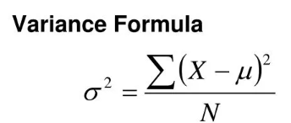
Magnetometer Variance
The magnetism sensor of the terminal measures the quantity of magnetism every 1 second and calculates the variance of the magnetism every 10 seconds. We find that the intensity of the magnetic field in the indoor environment varies dramatically. In indoors, we find that the variance is very high compared to outdoor areas . In outdoors, If the variance of magnetism is less than the threshold, it is estimated to be outdoor. And if more than or equal to the threshold, it is estimated to be indoor. The threshold of the variance is set to 18.

Slide 27
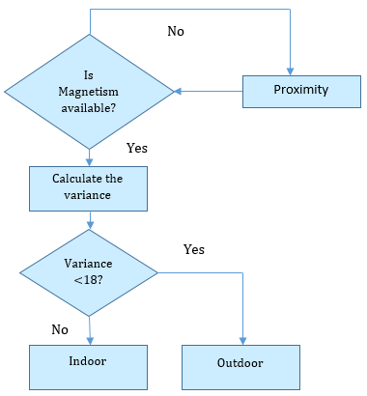
Flowchart of estimation by Magnetism

Slide 28
Challenges in Magnetism-Based Estimation
The estimation by magnetism cannot provide accurate results if the terminal is covered in a bag or a pocket. Therefore the covered situation of the terminal is estimated by a proximity sensor.
The magnetic variance is below the threshold for some cases, both indoors and outdoors. In these cases, the indoor-outdoor detection component magnetism detector fails to detect the right IO state.

Slide 29
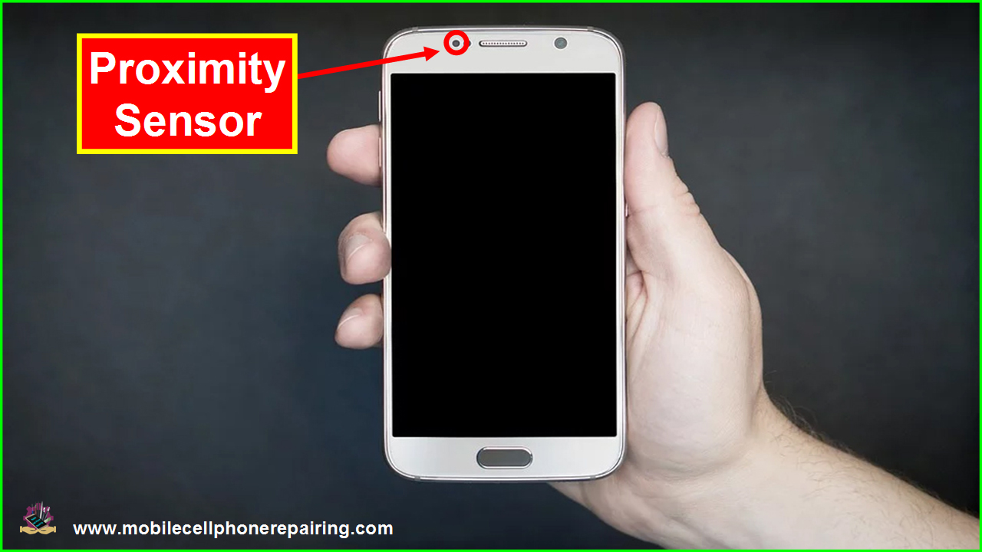
Proximity sensor
A proximity sensor detects the presence or absence of an object or a person in its vicinity, without direct physical contact. In our work, we exploit this feature to give an indication whether the android device is in the pocket, on table with screen facing down or on the hand with screen up to ensure intensity record values correctness.

Slide 30
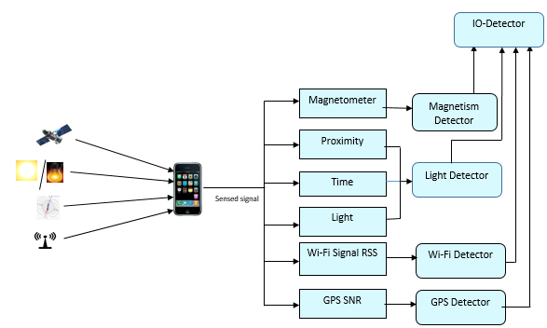
Hybrid Navigation System
The integration of GPS, WIFI, and Android Sensors enables seamless navigation between indoor and outdoor environments. Users can navigate from an indoor location to an outdoor location and vice versa without losing accuracy or connectivity. This technology is particularly useful for large campuses, shopping malls, and airports.
Combining Wi-Fi, GPS, and Android sensors.
Seamless indoor-outdoor transition.
Improved accuracy and reliability.

Slide 31
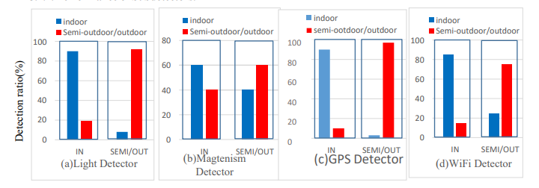
Performance of Subdetectors.
Light Detector has 90% accuracy indoors, 92% outdoors, struggles with low illumination.
Estimation based on magnetism reaches around 60% precision on average.
GPS detectors exceed 90% accuracy for both settings, reasonable power use.
Wi-Fi-based detection achieves 85% accuracy in campus experiments.

Slide 32
Performance of Aggregated IO-Detector
Compared with detection accuracy of individual detectors, in the aggregated IO-Detector both the precision and the recall are consistently above 90% for the indoor and outdoor environment type. The experiment results suggest that the IO-Detector accurately classifies the indoor/outdoor environments for most cases.

Slide 33
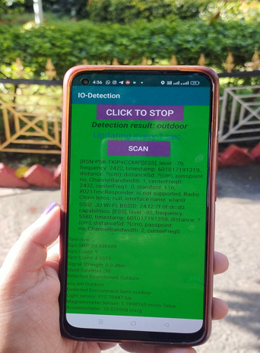
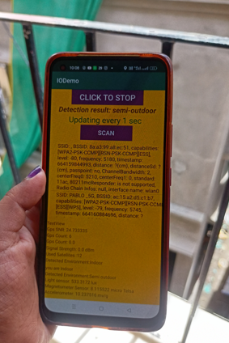
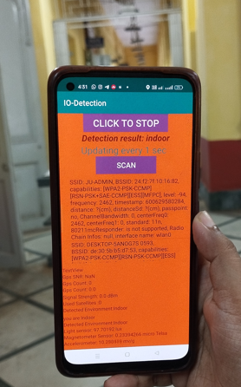
Experiment Results
Improved navigation efficiency and accuracy.
High user satisfaction with the prototype.
Seamless transitions between indoor and outdoor spaces.
Outdoor Semi-outdoor Indoor

Slide 34
Conclusion
Battery Efficiency: Mobile devices' battery life is crucial for users, and the proposed system's could impact energy consumption.
Multi-User Scenarios: Extending the system to support multi-user scenarios, where multiple users are in the same vicinity, could open up new possibilities for collaborative and interactive context-aware applications..
Privacy and Security: As the system relies on various sensors, GPS and Wi-Fi, ensuring user privacy and data security becomes paramount.
Scalability and Generalization: Evaluating the system's performance in larger-scale deployments and different geographical regions is essential to assess its generalization and scalability.

Slide 35
References
P. K., R. S., M. K. M., and Valentin Radu. "Poster: Am I Indoor or Outdoor?" Presented at MobiCom’14, Maui, Hawaii, USA, September 7-11, 2014.
A. K. P., C. C., and Manjarini Mallik. "Paving the Way with Machine Learning for Seamless Indoor–Outdoor Positioning: A Survey.", 2023.
Zhou, P., et al. "IODetector: A Generic Service for Indoor Outdoor Detection." Proceedings of SenSys’12 (The 10th ACM Conference on Embedded Networked Sensor Systems), 2012.
C. N., H. B., S. M., and L. Ravindranath. "Improving Wireless Network Performance Using Sensor Hints." Proceedings of USENIX NSDI (Networked Systems Design and Implementation), 2011.
Mohsen Ali Mohsen Al-awami “SENSEI/O: REALISTIC UBIQUITOUS INDOOR OUTDOOR DETECTION SYSTEM USING SMARTPHONES”,2014.

Slide 36
Thank You!

