Slide 1
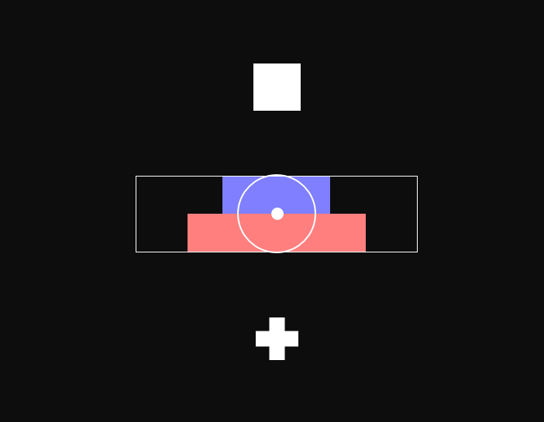
Press left
During this task you will decide whether to accept or avoid a series of offers. In each round, you will be presented with two bars.
Press right

Slide 2
Press left
The length of the BLUE bar represents a cash reward varying from 5 to 50 cents. The longer the blue bar, the higher the cash reward.
If you choose to take this offer, you will also receive an electrical shock.
The length of the RED bar represents the strength of this shock. If you choose NOT to take the reward, then you will not get shocked.
Press right

Slide 3
Press left
You make your choice by either pushing or pulling the joystick to choose either the or the .
If you choose the you will receive the cash and electric shock.
Think of the plus as ‘adding’ to your bank.
If you choose the you will receive no cash and no shock. The location of the and will vary from offer to offer.
Press right

Slide 4
Press left
You should pay attention to the length of both bars and consider both potential reward and shock when making each choice.
You will have 4 seconds to make each choice.
Next we will set the range of shock levels for you. It is important that the highest shock level is intense enough that you are hesitant to accept the shock despite the offer of money.
Press right

Slide 5
Press left
Now you will have a chance to practice the task.
Remember, it is important that you weigh both the potential reward and shock individually when making each choice.
If you have any questions, please ask the experimenter now.
If not, press right to begin.
Press right

Slide 6
Press left
PRACTICE
(assess performance, recalibrate if necessary)
Press right

Slide 7
Press left
We will break this task up into three runs.
At the end of each run you will see a screen telling you how much you earned out of the total offered during this run.
Press right

