Slide 1

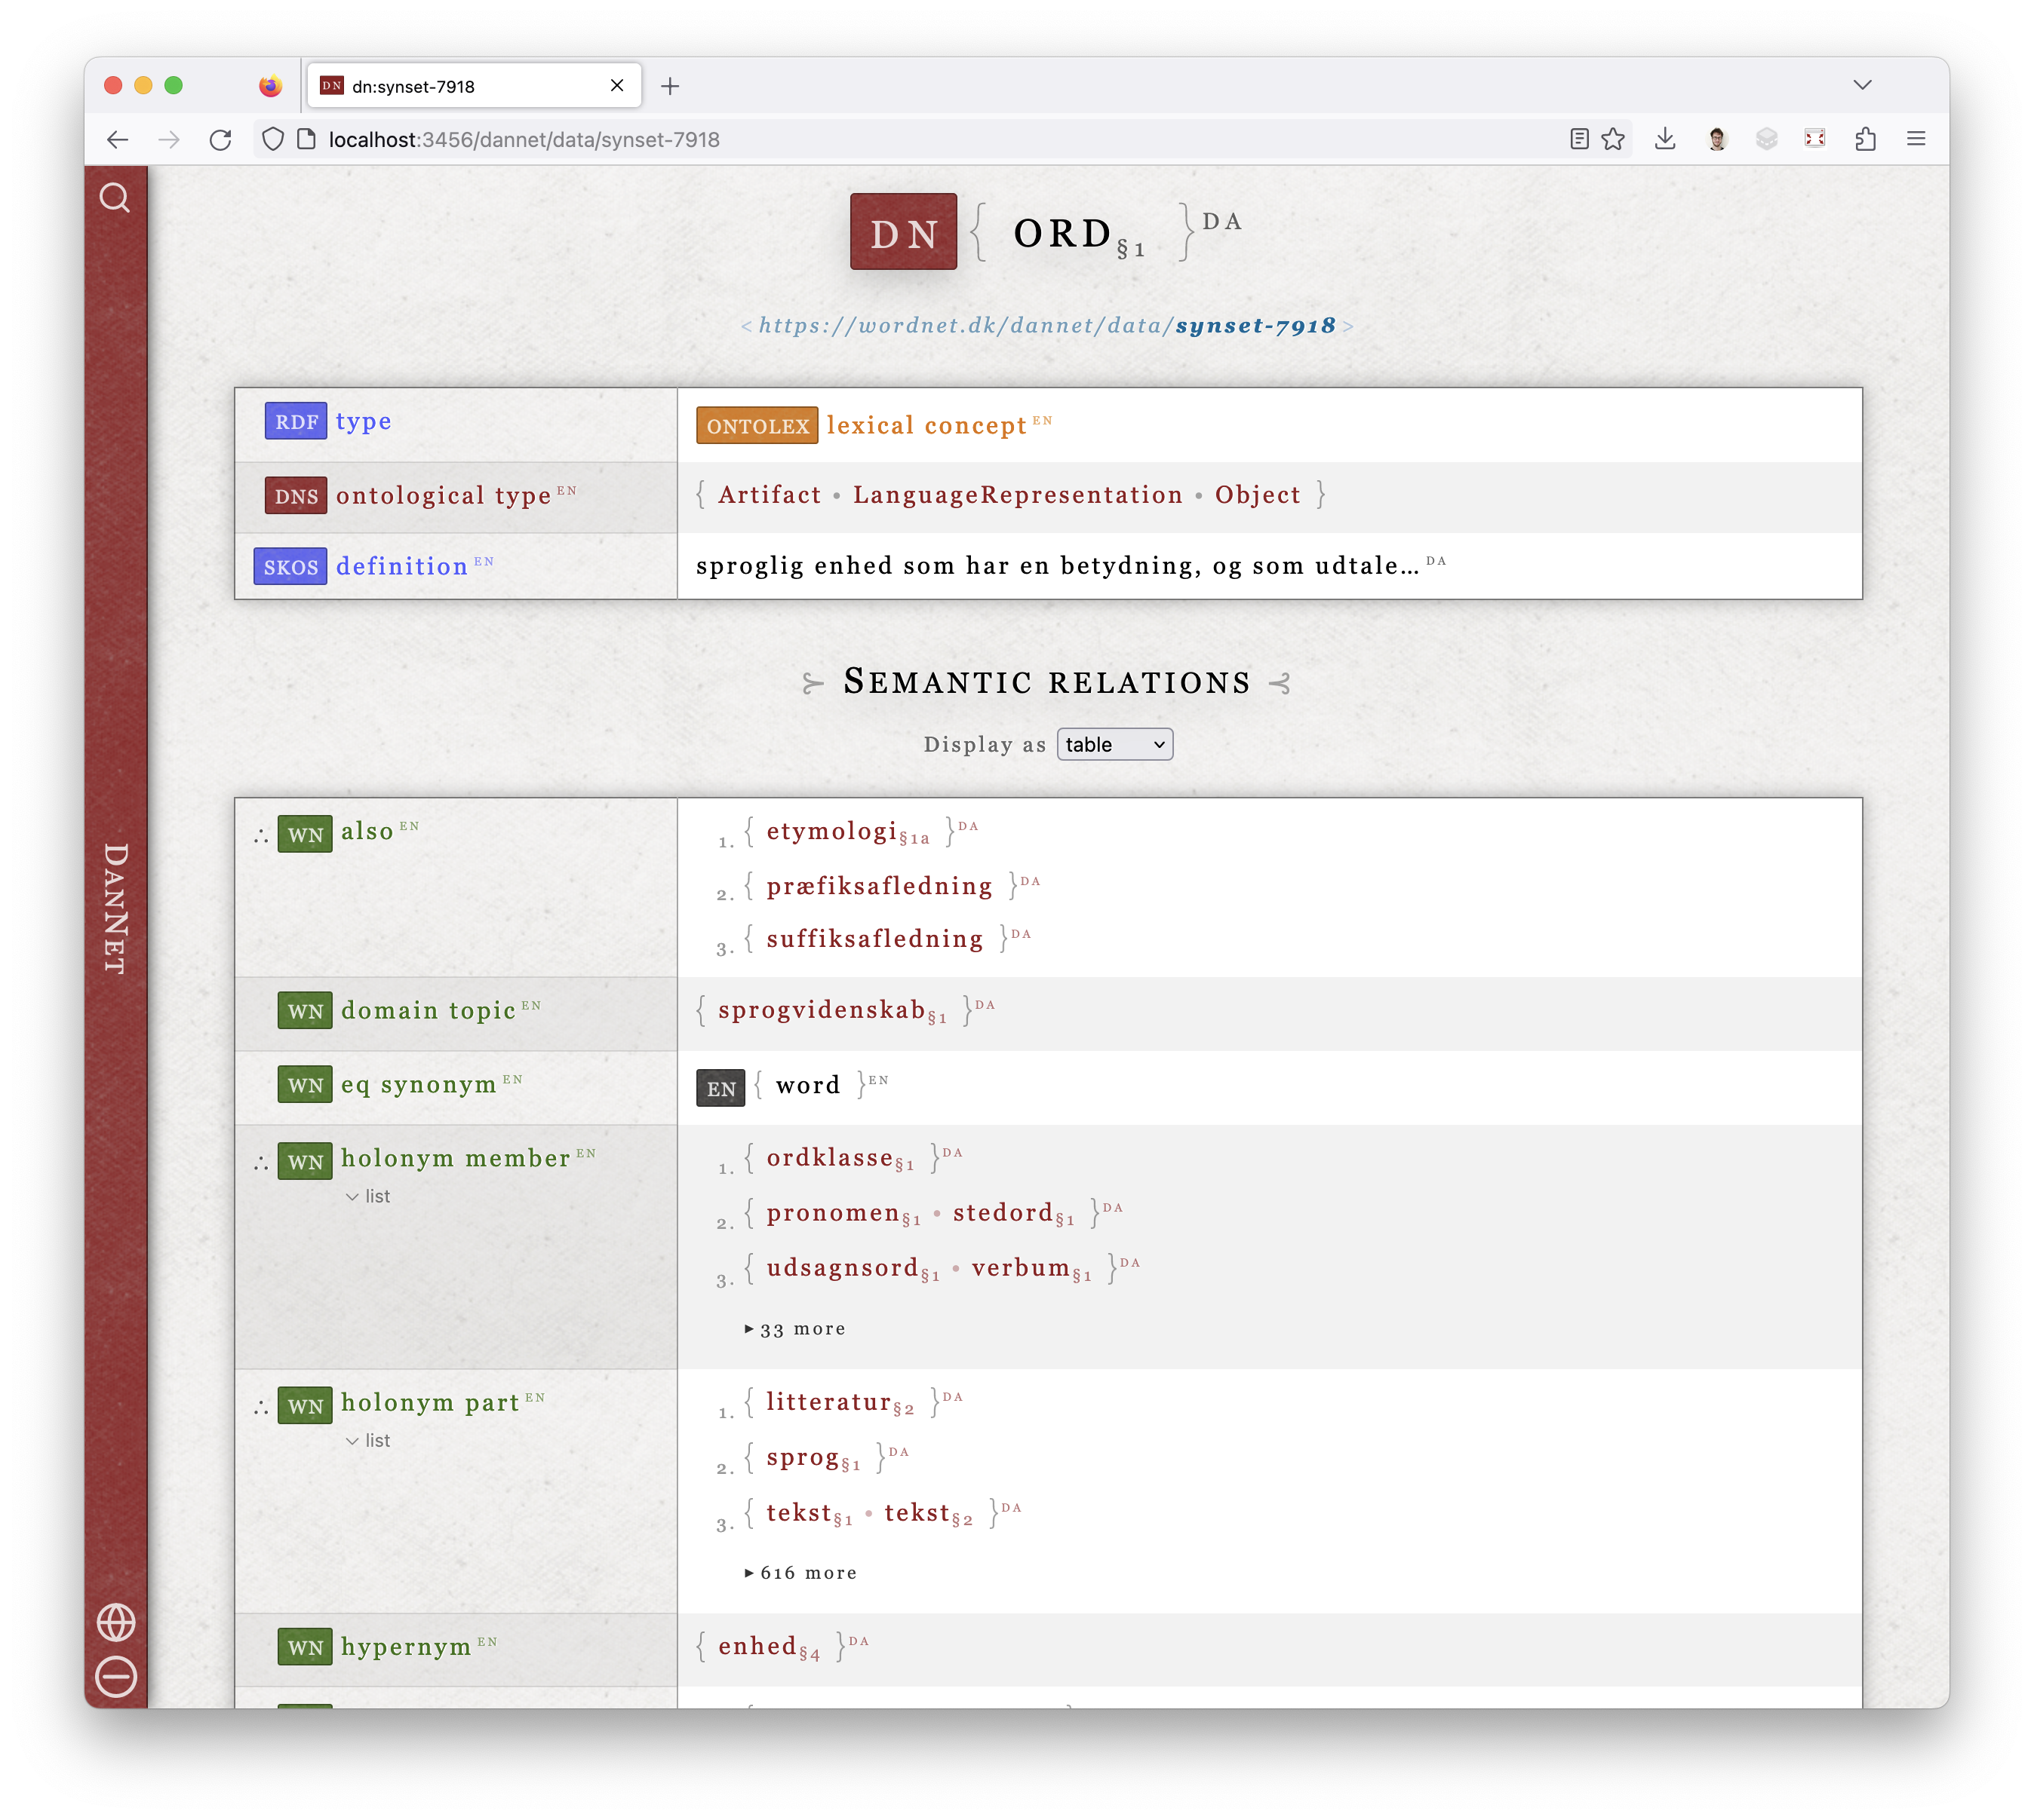
The new
wordnet.dk/dannet
SELECT DISTINCT ?slang
WHERE {
?sense lexinfo:register lexinfo:slangRegister .
?word ontolex:sense ?sense ;
ontolex:canonicalForm ?form .
?form ontolex:writtenRep ?slang .
}

