Slide 1
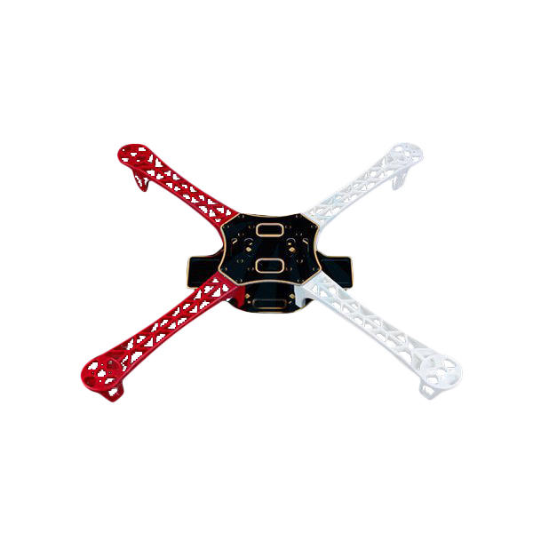
DRONE
with Live Streaming

Slide 2
Team Members
Saumya Mishra (2017230)
Siddhant Lohia (2017254)
Vikrant Sharma (2017289)
Kuhu Pyasi (2017327)
Sakshi Sharma (2017344)
Siddharth Charri (2017353)

Slide 3
Abstract
Drones are more formally known as unmanned aerial vehicles(UAVs). A drone is a flying robot that can be remotely controlled or fly autonomously through software controlled flight plans in their embedded systems. Live Streaming and drone cameras are a truly great combination. Drone live streams basically give humans ability to see what is happening far away right now and ability to see the ground from a bird’s eye view. Live video can be streamed directly on PC using Raspbian Os and Raspberry Pi. It can be used in surveillance of wild animals in college campus.

Slide 4
Components
A4 Frame
4 Brushless direct current Motors(1000KV)
4 ,30A ESC (Electronic Speed Controller)
1 pair Clockwise and 1 pair Counter-Clockwise Propellers
Lithium-polymer Battery(1100mAH, 11.1V)
Flight Controller (KK2.1.0)
Transmitter
Receiver
Raspberry Pi 3 model B+
Camera Module

Slide 5
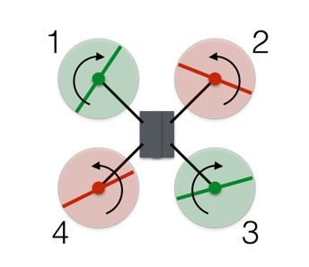
Working
Vertical Motion
Drones use rotors for propulsion and control.Spinning blades push air down as the rotor pushes down on the air, the air pushes up on the rotor. This is the basic idea behind lift, which comes down to controlling the upward and downward force. The faster the rotors spin, the greater the lift, and vice-versa.
Turning
With the two sets of rotors rotating in opposite directions, the total angular momentum is zero.

Slide 6
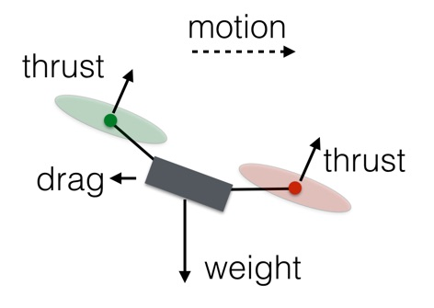
The red counterclockwise rotors have a positive angular momentum and the green clockwise rotors have a negative angular momentum. To rotate the drone clockwise,decrease the spin of rotor 1 and 3 and increase the spin for rotors 2 and 4. The angular momentum of the rotors doesn't add up to zero, so the drone body must rotate.
Forwards and Sideways

Slide 7
Increase the rotation rate of rotors 3 and 4 (the rear ones) and decrease the rate of rotors 1 and 2. The total thrust force will remain equal to the weight, so the drone will stay at the same vertical level. Also, since one of the rear rotors is spinning counterclockwise and the other clockwise, the increased rotation of those rotors will still produce zero angular momentum. The same holds true for the front rotors, and so the drone does not rotate. However, the greater force in the back of the drone means it will tilt forward. Now a slight increase in thrust for all rotors will produce a net thrust force that has a component to balance the weight along with a forward motion component.

Slide 8
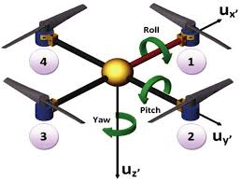
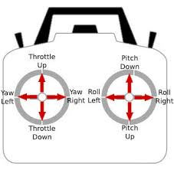
Roll,Pitch and Yaw-
Drones are controlled by changing roll,pitch and yaw .

Slide 9
Pitch-
Pitch is the movement of quadcopter either forward and backward. Forward Pitch is achieved by pushing the aileron stick forward, which makes the quadcopter tilt and move forward, away from you.Backward pitch is achieved by moving the aileron stick backwards(towards you), making the quadcopter, come closer to you.

Slide 10
-
Roll-
Roll is making the quadcopter fly sidewards, either to left or right. Roll is controlled with the aileron stick, making it move left or right, if you move the aileron stick to the left, the quadcopter will fly left, if you move the aileron stick to right, the quadcopter will fly right.

Slide 11
Yaw-
Yaw is the deviation/Rotating the head of the quadcopter either to right or left, Yaw can be controlled through the throttle stick, also called rudder, making it to rotate either to the left or right

Slide 12
We are using Raspberry Pi 3B+.Raspberry Pi is a low-cost, basic computer.1.4GHz 64-bit quad-core processor, dual-band wireless LAN, Bluetooth 4.2/BLE, faster Ethernet, and Power-over-Ethernet support (with separate PoE HAT).It consists of 40 pins including 26 GPIOs.26 GPIO pins are programmable pins.
GPIO stands for General Purpose Input Output. The Raspberry Pi has two rows of GPIO pins, which are connections between the Raspberry Pi, and the real world. Output pins are like switches that the Raspberry Pi can turn on or off (like turning on/off a LED light). But it can also send a signal to another device.
Raspberry Pi

Slide 13
Raspbian OS
Raspbian is a free operating system based on Debian optimized for the Raspberry Pi hardware. An operating system is the set of basic programs and utilities that make your Raspberry Pi run. However, Raspbian provides more than a pure OS: it comes with over 35,000 packages, pre-compiled software bundled in a nice format for easy installation on your Raspberry Pi.
1

Slide 14
Defence
Search and Rescue Operations
Aerial Photography
Uses
Broadcasting of Sports Event
Wildlife Surveillance
Public Safety

Slide 15
Problems Faced
Adjustment of BLDC’s RPM
Adjustment of center of gravity
Setting the P,I gain of Roll , Pitch and Yaw
Controlling the motion of Quadcopter
Binding the channels of receiver with transmitter
Controlling the output of flight controller

Slide 16
Future Aspects
Fully Autonomous
Use of Image Processing to detect wild animals in college campus
Surveillance

Slide 17
References
https://youtu.be/MgIKC-XFB74
https://youtu.be/_VNQJjA3nQw

Slide 18
Thank You

