Slide 1


Performance Cycle 2H 2018 2018年下半年绩效周期
Briefing for Grabbers Grab 员工简介
https://go.grab.com/performance
December 2018 2018年12月

Slide 2
Grab Performance Philosophy Grab 的绩效理念
Grab is committed in building a high-performance culture that enables your growth. Grab 致力于创建助您成长的高绩效文化。
At the core, we value and recognize your contribution and how you create value and impact for Grab while embodying our principles. 作为核心，我们重视并认可您的贡献，以及您在遵守原则的同时如何为 Grab 创造价值和影响力。
We aim to foster a strong growth mindset and feedback culture while investing in your development. 我们的目标是在投资发展的同时促进良好的成长理念和反馈文化。

Slide 3
Key Timelines 关键时间点

Slide 4
2H18 Performance Timeline 2018年下半年绩效时间点
Grabber initiates Feedback in Workday Grabber
在Workday发起反馈提名
Dec 3-7 12月3日至7日
Grabber Impact Check-in with People Manager 经理进行 Grab 员工影响记录
Dec 3-Jan 11 12月3日至1月11日
360 Feedback in Workday Workday 系统360 度 反馈
Dec 3-Jan 11 12月3日至1月11日
People Manager Proposed Rating in Workday 经理在 Workday 建议评分
By Jan 11 截止1月11日
Functional Calibrations 职能部门校定
Jan 14-Feb 8 1月14日至2月8日
Leadership Calibration 领导力校定
Feb 13 2月13日
Feedback Conversations with Final Rating 最终评定反馈谈话
Feb 14-28 2月14日至28日
Please note: 2H2018 Performance eligibility is for full-time permanent Grabbers who joined before October 1, 2018. 请注意：2018年下半年绩效评估适用于2018年10月1日前入职的全职 Grab 员工。

Slide 5
Key Changes for 2H2018 Cycle 2018年下半年周期关键变化

Slide 6
2H2018 Key Changes: 2018年下半年关键变化：
Based on Grabber Feedback 基于 Grab 员工的反馈
What it was like in 1H2018 2018年上半年的情况 | What has changed in 2H2018 2018年下半年的变化
Opening of Feedback tool in June 6月反馈工具启用 Feedback training was part of briefing sessions (which were not mandatory) 反馈培训是简报会的组成部分（非强制） Timeline of 150+ days before performance rating was communicated to Grabber 150 多天后再向 Grab 员工传达绩效评级 | Greater focus on Feedback : 更加关注反馈： Opening of Feedback tool at the beginning of Dec - more time to receive 360 feedback 在12月初启用反馈工具——更多时间接受 360 度反馈 Grabber Feedback Playbook and Manager Feedback Playbook - to foster stronger feedback culture Grab 员工反馈手册和经理反馈手册 – 促进更强大的反馈文化 Grabber receives Feedback & Final Rating within 90 days of receiving feedback 在收到反馈后的 90 天内，Grab 员工收到反馈和最终评级
Two conversations between Manager and Grabber: 经理和 Grab 员工之间的两场对话： Feedback Conversations 反馈谈话 Communication of rating via merit letter 通过调薪函来传达评级 Managers had difficulties when final rating was misaligned, post calibration, with feedback that managers have initially given 经理的最初反馈可能与职能部门校定结果不同，使沟通出现困难。 | Two conversations between Manager and Grabber changed to: 经理和 Grab 员工之间的两场对话变为： Grabber Impact Check-in Grab 员工影响审核 Feedback Conversations to communicate feedback & Leadership calibrated final rating 传达反馈和领导评定的最终评级的反馈谈话 This will diminish the inconsistent messaging going to Grabber on their performance impact. 这将减少 Grab 员工在绩效影响方面获得的不一致信息

Slide 7
Workday Feedback Forms Workday反馈形式
Self Evaluation - Peer 自我评价 – 同事

Slide 8
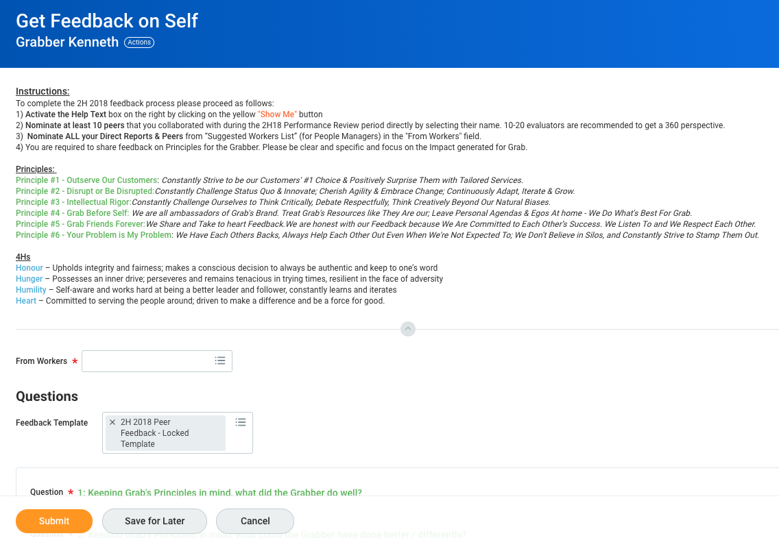
Request Feedback from Grabbers Grab 员工的反馈请求

Slide 9
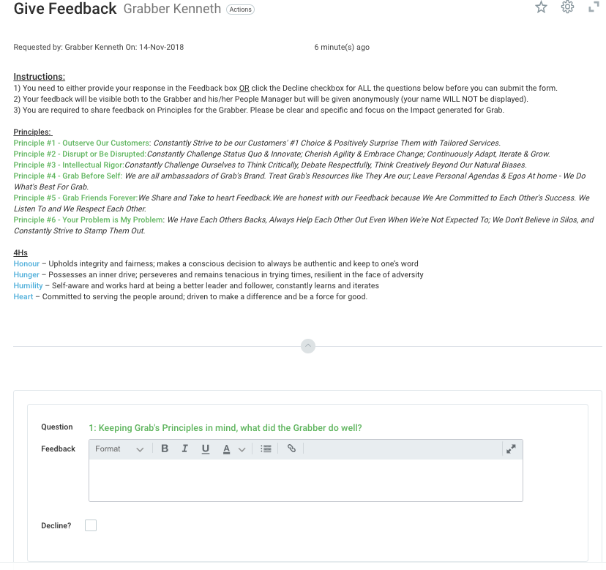
Giving Feedback to Grabbers 向 Grab 员工给予反馈

Slide 10
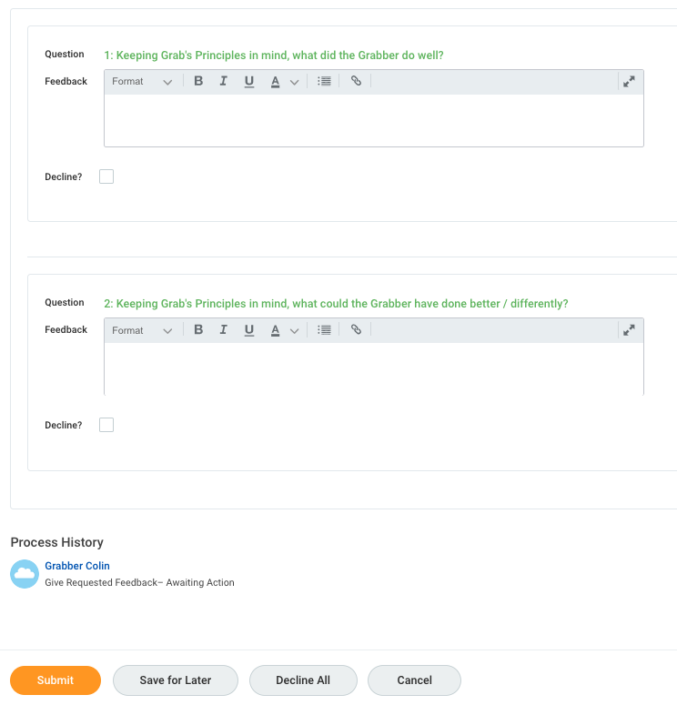
Giving Feedback to Grabbers 向 Grab 员工给予反馈
Question 问题
1: Keeping Grab’s Principles in mind, what did the Grabber do well? 1：就 Grab 的原则而言，Grab 员工在哪方面表现良好？
Feedback 反馈
Format 格式
Decline? 拒绝？
2: Keeping Grab’s Principles in mind, what the Grabber have done better/differently? 2：就 Grab 的原则而言，Grab 员工在哪方面做得更好/不同？
Question 问题
Feedback 反馈
Format 格式
Decline? 拒绝？
Process History 过程历史记录
Grabber Colin Grab 员工 Colin
Give Requested Feedback – Awaiting Action 就请求做出反馈——等待行动
Submit 提交
Save for Later 保存供以后使用
Decline All 拒绝所有
Cancel 取消

Slide 11
WorkDay Maintenance Dates WD维护日期
Monthly Maintenance (Includes Weekly Service Update) 每月维护（包括每周服务器更新） | December 14-15 12月14-15日 | Friday 11 pm to Saturday 7 am Pacific Time 太平洋时间周五晚上11点至周六早上7点 Saturday 2 pm to Saturday 10 pm (Singapore Time) 星期六下午2点至星期六晚上10点（新加坡时间）
2019 Maintenance Type 2019维护类型 | Dates 日期 | Tenant Downtime 租户停机时间
Monthly Maintenance (Includes Weekly Service Update) 每月维护（包括每周服务器更新） | January 12 & 18-19 1月12日和18-19日 | Friday 11 pm to Saturday 7 am Pacific Time 太平洋时间周五晚上11点至周六早上7点 Saturday 2 pm to Saturday 10 pm (Singapore Time) 星期六下午2点至星期六晚上10点（新加坡时间）
Quarterly Maintenance - Production tenants (Includes Weekly Service Update) 季度维护 – 产品使用方（包括每周服务器更新） | February 15-16 2月15-16日 | Friday 11 pm to Saturday 11 am Pacific time 太平洋时间周五晚上11点到周六11点 Saturday 2 pm to Sunday 2 am (Singapore Time) 周六下午2点至周日凌晨2点（新加坡时间）
Feature Release Delivery and Monthly Maintenance (Includes Weekly Service Update) 功能发布交付和每月维护（包括每周服务器更新） | March 8-9 3月8-9日 | Friday 11 pm to Saturday 7 am Pacific time 太平洋时间周五晚上11点至周六早上7点 Saturday 2 pm to Saturday 10 pm (Singapore Time) 星期六下午2点至星期六晚上10点（新加坡时间）

Slide 12
Peer Feedback 同事反馈

Slide 13
Peer Feedback 同事反馈
Select from a diverse pool of Grabbers 从不同的 Grab 员工池中选择
Grabbers you’ve worked closely within and outside your team 选择您在团队内外密切合作过的 Grab 员工
This has nothing to do with tenure or title, and everything to do with who you have worked with closely 这与您的任期或头衔无关，而与您曾经密切合作过的人有关
Select 10 - 20 Grabbers who would give the most meaningful feedback. Ideal to have a diverse & well rounded assessment 选择 10-20 名会给您最有意义的反馈的、非常适合进行多样化和全面评估的 Grab 员工。
Besides the WorkDay alerts it‘s also recommended you drop an email personally inviting them to share feedback 除了Workday提醒之外，还建议发送个人电子邮件邀请他们分享反馈

Slide 14
How to give constructive feedback 如何给出建设性的反馈

Slide 15
EBIS in Action – Giving Feedbak EBIS 在行动——给予反馈
EBIS | Purpose 用途 | Example 示例
Expectation 预期 | State clearly and specifically what were your expectations 清楚而具体地说明您的期望是什么 | E.g.: I needed some information for a critical project at very last minute notice. 如：我需要一些在最后一刻通知给我的重要项目的信息 (state your understanding) （说明您的理解）
Behaviour 行为 | Focus on observed behaviours 关注观察到的行为 | E.g.: Kenneth took the initiative to help me source and compile the information even though he already has too much on his plate. 如：Kenneth 主动帮助我 查找并编制信息，即使他本身就忙不过来了。 (focus on the behaviour & not the individual) （关注行为而不是个人）
Importance 重要性 | Make the person understand the “Why” behind the expectation 让对方明白期望背后的原因 | E.g.: This was beyond what he needed to do and it thoroughly displayed the YPIMP spirit. 如：这已经超出了他的职责范围，这充分体现了“您的问题就是我的问题”的精神。 (state the importance) （说明重要性）
Solution 解决方案 | Provide suggestions basis the giver’s experience 根据反馈者的经验提出建议 | E.g.: This experience made me feel that Kenneth is a great team player that we can rely upon. 如：这次经历让我觉得 Kenneth 是一个值得依赖的团队合作者。 (provide guidance) （给予指导）

Slide 16
Self Evaluation 自我评估

Slide 17
Preparing for your self evaluation 准备自我评估
Reflect on what you achieved in the last 6 months 回想一下您在过去 6 个月里取得的成就
Has this been impactful work ? 这是一项有影响力的工作吗?
Did your effort mirror the results ? 您的努力是否对结果有所影响？
What were your development points which were discussed in your last 1 on 1 meeting ? 您在上次一对一会议中讨论的发展要点是什么?
Have you met these goals & targets ? 您实现了目标吗？
Embrace the items which didn't work well for 2H2018 as development areas going into 1H2019 将2018年下半年未顺利进行的事项纳入2019年上半年发展领域

Slide 18
Grabber Impact Check-Ins Grab 员工影响审核

Slide 19
Grabber Impact Check-in Grab 员工影响审核
Purpose of this 1:1 between Grabber & People Manager is to give Grabbers an opportunity to reflect and share their impact from July to December. Grab 员工和经理的一对一会议旨在为 Grab 员工提供阐述和分享其在7月到12月所产生影响的机会。
The session is meant to be a listening session / supportive 1:1 to give People Managers further insight into Grabbers impact and ensuring Grabber feels heard and valued for their contributions. 此项会议是一场一对一意见听取会/支持会议，意在让经理进一步深入了解 Grab 员工的影响力，并确保 Grab 员工感到其贡献得以了解和重视。

Slide 20
Preparing for Grabber Impact Session 准备 Grab 员工影响力会议
Grabbers can prepare by reflecting on their impact during the current performance cycle. Information would mirror their inputs for self evaluations Grab
员工可以通过反映当前绩效周期中的影响来做好准备。信息将反映他们的自我评价
Encouraged to share & discuss their impact and thoughts with their people manager
鼓励与经理分享和讨论他们的影响和想法
You can also use the information from your self evaluations input to also discuss how you plan to impact the next performance cycle
您还可以使用自我评估信息来讨论您对如何影响下个绩效周期的计划

Slide 21
What are the Grab ratings ? 什么是 Grab 评级？

Slide 22
Overall Rating 综合评级
Performs at the highest level, well above the peer group and consistently showcases Grab Principles 最高级的表现，远高于同伴并始终遵循 Grab 原则
Demonstrates a unique understanding of work well beyond job requirements 对远超工作范围外的工作表现出独特认识
Role model for top performance and the Grab Principles 顶级绩效和 Grab 原则的模范
Clearly and consistently demonstrates exceptional accomplishments 清楚且持续地展示卓越的成就
Creates results that pave the way for others 创造成果，为他人铺路
Coaches, Motivates and inspires others 教育、鼓励和激励他人
Superb 极好
Exceeds Expectations 超出预期
Consistently surpasses performance goals and actively demonstrates Grab Principles 始终超越绩效目标，并积极地展示 Grab 原则
Demonstrates sound understanding of work well beyond job requirements 对远超工作范围外的工作表现出良好认识
Works independently with minimal supervision or follow-up 独立工作，很少监督或跟进
Completes on schedule with a high degree of accuracy with rare errors that are seldom repeated 按时完成，准确度高，少有错误
Meets All Expectations 满足所有期望
Performs consistently with peer group and demonstrates most Grab Principles 表现与同伴相当，并遵循大多数 Grab 原则
Reliable in achieving expected results, and is timely and efficient 可靠地实现预期结果，并且及时有效
Initiatives and outputs are generally adequate 积极性和产出通常足够
Capable and knowledgeable in most aspects of his/her job 就他/她大部分工作而言胜任且有认知
May require some supervision in getting the job done 在完成工作时可能需要一些监督

Slide 23
Overall Rating 综合评级
Needs Improvement 需要提升
Performs slightly below peer group but demonstrates majority of Grab Principles 表现略不如同伴，但遵循 Grab 大部分原则
Requires further improvement in more than one aspect of expected performance goals 需要在预期性能目标的多个方面进一步提升
May not be capable and knowledgeable in some aspects of his/her job 在他/她工作的某些方面可能不胜任且缺乏认知
Requires frequent supervision in getting the job done 在完成工作时需要经常监督
Poor 未达标
Performs clearly below peer group and consistently fails to demonstrate the majority of the Grab Principles 表现明显不如同伴，且时常未遵循 Grab 大部分原则
Requires further improvement in most areas of expected performance goals 需要在预期性能目标的大部分领域进一步提升
Lacks capability and knowledge in most aspects of his/her job 就他/她大部分工作而言不胜任且缺乏认知
Requires scheduled and tight supervision in getting the job done 在完成工作时需要计划和严格的监督

Slide 24
Feedback Conversations 反馈谈话
1:1 Listening sessions before People Manager submits proposed rating in Workday
经理在Workday提交建议评级之前的一对一意见听取会

Slide 25
Preparing for Feedback ! 准备反馈！
Listen Carefully 仔细聆听
For all types of feedback - Good things & things which could be better 所有类型的反馈——积极方面和可以提升的方面
Identify if feedback is FACT or OPINION 确定反馈是事实还是意见
Its ok to ask what‘s the intent of the feedback ? 可以询问反馈的目的是什么?
Don't get defensive 不要带有敌意。
Keep an open mind - Not all feedback is bad ! 保持开放的心态——并不是所有的反馈都是不好的!
Listen to the feedback without already planning a reply 在没有计划回复的情况下听取反馈
Give it some time 花些时间
Calmly think through the feedback 冷静地思考反馈
Asking for time will defuse the emotional load 思考时间会减轻您的情绪负担

