Slide 1

OPERATING SYSTEM
Process Synchronization
Spring 2026-Week 10
Contact
Islam Muhammad Zubair
mzislam@sejong.ac.kr
Office 459 AI Center
Notes:
Operating System Concepts – 10 Edition
Disclaimer
I fully acknowledge the authors of the books for providing slides and other material.

Slide 2
Outlines
What is Process Synchronization
What are problems with cooperating process
Race Condition
Critical Selection

Slide 3
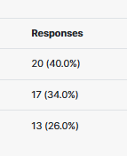

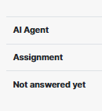
Poll Result
Short Agentic AI Project
OS-007
OS-006
Total marks 10 (Two Assignments)/30

Slide 4

How to Find a Project
You Just Need to do 20% Only
Reaming 80% AI will do for us.

Slide 5
PROMPT
Act as a senior AI architect and university project mentor. Suggest 10 beginner-to-intermediate Agentic AI project ideas suitable for a 4-week university Operating Systems course project. Requirements:
Must solve a real-world problem
Should be small and practical
Should not require a large dataset
Should be possible using Python
Should demonstrate agentic AI behavior (decision-making + actions)
Should be feasible for one student
Include:
project title
problem solved
features
tech stack
estimated difficulty
4-week implementation plan Focus on projects that are impressive but realistic for students.

Slide 6
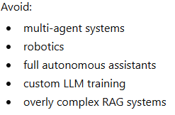
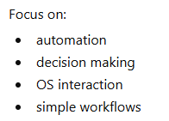
Suggestion
The project topic is completely open-ended.
Both OS-related and non-OS Agentic AI projects are acceptable.

Slide 7
Suggestion
The project domain is flexible and completely open to innovation.
Projects outside the Operating Systems domain are also acceptable, provided they are practical, well-defined, and feasible to complete within 4 weeks.
Timeline
Week 10-2 to 14-2= 4 Weeks
After 2 Week Progress Meeting and update millstone

Slide 8


Recap: Round Robin (RR) Quantum=3
 | AT | BT | CT | TAT | WT | RT
P1 | 0 | 8 | 22 | 22 | 14 | 0
P2 | 5 | 2 | 11 | 6 | 4 | 4
P3 | 1 | 7 | 23 | 22 | 15 | 2
P4 | 6 | 3 | 14 | 8 | 5 | 5
P5 | 8 | 5 | 25 | 17 | 15 | 9
For quantum q and n processes ready,
Fair: each process gets 1/n CPU time in chunks of at most q time units
Process P =5: each process gets 1/5 share (~20%)
Each execution slice is ≤ 3 time units
Live: no process ever waits more than (n-1)q time units
Maximum observed wait = 9 [satisfied (since 9 ≤ 12)]

Slide 9
Recap: Process Synchronization
Process Synchronization is a mechanism in operating systems used to manage the execution of multiple processes that access shared resources.
Its main purpose is to ensure data consistency, prevent race conditions and avoid deadlocks in a multi-process environment.
On the basis of synchronization, processes are categorized
Independent Process
Cooperative Process

Slide 10
Recap: Producer-Consumer Problem
Conditions
Producer side (Count will be incremented)
Before placing product into buffer producer have to check buffer is not FULL
Consumer side (Count will be decremented)
Before consuming product from buffer consumer have to check buffer is not empty
Count= No of Products in the buffer
Products
Count (Shared Variable)
Consumer
Count != 0
Consumed = Product
(consume product from buffer)
Count= count - 1
Count != Buffersize
Buffer = Product
(place product in buffer)
Count= count + 1
Buffer Memory
Count=0

Slide 11
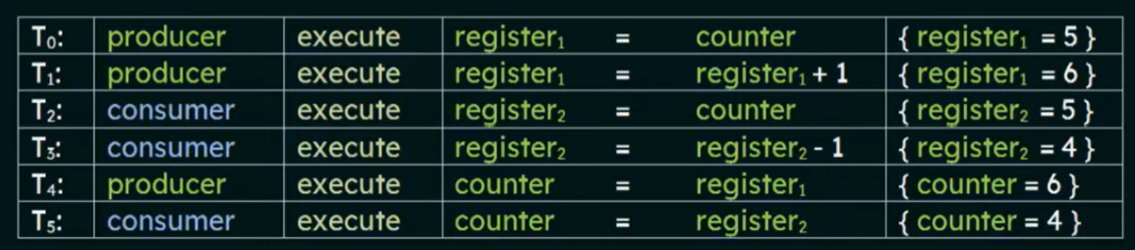
Recap: Race Condition
Count (Shared Variable) = 5
Race Condition

Slide 12
Critical Section Problem
To avoid problems such as race conditions and data inconsistency, only one process/thread should execute the critical section at a time using synchronization techniques.
we need to make threads coordinate with each other to ensure mutual exclusion in accessing critical sections of code
Each process has a segment of code, called a critical section
Common variables
Updating a table
Writing a file
When one process running in its critical section, no other process is allowed top execute critical section
P1
Buffer Memory
P1
P2
wait
Code Segment
Critical section

Slide 13
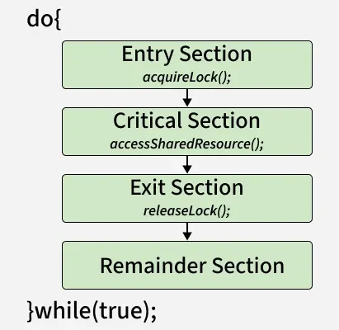
Process Code Segment:
1. Entry Section
The process requests permission to enter the critical section.
Synchronization tools (e.g., mutex, semaphore) are used to control access.
2. Critical Section:
The actual code where shared resources are accessed or modified.
3. Exit Section:
The process releases the lock or semaphore, allowing other processes to enter the critical section.
4. Remainder Section:
The rest of the program that does not involve shared resource access.
Code Segment

Slide 14
Critical Section
Requirements of Critical Section Solutions
Mutual Exclusion
At a time only one process is being executed in critical section
Progress
If no process is in the critical section, and some processes want to enter, the choice of who enters next should not be postponed indefinitely.
Ensures that the system continues to make progress rather than getting stuck.
Bounded Waiting
There must be a limit on how long a process waits before it gets a chance to enter the critical section.
Prevents starvation, where one process is repeatedly bypassed while others get to execute.

Slide 15
Critical Section
acquireLock();
Process Critical Section
releaseLock();

Slide 16
Semaphore
A semaphore is a synchronization tool used in operating systems to manage access to shared resources in a multi-process or multi-threaded environment.
It is an integer variable that controls process execution using atomic operations like wait() and signal(). Semaphores help prevent race conditions and ensure proper coordination between processes.
Controls entry into the critical section.
Maintains a counter representing available resources.
Ensures mutual exclusion among processes.
Can block and wake up processes during execution.
Widely used in concurrent programming.

Slide 17
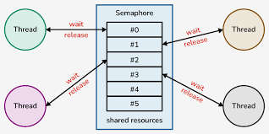
Semaphore

Slide 18
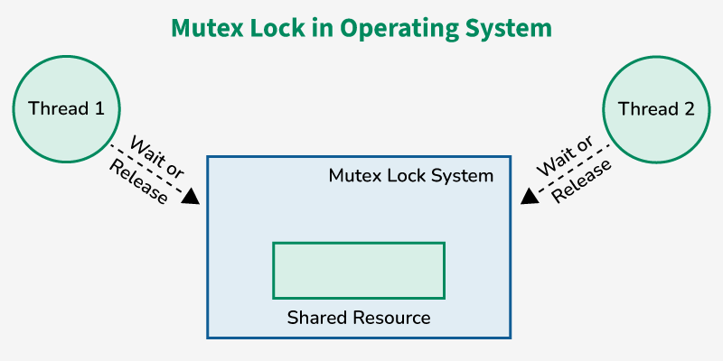
Mutex
A mutex is different from a binary semaphore, which provides a locking mechanism. It stands for Mutual Exclusion Object.
Mutex is mainly used to provide mutual exclusion to a specific portion of the code so that the process can execute and work with a particular section of the code at a particular time.
Mutual Exclusion:
no two processes can exist in the critical section at any given point of time
Notes:
Mutual Exclusion is a property of process synchronization that states that "no two processes can exist in the critical section at any given point of time

Slide 19
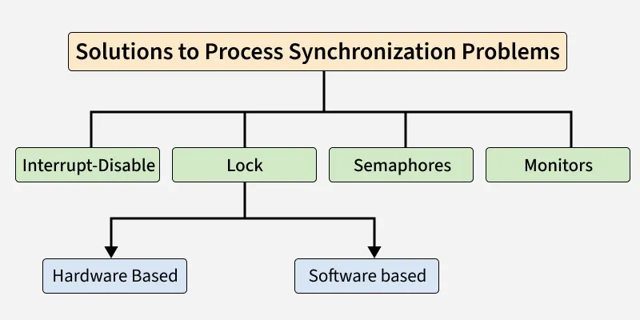
Process synchronization techniques
In a multiprogramming environment, multiple processes often compete for shared resources like memory, CPU, or files.
If not managed properly, this leads to race conditions where the final output depends on the order of execution.
Process synchronization techniques
Notes:
Mutual Exclusion is a property of process synchronization that states that "no two processes can exist in the critical section at any given point of time

Slide 20
Process synchronization techniques
Interrupt Disable
This method allows a process to disable all hardware interrupts before entering its critical section.
Since no interrupts can occur, the running process cannot be preempted. It executes its critical section without interference.
Lock
Locks ensure that only one process at a time can enter the critical section. A process must “acquire” the lock before entering, and “release” it after exiting. If another process tries to enter while the lock is held, it must wait.
Software-Based Locks
Hardware-Based Locks
Notes:
Mutual Exclusion is a property of process synchronization that states that "no two processes can exist in the critical section at any given point of time

Slide 21
Process synchronization techniques
Lock
Software-Based Locks
Software-based locks are implemented using algorithms that rely on shared variables (like flags, turn variables, or ticket numbers) to coordinate access to the critical section.
Peterson’s Algorithm: works well for exactly two processes.
Dekker’s Algorithm: One of the earliest algorithms for mutual exclusion. Works for exactly two processes using flags and a turn variable.
Bakery Algorithm: works for multiple processes, inspired by “take-a-number” systems in shops.
Hardware-Based Locks
Modern CPUs provide special atomic instructions that make lock implementation easier and faster. These are much simpler than software algorithms like Peterson’s or Bakery.
Notes:
Mutual Exclusion is a property of process synchronization that states that "no two processes can exist in the critical section at any given point of time

Slide 22


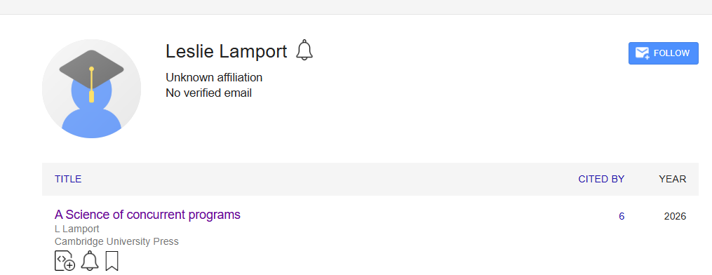
Process synchronization techniques
Lamport's bakery algorithm
https://www.youtube.com/watch?v=U719vQz-WFs&t=1094s
https://en.wikipedia.org/wiki/LaTeX
Leslie Lamport
"I'm not smart, I have the gift of abstraction...“
the “the ability to abstract” is literally what IQ (Intelligence Quotient) measures as signal for intelligence.
https://lamport.azurewebsites.net/
https://scholar.google.com/citations?hl=en&user=uG3icVgAAAAJ&view_op=list_works&sortby=pubdate
Notes:
Mutual Exclusion is a property of process synchronization that states that "no two processes can exist in the critical section at any given point of time

Slide 23


