Slide 1
Introduction
Location: Singapore
Problem Statement
You are interested to open up a coffee house in the north side of Singapore.
Particularly near to a shopping mall called Causeway Point.
Reason for this choice is that the assigned location is the hub for most of the financial/utility centers for the residents living in the north.
As it is the main hub, there are a numerous chain of cafes.
Hence, you are looking for a potential location that is less dense (with coffee houses) so that you can maximize your customer outreach.

Slide 2
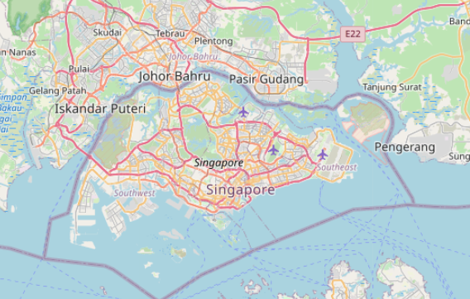
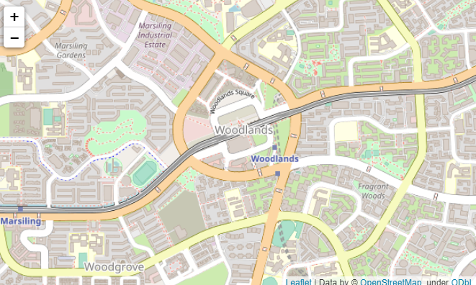
Context
Map of Singapore
Zoom in to Woodlands, SG

Slide 3
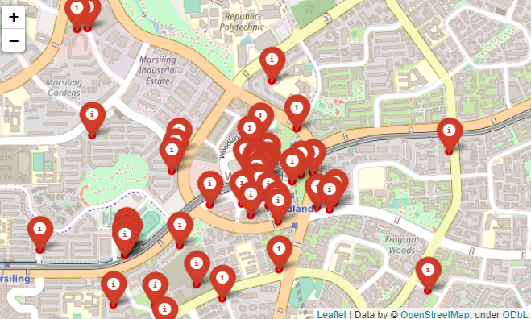
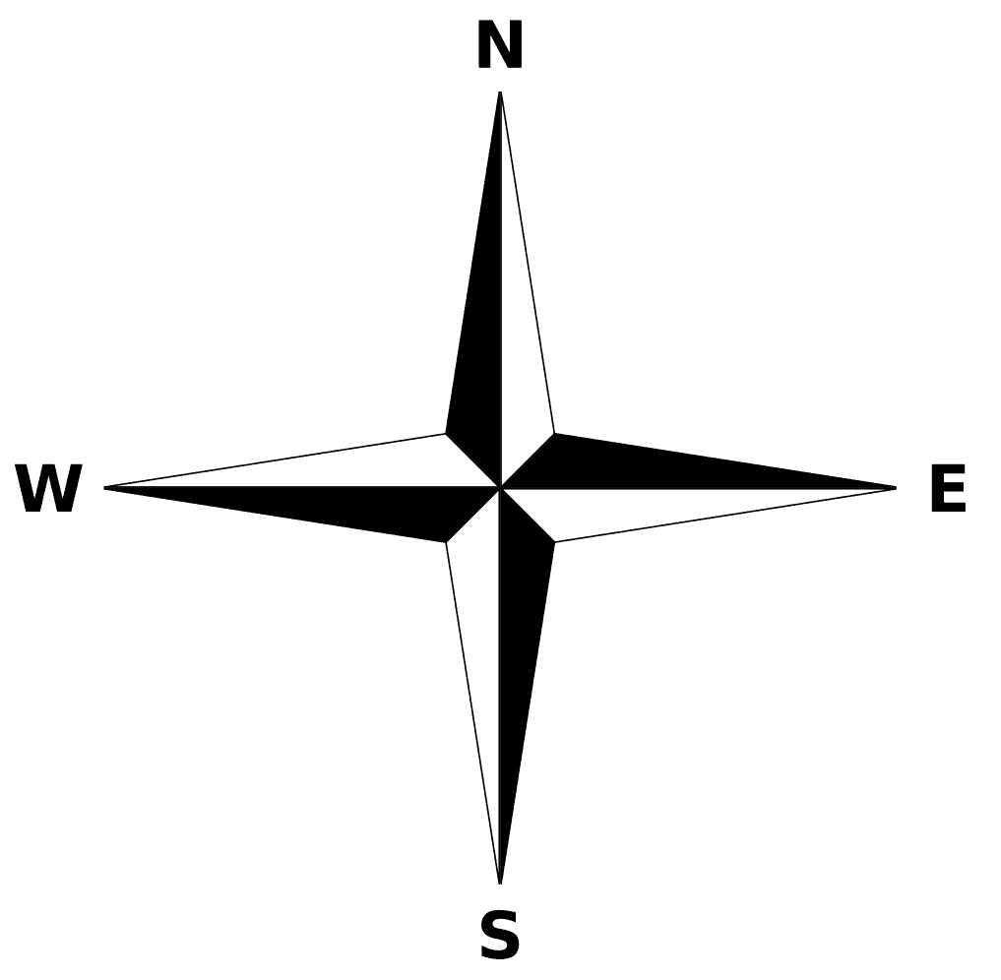
Conclusion
Marked up locations of all coffee and tea houses in the area
From the distribution, it is clear that the NE region of Woodlands has lesser competition. Hence market survey may begin from this region.

Slide 4
A full report consisting of all of the following components (15 marks):
Introduction where you discuss the business problem and who would be interested in this project. Target audience shall be people who are interested into coffee business, investors for any cafes.
Data where you describe the data that will be used to solve the problem and the source of the data. Source of data is taken from foursquare API, using the search venue function – we extracted all the coffee and tea houses in the vicinity around the targeted location for analysis.
Methodology section which represents the main component of the report where you discuss and describe any exploratory data analysis that you did, any inferential statistical testing that you performed, if any, and what machine learnings were used and why. No ML algorithm was used. Basic data visualization was used to determine the density of coffee/tea house clusters to guide investor decision on the optimal location for the new branch.
Results section where you discuss the results. See slides above.
Discussion section where you discuss any observations you noted and any recommendations you can make based on the results. See slides above.
Conclusion section where you conclude the report. See slides above.

