Slide 1
50.003: Elements of Software Construction
Week 12
Concurrency: Optimization

Slide 2
Course Plan
Week | Cohort Class 1 | Cohort Class 2 | Cohort Class 3 | Remarks
1 (Jan 22) | Software Development Process
2 (Jan 29) | Software Design and UML |  | Project Meeting I | Problem Set 1
3 (Feb 5) | Software Design and UML |  | Guest Lectures
4 (Feb 12) | Design Patterns |  |  | Problem Set 2. Quiz 1
5 (Feb 19) | Software Testing |  | Project Meeting II
6 (Feb 26) | Software Testing |  |  | Problem Set 3
7 (Mar 5) | Recess |  |  | Problem Set 4
8 (Mar 12) | Software Debugging, Code smells and Maintenance |  | Project Meeting III | Quiz 2
9 (Mar 19) | Concurrency: Requirement |  |  | Problem Set 5
10 (Mar 26) | Concurrency: Design and Implementation |  |  | Problem Set 6; Quiz 3
11 (Apr 2) | Concurrency: Testing |  | Project Meeting IV | Problem Set 7
12 (Apr 9) | Concurrency: Optimization |  |  | Problem Set 8; Quiz 4
13 (Apr 16) | Final Project Presentation (15 minutes for each group) |  |  | Project Report/Code Due
14 (Apr 27) | Final Exam

Slide 3
Plan of the Week
Executor and thread pools
Finding Exploitable Parallelism
Non-blocking algorithms

Slide 4
Executor and Thread Pools
Part 1

Slide 5
Tasks
Most concurrent applications are organized around the execution of tasks: abstract, discrete units of work.
Designing your program organization around tasks
Identify sensible task boundaries
Ideally, tasks are independent activities: work that does not depend on other tasks
Independence facilitates concurrency
Notes:
Don’t extend thread class: mixing computation of the class and thread control. So existing methods in a thread class. It mixes thread control with the actual task. This is often a bad idea because these are separate things
If I have to make a data pool. Tasks are the kind of jobs we have to finish. Educating students, during research. What kind of employees we hire and what kind of organizations, these are separate issues.
Thread pools are separations. They are execution policies. We are replacing a different set of tasks. We want to focus on identifying tasks. Do not want to deal with thread control, separation etc.
Idea is to identify units of work that are independent, of the right size. If all units work, can map them to threads.

Slide 6
Example: Server
Most server applications offer a natural choice of task boundary: individual client requests.
Executing tasks sequentially
This might work if handleRequest returns immediately – not for real world web server.
public class SingleThreadWebServer {
public static void main (String[] args) throws Exception {
ServerSocket socket = new ServerSocket(80);
while (true) {
Socket connection = socket.accept();
handleRequest(connection);
}
}
Notes:
Let’s consider server. Server should be a place where multi-threads work because you have multiple clients. Can look at this particular programs. It is a naïve recommendation nof a program. Will set up a server and set up one client. This is a method call where I handle the client. I have to serve the client.
This is sort of naïve because this kind of client takes time. If you are serving one and another, all the other clients are set to wait. You wouldn’t be using that server because if there are many clients, you won’t be using that.
What if we use threads? Here, I have a natural bound array of tasks.

Slide 7
One Thread Per Task
A more responsive approach is to create a new thread for servicing each request
class ThreadPerTaskWebServer {
public static void main (String[] args) throws Exception {
ServerSocket socket = new ServerSocket(80);
while (true) {
final Socket connection = socket.accept();
Runnable task = new Runnable () {
public void run() {
handleRequest(connection);
}
};
new Thread(task).start();
}
}
Notes:
Each client has a different task. There is a natural boundary between each thread. Once I connect to one client, I will start a task and create a new thread to handle each client.

Slide 8
One Thread Per Task
Task processing is offloaded from the main thread – more responsive.
Tasks can be processed in parallel – improved throughput.
Task-handling code must be thread-safe, because it may be invoked concurrently for multiple tasks.
It works under light or moderate load.
Example: ThreadPerTaskWebServer.java
Notes:
It will be more responsive (client could clear that they are connected; lead to some problems if the number of clients is not.. If you have a huge number of clients trying to connect, soon server will become unstable. Too many threads; resources taken. The more clients; the more threads you have. The more resources you dedicate to creating threads and less to actually completing the task. This is unreliable, unstable, not being able to serve properly each and every client.

Slide 9
Unbound Thread Creation
For production purposes (large webservers for instance) task-per-thread has some drawbacks.
Thread creation and tear down involves the JVM and OS. For lots of lightweight threads this is not very efficient.
Active Threads consume extra memory, for instance to provide for a thread stack.
If there are less CPU's than threads, some threads sit idle, consuming memory.
There is a limit on how many threads you can have concurrently. If you hit this limit your program will most likely become unstable.
Notes:
If you don’t try to control no of threads, serving more and more clients. Have unbounded thread creation.
In terms of efficiency doesn’t make sense because you limit number of cores in CPU, doesn’t mean that clients are served at the same time. Only 8 threads for 8 cores, even if you have 100 threads at the same time.
All these threads are taking computer resources, managed by operating system. Windows, IOS, ubuntu, there’s a limit of the number of threads can rely on heavily. There’s overhead in trying to schedule so many threads. Before I can talk about the thread pool, whether bad idea,

Slide 10
Cohort Exercise 1
Given MultipleClient.java and SingleThreadWebServer.java and ThreadPerTaskWebServer.java, compare the performance of the two implementations of the Web server. Vary the number of threads (10,100,1000) and see the trend. Work in pairs (one executes MultipleClients.java and the other executes the server program).

Slide 11
The Executor Framework
Single thread
poor responsiveness and throughput
Thread-per-task
Poor resource management (consider a deny of service attack)
The executor framework offers flexible thread pool management
Notes:
Can I not concerned with creating threads, how many threads shall I create, can we have not an automatic framework where this is automatically done for me. What I need, having a HR department sourcing the people we need and accomplishing all your tasks. That’s available, it is called the executor framework. Take care of everything related to execution policy.
Executor has only one main method, the execute method.

Slide 12
Executor
Executor provides a standard means of decoupling task submission from task execution.
The Runnable is the task itself.
The method execute defines how it is executed.
public interface Executor {
void execute (Runnable command);
}
Example: ExecutorWebServer.java
Notes:
The idea you need to know as user of executor method is to give tasks and executor figures out the rest for you. Having one thread per client is a bad idea. So I use the executor and using one implementation of executor with the bound on the number of threads to ever serve my client. If you had done your experiments right, you figure out with the number of tasks per server, this is you setting the number of threads which I will limit my clients to. So all it does is to submit to thread pool.
ThreadPool has its own organization, you don’t have to care. Just finish the task for me.

Slide 13
Execution Policy
Decoupling submission from execution is that it lets you specify the execution policy for a given class of tasks.
In what thread will tasks be executed?
In what order should tasks be executed (FIFO)?
How many tasks may execute concurrently?
How many tasks may be queued pending execution?
If a task has to be rejected because the system is overloaded, which task should be selected and how the application be notified?
What actions should be taken before or after executing a task?
Example:
SequentialExecutorWebServer.java
ThreadPerTaskExecutorWebServer.java
Notes:
Lock in policy : thread safety
Execution policy: performance. There is a range of questions: what threads were executed, in what order. How many threads were created to execute these tasks at the same time. All these questions you have to answer if you want to design your own execution policy.
There are implementations in Java readily available.

Slide 14
Thread Pools
tasks
thread pool
task queue
execution
policy
define as Runnable of each
Executor object
Define in Execute() of
the executor class
Notes:
Try to identify tasks with right size, such that threads are independent from each other. Using thread pool, submit all these tasks to the thread pool. This is what we call task queue which we allow to queue all your tasks. This is for the executor implementation where it estimates how to deal with all these tasks you are executing. As user, need not concern with queuing. This will be hidden away from you.

Slide 15
Advantage of Thread Pools
Reusing an existing thread; reduce thread creation and teardown costs.
No latency associated with thread creation; improves responsiveness.
By properly tuning the size of the thread pool, you can have enough threads
to keep the processors busy while not having so many that your application
runs out of memory or thrashes due to competition among threads for resources
Notes:
If you try to create and tear down threads, there are overheads. Creating a thread requires to set up the stack, allocate certain memory, and set of fields. These take 1000s of clock cycles which is quite expensive if really big task. Thread pools have policies of reusing threads. Dynamically allocate tasks to these employees. Every time new task, hire new one without thread pool. Maintaining workforce more efficient.

Slide 16
Thread Pool Implementations
newFixedThreadPool
Fixed-size thread pool; creates threads as tasks are submitted, up to the maximum pool size and then attempts to keep the pool size constant
newCachedThreadPool
Boundless, but the pool shrinks and grows when demand dictates so
newSingleThreadExecutor
A single worker thread to process tasks, sequentially according to the order imposed by the task queue
newScheduledThreadPool
A fixed-size thread pool that supports delayed and periodic task execution.
Example: ScheduledThreadPool.java
Notes:
Number of fine-tuned efficiency in Java.
First One: pool with bound on number of threads. When declare as thread pool, can have 100 threads. When task are being submitted, there shall be no threads in the pool. Created thread for that task, then another until 100 tasks are submitted. Will create 100 threads if take care of task. If there are more tasks submitted, will not create new tasks. Tasks finished, ask old thread to deal with this or queue until someone is available.
Second One: Whatever executor framework, create more and more threads, but what this thread pool does is anticipate based on the number of tasks. More tasks in short time, anticipate new threads needed and grow the size of the pool. If the tasks are all produced, then try to layout people by destroying some threads.
SingleThreadExecutor: one thread
Fourth One: Supports more complicated ways of submitting tasks. You have only one way to submit task: execute. Allow users to declare when want task to start. Can declare tasks to be periodic; this task executed every five minutes and allows thread pool to predict how many tasks to be executed.

Slide 17
Cohort Exercise 2
Modify ThreadPerTaskExecutorWebServer.java to use newFixedThreadPool with 100 threads. Name your program ExecutorWebServer.java.
Compare its performance with the sequential and thread-per-task web server using MultipleClient.java (with the smaller number) with 10, 100, 1000 client threads.

Slide 18
Executor Lifecycle
Shut down an Executor through ExecutorService
public interface ExecutorService extends Executor {
void shutdown();
List<Runnable> shutdownNow();
boolean isShutdown();
boolean isTerminated();
boolean awaitTermination(long timeout, TimeUnit unit)
throws InterruptedException;
// … additional convenience methods for task submission
}
Notes:
How do I terminate the executor. There are easier interrupted exceptions, check if I am interrupted. For executor, because it is a pool of threads, have to terminate all of them if you want to terminate the thread pool. It is a subclass of executor framework that exerts control over the executor.
Can shutdown, and shutdownnow();

Slide 19
shutdown() vs shutdownNow()
shutdown()
will just tell the executor service that it can't accept new tasks, but the already submitted tasks continue to run
shutdownNow()
will do the same AND will try to cancel the already submitted tasks by interrupting the relevant threads. Note that if your tasks ignore the interruption, shutdownNow() will behave exactly the same way as shutdown().
Notes:
Shut down closes door, say no more new tasks. All have been executing will run to finish. Will complete all the tasks completed
ShutDownNow(): not just new tasks eliminated, but cancel all submitted tasks by interrupting all threads executing. If you remember our discussion, the interrupt wrecks thread that are executing. The thread executing my task, is it implemented or not. What if I’m being interrupted? Otherwise, it does nothing.

Slide 20
Task Coupling and Execution Policy
Thread pools work best when tasks are homogeneous and independent.
Dependency between tasks in the pool creates constraints on the execution policy which might result in problems (deadlock, liveness hazard, etc.)
Long-running tasks may impair the responsiveness of the service managed by the Executor.
Reusing threads create channels for communication between tasks – don’t use them.
Notes:
With thread pool, fork some identifying tasks, without being easy. You want tasks that are similar to each other in terms of size. If they are independent, since you are only submitting your tasks. If tasks are depending on each other. The task 1 depending on task 2, task 3 on task 2 and so on. When you submit all these tasks to the thread pool, might be really bad because thread pool might decide let’s submit task 2 first. Therefore, it is no good. In general, you want tasks to be dependent and of the right size. If task is too large, then one thread is used up for that one time. Too small, you have overhead, trying to identify which thread this task is assigned to.
Some users; when you try to use thread pool, threads are reused, You can try to store data using the thread class. Then you can have the task variable. Write to their variable so that a later task can pick up the information. Introduces dependencies between tasks. Keep your tasks independent from each other.

Slide 21
Sizing Thread Pools
The ideal size for a thread pool depends on the types of tasks and the deployment system
If it is too big, performance suffers
If it is too small, throughput suffers
Heuristics
For compute intensive tasks, N+1 threads for a N-processor system
For tasks including I/O or other blocking operations, you want a larger pool
Notes:
When we try to use thread pool, I will use this existing execution npolicy. There is this 100 value that we use to put bound on size of thread pool. How to calculate that number? We can try 5, 1000 and see which will give the best performance only if you can test with a realistic workload similar to whatever you encounter in practice. If you can’t, you need some guidelines on how to choose the right number.
For instance, if task is CPU intensive, your task is basically computation. Factory is basically computation. A good heuristic for choosing size of pool is N + 1 where N is the number of cores in CPU. I don’t want too big a CPU, I only have a number of cores.
If your tasks has a lot of IO operations, database and reading files and waiting for network messages. You can have a thread pool which is much larger than the number of cores. You have the chance of using the same number of cores for a number of threads. There is a formula to calculate the size of thread pool.

Slide 22
Optimal CPU Utilization
Given these definitions:
N = number of CPUs
U = target CPU utilization
W/C = ratio of wait time to compute time
The optimal pool size is:
M = N * U * (1 + W/C)
The number of CPUs can be obtained by: Runtime.getRuntime().availableProcessors()

Slide 23
Cohort Exercise 3
Given MultipleClient.java (with the bigger number and 5 clients) and ExecutorWebServer.java, tune the thread pool size in the factor web server example for optimal performance.

Slide 24
Sizing the Queue
tasks
thread pool
task queue
execution
policy
The queue may grow unbounded!
When a bounded task queue fills up, the saturation policy comes into play.
The default: throw RejectedExecutionException

Slide 25
More Than CPUs
Other resources that can contribute to sizing constraints are memory, file handles, socket handles, database connections, etc.
Add up how much of those resources each task requires and divide that into the total quantity available
Alternatively, the size of the thread pool can be tuned by running the application using different pool sizes and observing the level of CPU and other resource utilization.

Slide 26
Finding Exploitable Parallelism
Part 2

Slide 27
Finding Exploitable Parallelism
The executor framework makes it easy to submit and execution tasks as well as specify an execution policy.
How do you define the tasks such that you can get the maximum performance?
Notes:
There’s this task of identifying tasks which is essential. To be able to get the best performance possible.

Slide 28
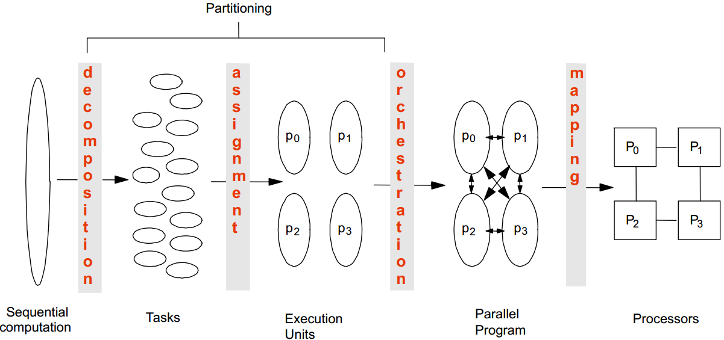
Common Steps to Parallelization
Notes:
There are a number of steps where you can see more performance. If you would like to have multiple threads at the same time, these are the steps you should follow. If you are given a huge task (say a program). It has been done in a sequential way. The task is to break this huge block into smaller ones. The consideration is how should you break the tasks that you get small tasks that are similar size, independent.
This step: there is no simple solution. You have to do this yourself. But in general, it is a process where some kind of intelligence is needed. You should try to group them. You have all these tasks to be finished and you have a few employees in your organization. What tasks seem to be mostly related to each other? You want to group tasks which are related to each other in the same group.
If you were to do random assignment, these group of tasks will have assignment on each other. You should have tasks independent on each other in the same group. That is second step assignment, grouping tasks into larger groups.
Orchestration: Assigning groups to threads. Which thread is for which group of tasks
Last step: You have to run this different group of tasks on the hardware you have and this is mapping to the basic hardware that you have.

Slide 29
Decomposition
Break up the computation into “self-contained” tasks to be divided among processes
Tasks shouldn’t be too small or too big
Too small: the ratio of useful work vs overhead becomes small
Too big: Number of tasks available at a time is upper bound on achievable speedup
Tasks may become available dynamically
Notes:
You want to break the computation into self contained task to be divided among processes. Shouldn’t be small or too big.
One complication you have to deal with in real applications you may not have a full picture of all the tasks you have. There are certain systems in the case of a web server where you do not know how many tasks that would be. You are supposed to anticipate what other tasks. Assignment: The idea is to balance the workload on each group of tasks and try to reduce the indication between each and every group of tasks. Typically, you do this using coding inspection.
Trying to understand dependencies between tasks, there are standard formulas. What is the data flow in your application? Which code uses data from which other part.
There are design patterns for this statement as well. This happens repeatedly in practice and people try to recite them as recipe. If you were to apply design pattern, you can do assignment job.

Slide 30
Assignment
Specify mechanism to divide work among cores
We may want to balance the amount of work for each core
and reduce communication between the threads
Structured approaches usually work well
Code inspection or understanding of application
Apply Well-known design patterns

Slide 31
Orchestration and Mapping
Figure out what kind of communication is needed between each pair of threads
Less communication is better: preserve locality of data
Schedule the threads to satisfy tasks dependences
Use Executor
Notes:
If you decide to use Thread pools, no need to concern yourself with orchestration and mapping by mechanism provided in thread pool implementations. To make sure you choose the right executor.

Slide 32
Example: FactorWebserver
setup and wait for first connection
handlerequest
wait for second connection
handlerequest
wait for third connection
…
Notes:
Let me use a simple example to illustrate every step. If you see the factor webserver:
First job is to identify the task. This is a step where you have some intelligence to do that. For some servers, there are natural boundaries between tasks.
The first task to set up and wait for the first connection and the second task, while serving the first customer, the second task waiting for second connection.
Here, I’m assuming that this is the task boundary we’ve agreed upon. Your decision on how to cut this program into little pieces. Each request could be a set of independent tasks.
Second step: Once you have identified the set of tasks, you try to understand dependency.

Slide 33
Dependency
Bernstein’s Condition
Ri: set of memory locations read (input) by task Ti
Wj: set of memory locations written (output) by task Tj
Two tasks T1 and T2 can run in parallel if input to T1 is not part of output from T2; and input to T2 is not part of output from T1 outputs from T1 and T2 do not overlap.
Example: If T1: a = x+y and T2: b = x+z, then R1 = {x, y}; W1 = {a}; R2 = {x, z}; W2 = {b}
*** assume that x, y and z are different memory locations
Notes:
Minimise communication between threads. Threads are employees, less communication, faster for them to finish their work. In general, you want to understand dependencies to minimize communication later on.
There is Bernstein’s Condition: Doesn’t apply to distributed programming. For each task, you try to identify what the set of memory locations read by the task. Try to understand what the memory locations are written by task.
If I’m writing to certain parts and you are reading the same part: induces the dependency. You have basically independence between these two tasks. IF this is my simple task, t1 and t2. Remember that the set of tasks t1 and t2 are exploit.
You can decide whether they are independent or not.

Slide 34
Example: FactorWebserver
setup and wait for first connection
handlerequest
wait for second connection
handlerequest
wait for third connection
…
Notes:
Dependency here is that we share the same socket objects. (first and third)

Slide 35
Example: FactorWebserver
calls of handlerequest can run in parallel.
Thread 1
Thread 1
Thread 2
Thread 3
1
1
2
2
3
4
3
5
4
5
…
…
Notes:
Put in a different group so that 4 and 5 can run at the same time.

Slide 36
Orchestration Revisited
Given a collection of concurrent tasks, what are the important considerations in mapping tasks to units of execution (e.g., threads)?
Magnitude of number of execution units platform will support (less a problem if you use Executor)
Cost of sharing information among execution units
What if we can only have maximum 4 threads for the server?
Consider parallelizing the Depth-First Search algorithm

Slide 37
Patterns for Parallelization
Provides a cookbook to systematically guide programmers
Decompose, Assign, Orchestrate, Map
Can lead to high quality solutions in some domains
Provide common vocabulary to the programming community
Each pattern has a name, providing a vocabulary for discussing solutions
Helps with software reusability, malleability, and modularity
Written in prescribed format to allow the reader to quickly understand the solution and its context

Slide 38
Patterns for Parallelization
“Patterns for Parallel Programming”, Mattson, Sanders, and Massingill (2005).
The patterns could help you in
Exposing concurrent tasks
Mapping tasks to processes to exploit parallel architecture
Providing supporting code and data structures
Providing low-level mechanisms needed to write parallel programs

Slide 39
Single Program, Multiple Data
All threads/processes run the same program, operating on different data. This model is particularly appropriate for problems with a regular, predictable communication pattern.
MATLAB supports SPMD blocks.
Often adopted for GPU programming
Notes:
Same program for different data, independent for each other.
i.e. multiple threads searching through same string array.
Carve into different parts

Slide 40
Cohort Exercise 4
Given Exercise1.java, apply SPMD (Single Program, Multiple Data) design pattern for concurrent programming to parallelize the program which approximates π by integration.

Slide 41
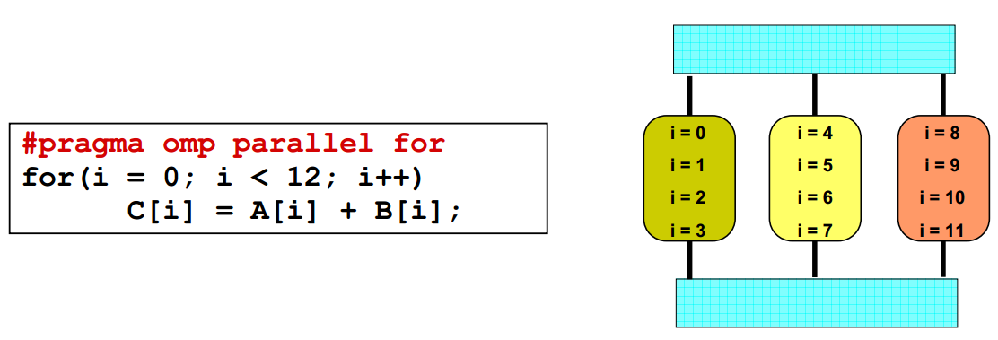
Loop Parallelism Pattern
Given a loop, each thread/process execute part of the loop.
Programming models like OpenMP provide directives to automatically assign loop iteration to execution units

Slide 42
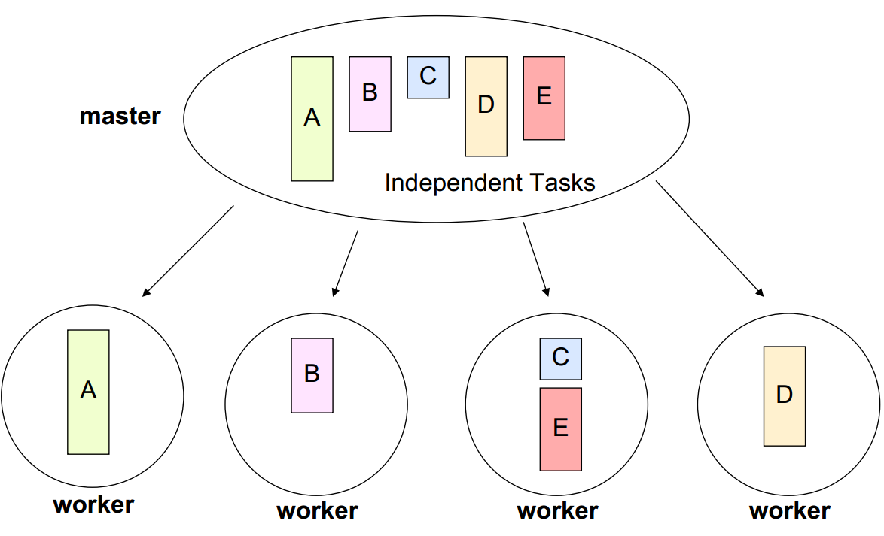
Master/Worker Pattern
A master thread/process divides a problem into several sub-problems and dispatches them to several worker processes.

Slide 43
Fork/Join Pattern
Tasks are created dynamically
Tasks can create more tasks
Manages tasks according to their relationship
Parent task creates new tasks (fork) then waits until they complete (join) before continuing on with the computation

Slide 44
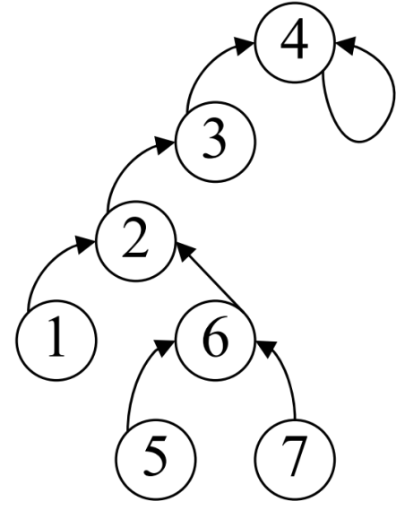
Example: PRAM
How to parallelize BFS?
Start from a root, and visit all the connected nodes in a graph
Nodes closer to the root are visited first
Nodes of the same hop-distance (level) from the root can be visited in parallel

Slide 45
Example
ParallelRecursive.java

Slide 46
Performance vs Complexity
One of the primary reasons to use threads is to improve performance.
Techniques for improving performance also increase complexity and the likelihood of safety and liveness failures.
Avoid premature optimization. First make it right, then make it fast – if
it is not already fast enough.
The quest for performance is probably the single greatest source of
concurrency bugs.

Slide 47
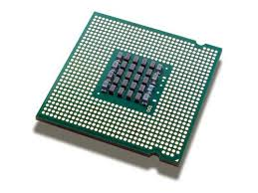



Bottleneck
Your program
Find out what the bottleneck is before you optimize.

Slide 48
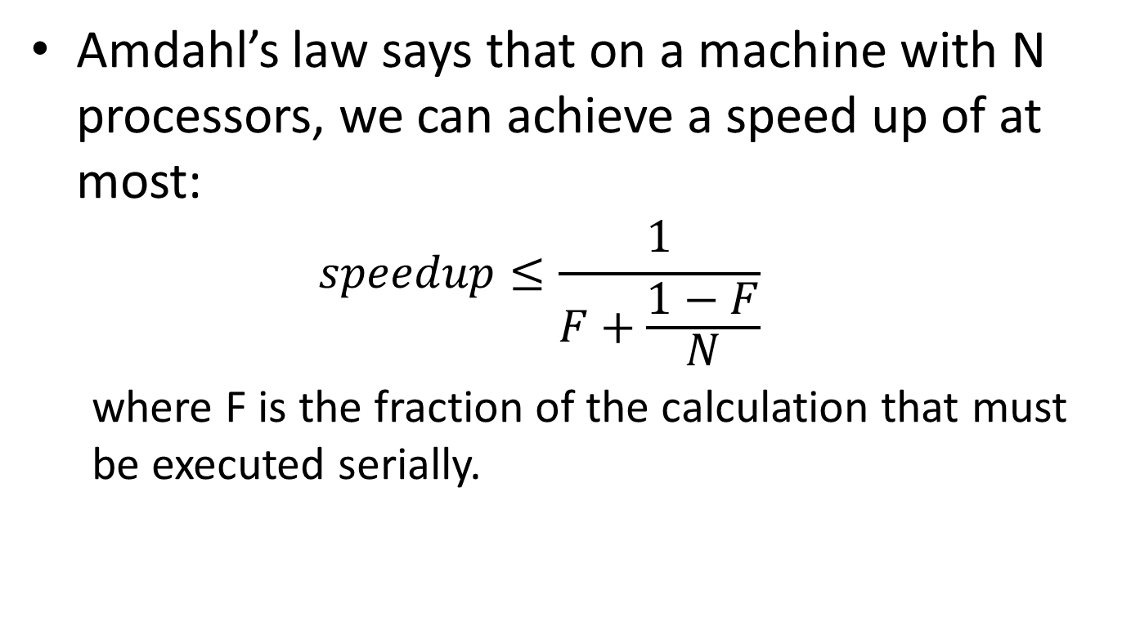
Amdahl’s Law
Amdahl’s law says that on a machine with N processors, we can achieve a speed up of at most:
$$speedup≤\frac{1}{F+\frac{1−F}{N}}$$
where F is the fraction of the calculation that must be executed serially.
Notes:
Some part of your program must be sequential. There is a part where you have to start one by one. Some part is sequential/serial.

Slide 49
Serialization
class Slave extends Thread {
private final BlockingQueue<Runnable> queue;
private final ExecutorService exec = Executors.newFixedThreadPool(100);
public Slave (BlockingQueue<Runnable> queue) {
this.queue = queue;
}
public void run() {
while (true) {
try {
exec.execute(queue.poll());
}
catch (Exception e) {
break;
}
}
}
}
All Concurrent applications have some sources of serialization

Slide 50
Cohort Exercise 5
Complete the following table to calculate maximum speedup
Given PerformanceExperiment.java, vary the number of the threads and see how much speedup you can get.
N, F | Speedup
10, 10% | 1/(0.1+0.09)
100, 10% | 1/(0.1+0.009)
∞, 10% | 10
10, 25% | 1/(0.25+0.075)
100, 25% | 1/(0.25+0.0075)
∞, 25% | 4
Notes:
$$speedup≤\frac{1}{F+\frac{1−F}{N}}$$

Slide 51
Cost Introduced by Threads
Context switching: requires saving the execution context of the currently running thread and restoring the execution context of the newly scheduled thread
CPU time spent on JVM/OS
Cache misses
Costs about 5,000 to 10,000 clock cycles
Memory synchronization:
Memory barriers inhibit compiler optimization
Notes:
Possibility of context switching. Have another thread executing. Clock cycles wasted. Jobs done by JVM and then possibly in cache mist. If I switch out one thread. The cache holding all the values may not be useful for the new thread. It can take 10,000 clock cycles.

Slide 52
Lock/Release Cost
Access to resources guarded by an exclusive lock is serialized – one thread at a time delay may access it
Example: a naïve execution would require and release the lock on the vector four times.
It gets much worse with lock contention.
public String getNames() {
List<String> names = new Vector<String>();
names.add(“Alice”);
names.add(“Bob”);
names.add(“Carl”);
return names.toString();
}
Notes:
Minimize Program being sequential. Locking makes program become sequential. Speedup would be quite limited. Look at the naïve looking program
Vector designed to be sequential, so need to lock four times.

Slide 53
Lock Contention
Two factors influence the likelihood of contention for a lock
How often that lock is requested
How long it is held once acquired
There are three ways to reduce lock contention
Reduce the duration for which locks are held
Reduce the frequency with which locks are requested
Replace exclusive locks with coordination mechanisms that permit greater concurrency
Notes:
You want to limit lock contention. Avoid traffic jam.
The kind of traffic is determined by how many streets you have and how long that is. The longer and the less streets you have, the more likely you have a traffic jam.
By these three ideas: one, try to reduce the duration for which locks are held. You can have one thread writing while other threads are reading at the same time.
Get rid of locks with coordination methods.

Slide 54
“Get in, get out”
public class ReduceLockScope {
//@GuardedBy("this")
private final Map<String, String> attributes = new HashMap<String, String>();
public synchronized boolean userLocationMatches (String name, String regexp) {
String key = "users." + name + ".location";
String location = attributes.get(key);
if (location == null) {
return false;
}
else {
return Pattern.matches(regexp, location);
}
}
}
Notes:
It is exclusive to only one thread at any time. As long as there is one thread in this box.
There are some string operations. There are some success in the map. REGEX is a typically expensive operation. If you take a closer look, most of the code here doesn’t require access to your state. What you could do is lock the state.

Slide 55
“Get in, get out”
public class ReduceLockScope {
//@GuardedBy("this")
private final Map<String, String> attributes = new HashMap<String, String>();
public boolean userLocationMatches (String name, String regexp) {
String key = "users." + name + ".location";
String location;
synchronized (this) {
location = attributes.get(key);
}
if (location == null) {
return false;
}
else {
return Pattern.matches(regexp, location);
}
}
}
The amount of serialized code is reduced!
Notes:
Put just one into the synchronized lock.

Slide 56
“Get in, get out”
public class ReduceLockScope {
//@GuardedBy("this")
private final Map<String, String> attributes = new ConcurrentHashMap<String, String>();
public boolean userLocationMatches (String name, String regexp) {
String key = "users." + name + ".location";
String location = attributes.get(key);
if (location == null) {
return false;
}
else {
return Pattern.matches(regexp, location);
}
}
}
Delegating thread safety to ConcurrentHashMap

Slide 57
Reducing Lock Granularity
object
lock
Every thread acquires the lock to
access any locked object

Slide 58
Reducing Lock Granularity
object
lock
Every thread acquires the lock to
access any locked object

Slide 59
Reducing Lock Granularity
lock
object
Lock splitting
Notes:
This only works if there is no specification between the blue and red objects. If you are sure that the red and blue are independent, can make sure to have a better locking policy.

Slide 60
Lock Splitting
public class ServerStatus {
public final Set<String> users; //@GuardedBy("this")
public final Set<String> queries; //@GuardedBy("this")
...
public synchronized void addUser(String u) {
users.add(u);
}
public synchronized void addQuery(String q) {
queries.add(q);
}
public synchronized void removeUser(String u) {
users.remove(u);
}
}
Notes:
Who are my users and what are the queries have been asked. These objects, queries are independent. You can revisit your locki npolicy in this class.

Slide 61
Lock Splitting
public class ServerStatus {
public final Set<String> users; //@GuardedBy(“users")
public final Set<String> queries; //@GuardedBy(“queries")
...
public void addUser(String u) {
synchronzied (users) { users.add(u); }
}
public void addQuery(String q) {
synchronized (queries) { queries.add(q); }
}
public synchronized void removeUser(String u) {
synchronzied (users) { sers.remove(u); }
}
}

Slide 62
Lock Stripping
Lock splitting can sometimes to extended to partition lock on a variable sized set of independent object, which is called lock stripping.
Example: ConcurrentHashMap, 16 locks
Notes:
Let’s use more locks. Lockin policy says that this lock may be for this set of objects. Looking for objects that can be added in, and still figure out which lock I will use.

Slide 63
Alternatives to Exclusive Locks
To forego the use of exclusive locks in favor of a more concurrency-friendly means of managing shared state
Read-write locks: more than one reader can access the shared resource concurrently, but writers must acquire the lock exclusively
Immutable objects
Atomic variables

Slide 64
Cohort Exercise 6
Given StripedMap.java, assume that the objects in the buckets are independent. Complete method get(), size() and clear() using the idea of lock stripping.

Slide 65
Using Future
Using Future to download while rendering text concurrently
Place time limits on tasks
Use Future.get(long timeout, TimeUnit unit) to time out
Click here for a sample program:
FutureRenderer.java
Click here for a sample program:
FutureRenderer2.java
Notes:
You can use it to speed up implementation. While the image might be quite blurry. Or you are looking at some part of the image. Instead of some other parts. That is what we are speeding up. When we load parts of image, we use threadpool.

Slide 66
Non-blocking Synchronization
Week 12

Slide 67
Disadvantage of Locking
The ratio of scheduling overhead to useful work can be quite high when the lock is frequently contended – due to context switch and scheduling delays.
A thread with the lock may be delayed (due to a page fault, scheduling delay, etc.).
Locking is simply a heavyweight mechanism for simple operations like count++

Slide 68
Can we get rid of locks?

Slide 69
Reality is Messy
Java Programs
What if we know what are the atomic steps?
Bytecode
What are the atomic steps? For example, how many steps are “i++”?
What are the order of execution? Given “i++; j++; i++”, can we switch the last two statements?
JVM
Physical Machine
Where are the variable values stored? Cache, heap memory, stack memory.

Slide 70
Hardware Support for Concurrency
Processors designed for multiprocessor operation provide special instructions for managing concurrent access to shared variables, for example:
compare-and-swap
load-linked/store-conditional
OSs and JVMs use these instructions to implement locks and concurrent data structures

Slide 71
Compare and Swap
CAS has three operands
a memory location V,
the expected old value A,
and the new value B.
CAS updates V to the new value B, but only if the value in V matches the expected old value A; otherwise, it does nothing. In either case, it returns the value currently in V.
Click here for a sample program: SimulatedCAS.java

Slide 72
A Non-blocking Counter
public class CasCounter {
private SimulatedCAS value;
public int getValue() {
return value.get();
}
public int increment() {
int v;
do {
v = value.get();
} while (v != value.compareAndSwap(v, v + 1));
return v + 1;
}
}
Is it thread-safe?
Is it more efficient than a lock-based counter?
Any potential problem?
CAS is used to implement AtomicXxx in Java

Slide 73
Cohort Exercise 7
Given CasCounterTest.java, design and implement a performance test to compare the CAS-based counter (using AtomicInteger) and lock-based counter.

Slide 74
CAS in Java
CAS is supported in atomic variable classes (12 in java.util.concurrent.atomic), which are used, to implement most of the classes in java.util.concurrent
AtomicInteger, AtomicBoolean, AtomicReference, etc.
Notes:
Should see much better in CAS then using locks.

Slide 75
Non-blocking Algorithms
An algorithm is called non-blocking if failure or suspension of any thread cannot cause failure or suspension of another thread;
Non-blocking algorithms are immune to deadlock (though, in unlikely scenarios, may exhibit livelock or starvation)
Non-blocking algorithms are known for
Stacks (Treiber’s), queues, hash tables, etc.

Slide 76
Example 1: Atomic Range
Click here for a sample program: CasNumberRange.java
Notes:
Lower would always be less than equal to upper. We have a class that stores these two values. And an atomic reference. Atomic reference is a special atomic type. The reference is atomic.

Slide 77
Example 2: Non-blocking Stack
Considerably more complicated than their lock-based equivalent
The key is figuring out how to limit the scope of atomic changes to a single variable
Click here for a sample program: ConcurrentStack.java

Slide 78
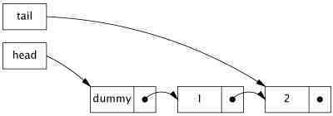
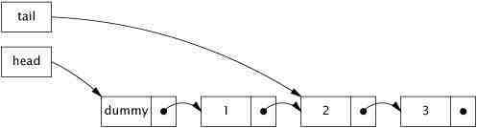
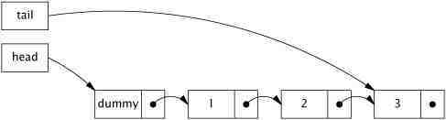
Example 3: Non-blocking Linked List
It is called Michael-Scott non-blocking linked-queue algorithm
Queue insertion:

Slide 79
Example 3: Non-blocking Linked List
normal state
Intermediate state
normal state
Observation: if the queue is in the normal state, tail.next is null.
Click here for a sample program: LinkedQueue.java

Slide 80
How do we prove that the algorithm is correct?

Slide 81
while (true) {
1. Node<E> curTail = tail.get();
2. Node<E> tailNext = curTail.next.get();
3. if (curTail == tail.get()) {
4. if (tailNext != null) {
5. tail.compareAndSet(curTail, tailNext);
6. } else {
7. if (curTail.next.compareAndSet(null, newNode)) {
8. tail.compareAndSet(curTail, newNode);
9. return true;
0. }
}
}
}
1
2
3
4
5
6
7
8
9
0

Slide 82
Thread 1
Thread 2
1
1
2
2
3
3
4
4
5
5
6
6
7
7
8
8
9
9
0
0

Slide 83
Summary
Atomic variables and non-blocking algorithms are the best
It is a lot trickier to design non-blocking algorithms – if you do, you might have an algorithm named after you!

Slide 84

Software Engineering
User Requirements
The species we called programmers
System Implementation

Slide 85
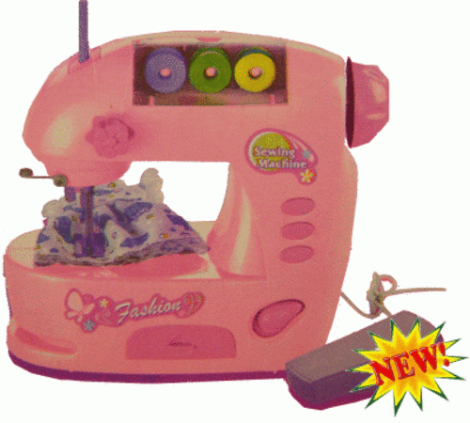
Software Engineering
User Requirements
the magical programming machine
System Implementation
***The synthesis problem (i.e., synthesizing a program from a specification automatically) is undecidable (i.e., there doesn’t exist an algorithm which could solve the problem in finite time).

