Slide 1
50.003: Elements of Software Construction
Week 10
Concurrency: Design and Implementation

Slide 2
Course Plan
Week | Cohort Class 1 | Cohort Class 2 | Cohort Class 3 | Remarks
1 (Jan 22) | Software Development Process
2 (Jan 29) | Software Design and UML |  | Project Meeting I | Problem Set 1
3 (Feb 5) | Software Design and UML |  | Guest Lectures
4 (Feb 12) | Design Patterns |  |  | Problem Set 2. Quiz 1
5 (Feb 19) | Software Testing |  | Project Meeting II
6 (Feb 26) | Software Testing |  |  | Problem Set 3
7 (Mar 5) | Recess |  |  | Problem Set 4
8 (Mar 12) | Software Debugging, Code smells and Maintenance |  | Project Meeting III | Quiz 2
9 (Mar 19) | Concurrency: Requirement |  |  | Problem Set 5
10 (Mar 26) | Concurrency: Design and Implementation |  |  | Problem Set 6; Quiz 3
11 (Apr 2) | Concurrency: Testing |  | Project Meeting IV | Problem Set 7
12 (Apr 9) | Concurrency: Optimization |  |  | Problem Set 8; Quiz 4
13 (Apr 16) | Final Project Presentation (15 minutes for each group) |  |  | Project Report/Code Due
14 (Apr 27) | Final Exam

Slide 3
Thread-Safety
To achieve thread-safety, identify every object (say, of type A) in a program which is shared by multiple threads and make sure type A is thread-safe.

Slide 4
Building Thread-Safe Classes
From scratch
By extending the class
Through client-side locking
Through composition

Slide 5
Design a Thread-Safe Class
The design process for a thread-safe class should include these three basic elements:
Identify the variables that form the object’s state;
Identify the requirements (e.g., invariants, post-conditions) that constrain the state variables;
Establish a policy for managing concurrent access to the objects state.
Implement the policy.

Slide 6
Step 1: Identifying States
An object’s state includes all of its mutable variables
If they are all of primitive type, the fields comprise the entire state.
If the object has fields that are references to other objects, its state will encompass fields from those as well.
Example: MyStack.java

Slide 7
Tips
The smaller this state space, the easier it is to reason about.
Use “final” as long as you can.
public class MyStack {
private final int maxSize;
private long[] stackArray;
private int top;
…
}

Slide 8
Step 2: Identifying Requirements
You cannot ensure thread safety without understanding an object’s specification. Constraints on the valid values or state transitions for state variables can create atomicity and encapsulation requirements.
Example: MyStackThreadSafe.java

Slide 9
Step 3: Designing Policy
Guard each mutable state variable with one lock. Make it clear which lock.
Guard related variables with the same lock.
Example: MyStackThreadSafe.java

Slide 10
Step 4: Implementing Policy
Make sure every access of any variable is guarded by the lock according to the policy.
Make sure access of the related variables in the same method is in synchronized block.
Add waiting (and notify) to handle pre-conditions.
Example: MyStackThreadSafe.java

Slide 11
Cohort Exercise 1
Similarly identify the pre-condition/post-condition of other methods in MyStack.java and make the class thread-safe.
Document what is your locking policy and why.
Apply wait/notify whenever relevant.

Slide 12
Extending the Class
You build a thread-safe class through extending the class if
there is a thread-safe class supporting almost all the operations your want;
and you know the locking policy of the class (so that you can follow the same policy);
and you don’t have the source code.
Example: BetterVector.java

Slide 13
The Problem of Private Locks
Instead of guarding state variables by locking “this”, private locks can be used too.
Example:
public class PrivateLock {
private final Object myLock = new Object();
//@GuardedBy(“myLock”)
Widget widget;
void someMethod() {
synchronized(myLock) {
//Access or modify the state of widget
}
}
}
Private Locks are flexible and risky.

Slide 14
Extending the class
More fragile than modifying the class directly, because the implementation of the synchronization policy is now distributed over multiple, separately maintained source files.
Example: ExtendedPair.java and ExtendedPairWrong.java

Slide 15
Client-side Locking
You can build a thread-safe class through client-side locking if
We don’t have the source code or enough access to the internal state so that we can extend the class.
You know the client’s locking policy (i.e., there are no private locks).

Slide 16
Client-side Locking
Example: Add a method addIfAbsent to Collections.synchronizedList
public class ListHelper<E> {
public java.util.List<E> list =
Collections.synchronizedList(new ArrayList<E>());
}

Slide 17
Question
Is this thread safe?
public class ListHelper<E> {
public java.util.List<E> list =
Collections.synchronizedList(new ArrayList<E>());
public synchronized boolean putIfAbsent(E x) {
boolean absent = !list.contains(x);
if (absent) {
list.add(x);
}
return absent;
}
}
Wrong! Correct example: ListHelper.java

Slide 18
Cohort Exercise 2
Assume that multiple threads may call the static methods defined in FirstExample.java. Refer to the next slide for a particular problem of the implementation. Fix the program.

Slide 19
Hint
public static Object getLast(Vector list) {
int lastIndex = list.size() - 1;
return list.get(lastIndex);
}
public static void deleteLast(Vector list) {
int lastIndex = list.size() - 1;
list.remove(lastIndex);
}
Thread A
size:10
get(9)
Thread B
size:10
remove(9)

Slide 20
Client-Side Locking
Even more fragile than extending the class because it distributes the locking policy for a class into classes that are totally unrelated.
Modifying the class: keeps the locking code in the same class
Extending the class: distributes the locking code in the class hierarchy

Slide 21
Composition
It is less fragile if list is accessed only through improvedList.
It doesn’t care whether list is thread-safe or not.
It adds performance penalty due to the extra layer of synchronization.
Example: ImprovedList.java

Slide 22
Cohort Exercise 3
Write a thread-safe class named SafeStack which extends java.util.Stack<E> with two operations pushIfNotFull(E e) and popIfNotEmpty().

Slide 23
Documenting
Documentation is one of the most powerful tools for managing thread safety.
Document a class’s thread safety guarantees for its clients; document its locking policy for its maintainers.

Slide 24
The above methods assume that the only way to access the state in the class is through calls of visible methods.

Slide 25
Instance Confinement
Is the following class thread-safe?
public class MyStack {
private final int maxSize;
private long[] stackArray;
public int top;
//invariant: top < stackArray.length && top >= -1
…
//all methods are synchronized.
}

Slide 26
Encapsulating Data
Identify the intended scope of objects
To a class instance (e.g., a private data field)
To a lexical scope (e.g., a local variable)
To a thread (e.g., an object which is not supposed to be shared across threads)
Instance confinement is one of the easiest ways to build thread-safe classes

Slide 27
Encapsulating Data
Make sure the objects don’t escape their scope
Bad Example 1:
public class MyStack {
private final int maxSize;
public long[] stackArray;
private int top;
//top < stackArray.length && top >= -1
…
}

Slide 28
Encapsulating Data
Make sure the objects don’t escape their scope
Bad Example 2:
public class MyClass {
//guard by “this”
private String[] states = new String[]{…};
private int size = states.length;
public synchronized String[] getStates() {
return states;
}
}
Example: PersonSet.java

Slide 29
Cohort Exercise 4
Assume a taxi tracking system which tracks taxis in Singapore. The updater threads would modify taxi locations and the view thread would fetch the locations of the taxis and display them. Examine Tracker.java (shared by the updater thread and the view thread) and make it thread-safe. Ensure instance confinement.

Slide 30
Publishing State Variables
When is it safe to publish state variables?
If a state variable is thread-safe, does not participate in any invariant that constrain its value, and has no prohibited state transitions for any of its operations, then it can be safely published.
It still might not be a good idea, since publishing mutable variables constrains future development and opportunities for sub-classing.

Slide 31
Example: PublishingTracker.java
Assuming that there is no additional constraints on vehicle locations, other than that they must be this given pair.
PublishingTracker delegates its thread-safety to ConcurrentHashMap and Point.

Slide 32
Delegating Thread Safety
If a class is composed to multiple independent thread-safe state variables, then it can delegate thread safety to the underlying state variables.
If a class has invariants the relate its state variables, then delegation may not work.

Slide 33
Remedy for Deadlock
A program that never acquires more than one lock at a time cannot experience lock-ordering deadlocks.

Slide 34
Remedy for Deadlock
A program will be free of lock-ordering deadlocks if all threads acquire the locks they need in a fixed global order.
Is this deadlocking? Thread A locks a, b, c, d, e in the sequence and thread B locks c, f, e.
Is this deadlocking? Thread A locks a, b, c, d, e in the sequence and thread B locks e, f, c.
public void transferMoney (Account from, Account to) {
synchronized (from) {
synchronized (to) {
……
}
}
}
Click here for a sample program: TransferFixed.java

Slide 35
Avoid Deadlocks
Strive to use open calls (calling a method with no locks held) throughout your program
Sample program: DLExampleFixed.java

Slide 36
Avoid Deadlocks
Use the timed tryLock feature of the explicit Lock class instead of intrinsic locking.
Sample program: Trylockexample.java

Slide 37
Cohort Exercise 5
Fix DiningPhil.java by making it deadlock-free, in two different ways.

Slide 38
Requirements Satisfied
Multi-thread programs have at least the following additional requirements.
No race condition
No visibility issue
No execution ordering problem
No deadlocks
Efficiency! (to be “solved” in week 12)

Slide 39
Summary
It is the mutable state, stupid.
Make fields final unless they need to be mutable.
Immutable objects are automatically thread-safe.
Encapsulation makes managing complexity practical.
Guard each mutable with a lock.
Guard all participants of an invariant with the same lock.
Hold locks for the duration of compound actions.
Any program that accesses a mutable from multiple threads without synchronization is a broken program.
Never rely on clever reasoning on why you do not need. synchronization in those situations.
Include thread safety into the design process or explicitly document that your class is (intentionally) not thread-safe.
Document your synchronization policy.

Slide 40
Building blocks

Slide 41
Concurrency-Related Library
Synchronized Collections
Concurrent Collections
Synchronizers (next week)

Slide 42
Synchronized Collections
Some of the older (jdk2) collections are synchronized and thus thread-safe.
Vector: http://hg.openjdk.java.net/jdk7/jdk7/jdk/file/00cd9dc3c2b5/src/share/classes/java/util/Vector.java
Hashtable
Collections.synchronizedXxx
These are essentially built with

Slide 43
Synchronized Classes
Why is this not ideal?
It is not efficient if list is big and/or doSomething() is slow.
public static void doSomething (Vector list) {
synchronized (list) {
for (int i = 0; i < list.size(); i++) {
doSomething(list.get(i));
}
}
}
Vector is considered a “legacy” collection class. “Modern” collection
Classes use Iterator.

Slide 44
Example
What could happen to the following code if widgetList is accessed by multiple threads?
***Internally, javac generates code that uses an Iterator, repeatedly calling hasNext and next to iterate the list. If a modification count (associated with the collection) changes during iteration, hasNext or next throws ConcurrentModificationException. This is called fail-fast.
List<Widge> widgeList = Collections.synchronizedList(new ArrayList<Widget>());
…
for (Widget w : widgetList) {
doSomething(w);
}

Slide 45
Hidden Iterator
Lock everywhere a shared collection might be iterated.
class HiddenIterator {
private final Set<Integer> set = new HashSet<Integer>();
public synchronized void add(Integer i) { set.add(i); }
public synchronized void remove (Integer i) { set.remove(i); }
public void addTenThings() {
Random r = new Random();
for (int i = 0; i < 10; i++) {
add(r.nextInt());
}
System.out.println ("DEBUG: added ten elements to " + set);
}
}

Slide 46
Discussion
Problems with locking a collection
If the collection is large or the task performed is lengthy, other threads could wait a long time.
It increases the risk of problems like deadlock.
The longer a lock is held, the more likely it is to be contended.
Alternative?
Clone the collection, lock and iterate the copy.
Week 12: How about designing concurrent collections without ever using locks?

Slide 47
Concurrent Collections
Java 5.0 improves on the synchronized collection by providing several concurrent collection classes.
Replacing synchronized collections with concurrent collections can offer dramatic scalability improvement with little risk.

Slide 48
ConcurrentHashMap
It is a HashMap designed for concurrency.
It uses a finer-grained locking mechanism called lock striping.
Uses an array of 16 locks.
Each lock guards 1/16 of the hash buckets.
Bucket N is guarded by lock N mod 16.
The iterators returned by ConcurrentHashMap are weakly consistent (i.e., it is OK to modify the collection while iterating through it) instead of fail-fast.
It cannot be locked for exclusive access.

Slide 49
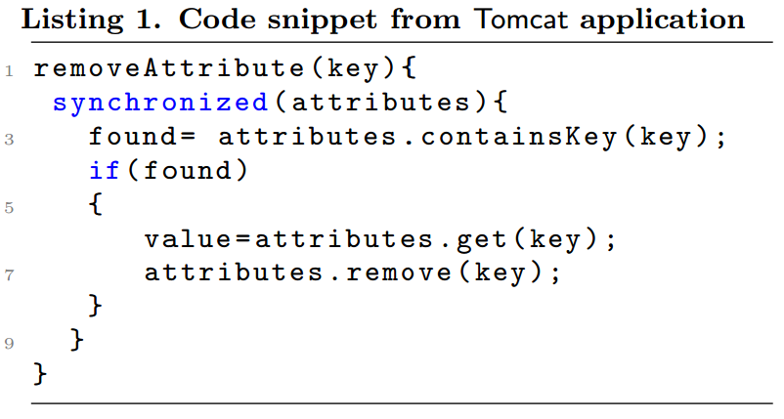
One Case
Tomcat Bug: 53498
https://bz.apache.org/bugzilla/show_bug.cgi?id=53498
The fix
Any problem?

Slide 50
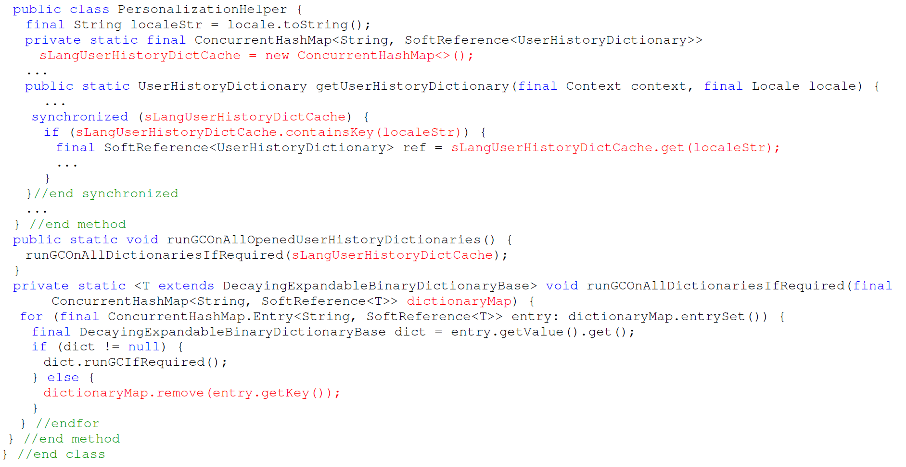
Another Case

Slide 51
CopyOnWriteArrayList
It is a concurrent replacement for a synchronized list that offers better concurrency in some common situations.
A new copy of the collection is created and published every time it is modified.
All write operations are protected by the same lock and read operations are not protected.

Slide 52
CopyOnWriteArrayList
http://grepcode.com/file/repository.grepcode.com/java/root/jdk/openjdk/6-b14/java/util/concurrent/CopyOnWriteArrayList.java#CopyOnWriteArrayList.setArray%28java.lang.Object%5B%5D%29
When is this probably not efficient?

Slide 53
BlockingQueue
Producer-Consumer patterns are very common in programs; Usually some kind of buffering is involved between P and C; The buffer can be implemented as a blocking queue.
Blocking queues are a powerful resource management tool for building reliable applications: they make your program more robust to overload by throttling activities that threaten to produce more work than can handled.

Slide 54
Cohort Exercise 6
Analyze GDesktopProb.java which implements the skeleton of Google Desktop. There is some potential problem regarding thread-safety of the implementation. Fix it.

Slide 55
FutureTask
Future task are made up of Future and Callable, the result bearing relative of Runnable.
There are several ways to complete:
Normal completion; cancellation; and exception.
Once a FutureTask is completed in cannot be restarted.
Future.get() returns the result immediately if ‘the future is here’ (Task is completed) and Blocks if the task is not complete yet.
Sample program: FutureTaskExample.java; FutureTaskExample2.java;

Slide 56
Example
Nearly every server application uses some form of caching.
Poor concurrency
Click here for a sample program: Cache.java
Is it good to have the cache in this case?
Thread A:
L | service(a) | U
Thread B:
L | service(b) | U
L | Return cache(a) | U
Thread C:
Click here for a sample program: CacheV1.java

Slide 57
Example
Minor problem
service(a)
not in cache
compute
service(a)
add service(a)
to cache
Thread A
Thread B
service(a)
not in cache
compute
service(a)
add service(a)
to cache
This is a big problem if factor(a) is required to execute once-and-only-once.
Click here for a sample program: CacheV2.java

Slide 58
Example
Minor problem
service(a)
not in cache
put Future
in Cache
compute
service(a)
set result
Thread A
service(a)
not in cache
put Future
in cache
compute
service(a)
set result
Thread B
This is a big problem if factor(a) is required to execute once-and-only-once.

Slide 59
Cohort Exercise 7
Fix the minor problem on the previous slide. Notice that you can’t apply client-side locking on ConcurrentMap.
How do we make sure that factor(a) is executed once only for any a?

