Slide 1
50.003: Elements of Software Construction
Concurrency: Testing

Slide 2
Course Plan
Week | Cohort Class 1 | Cohort Class 2 | Cohort Class 3 | Remarks
1 (Jan 22) | Software Development Process
2 (Jan 29) | Software Design and UML |  | Project Meeting I | Problem Set 1
3 (Feb 5) | Software Design and UML |  | Guest Lectures
4 (Feb 12) | Design Patterns |  |  | Problem Set 2. Quiz 1
5 (Feb 19) | Software Testing |  | Project Meeting II
6 (Feb 26) | Software Testing |  |  | Problem Set 3
7 (Mar 5) | Recess |  |  | Problem Set 4
8 (Mar 12) | Software Debugging, Code smells and Maintenance |  | Project Meeting III | Quiz 2
9 (Mar 19) | Concurrency: Requirement |  |  | Problem Set 5
10 (Mar 26) | Concurrency: Design and Implementation |  |  | Problem Set 6; Quiz 3
11 (Apr 2) | Concurrency: Testing |  | Project Meeting IV | Problem Set 7
12 (Apr 9) | Concurrency: Optimization |  |  | Problem Set 8; Quiz 4
13 (Apr 16) | Final Project Presentation (15 minutes for each group) |  |  | Project Report/Code Due
14 (Apr 27) | Final Exam

Slide 3
Testing Sequential Program
int previousMax;
0. public int max (int[] list) {
1. int max = list[0];
2. for (int i = 1; 3. i < list.length; 4. i++) {
5. if (max < list[i]) {
6. max = list[i];
7. }
8. }
9. previousMax = max;
10. return max;
11. }
0
list = …
1
max = list[0]
2
i = 1
i >= list.length
9
3
previous=max
i < list.length
i++
return max
10
4
5
max >= list[i]
max < list[i]
…
11
8
7
6
max = list[i]

Slide 4
Test Execution
With input = [2,4]
0
1
2
3
5
6
10
9
3
4
8
7
11
…
i
: a configuration of the program with control at line i

Slide 5
Test Execution
With input = [4,2]
0
1
2
3
5
10
9
3
4
8
7
11
…
i
: a configuration of the program with control at line i

Slide 6
Testing
For sequential programs,
Finding the right inputs
For concurrent programs,
Finding the right inputs and scheduling
To be able to generate more scheduling, we could use Thread.sleep(), and synchronizers.

Slide 7
Synchronizers
A synchronizer is an object that coordinates the control flow of threads based on its state.
Semaphore
CyclicBarrier
CountDownLatch
Phaser

Slide 8
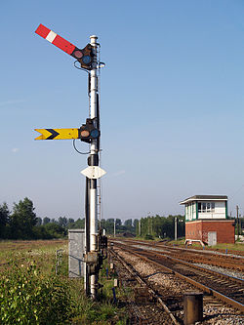
Semaphores
A semaphore maintains a set of permits. Each acquire() blocks if necessary until a permit is available, and then takes it. Each release() adds a permit, potentially releasing a blocked acquirer.
Thread A
Thread B
Thread C
Semaphore
(with 2 permits)
Example: SemaphoreExample.java

Slide 9
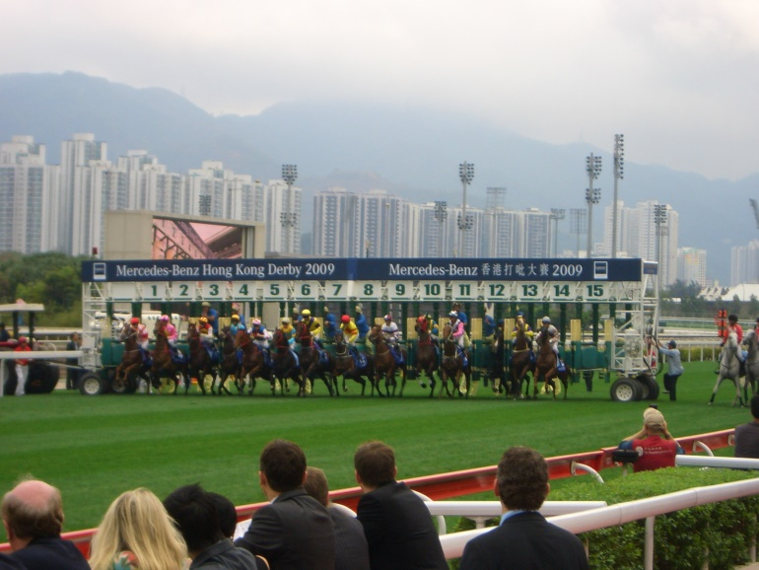
Cyclic Barriers
A synchronization aid that allows a set of threads to all wait for each other to reach a common barrier point. The barrier is often called cyclic because it can be re-used after the waiting threads are released.
Thread A
Thread B
Thread C
Barrier
Click here for a sample program: BarrierExample.java

Slide 10
Cohort Exercise 1
Given MyCyclicBarrier.java, complete method await() such that you can replace CyclicBarrier in BarrierExample.java with MyCyclicBarrier without changing its behaviour.

Slide 11
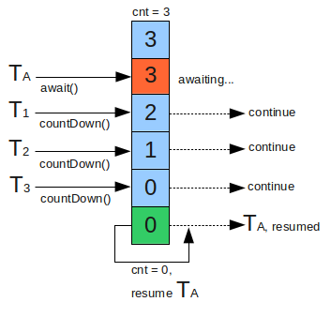
CountDownLatch
A synchronization aid that allows one or more threads to wait until a set of operations being performed in other threads completes.
Click here for a sample program: CountDownLatchExample.java

Slide 12
Cohort Exercise 2
Given an (large) array of strings (of grades), write a multi-threaded program, using CountDownLatch, to check whether the array contains 7 “F”. Stop all threads as soon as possible.

Slide 13
Phaser
Phaser (introduced in Java 7)
A reusable synchronization barrier, similar in functionality to CyclicBarrier and CountDownLatch but supporting more flexible usage.
Sample program: PhaserExample.java

Slide 14
Cohort Exercise 3
Draw the state machine diagram for a Phaser object.
A state should be identified by three numbers: the phase number, the number of registrations, the number of arrivals. For simplicity, limit the numbers to maximum 2.
The transitions should be labelled with methods in the class.

Slide 15
Barrier vs Latch vs Phaser
CountDownLatch
Created with a fixed number of threads
Cannot be reset
Allow threads to wait (method await) or continue with its execution (method countdown())
Cyclic Barrier
Can be reset.
Does not provide a method for the threads to advance. The threads have to wait till all the threads arrive.
Created with fixed number of threads.
Phaser
Number of threads need not be known at Phaser creation time. They can be added dynamically.
Can be reset and hence is, reusable.
Allows threads to wait (method arriveAndAwaitAdvance()) or continue with its execution(method arrive()).
Supports multiple Phases.

Slide 16
Testing for Concurrency
Testing for correctness
Safety: nothing bad ever happens
Liveness: something good eventually happens (e.g., no deadlock)
Testing for performance
Throughput: the rate at which a set of concurrent tasks is completed
Responsiveness: the delay between a request and completion of some action
Notes:
If my testing goal: my insertion will never fail. Never throw run time exception. Nothing bad every happens. Refers to assertion violation, run time exception. There is another set of problems. Something good happens. You will be always safe. One typical example that you’ve seen is deadlock. You should make sure that your program would not deadlock. So that’s a typical example of liveness. We will be focusing on safety problems.
In terms of testing for programs, that is efficiency. The point of having multiple threads is to do things more efficient. Whether it is true or not. Sometimes, it may not be the case. If you don’t, if you are not careful with your login policy. You should be able to write a test case whether my program has improved. In terms of performance like throughput. Within certain time. And then responsiveness. Or delay in terms of accomplishing a certain task. So far we have been focusing on data structures which are more efficient.
More operations in the same class more efficiently.

Slide 17
Step 1: Identifying Specification
You must know what is correct.
Identify
class invariants which specify relationships among the variables;
pre/post-conditions for each method;
whether the class is thread-safe and how its states guarded
Sample program: BoundedBufferWithSpec.java
Notes:
Class invariants: post conditions for each and every method. Your login policy.

Slide 18
Step 2: Basic Unit Tests
Create an object of the class, call its methods (in different sequences with different inputs) and assert post-conditions and invariants.
Sample program: BoundedBufferTest.java
Test: testIsEmptyWhenConstructued()
Notes:
Unit test are test cases you build whenever you finish one task. Each and every method implementing the task and sequences of methods caused when doing the task. If I provide certain task input to these methods. Whether theses post conditions should be satisfied. None of your test cases would be violating the precondition of any method. Precondition assumed to be always satisfied.

Slide 19
Step 3: Test for Concurrency
Set up multiple threads performing operations over some amount of time and then somehow test that nothing went wrong
Mind that the test programs are concurrent programs too!
It’s best if checking the test property does not require any synchronization
Sample program: BoundedBufferTest.java
Test: testIsFullAfterPuts()
Notes:
Perform operations over the shared test somehow. Do mind that in this setting, since you have to create multiple tests, the test cases get more complicated. There you will get into the same set of problems that you do in multivariable. Your test conditions might go to conditions. It shouldn’t be a bug due to test case but due to original problems. What are the issues with multivariable programs?
Scheduling. We want to test the program with different schedules. You should be test your program on scheduling which may happen in real life. Which you actually run the program. The test result may not be useful. I never really tested the kind of scheduling which will actually happen. Well you might be able to do the principle where we observe animals in nature, testing multi-threaded program. Avoid multi-synchronization locking in the original program. Avoid introducing more loss into your test cases. The scheduler has to cater for your locking in your test cases.
Let me give you some example; the same bounded buffer example.

Slide 20
Cohort Exercise 4
Given BoundedBufferTest.java,
write two more test cases (with threads)
document what you are testing for.

Slide 21
Additional Synchronization
Example: how do we test that everything put into the buffer comes out of it and that nothing else does, assuming there are multiple producers and consumers?
A naïve approach: maintain a “shadow” list and assert that the buffer is consistent with the “shadow” list
Use a check sum function would be better (see example later)
Notes:
You want to avoid introducing any synchronization in test cases, because it messes up with scheduling. Likely scheduling you get with test case would be different then if you are running program without test cases. Whether I introduce an in is to achieve whether you maintain a shadow list. I need to know what are the elements that you inserted in. But then remember this is a multithreaded test case. The data structure that you use to insert into a buffer is a data structure shared by multiple threads. Must be thread safe. You find that whatever is in the bounded buffer is different in shadow list. It is shadow list that is subject to race conditions because you are wasting your effort. You are debugging test program rather than actual.
Do not use it, you need to add in additional synchronization. We use check sum. To maintain synchronization, we try to use checksum. Take the sum of all the elements that are circulated. That’s a much simpler data structure to maintain. To maintain the buffer 35 I get 8. I could look at all elements in the buffer, take their sum and compare sum with the sum they are expecting. While it would not be perfect, and then the actual number happens to be 4 and 4. Say the chances up there is quite low. The point is to use the check sum, I have a simple data structure to maintain in test program, and will not require synchronization. Only synchro is in your program. Your scheduling would run with the similar scheduling that you have in practice.

Slide 22
Example
Some test data should be generated randomly
Random number generator can create couplings between classes and timing artifacts because most random number generator classes are thread-safe and therefore introduce additional synchronization.
Use pseudo-random number generator
static int xorShift (int y) {
y ^= (y << 6);
y ^= (y >>> 21);
y ^= (y << 7);
return y;
}
Notes:
Another problem is to test if in the bounded buffer. The actual numbers. What numbers to put into the buffer. Readily generate integers and put it into the bounded buffer. The remnant class is thread safe and that’s daring scenario as once you see it is thread safe, you are implementing it with the locking synchronization in place. You are not introducing synchronization. Mess up when you run the program.
We use a pseudo number generator. With any input integer, does function of shifting as a result. Whatever number you get is completely random (pseudo). Even for such little details, you want to avoid additional synchronization which does not require any synchronization. Show an example to see if test in the buffer are the same number I put it in.

Slide 23
Example
Click here for a sample program: PutTakeTest.java

Slide 24
Generating More Scheduling
Test with more active threads than CPUs
Testing with different processor counts, operating systems, and processor architectures
Encourage context switching using Thread.yield() or Thread.sleep(10)
Public synchronized void transfer (Account from, Account to, int amount) {
from.debit(amount);
if (random.nextInt(1000) > THREADHOLD) {
Thread.yield();
}
to.credit(amount);
}

Slide 25
Testing Blocking Operations
How do we test that an operation has been blocked (in a concurrent context)?
Click here for a sample program: BoundedBufferTest.java
Test: testTakeBlocksWhenEmpty()

Slide 26
Step 4: Testing for Performance
Identify appropriate test scenarios – how the class is used
Sizing empirically for various bounds, e.g., number of threads, buffer capabilities, etc.
Click here for a sample program: TimedPutTakeTest.java
TimedPutTakeTestABQ; TimedPutTakeTestLBQ.java

Slide 27
Cohort Exercise 5
Design a test to compare the performance difference between Collections.synchronizedMap and ConcurrrentHashMap.

Slide 28
Beyond Testing
Code review (e.g. Team Explorer)
Static analysis (e.g. Coverity Scan, and Facebook Infer)
Symbolic execution (e.g. KLEE, and Microsoft SAGE)
Model checking (e.g. SPIN, Uppaal, and Microsoft Static Analyzer)
Theorem proving (e.g. Coq and PVS)

