Slide 1
50.003 Elements of Software Construction

Slide 2
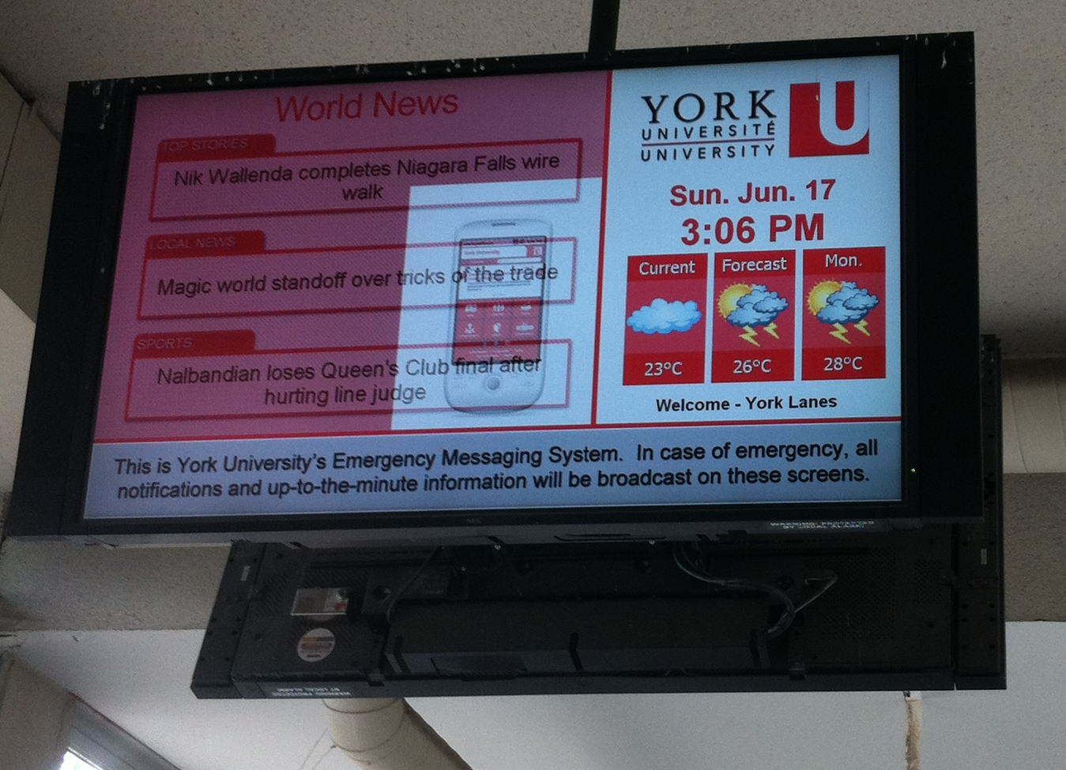
Instructor: Sun Jun
Sun Jun
Father of Two
Computer Scientist
Likes Algorithms
Vulcan Type
Office: 1.302-11
sunjun@sutd
weChat: sunjunprof

Slide 3

Instructor: Sudipta Chattopadhyay
Likes formula, logic, code, hardware and anything related to computer systems
Likes Soccer
(Sometimes) speaks fast, loud, non-stop
Find out more at
http://sudiptac.bitbucket.io/
Emailsudipta_chattopadhyay@sutd.edu.sg
Office: 1.702-14

Slide 4
Teaching Assistant
Pham Hong Long
Third Year PhD Student in ISTD
Like coding and algorithms
Research topic: program analysis, program verification, software engineering
Email: honglong_pham@mymail.sutd.edu.sg

Slide 5
Teaching Assistant
Sridhar Adepu
Second year PhD student
Likes running and hiking
Research interests: cyber physical systems security
Email: adepu_sridhar@mymail.sutd.edu.sg

Slide 6
Teaching Assistant
Koh En Yan
Second year PhD student
Likes singing and Kdrama
Research interests: music information retrieval
Email: enyan_koh@mymail.sutd.edu.sg

Slide 7
Course Plan
Week | Cohort Class 1 | Cohort Class 2 | Cohort Class 3 | Remarks
1 (Jan 22) | Software Development Process |  | Guest lecture
2 (Jan 29) | Software Design and UML |  | Project Meeting I | Problem Set 1
3 (Feb 5) | Software Design and UML
4 (Feb 12) | Design Patterns |  |  | Problem Set 2. Quiz 1
5 (Feb 19) | Software Testing |  | Project Meeting II
6 (Feb 26) | Software Testing |  |  | Problem Set 3
7 (Mar 5) | Recess |  |  | Problem Set 4
8 (Mar 12) | Software Debugging, Code smells and Maintenance |  | Project Meeting III | Quiz 2
9 (Mar 19) | Basics of Concurrency: Threads, Synchronization, Sockets |  |  | Problem Set 5
10 (Mar 26) | Thread Safe Java Class |  |  | Problem Set 6; Quiz 3
11 (Apr 2) | Testing Concurrent Programs |  | Project Meeting IV | Problem Set 7
12 (Apr 9) | Performance |  |  | Problem Set 8; Quiz 4
13 (Apr 16) | Final Project Presentation (15 minutes for each group) |  |  | Project Report/Code Due
14 (Apr 27) | Final Exam

Slide 8
Components
Problem Sets – 20%
Quizzes – 10%
Course Project – 40%
Project Meetings 1, 2, 3, 4 (each 5%)
Final presentation, demo and report (20%)
Final Exam – 30%
The project weights more than the exam.

Slide 9
Course Project
You and your team will form a software company.
Your company will develop a product
Client is SUTD
Client is IBM
Project descriptions
See edimension (“/Project” folder)
You have only three months!

Slide 10
More on Project
For each project meeting, each group submits a short report in class to the instructor
Project Meeting 1 (5%)
At least five use cases of your product (informal, such as via a sketch board, is OK) 2%
Clarification of doubts or gaps in the requirement 1%
Development Process, Constraints and risks 1%
Project timeline and distribution of workloads 1%
You have only three months!

Slide 11
More on Project
Project Meeting 2 (5%)
Any changes in requirement (compared to 1st meeting) 0.5%
Formal documentation of use cases 1%
Initial design (at least class diagrams and preferably more) 1%
Implementation of some basic features (demo) 1%
Testing plan 1%
Commit records to show workload distribution 0.5%
You have only three months!

Slide 12
More on Project
Project Meeting 3 (5%)
Any changes in requirement and design (compared to 2nd meeting) 0.5%
(Almost) complete design 1%
Implementation of additional features (over last meeting) in your product (demo) 2%
Implementation of some tests (demo) 1%
Commit records to show workload distribution 0.5%
You have only three months!

Slide 13
More on Project
Project Meeting 4 (5%)
Any changes in requirement, design and implementation (compared to 3rd meeting) 0.5%
Implementation of most features in your product (demo) 1.5%
Implementation of unit tests (demo) 1%
Implementation of some system tests (demo) 1%
Commit records to show workload distribution 1%
You have only three months!

Slide 14
More on Project
Final presentation and demo (20%)
15 minutes presentation that includes demo of the product and how it was tested (5%)
Report and code (one per group, 10%)
Includes final requirement, design, implementation structure, test structure, challenges faced and how they were resolved
A github (or similar) repository link for the project source code
Individual report on your contribution to the project (5%)
You have only three months!

Slide 15
Miscellaneous
Course Website:
Will be on eDimension
Office Hour: Fridays 15:00 – 16:00

Slide 16
Cohort Exercise 1 (10 Min)
Find your group and sit together.
Say hello to each other.
Come up with a name for your app company.
Discuss how you plan to finish it before the deadline.

