Slide 1
Introduction to UML 2
Elements of Software Construction
Week 3

Slide 2
Exercise 0 (10 minutes)
Read the system requirement in the file telenetwork.pdf

Slide 3
Use Case Diagrams
A diagram that shows a set of use cases and actors and their relationships.
Use case diagrams represent system functionality, the requirements of the system from the user’s respective.

Slide 4
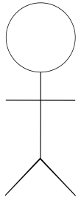
Actors
Actors are the people or systems that provide or receive information from the system; they are among the stakeholders of a system, which could be human beings, other systems, timers and clocks or hardware devices.
Actors that stimulate the system and are the initiators of events are called primary actors (active). Actors that are only receive stimuli from the system are called secondary actors (passive).

Slide 5
Exercise 1
Make a Call
Who are the primary and secondary actors?

Slide 6
Exercise 2
Send Dialtone
Who are the primary and secondary actors?

Slide 7
Who are the Actors?
Actors
Who/what will be interested in the system?
Any human interested in making telephone calls
Who/what will want to change the data in the system?
The switch
Who/what will want to interface with the system?
The telephones, The switch
Who/what will want information from the system?
The telephone network operators

Slide 8
Use Case in Use Case Diagrams
Use Case
Is a description of a set of sequences of actions, including variants, that system performs that yields an observable value to an actor.
Should ideally begin with a verb.
Make a Call

Slide 9
Notations: between Use Cases
include
Specifies that the source use case explicitly incorporates the behaviors of another use case at a location specified by the target
extend
Specifies that the target use case extends the behaviors of the source
<<include>>
<<extend>>

Slide 10
Use Case Diagram: Example
Report Error
<<include>>
Check Dialled Number
<<extend>>
Record
Dialled
Number

Slide 11
Use Case Diagram: Example
Send Ringtone
<<precedes>>
Acknowledge Call Request
<<precedes>>
Establish Connection
Switch
Notes:
The <<precedes>> paradigm captures which use-case is a pre-condition of another use-case.

Slide 12
Granularity of Use Cases
Send Message to Subscriber
Send
Ringtone
Switch
Send
Dialtone
Send
Busytone
Generally, a use case should embody sufficient levels of granularity without which the use case may not be rendered as useful.
Notes:
Say that managing references include add, delete and reorder.

Slide 13
Cohort Exercise 3 (10 minutes)
Draw the use case diagram for the subscribers in Telephone Network System. Pay attention to the granularity of use cases.

Slide 14
Cohort Exercise 4 (15 minutes)
Draw the use case diagram for the Telephone switch in the Telephone Network System. Combine it with the use cases involving subscribers. Pay attention to the granularity of use cases.

Slide 15
Misuse cases
Use cases only capture how a system is used
Use cases do not consider adversarial scenarios
Abusing system functionality
Hacking and malfunctioning
In general, any non-functional requirement, especially security
Clients and customers are unlikely to provide misuse cases
The onus is on the software engineers

Slide 16
Misuse cases: Example
Consider an e-commerce website where arbitrary users can purchase different items
The actors can be
Customer
System

Slide 17
Use Case Diagram: Online Purchase
Purchase Item
User or
System
Notes:
The <<precedes>> paradigm captures which use-case is a pre-condition of another use-case.

Slide 18
Misuse Case : Online Purchase
Deny Purchase
Purchase Item
Threatens
Customer
User or
System
Notes:
The <<precedes>> paradigm captures which use-case is a pre-condition of another use-case.

Slide 19
Misuse Case : Online Purchase
Deny Purchase
Purchase Item
Threatens
Prevent
Customer
Digital Signature
Security Control
Includes
User or
System
Notes:
The <<precedes>> paradigm captures which use-case is a pre-condition of another use-case.

Slide 20
Misuse Case : Online Purchase
Deny Purchase
Purchase Item
Threatens
Prevent
Customer
Digital Signature
Threatens
Steal User Info
Security Control
Includes
User or
System
Hackers
Notes:
The <<precedes>> paradigm captures which use-case is a pre-condition of another use-case.

Slide 21
Misuse Case : Online Purchase
Deny Purchase
Purchase Item
Threatens
Prevent
Customer
Digital Signature
Threatens
Steal User Info
Security Control
Includes
User or
System
Encrypt Request
Prevent
Includes
Hackers
Notes:
The <<precedes>> paradigm captures which use-case is a pre-condition of another use-case.

Slide 22
Misuse Case : Online Purchase
Deny Purchase
Purchase Item
Threatens
Prevent
Customer
Digital Signature
Threatens
Steal User Info
Security Control
Includes
User or
System
Encrypt Request
Prevent
Includes
Threatens
Change User info
Hackers
Notes:
The <<precedes>> paradigm captures which use-case is a pre-condition of another use-case.

Slide 23
Misuse Case : Online Purchase
Deny Purchase
Purchase Item
Threatens
Prevent
Customer
Digital Signature
Threatens
Steal User Info
Security Control
Includes
User or
System
Encrypt Request
Prevent
Includes
Threatens
Includes
Change User info
Prevent
Authentication
Hackers
Notes:
The <<precedes>> paradigm captures which use-case is a pre-condition of another use-case.

Slide 24
Misuse Case Diagram: Example
Denial of Service Attack
Purchase Bitcoin
Brute force Password Attack
Hackers
User or
System
Exploit System vulnerability
Send malicious update
Notes:
The <<precedes>> paradigm captures which use-case is a pre-condition of another use-case.

Slide 25
Misuse Case Diagram: Example
Denial of Service Attack
Purchase Bitcoin
Brute force Password Attack
Monitor network
Hackers
User or
System
System Patch
Exploit System vulnerability
Monitor login attempts
Send malicious update
Notes:
The <<precedes>> paradigm captures which use-case is a pre-condition of another use-case.

Slide 26
Cohort Exercise 5 (10 minutes)
Complete the misuse case diagram for Telephone Network System. Assume the presence of a malfunctioning telephone switch in the network. Incorporate at least two misuse cases. Assume periodic network scan to detect such malfunctioning switch.

Slide 27
Cohort Exercise 6
Consider a swarm of robots where a user can control any robot via mobile. Each robot can communicate to the user or to another robot. A hacker can affect the system by injecting a malware in the mobile or tapping on the communication between robots (e.g. modifying or delaying packets sent through the network). Draw the combined use-misuse case diagram for the system. Integrate anti-malware and network monitoring as security solutions for blocking attackers.

Slide 28
Sequence Diagram
A sequence diagram is an interaction diagram that highlights the order in which the messages are exchanged.
Sequence diagram complements a use case with details on the workflow of events.

Slide 29
Lifelines
lifeline notation elements are placed across the top of the diagram. Lifelines represent either roles or object instances that participate in the sequence being modeled.
S1: Subscriber
An object named S1 of type Subscriber.

Slide 30
Messages
To show an object (i.e., lifeline) sending a message to another object, you draw an arrow to the receiving object.
S1: Subscriber
T1: Switch
S2: Subscriber
Lift_Receiver()
Send_Dialtone()
Dial_Number(N1)
Check_Number(N1)
Valid_number()
Send_Ringtone()
Optional Messages are put dotted.

Slide 31
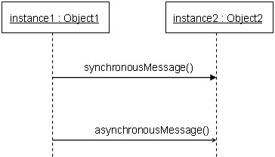
Arrows and Orders
A solid arrowhead if a synchronous call operation
A stick arrowhead if an asynchronous signal
The order of the messages is defined two rules:
On the same lifeline, a higher message precedes a lower message
Message sending precedes message receiving
Notes:
Ask the difference between synchronous and asynchronous call? Say that caller has to wait when a synchronous signal is sent.

Slide 32
Synch and Asynch Messages
S1: Subscriber
T1: Switch
S2: Subscriber
Lift_Receiver()
Send_Dialtone()
Synchronous
Dial_Number(N1)
Check_Number(N1)
validity
Send_Ringtone()
Asynchronous
Send_Waittone()

Slide 33
Cohort Exercise 7 (10 minutes)
Draw the sequence diagram for the telephone network in following scenarios (Refer to the diagram):
S1 makes a call to S2
While S1->S2 call in process, S3 makes a call to S2
S1->S2 call is established
Since S2 is busy, outgoing call by S3 is refused
S3 hangs up
S1 hangs up
S2 hangs up

Slide 34
Alternatives
Assume that a subscriber may dial a valid or invalid phone number. The messages exchanged for a valid or invalid phone number might be different.

Slide 35
Alternatives
S1: Subscriber
T1: Switch
S2: Subscriber
Lift_Receiver()
Send_Dialtone()
Dial_Number(N1)
Check_Number(N1)
validity
Alt
Send_Ringtone()
[validity == true]
Send_Waittone()
[else]
Send_error()

Slide 36
Loops
Assume that a subscriber has a record of phone numbers (each phone number can be valid or invalid). We need a sequence diagram where the subscriber make a call to each phone number in her record.

Slide 37
Loops
S1: Subscriber
T1: Switch
S2: Subscriber
Loop
[Has_another_number == true]
Get_another_Number(N1)
Dial_Number(N1)
Check_Number(N1)
validity
Alt
Send_Ringtone()
[validity == true]
Send_Waittone()
[else]
Send_error()
Has_another_number ()

Slide 38
Timeout
Timeout messages might be incorporated if certain messages occur only after a specific time interval is elapsed.

Slide 39
Timeout
S1: Subscriber
T1: Switch
S2: Subscriber
Lift_Receiver()
Send_Dialtone()
Dial_Number(N1)
Check_Number(N1)
validity
Send_Ringtone()
Send_Waittone()
Timeout (1 sec)
Hangup

Slide 40
Cohort Exercise 8 (10 minutes)
Draw the sequence diagram for the telephone network in following scenarios (Refer to the diagram):
S1 makes a call to S2
S3 makes a call to S2
If S1 receives waittone message in 1 second, then S1->S2 call is established
Otherwise, S1 is refused to connect to S2
S1 hangs up

Slide 41
Parallel
A telephone switch needs to handle multiple heterogeneous messages at the same time. For instance, consider the case when it receives messages from a subscriber and from a remote switch at the same time.

Slide 42
Parallel (Scenario 1)
S1: Subscriber
T1: Switch
S2: Subscriber
Lift_Receiver()
Send_Dialtone()
Dial_Number(N1)
Check_Number(N1)
validity
Send_Ringtone()
Send_Waittone()

Slide 43
Parallel (Scenario 2)
S1: Subscriber
T1: Switch
T2: Switch
Lift_Receiver()
Send_Dialtone()
Dial_Number(N1)
Check_Number(N1)
validity
Req()
Ack()

Slide 44
Parallel (Combined)
S1: Subscriber
T1: Switch
T2: Switch
S2: Subscriber
Lift_Receiver()
Send_Dialtone()
Dial_Number(N1)
Check_Number(N1)
validity
Par
Req()
Ack()
Send_Ringtone()
Send_Waittone()

Slide 45
Cohort Exercise 9 (15 minutes)
Draw the sequence diagram for the telephone network in following scenarios (Refer to the diagram):
Two subscribers, say S1 and S2 wanted to talk with each other with no other subscriber attempting any telephone call in between. Both S1 and S2 make call to each other, both calls fail to establish and both S1 and S2 hang up.

Slide 46
Class diagrams
A class diagram depicts a set of classes, interfaces, and collaborations and their relationships. Class diagrams are used most frequently while modelling object-oriented systems.

Slide 47
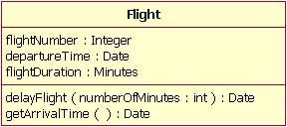
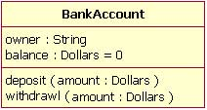
Basics
Class name
Class attribute list
Class operations list

Slide 48
Cohort Exercise 10 (10 minutes)
Draw the different classes (with attributes and operations) in the telephone network system. At least three classes should be drawn – 1) Telephone switch, 2) Subscriber, and 3) Telephone call.

Slide 49
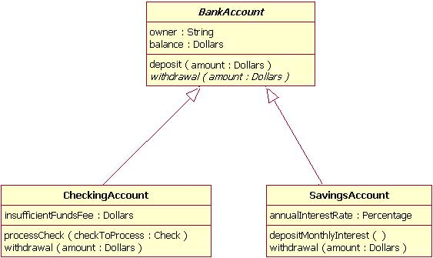
Inheritance

Slide 50
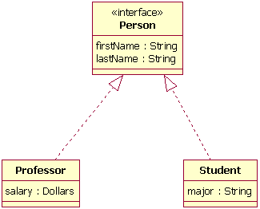
Interfaces
Dotted line indicates it’s NOT inheritance.
Notes:
Interface is an abstract class. Does not contain any implementation. The class implementing the interface must define all methods of the interface.

Slide 51
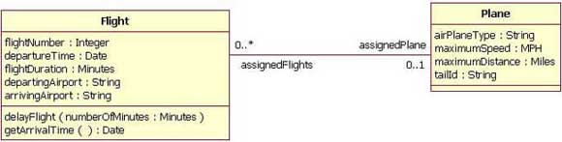
Associations
When you model a system, certain classes will be related to each other.
Bi-directional (standard) association: both classes are aware of each other and their relationship
Notes:
Say that different planes can be assigned to the same flight. And different flights can be done by the same plane.

Slide 52
Multiplicity
Indicator | Meaning
0..1 | Zero or one
1 | One only
0..* | Zero or more
* | Zero or more
1..* | One or more
3 | Three only
0..5 | Zero to Five
5..15 | Five to Fifteen
Notes:
Draw the association here again on the board and put multiple options. Ask students about which option mean what?

Slide 53
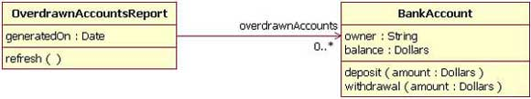
Uni-Directional Association
In a uni-directional association, two classes are related, but only one class knows that the relationship exists.
Notes:
Why do you think it is unidirectional? Can overdrawnbankaccount report be part of an account?

Slide 54
Cohort Exercise 11 (10 minutes)
Assuming you have drawn the different classes (with attributes and operations) in the telephone network system. At least three classes should have been be drawn – 1) Telephone switch, 2) Subscriber, and 3) Telephone call.
Show the association and multiplicity among these classes. Be careful with bi-directional and uni-directional association. Label each association.

Slide 55
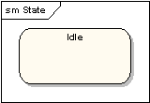
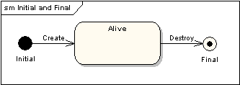
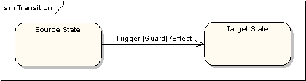
State Machine Diagram
States
Initial and final states
Transitions

Slide 56
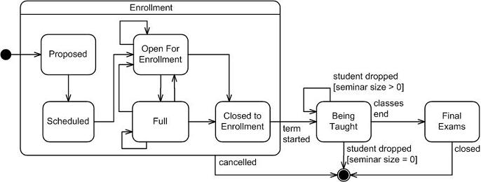
State Machine Example
Notes:
Talk about the big state. Talk about transition label – note they are conditional as well as unconditional, give examples.

Slide 57
Cohort Exercise 12 (10 minutes)
Draw the state machine diagrams of Telephone call and subscriber. Pay attention to your class diagram and transitions in the state diagram.

Slide 58
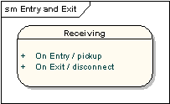
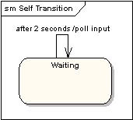
State Machine Diagrams: More
State actions
Self-looping actions

Slide 59
Cohort Exercise 13 (10 minutes)
Augment the state machine diagrams of Telephone call and subscriber to include the following features (Pay attention to your class diagram and transitions in the state diagram):
A call is disconnected if someone talks over 1 hour
After dialling a number, the caller waits at most 10 seconds for the connection to be established. Otherwise, she hangs up.

Slide 60
Concurrent states
Consider the case again where a telephone switch has to perform many activities at the same time. Each separate activity can be modeled as a concurrent state.

Slide 61
Concurrent states
Handle Calls
Ack
As Local
Waiting Remote
ConnectSuccess
Valid_number / Req
Connected
Join
As Remote
Waiting Callee
Lift_receiver
Req / Ack, Ringtone
A switch may act as a local and remote switch at the same time

Slide 62
Concurrent states
Handle Calls
Fork
Ack
Idle
As Local
Waiting Remote
ConnectSuccess
Valid_number / Req
Connected
Join
As Remote
Waiting Callee
Lift_receiver
ConnectFailure
Req / Ack, Ringtone
Timeout/ConnectFailure
Callee
Failed
A switch may act as a local and remote switch at the same time

Slide 63
Cohort Exercise 14 (5 minutes)
The state diagram in the previous slide does not include messages from the switch to the subscriber. Augment the state diagram to include these messages.

Slide 64
Further Reading

Slide 65
Other UML diagrams (Reading)
A set of object and their relationships are shown in an object diagram, which is a snapshot of instances of classes represented in class diagrams.
A component diagram represents an encapsulated class and its interfaces, ports, and internal structure which may consist of nested structures and connectors.

Slide 66
Other UML diagrams (Reading)
An interaction diagram shows the interaction between objects or roles, via sending of messages back and forth between them.
An activity diagram is UML’s closest counterpart to the flow chart of the structural programming world; it shows the structure of a process or other computation with a step-by-step flow of control and data.
A deployment diagram represents the configuration of run-time processing nodes and components that run on them

Slide 67
Other UML diagrams (Reading)
A package diagram depicts the decomposition of the model into organizational units and how they are dependent amongst one another.
An interaction overview diagram represents a hybrid of an activity diagram and a sequence diagram.

