Slide 1
50.003: Elements of Software Construction
Week 1
Software Development: Life Cycle and Methodologies

Slide 2
Plan for the Week
First Class: Overview of Software Engineering and Software Development Processes
Second Class: More on Software Development Processes
Third Class: Perspective from Industry

Slide 3
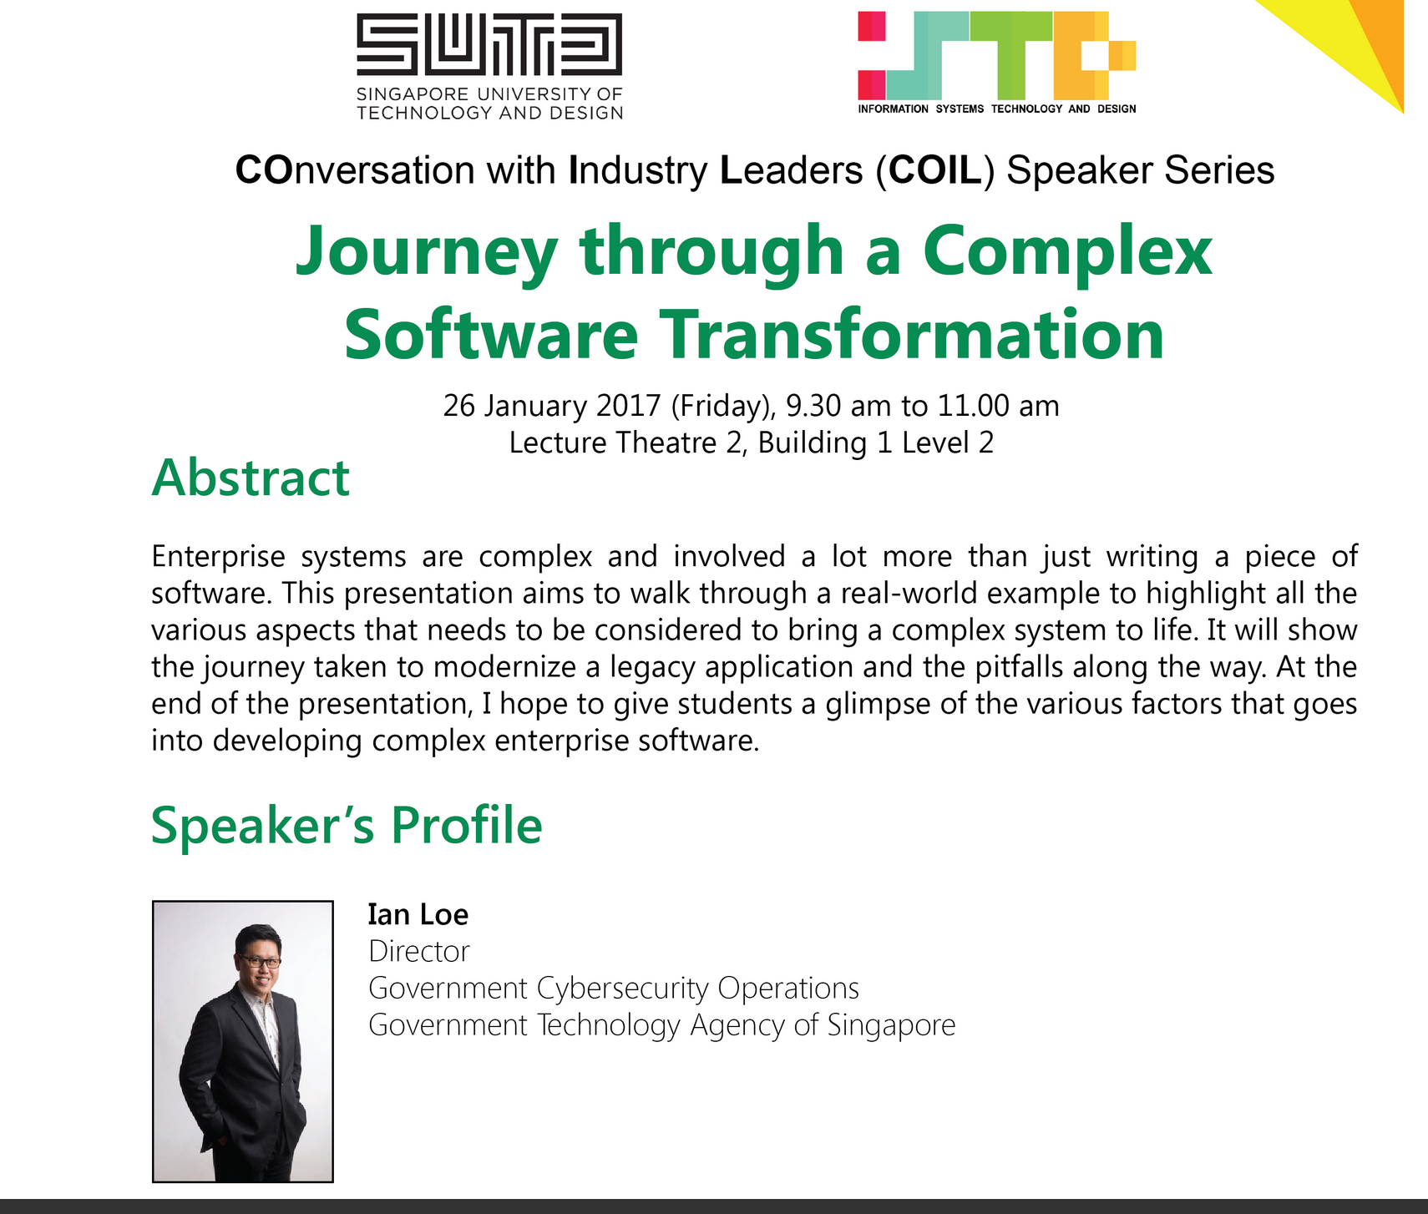

Slide 4
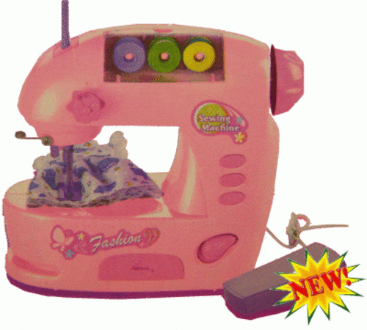
Software Engineering
User Requirements
the magical programming machine
System Implementation
***The synthesis problem (i.e., synthesizing a program from a specification automatically) is undecidable (i.e., there doesn’t exist an algorithm which could solve the problem in finite time).

Slide 5

Software Engineering
User Requirements
The species we called programmers
System Implementation

Slide 6
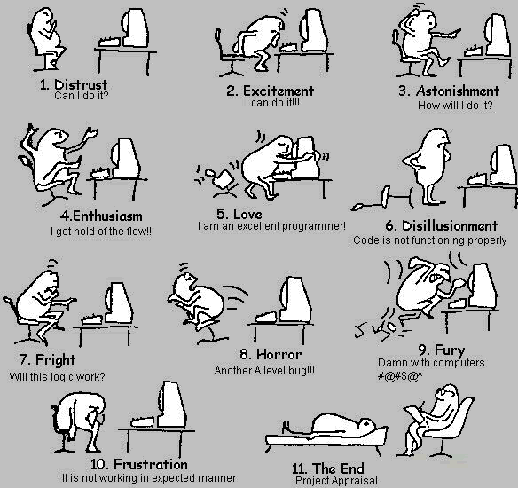
A Programmer’s Life
Notes:
It starts with excitement and discovery. But as it goes on, turns into grunt work and frustration. In the end, you are almost dead. The first few class of this course will be to teach some process to avoid those scenarios. Basically planning.

Slide 7
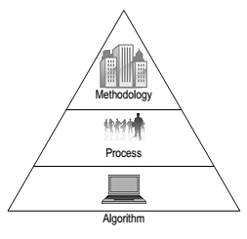
More Than Just Coding Skills
Coding Skills
where we are at
Notes:
Give the example of building a flyover. Say the contrast that in software, we get to fix the error if something goes wrong.

Slide 8
The Big Questions
Why are we worried about methodologies?
What is the software development life cycle (SDLC)?
What are the different software development methodologies?
How to choose one methodology over another?

Slide 9
More Than Just Coding Skills
Coding Skills
where we are at

Slide 10
Methodologies
Code-a-bit-test-a-bit (CABTAB)
Waterfall
Rapid prototyping
Iterative and incremental
Agile methods

Slide 11
CABTAB
Code-a-bit-test-a-bit (CABTAB) is hardly recognized as a methodology, although it is widely used in programming.
It is unsuitable for anything other than very small systems of limited scope.
We need a process!

Slide 12
Software development life cycle (SDLC)
The SDLC is the sequence of activities covering
requirements
analysis
design
implementation
testing
over which a software system is developed.

Slide 13
Requirements
During the requirements workflow, the primary activities include
Listing candidate requirements (very informal)
Understanding the system context through domain modelling and business modelling
Capturing functional as well as non-functional Requirements

Slide 14
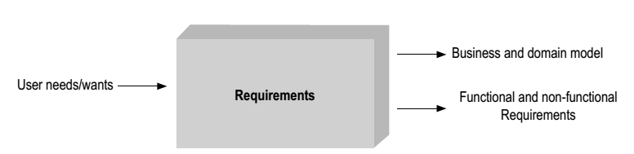
Requirements
Android App: Show nearby restaurants
GPS
Search
Paid users
Display
Unpaid users
Domain
Business

Slide 15
Requirements
A functional requirement is one on the functionality of the system, e.g., “the system must book movie ticket if the user has paid for it”.
A non-functional requirement might be on the performance of the system, e.g., “the system must book the ticket within 30 seconds”.

Slide 16
Requirements
Requirements should be captured in the language of the user.
Use cases help distil the essence of requirements as sets of action-response transactions between the user and the system (e.g., as user cases).
Example:
Action <Put $1 -> Press Button>, Response <Dispense Coffee>
Action <Press Button>, Response <Nothing>
Notes:
Who is the user here? The customer.

Slide 17
Analysis
A key theme of the analysis workflow is to understand how and where requirements interact and what it means for the system.
In an ideal world:
Action <Press “a”>, Response <Do “this”>
Action <Press “b”>, Response <Do “that”>
In real world:
Action <Put $1 -> Press “tea”>, Response <Dispense “tea”>
Action <Press [any]>, Response <Display “No stock” if tea is finished>
Notes:
Talk about the interaction where you put coin first in one case and in the other case, you just want to know whether things are available. Because when you talk with the customer, he himself does not know everything that she wants. A key job of the developer is to help customer find out what she wants.

Slide 18
Analysis
Analysis also involves
Detecting and removing ambiguities and inconsistencies amongst requirements
Requirement 1: “the system must book movie ticket if the user has paid for it”
Requirement 2: “the system must book tickets within 30 seconds”
Developing an internal view of the system
Identifying the analysis classes and their collaborations
Analysis classes are preliminary placeholders of functionality
Notes:
Say it is both incomplete and inconsistent. Incompleteness: show by what if user book 100000 tickets at the same time, what happens to the money? Inconsistency: show by it takes more time than 30 seconds to print say 50 tickets.

Slide 19
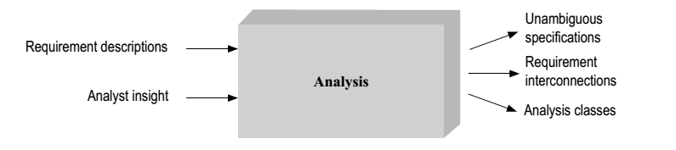
Analysis

Slide 20
Design
Deciding on the collaboration between components lies at the heart of software design.
A component fulfils its own responsibility through the code it contains.
A component exchanges information by calling methods on other components, or when other components call its own methods.
Notes:
Give an example in the context of programming. Two functions exchanging information.

Slide 21
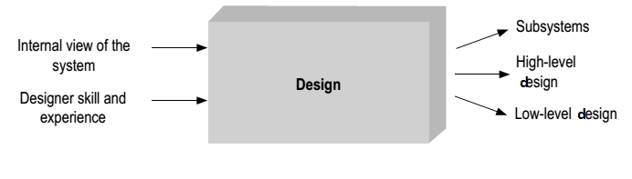
Design
The design workflow involves
Considering specific technologies (e.g. which language and platform?)
Decomposing the system into implementation units
Notes:
Explain high-level design and low-level design. Highlight that low-level design is kind of coding and implementation.

Slide 22
Implementation
A large part of implementation is programming.
Implementation also involves
Unit testing
Planning system integrations (consider cases where the system communicates with external hardware)
Devising the deployment model (how do you ship: binaries, libraries etc.)
Notes:
Explain unit testing and integration testing briefly. Say that we will learn more about it during the software testing lectures.

Slide 23
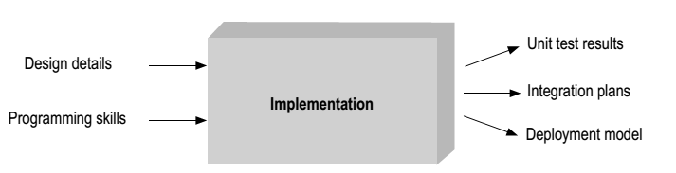
Implementation

Slide 24
Testing
The primary activities of the test workflow include
Creating test cases (manual or automatic),
Running test procedures, and analysing test results.
Due to its very nature, testing is never complete.
Notes:
Say that we will learn something about automatic test generation strategies later in the course. Highlight the completeness issue of testing, emphasize well.

Slide 25
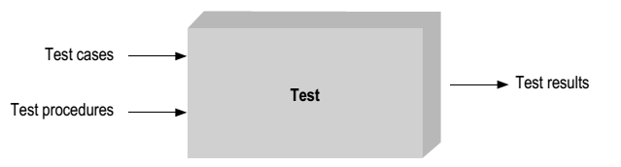
Test
Notes:
Test results: pass or fail.

Slide 26
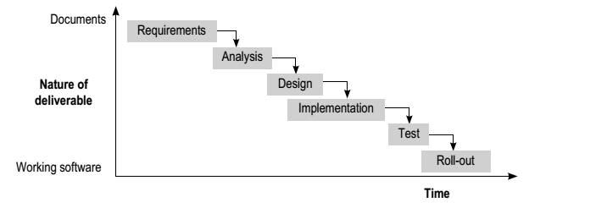
Waterfall model
Software Engineering: Concepts and Applications by Subhajit Datta
(Oxford University Press, 2010)
Notes:
Explain that we have discussed different stages of software development in isolation, but we have not discussed how this stages interact among them. Now we will describe a few standard models that capture the relationship between different models.

Slide 27
Waterfall model
The Waterfall model uses the metaphor of falling water to underline the sequential nature of software development.
It is suited to projects of limited uncertainty and risks.

Slide 28
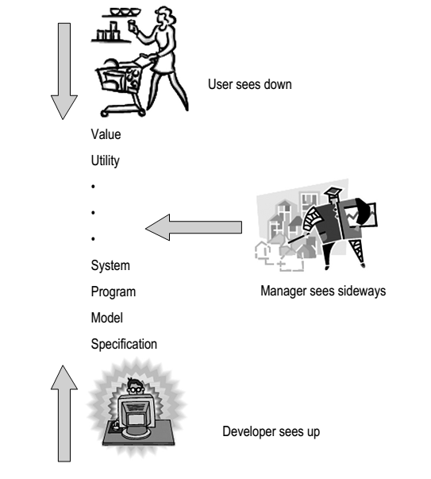
Waterfall Model: Problems
What do I want?
How do I do it?

Slide 29
Waterfall Model
https://www.youtube.com/watch?v=0NAsk0noT_U

Slide 30
Cohort Exercise I (10 min)
In his 2000 Turing lecture ‘The Design of
Design’, Frederick Brooks said, ‘The Waterfall Model is Dead Wrong’. I suppose you would agree to certain extent.
The waterfall model assumes that the different stages of software development are sequential. Discuss with your group on the actual relationship between the 5 activities in SDLC + the stage of maintenance.

Slide 31
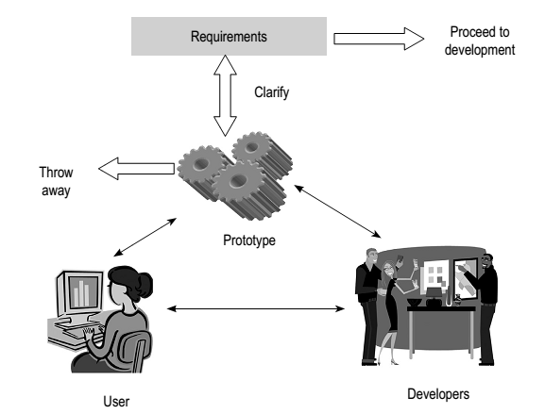
Rapid Prototyping
Software Engineering: Concepts and Applications by Subhajit Datta
(Oxford University Press, 2010)
Notes:
Prototype gives an initial idea to the user how the product will look like. It has to be built fast in order to fix any ambiguities in the requirement. This way rapid prototype can avoid errors and ambiguities that appear much later in the software development process and allow opportunities to fix them quickly. Prototype should only include core functionalities, other extra functionality or non-functional requirement such as security and performance can be ignored.

Slide 32
Rapid Prototyping
Rapid prototyping recommends the building of prototypes to clarify requirements and system scope.
The prototypes, however, should never become the final system.
Once the requirements have been sort out, the system is built formally
Timing is crucial for the prototype

Slide 33
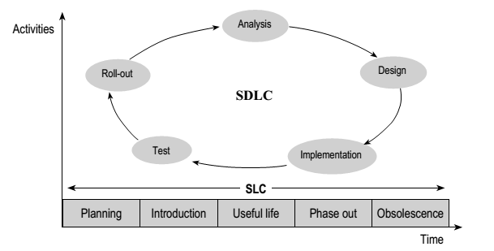
Software Development Life Cycle versus Software Life Cycle
Software Engineering: Concepts and Applications by Subhajit Datta
(Oxford University Press, 2010)
Notes:
Requirement changes over time, and subsequently design and analysis. For instance, customer wants new features. This will continue and propagate through all phases of the software development life cycle. Planning and introduction of the software, the time software is used, the time it is gradually stopped in phase out and finally, when the software is no longer used.

Slide 34
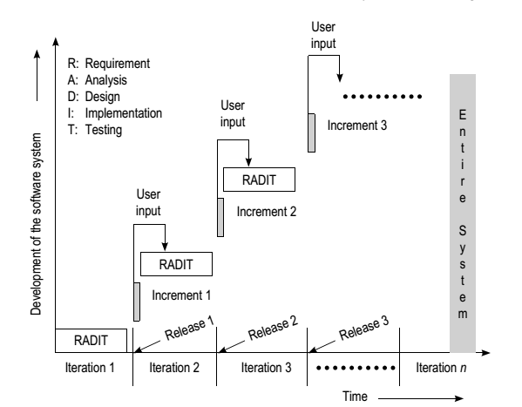
Iterative and Incremental Development
Software Engineering: Concepts and Applications by Subhajit Datta
(Oxford University Press, 2010)

Slide 35
Iterative and Incremental Development
In iterative and incremental development, the software system is built through a series of time-boxed development cycles—iterations—leading to tangible and testable additions to the overall system functionality—increments.
This is an expedient model for building systems with initial ambiguity of scope and changing requirements.
Notes:
Note the difference with rapid prototyping. Here we do not throw away the previous incremental developments. (End of Lecture 1)

Slide 36
The Agile Manifesto
“We are uncovering better ways of developing software by doing it and helping others do it. Through this work we have come to value:
Individuals and interactions over Processes and tools
Working software over Comprehensive documentation
Customer collaboration over Contract negotiation
Responding to change over Following a plan
That is, while there is value in the items on the right, we value the items on the left more”
http://agilemanifesto.org/ February 2001

Slide 37
12 Agile Principles
Customer satisfaction by rapid delivery of useful software
Welcome changing requirements, even late in development
Working software is delivered frequently (weeks rather than months)
Close, daily cooperation between business people and developers
Projects are built around motivated individuals, who should be trusted
Face-to-face conversation is the best form of communication (co-location)
Working software is the principal measure of progress
Sustainable development, able to maintain a constant pace
Continuous attention to technical excellence and good design
Simplicity—the art of maximizing the amount of work not done—is essential
Self-organizing teams
Regular adaptation to changing circumstance

Slide 38
Cohort Exercise 2 (5 min)
You have a sense of the course project by now. If you don’t, please make sure you do ☺
Read the Agile manifesto and principles and discuss with your team on what it means in terms of developing your project.

Slide 39
What is the Agile Method?
https://www.youtube.com/watch?v=-zDct5d2smY

Slide 40
Cohort Exercise 3 (10 min)
You have a sense of the course project by now. If you don’t, please make sure you do ☺
On the basis of what we have discussed so far, which methodology do you think would be suitable for developing your class project? Agree on some timeline on some milestones.

Slide 41
In terms of timeline, how we know how much effort and time a software development project needs?

Slide 43
Effort
Time
Money

Slide 44
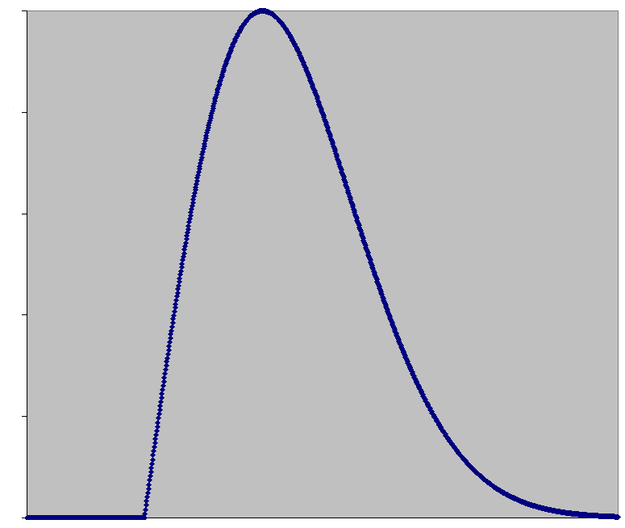
Resource
Project starts
Project ends
Time

Slide 45
Effort
Time

Slide 46
The Software Equation
(B^{1/3} * Size ) / Productivity = Effort^{1/3} * Time^{4/3}
B = Special skill factor
Productivity = a productivity parameter (depends on team)
Effort = Human effort in years or months
Time = Time to complete project in years or months
The models basis was formed through analysis of productivity data collected from over 4000 modern day software development projects.^{[1]}
The software equation was derived from the Putnam-Norden-Rayleigh Curve which can be used to show the non-linear correlation between time to complete the project and applied human effort.^{[2]}

Slide 47

Depends on you and your team

Slide 48
Depends on the scale of your project

Slide 49
Inverse relationship

Slide 50
Solving for effort
Effort = B * ( Size/(Productivity * Time^{4/3}))³
Effort: project effort measured in person-months or person-years
Size: a lines of code estimate for the project
Time: length of project measured in months or years
B: a special skills factor
Productivity: a productivity parameter (depending on your team)

Slide 51
Defining B
B, the special skills factor, is related to the size of the product.
B Value | Size of Project
0.16 | 5-15K
0.18 | 20K
0.28 | 30K
0.34 | 40K
0.37 | 50K
0.39 | > 50K

Slide 52
Defining Productivity
Research from the collected productivity data supplies initial values for productivity determined by the type of software being developed.
Productivity Value | Description
2,000 | Real time embedded software
10,000 | Telecommunication software
12,000 | Scientific software
28,000 | Business system applications

Slide 53
Quick Question
Effort = B * ( Size/(Productivity * Time^{4/3}))³
What is the relationship before time and effort in the equation?

Slide 54
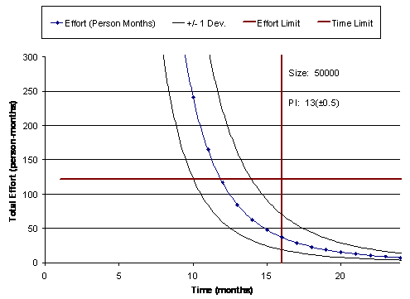

Slide 55
Impossible zones

Slide 56
You can only operate here

Slide 57
In case you have not noticed, this
is just an example. You do not have 15 months, not even
15 weeks!
You can only operate here

Slide 58
You can pour more effort into less time, but there
are limits … ☹

Slide 59


Slide 60
“In project management, a death march is a project where the members feel it is destined to fail and/or requires a stretch of unsustainable overwork.”

Slide 61
“In project management, a death march is a project where the members feel it is destined to fail and/or requires a stretch of unsustainable overwork.”

Slide 62
Cohort Exercise 4 (10 min)
Your project needs to be completed in 3 months. The estimated size of the system you are developing is 20,000 LOC.
Find out how much effort your team will need (assume productivity = 1200).
The team members decide to take a break during recess week (0.25 month). Is it wise?
Amongst the following choices, select the measure(s) you feel are most appropriate for your team to meet the original deadline and have the planned break.
Add two new members to the team immediately?
Every member of the team work longer hours each day?
Re-estimate the size of the system to be lower than 20,000 LOC?

Slide 63
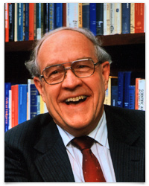
This week’s reading
Brooks, Frederick. P., Jr. (April 1987). "No Silver Bullet: Essence and Accidents of Software Engineering". Computer 20 (4): 10–19. doi:10.1109/MC.1987.1663532
http://tinyurl.com/c682zju

Slide 64
References
Datta, Subhajit , 2010. Software Engineering: Concepts and Applications. Oxford University Press. (ISBN 978-0-19-569656-1)
Ulrich, Karl T. , 2011. Design: Creation of Artifacts in Society. University of Pennsylvania. (ISBN 978-0-9836487-0-3)
Brooks, Frederick P. , 2010. The Design of Design: Essays from a Computer Scientist. Addison-Wesley Professional. (ISBN - 978-0201362985)
Putnam, Lawrence H.; Ware Myers (2003). Five core metrics : the intelligence behind successful software management. Dorset House Publishing. (ISBN 0-932633-55-2.)

Slide 65
Homework This Week
Meet and discuss with your group on how you plan to finish the project within the deadline.

