Slide 1
Presentation for Group 6
TOR Project

Slide 2
What’s a Tor?
The Onion Router: a browsing tool used to surf the web anonymously.
From The second-generation onion router:
a circuit-based low-latency anonymous communication service.
Clients choose a path through the network, and build a circuit in which each node in the path knows its predecessor and successor, but no other nodes in the circuit. Traffic flows down the circuit in fixed-size cells, which are unwrapped by a symmetric key at each node and relayed downstream.

Slide 3
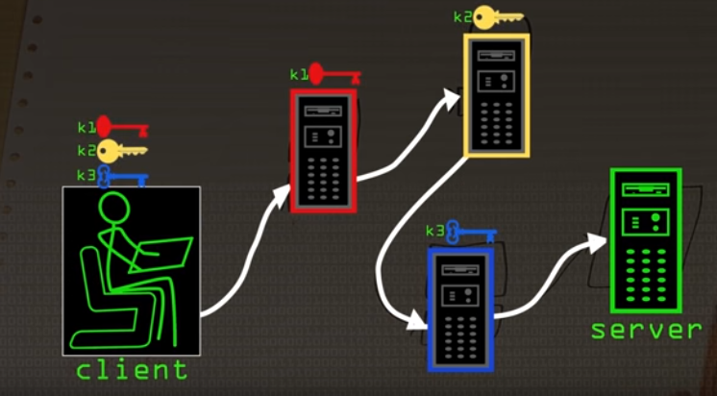

Slide 4


Slide 5
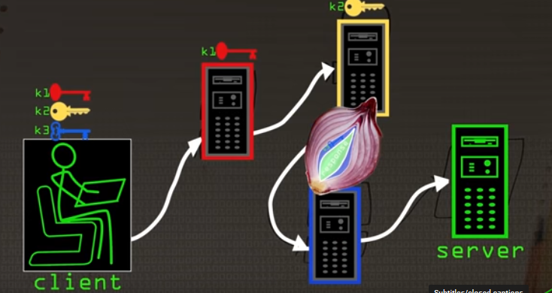

Slide 6
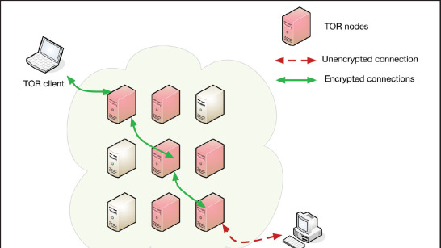

Slide 7
Tor Protocol
Client creates a circuit, with three hops in our example, by first establishing a shared key exchange
First to third node follows. The circuit is extended whenever they want with new nodes at the end
All previous messages have encrypted

Slide 8
Possible Drawbacks?
Slow:
Nodes might be serving clients all the time
Large global hops may occur
Secured websites with Login:
Still use TLS and HTTPS to actual servers
Tor acting as a proxy
Attackers can still sniff at the network!

Slide 9
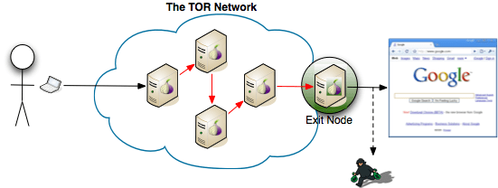
A Correlation Attack

Slide 10
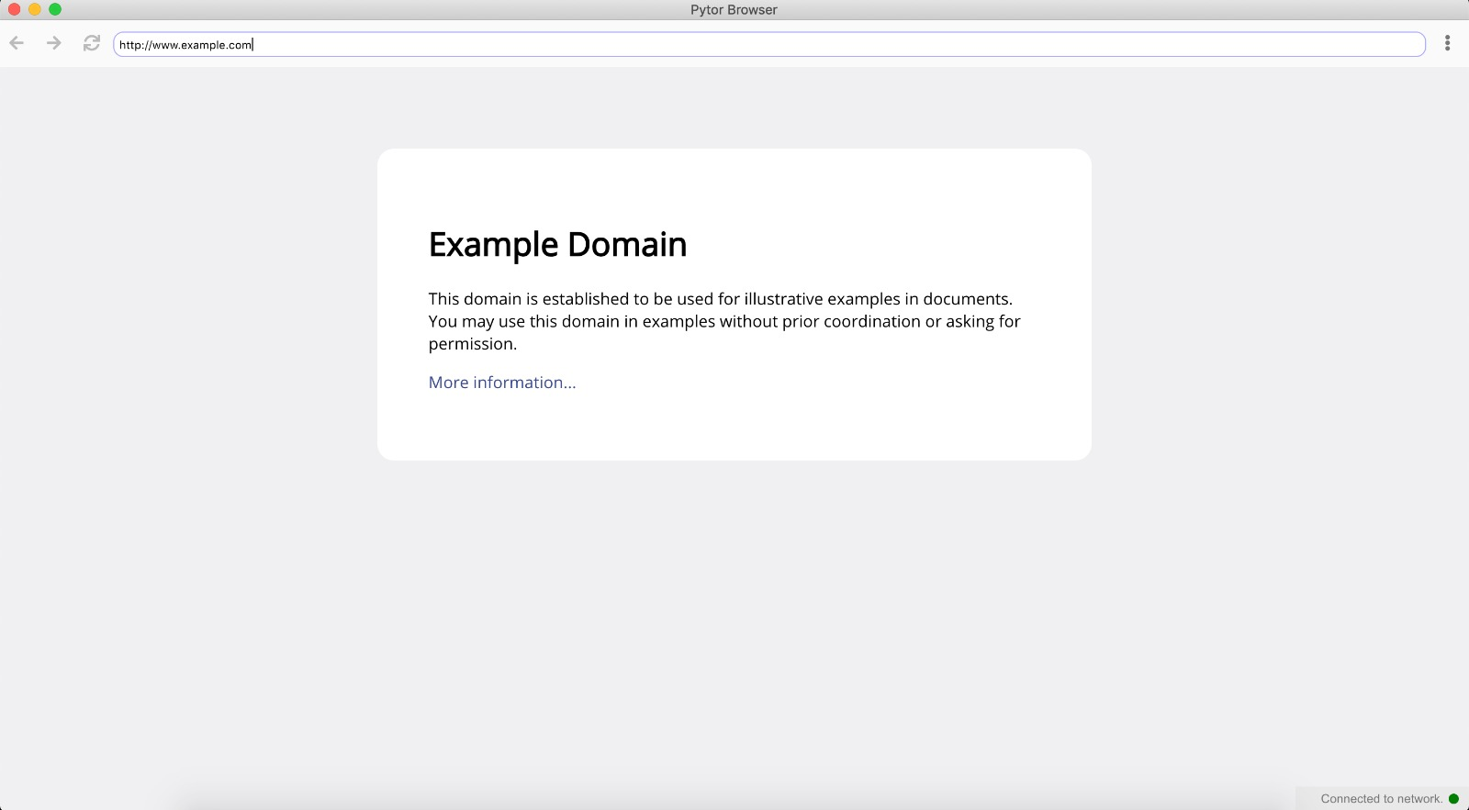
Our Implementation

Slide 11
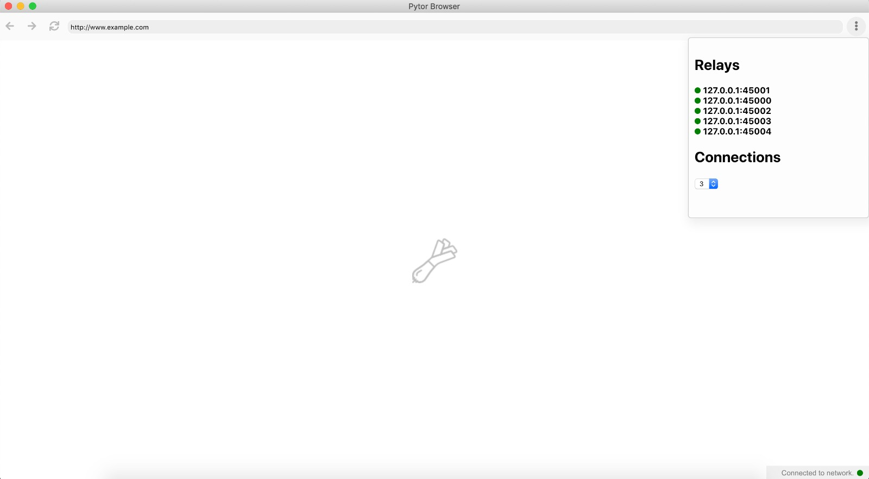

Slide 12
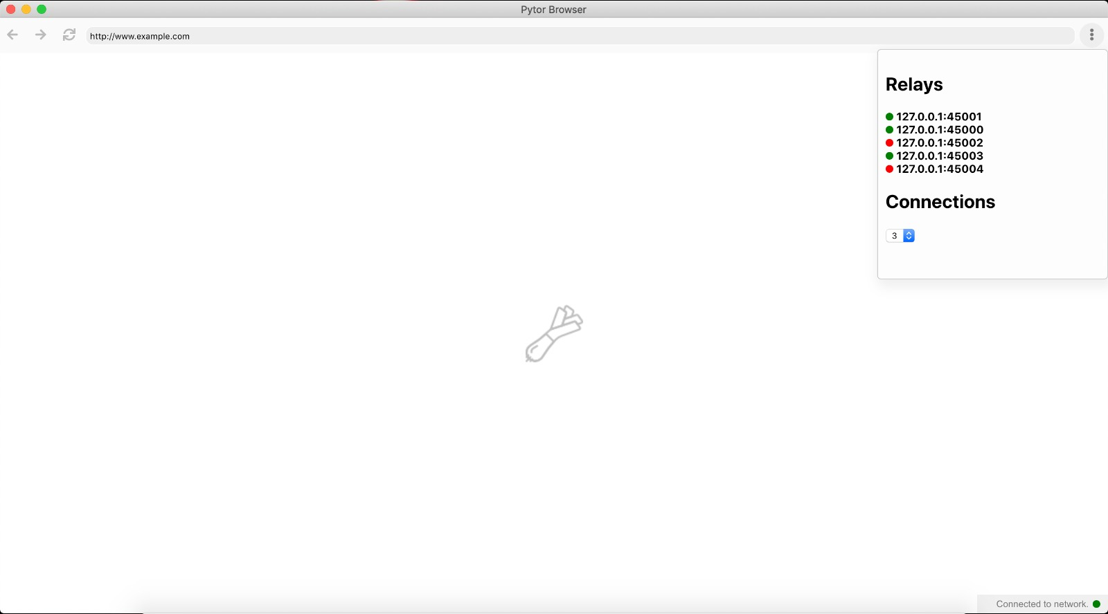

Slide 13
Differences between TOR and our Project
Implementations | Our Tor Implementation | Main TOR Implementation
Language it is written in | Python with NodeJS front end | C
Byte Size | 4970 bytes | 512 bytes
Cells | Header: Contains checksum, length of relay payload, and relay command | Header: Contains padding, create and destroy (of circuit), streamID, checksum, length of relay payload, and relay command
Constructing a circuit | Nodes randomly shuffled, chosen. A create cell is sent along to the first node. Diffie-Hellman Handshake implemented. | Diffie-Hellman Handshake implemented. Circuit established first by sending the nodes along
Congestion Control | None | Circuit-level throttling and Stream-level throttling implemented.
Number of Nodes implemented | 3-5 | 3
Rendezvous Point | None Implemented as it was not in our intended scope due to time constraint. | Provided for responder anonymity via location-protected servers. Meant for hidden services.
Localhost | Due to network constraints, we were unable to move between multiple computers and IP addresses. Thus we opened a series of ports on our local computer to operate as nodes | Global nodes.

