Slide 1
NLP学习

Slide 2

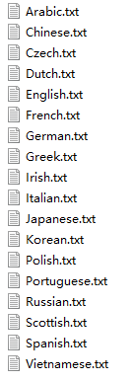
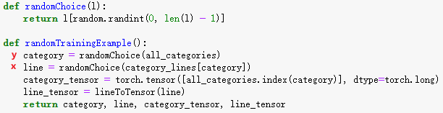
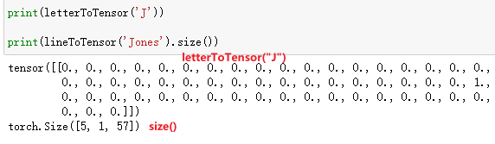
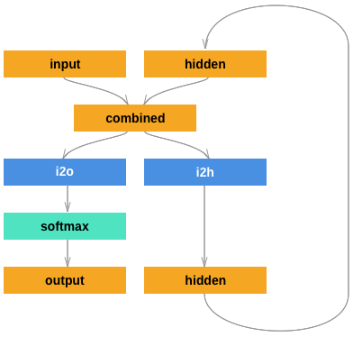
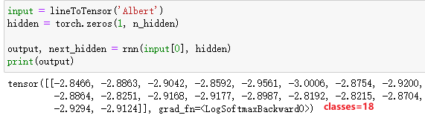
data
18 classes
字符变换
input
name2Tensor
<line_length*1*n_letters>
网络
output

Slide 3
分类
Training
NLLoss
output
category
hidden
RNN
RNN
RNN
x1
x2
x3

Slide 4
生成
Training
x2
x3
EOF
NLLoss
generate
o1
o2
o3
o1
o2
o3
H2O
H2O
H2O
H2O
H2O
H2O
y1
y2
y3
y1
y2
y3
hidden
RNN
RNN
RNN
hidden
RNN
RNN
RNN
x1
x2
x3
x1

Slide 5
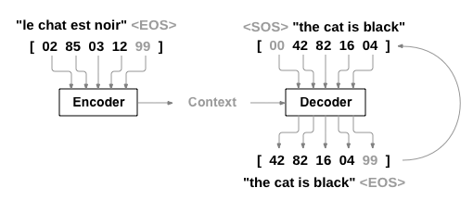

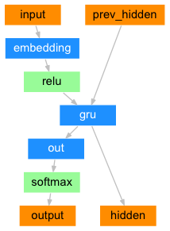
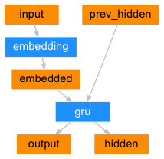
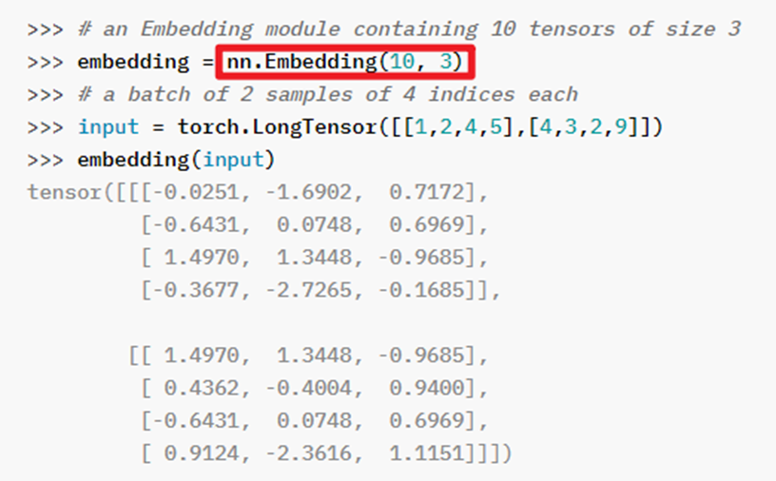
[max_length, encoder.hidden_size]
Encoder_outputs
encoder
decoder
总共有10个单词, 每个单词用3维数组表示

Slide 6
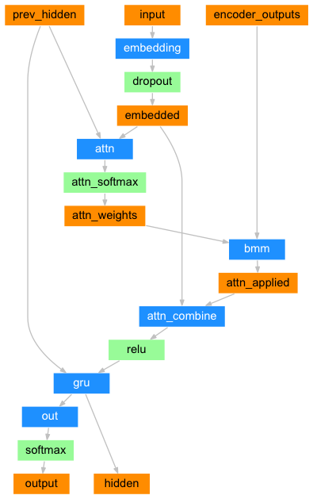
Encoder_outputs:
[max_length, encoder.hidden_size]→[10,256]
Input: [index]->[1,1]
Hidden: encoder_hidden→[1,1,256]
[1,1,256]
[1,1]
[10,256]
[1,1,256]
[1,1,256]
Attention
[1,10]
[1,10]
[1,1,256]
[1,1,256*2]
decoder
[1,1,256]
Atten 核心
[1,1,256]
[1,3083]
[1,1,256]
总共有3083个单词

Slide 7
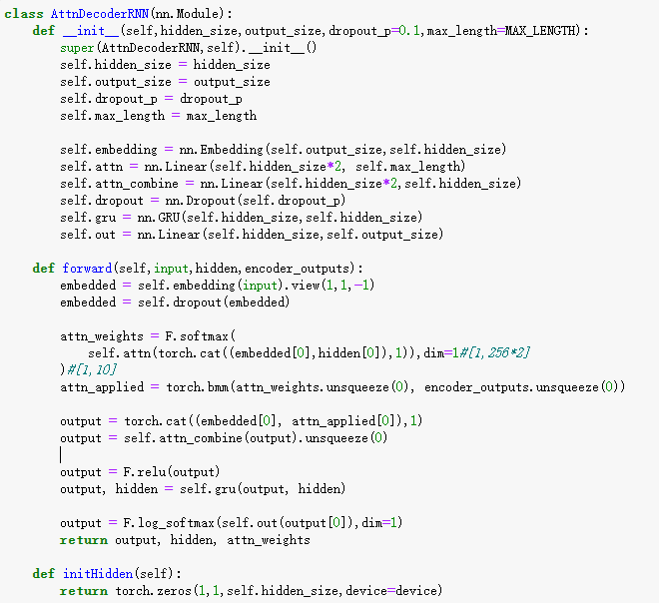
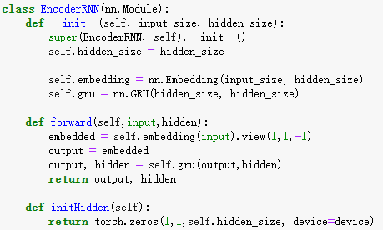

Slide 8
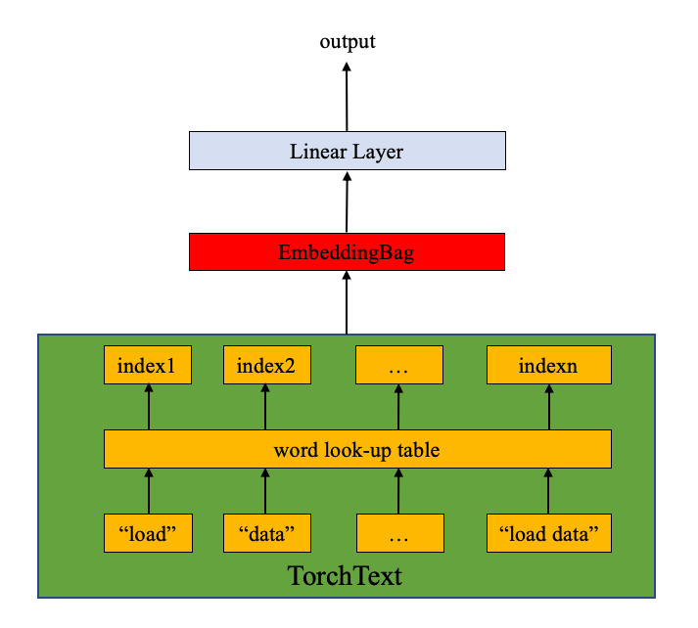

Slide 9
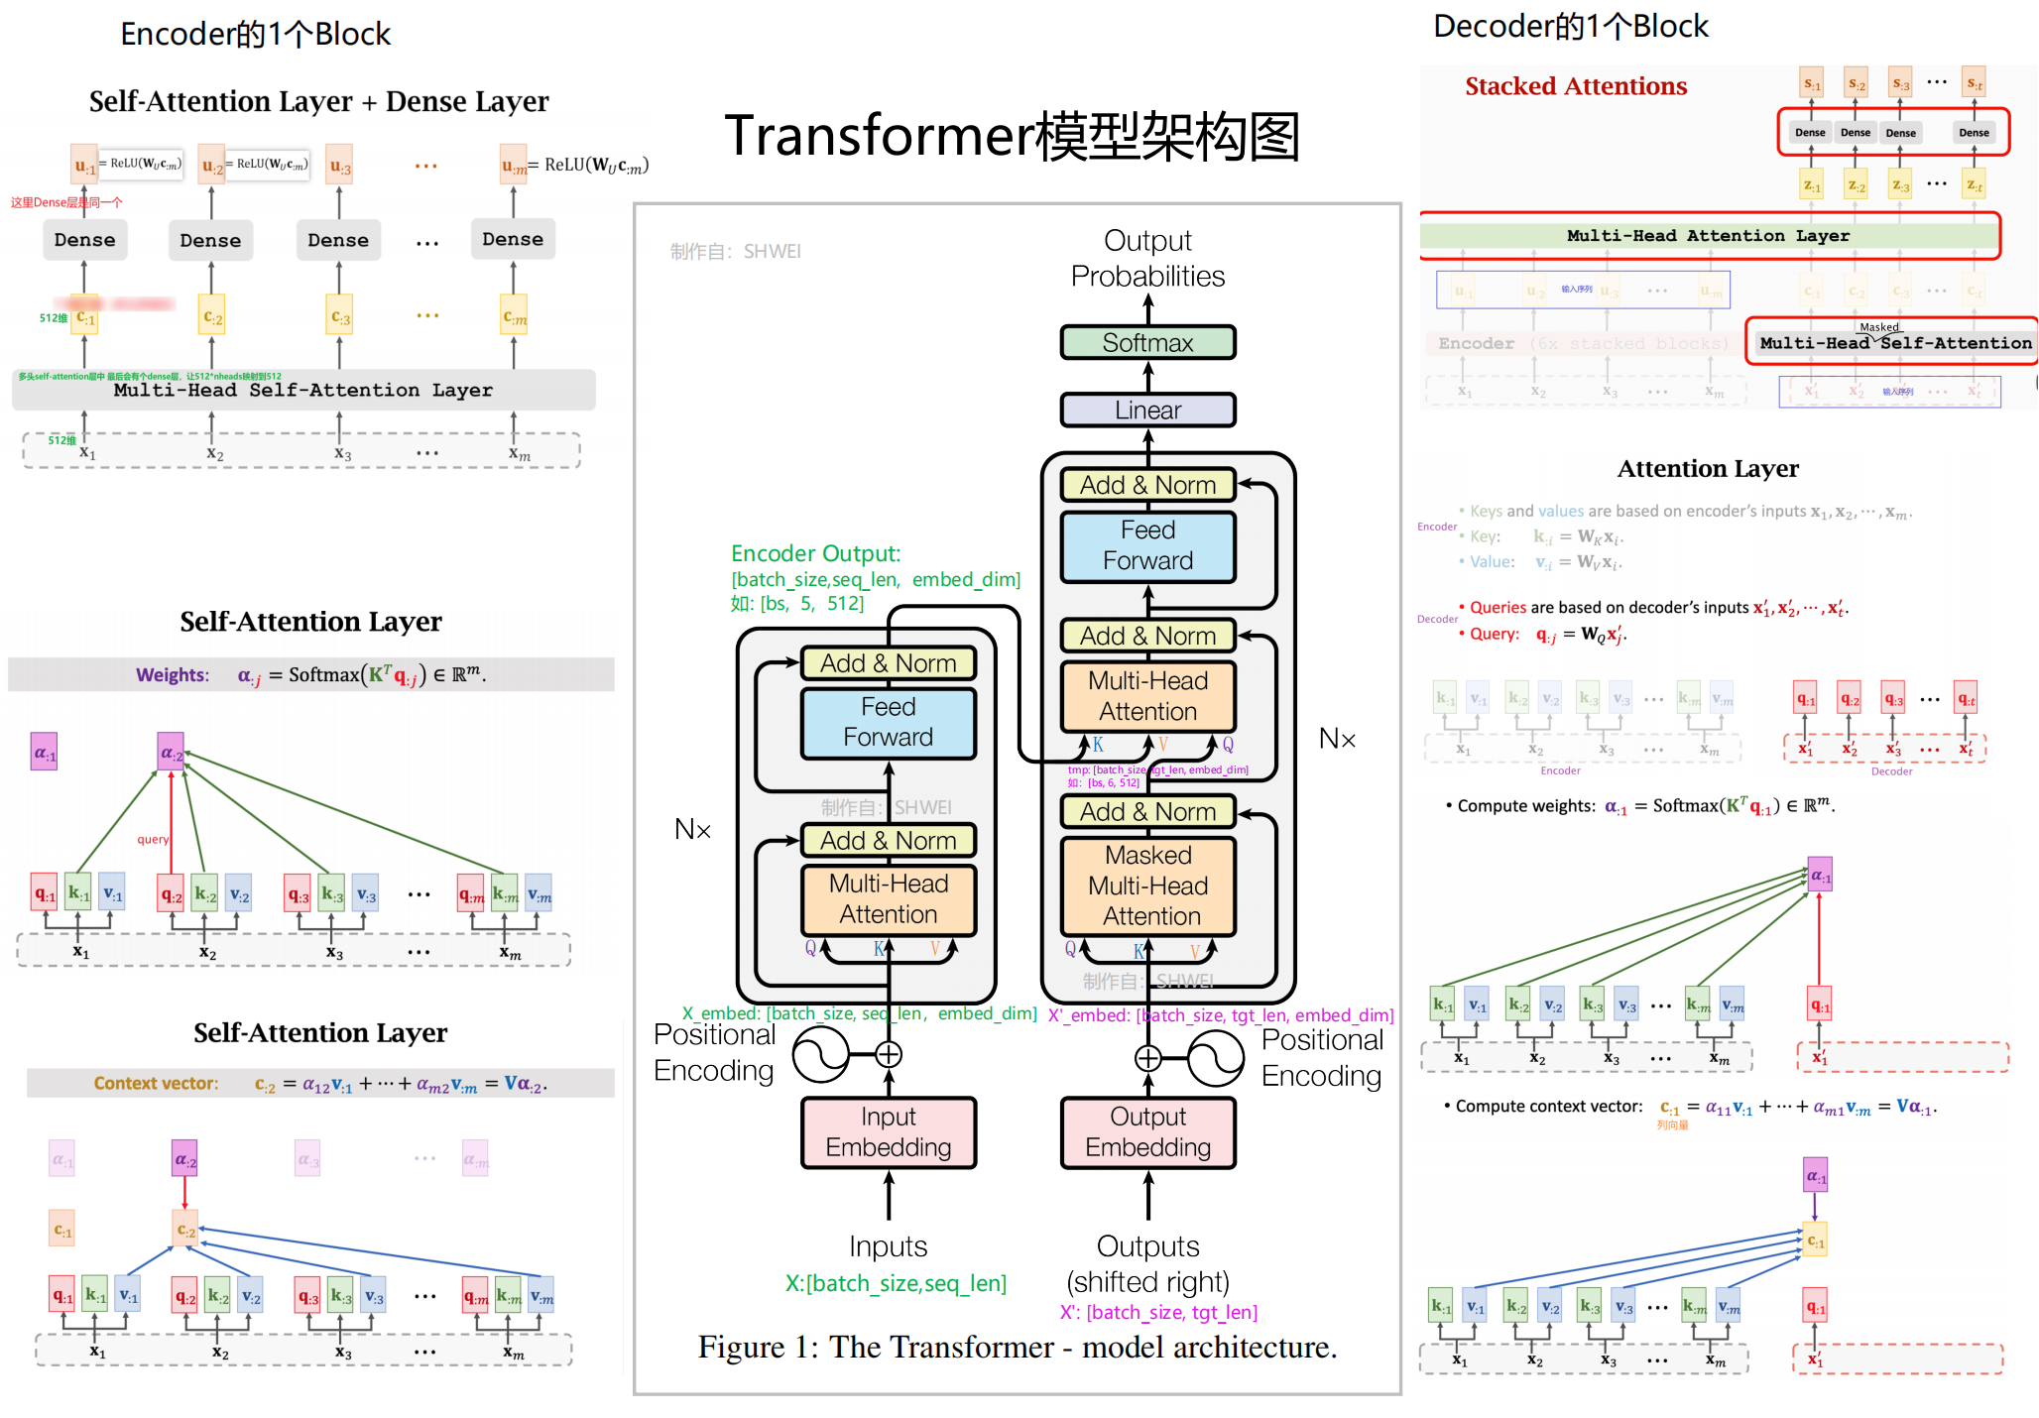

Slide 10
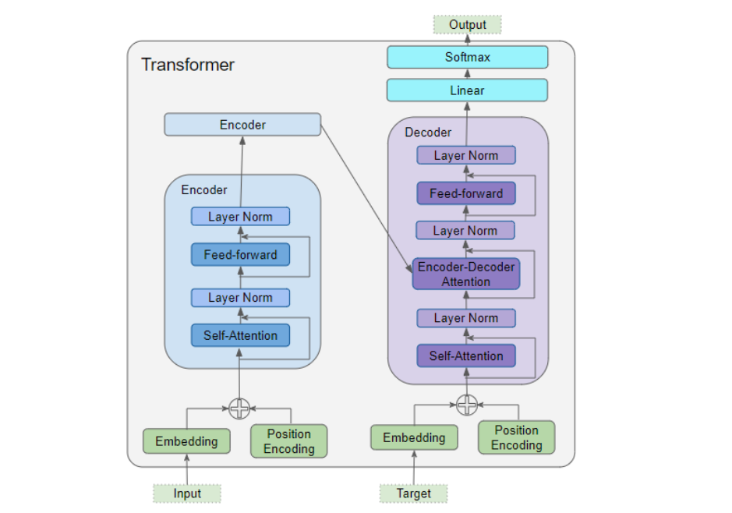

Slide 11
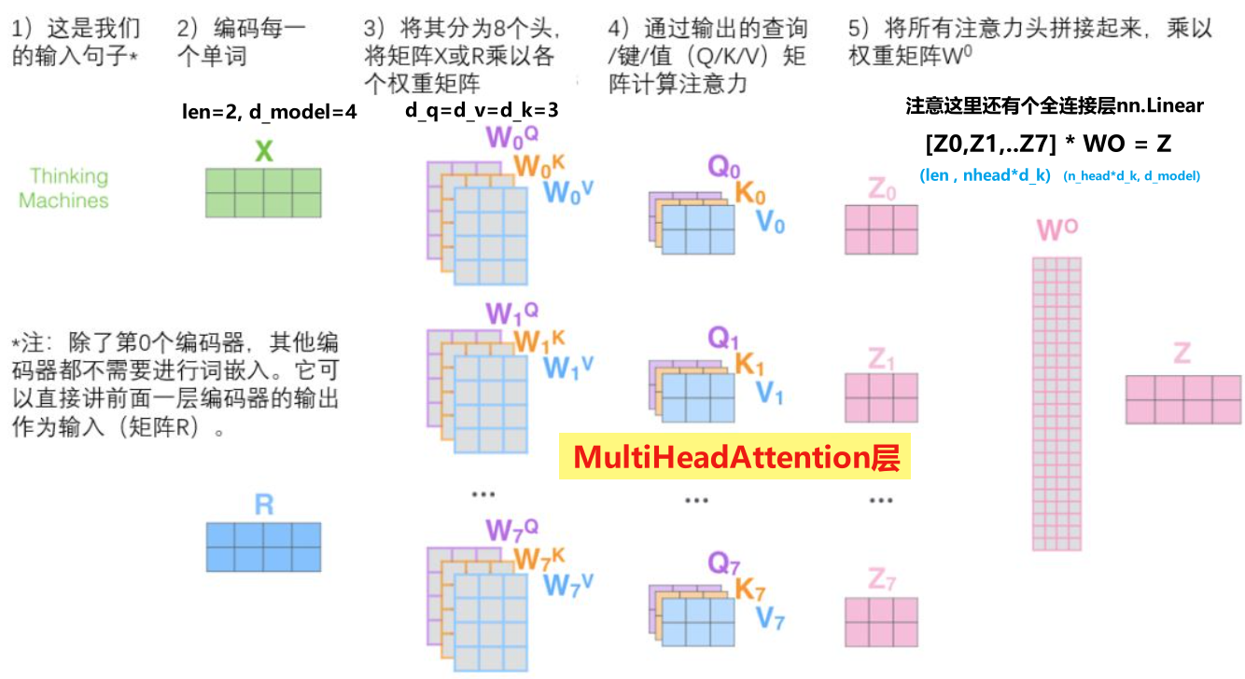

Slide 12
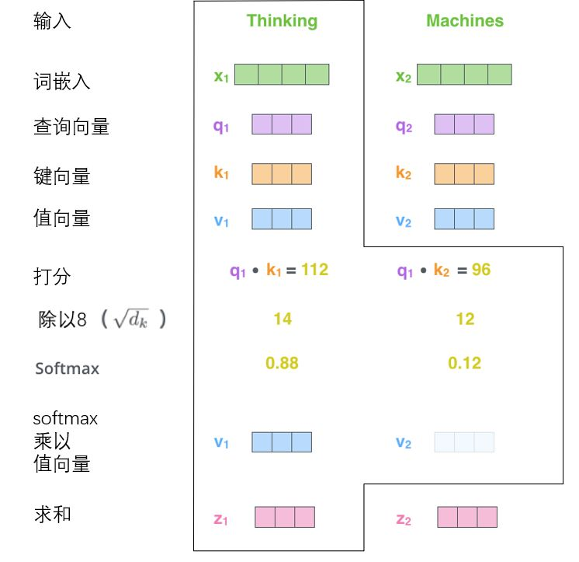
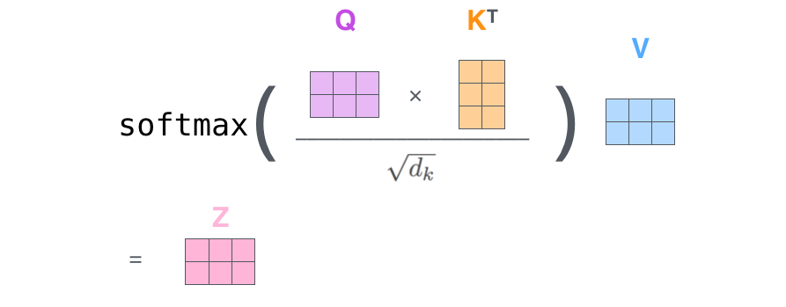

Slide 13

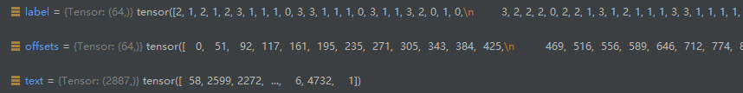
AG_NEWS:[class, new]
Batch_size: 64

