Slide 1
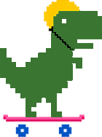
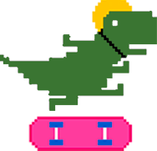

Dinosaur skateboarding

Slide 2
Title and Content Layout with List
Goal:
make the character jumping over obstacles in front of infinite parallel scrolling background.
Tools: Pygame
Leaning: operate pygame and use class organize code
Extension:
create score class to accumulate the scores
add background music
Add various obstacles
Change character directions

Slide 3
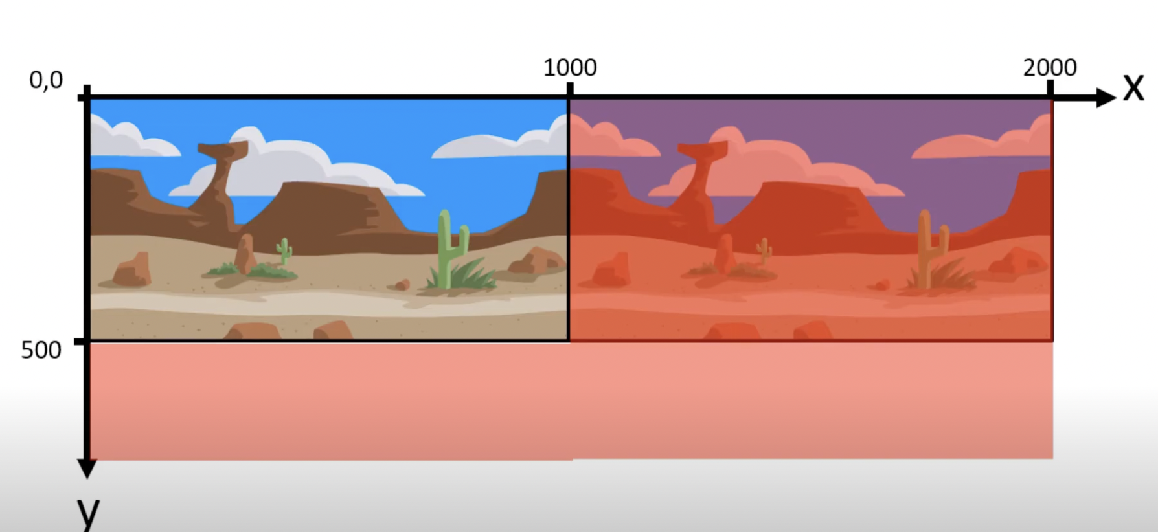
Make parallel scrolling background

Slide 4
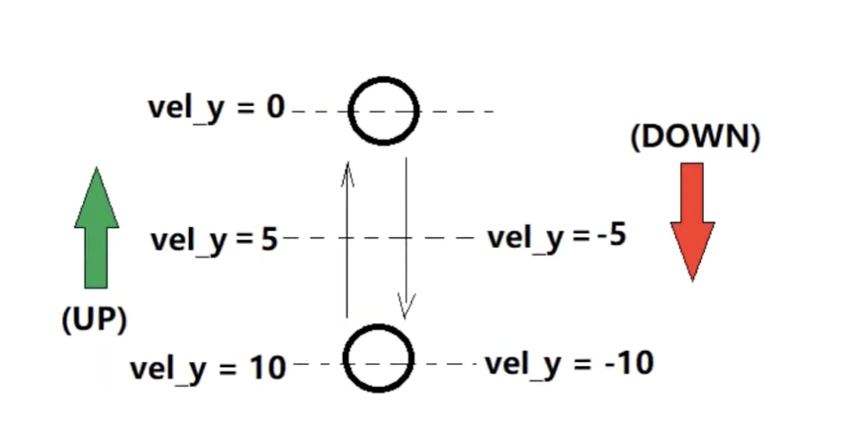
Jumping motion

