Slide 1
Capstone Project - The best place for a beer shop
Applied Data Science Capstone by IBM/Coursera
Roman Makarov (May,2019)

Slide 2
Customer requirements:
Open a small business in Moscow
Shop has to be located in the appropriate district.
Shop has to be located near customer’s house.
Payback period should be minimal.
Choose best price/quality trademark

Slide 3
Business problems
What is the best trademark (according to customer’s investments etc.)?
What is the best place of the city to open a beer shop according to standard of living?
What is the most visited place for the shop (place with other entertainment)?
What is the best place for the shop depending on a location (the nearest to customer’s house place etc.)?

Slide 4
Data acquisition
Data is represented on the official web sites
http://moscow.gks.ru/
Data from open sources (like Wikipedia)
https://en.wikipedia.org/
GEO Data (retrieved by some web services)
https://tech.yandex.com/maps/
https://foursquare.com
Standard of living indicators
https://www.irn.ru/rating/moscow/
https://rbc.ru/

Slide 5
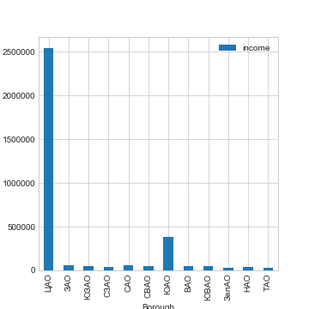
Districts by income
One district with extremely high price
One district with high price
Others are the same

Slide 6
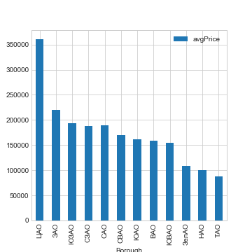
Districts by real estate price
Districts may be divided into clusters

Slide 7
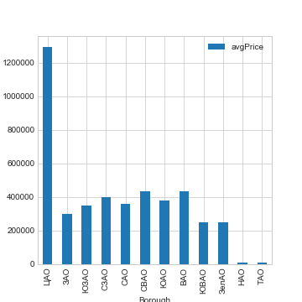
Districts by average rent price
One district with extremely high price
Others may be divided into clusters

Slide 8
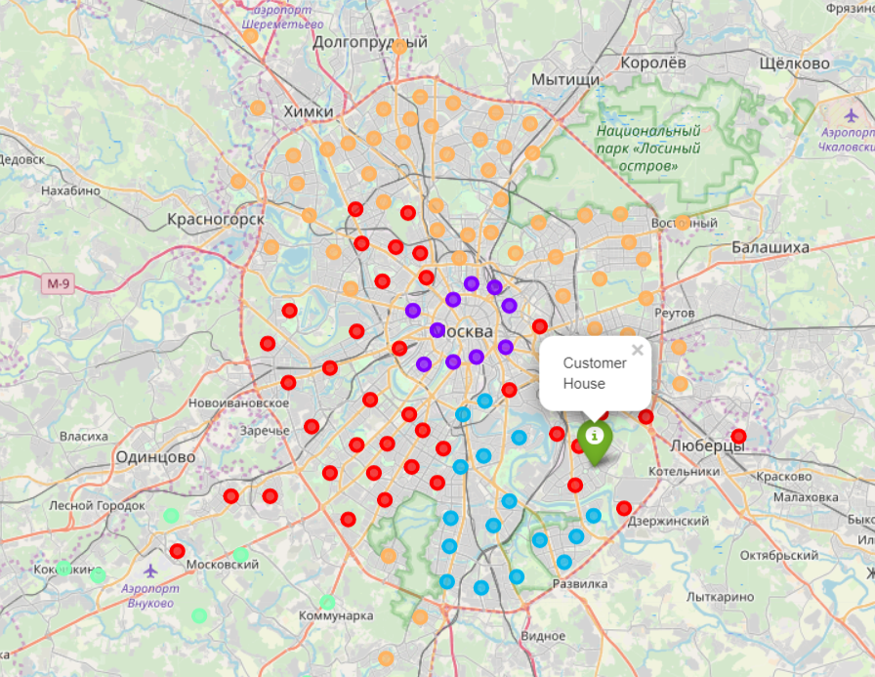
General map of Moscow clusters

Slide 9
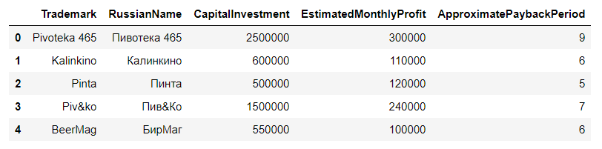
Table of selected franchises

Slide 10
The best districts by all the features (in Russian)
Южнопортовый
Нижегородский
Рязанский
Текстильщики
Печатники
Кузьминки
Люблино
Марьино
Выхино-Жулебино
Капотня
Некрасовка
Лефортово

Slide 11
The best franchises
Kalinkino (http://kalinkino.com/franchise.html)
Pinta (http://pinta-company.ru/franshiza)
BeerMag (https://www.russtartup.ru/franchising/vsefranshiza/franchajzing-pivnogo-magazina-birmag.html)

Slide 12
Conclusion
The collected information helps to make a right decision.
The collected information is statistically correct.
The final decision of optimal business strategy will be completed by the customer only.

