Slide 1
NUMERICAL METHODS ASSIGNMENT
x³ + 7x² + 5x − 4 = 0
Newton-Raphson • Secant • RK4
MATLAB FOR & WHILE loops

Slide 2
Problem and Function
Solve f(x)=x³+7x²+5x−4=0
f′(x)=3x²+14x+5
Tolerance = 10⁻⁸

Slide 3
Newton-Raphson
xₙ₊₁=xₙ−f(xₙ)/f′(xₙ)
Starting guesses: 0, −1, −6
Roots: −6.06724009, −1.40274987, 0.46998995

Slide 4
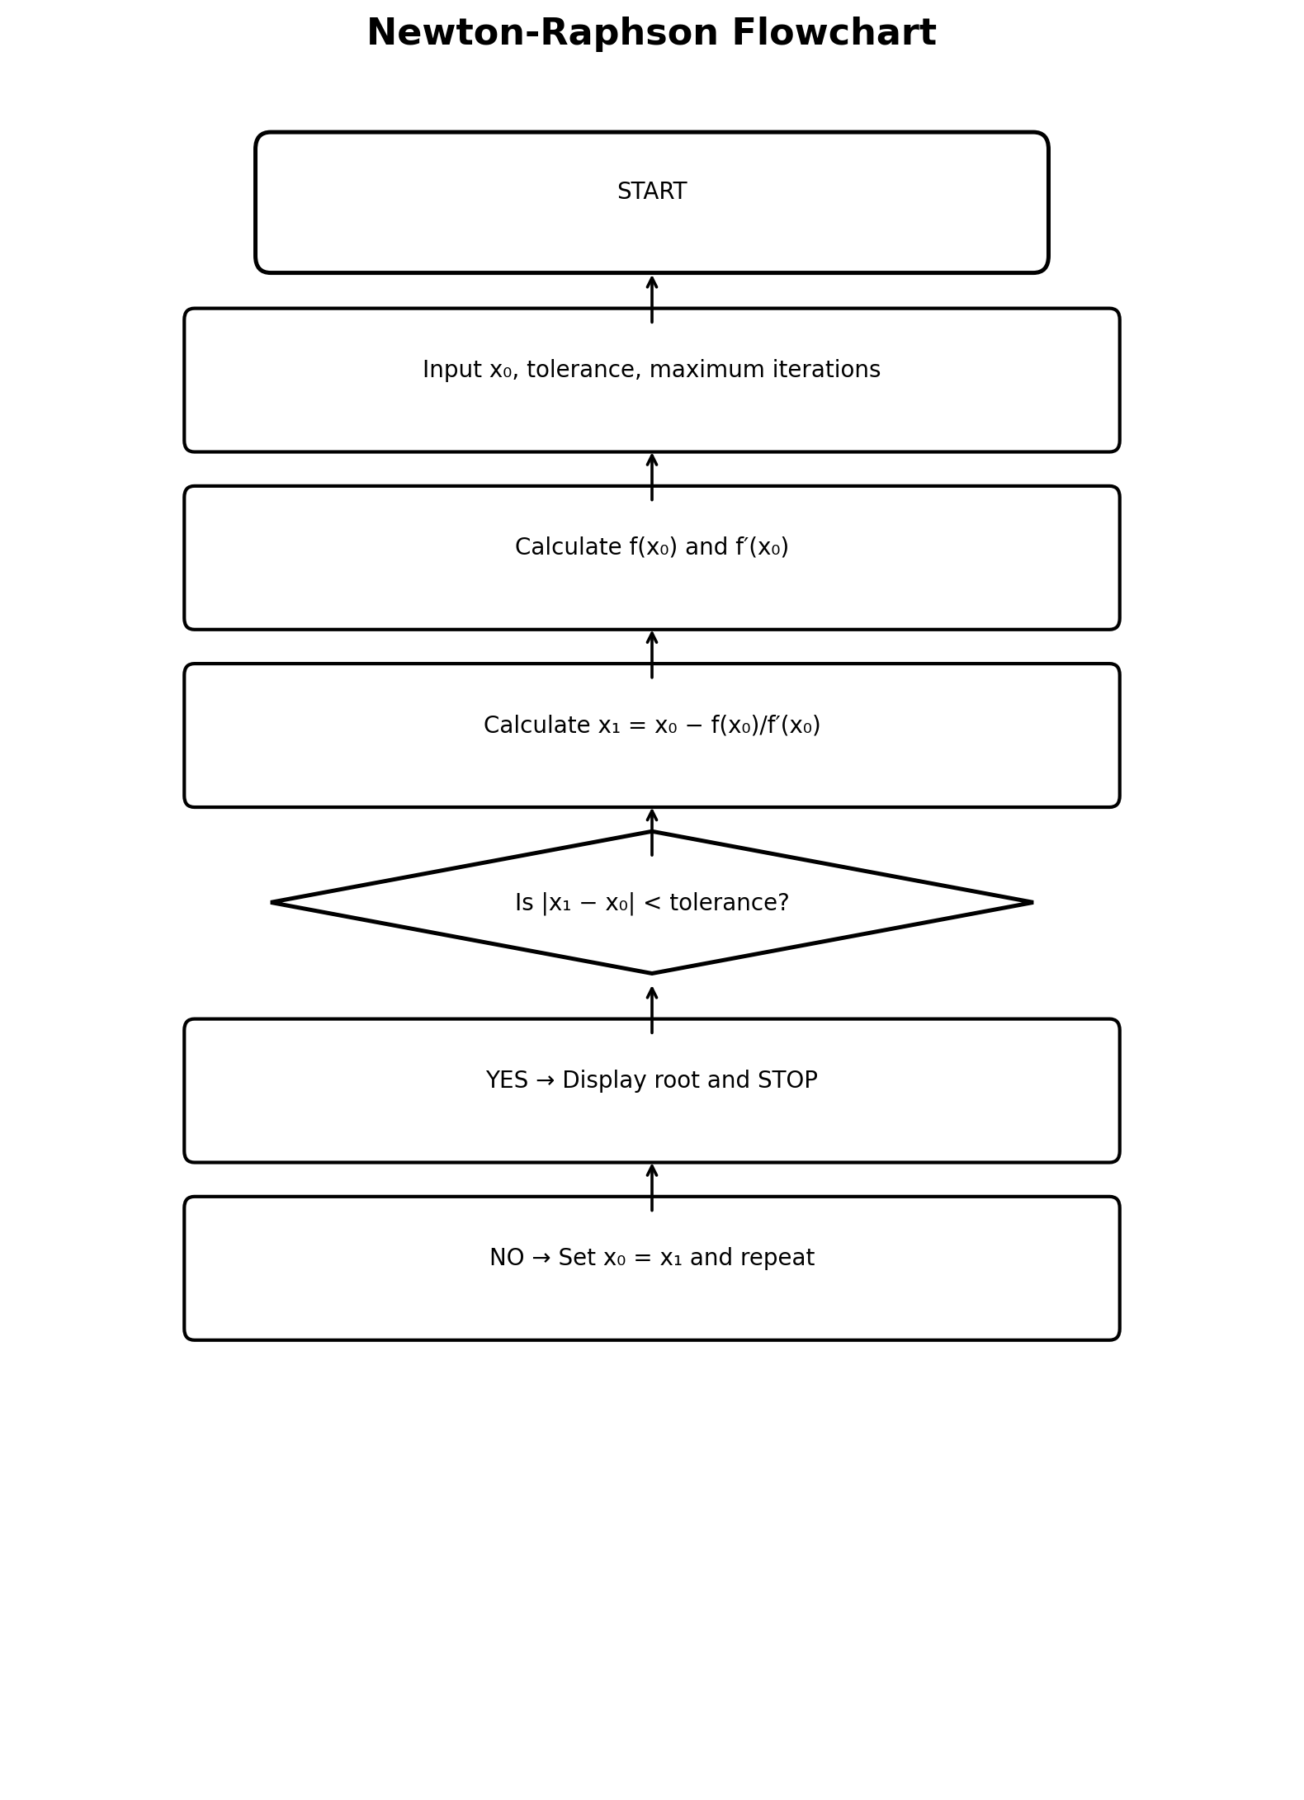
Newton-Raphson Flowchart

Slide 5
Secant Method
xₙ₊₁=xₙ−f(xₙ)(xₙ−xₙ₋₁)/[f(xₙ)−f(xₙ₋₁)]
No derivative is required.
Roots: −6.06724009, −1.40274987, 0.46998995

Slide 6
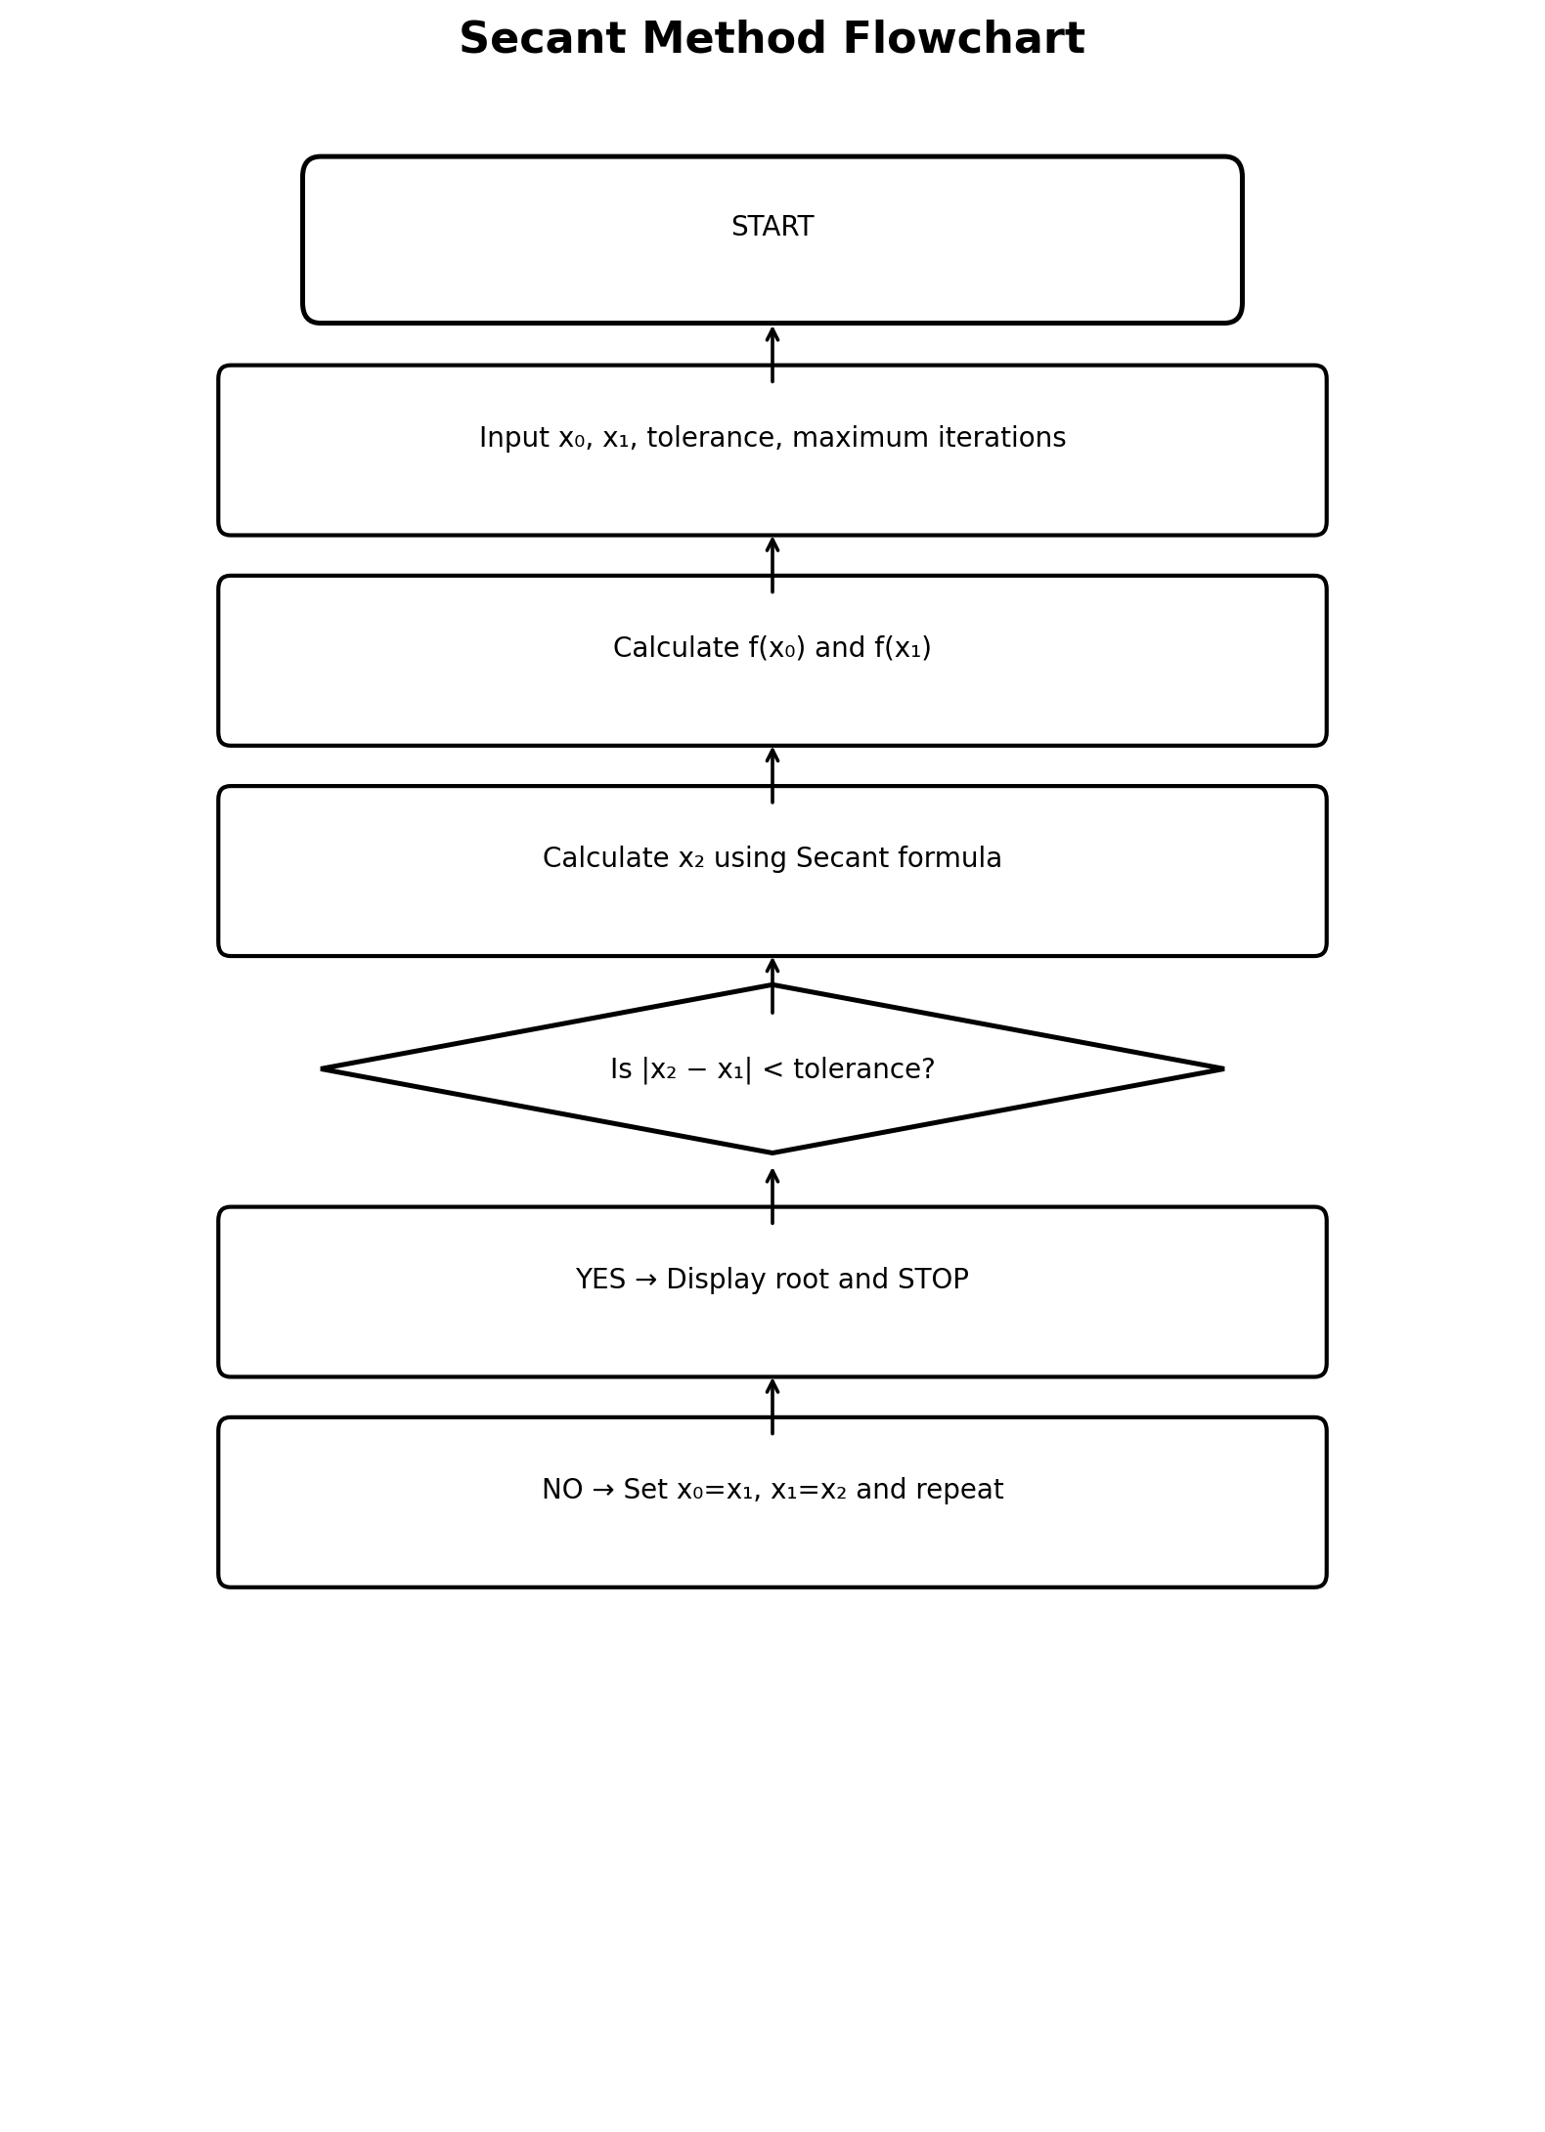
Secant Flowchart

Slide 7
Runge-Kutta (RK4)
RK4 normally solves ODEs.
Use y′=−F(y)/F′(y).
At equilibrium y′=0, so F(y)=0 and the equilibrium values are the polynomial roots.

Slide 8
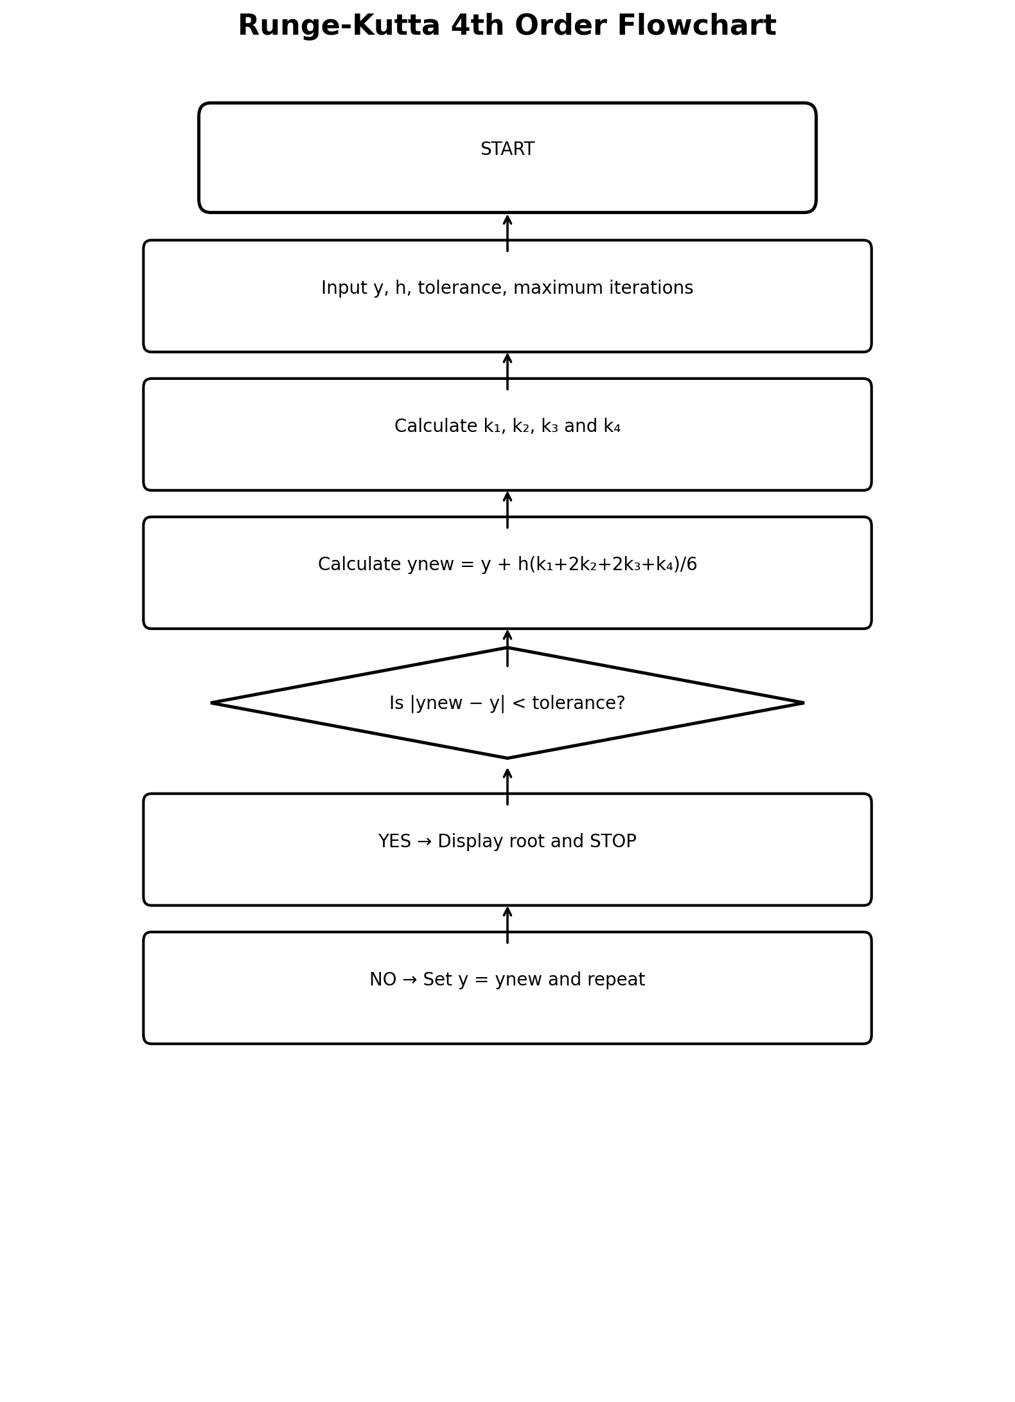
RK4 Flowchart

Slide 9
Pseudocode
START → Input values → calculate new approximation → calculate error → test tolerance → update and repeat → display root → STOP.

Slide 10
MATLAB FOR and WHILE
FOR: repeat up to a maximum number of iterations and stop when tolerance is reached.
WHILE: continue while error is above tolerance and the iteration limit is not reached.

Slide 11
Final Results
Newton-Raphson: −6.06724009, −1.40274987, 0.46998995
Secant: −6.06724009, −1.40274987, 0.46998995
RK4 continuous Newton: approximately the same roots.

Slide 12
Conclusion
The same polynomial was solved using the three requested approaches. Flowcharts, pseudocode, worked iterations, and MATLAB FOR/WHILE programs are included.

