Slide 1








$$y$$
$$(x_{1}, y_{1}+δ)$$
$$s_{a}$$
$$(x_{1}, y_{1})$$
$$\overline{slp}=\min_{1≤i<j≤k}{\frac{\left(y_{j}+δ\right)−(y_{i}−δ)}{x_{j}−x_{i}}}$$
$$s_{d}$$
$$s_{b}$$
$$(x_{1}, y_{1}−δ)$$
$$s_{c}$$
$$\underline{slp}=\max_{1≤i<j≤k}{\frac{\left(y_{j}−δ\right)−(y_{i}+δ)}{x_{j}−x_{i}}}$$
Tolerance range
$$x$$
$$s_{a}, s_{b}, s_{c}, s_{d}$$
Intersection of line ${(s}_{a}, s_{c})$ and line ${(s}_{b}, s_{d})$

Slide 2

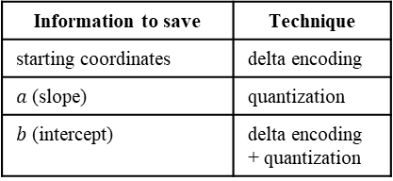


$$y$$
Information to save | Technique
starting coordinates | delta encoding
$a$ (slope) | quantization
$b$ (intercept) | delta encoding + quantization
$$y=a_{i}x+b_{i}$$
$$x$$

Slide 3




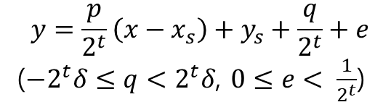



$$q+1$$
$$y$$
$$a=\frac{p}{2^{t}}$$
$$q$$
$$e$$
$$y=\frac{p}{2^{t}}\left(x−x_{s}\right)+y_{s}+\frac{q}{2^{t}}+e$$
($−2^{t}δ≤q<2^{t}δ$, $0≤e< \frac{1}{2^{t}}$)
$$q+1$$
$$q$$
$$…$$
$$2$$
$$1$$
$$\frac{1}{2^{t}}$$
$$(x_{s},y_{s})$$
$$x$$

Slide 4
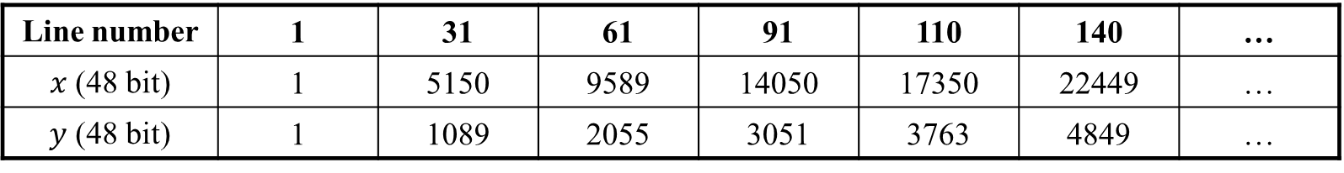
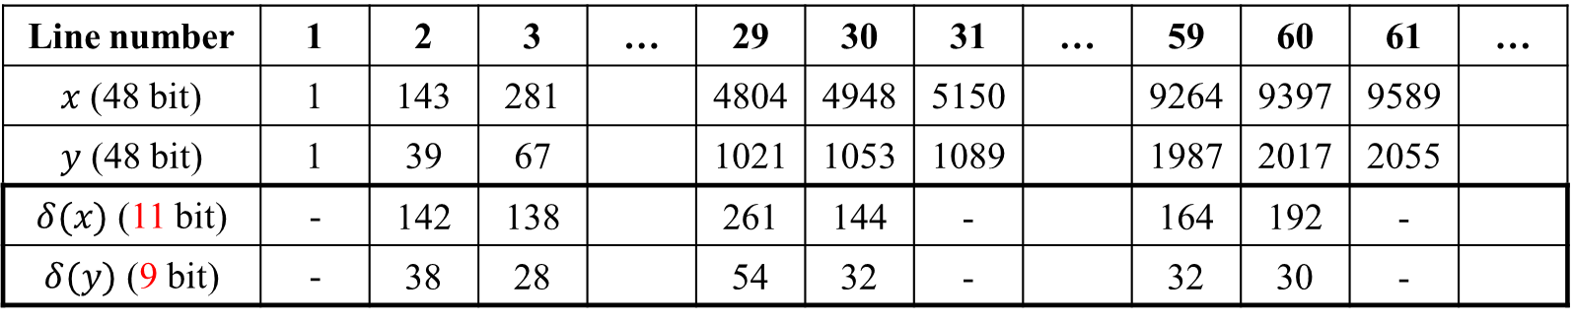
Binary search
Line number | 1 | 31 | 61 | 91 | 110 | 140 | …
$x$ (48 bit) | 1 | 5150 | 9589 | 14050 | 17350 | 22449 | …
$y$ (48 bit) | 1 | 1089 | 2055 | 3051 | 3763 | 4849 | …
Line number | 1 | 2 | 3 | … | 29 | 30 | 31 | … | 59 | 60 | 61 | …
$x$ (48 bit) | 1 | 143 | 281 |  | 4804 | 4948 | 5150 |  | 9264 | 9397 | 9589
$y$ (48 bit) | 1 | 39 | 67 |  | 1021 | 1053 | 1089 |  | 1987 | 2017 | 2055
$δ(x)$ (11 bit) | - | 142 | 138 |  | 261 | 144 | - |  | 164 | 192 | -
$δ(y)$ (9 bit) | - | 38 | 28 |  | 54 | 32 | - |  | 32 | 30 | -
: Data stored

