Slide 1
Publication

Slide 2
Title
E2E Self-adaptive Service Function Chain Orchestration in an SDN-based Mobile Edge
Service Function Chain Orchestration With Self-healing in an SDN-based Datacenter
Keywords
self-adaptive/dynamic/E2E service chaining
Similar Works
Field Trial of Multi-Layer Slicing Over Disaggregated Optical Networks Enabling End-to-End Crowdsourced Video Streaming
A Latency-Aware Real-Time Video Surveillance Demonstration: Network Slicing for Improving Public Safety
End-to-end network slicing for 5G mobile networks
An end-to-end performance analysis for service chaining in a virtualized network
Demonstration of latency-aware and self-adaptive service chaining in 5G/SDN/NFV infrastructures
SDN controller for context-aware data delivery in dynamic service chaining

Slide 3
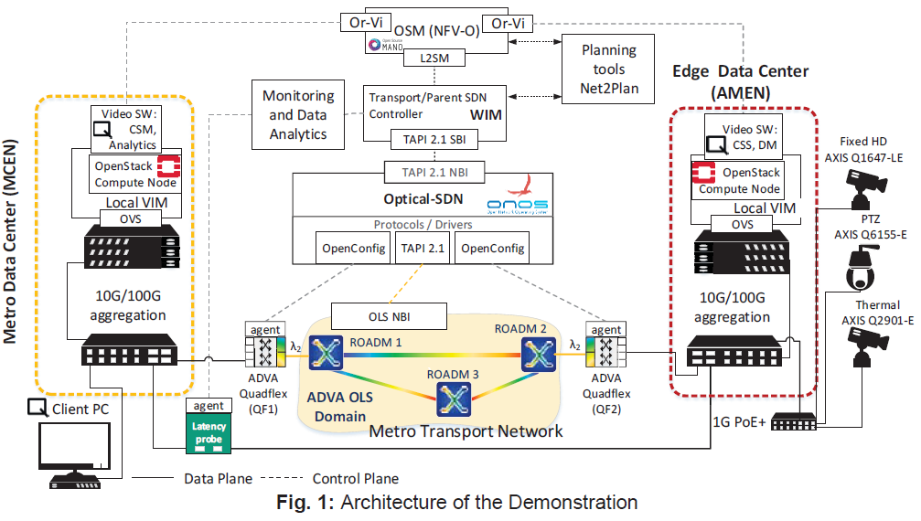
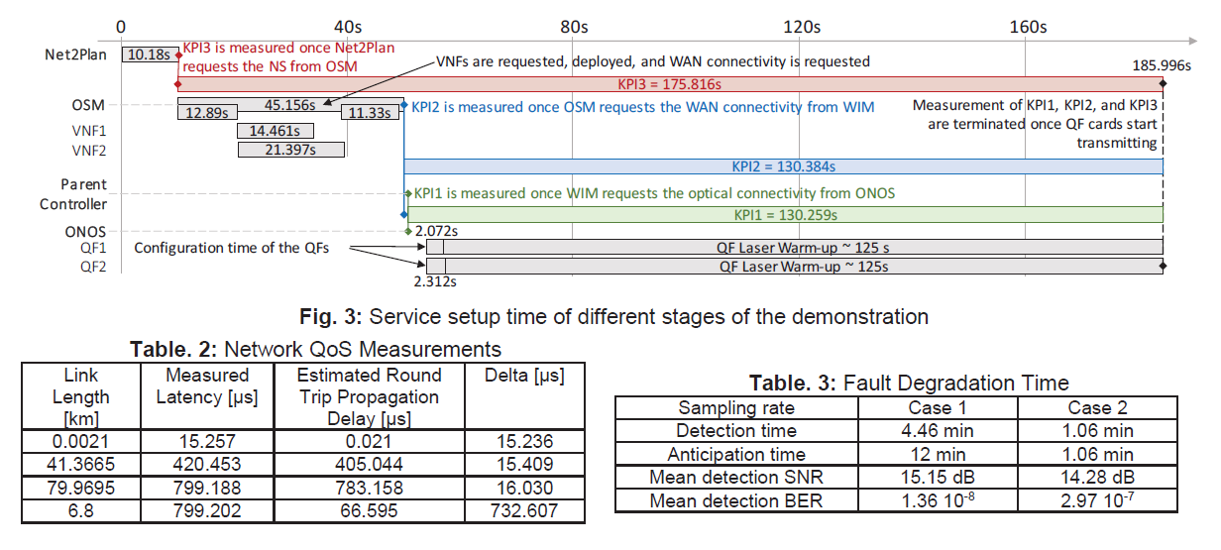
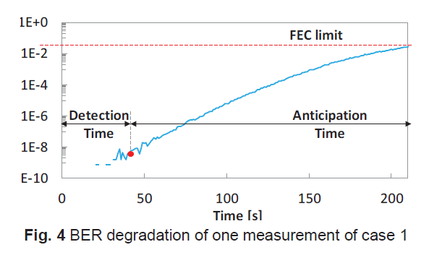
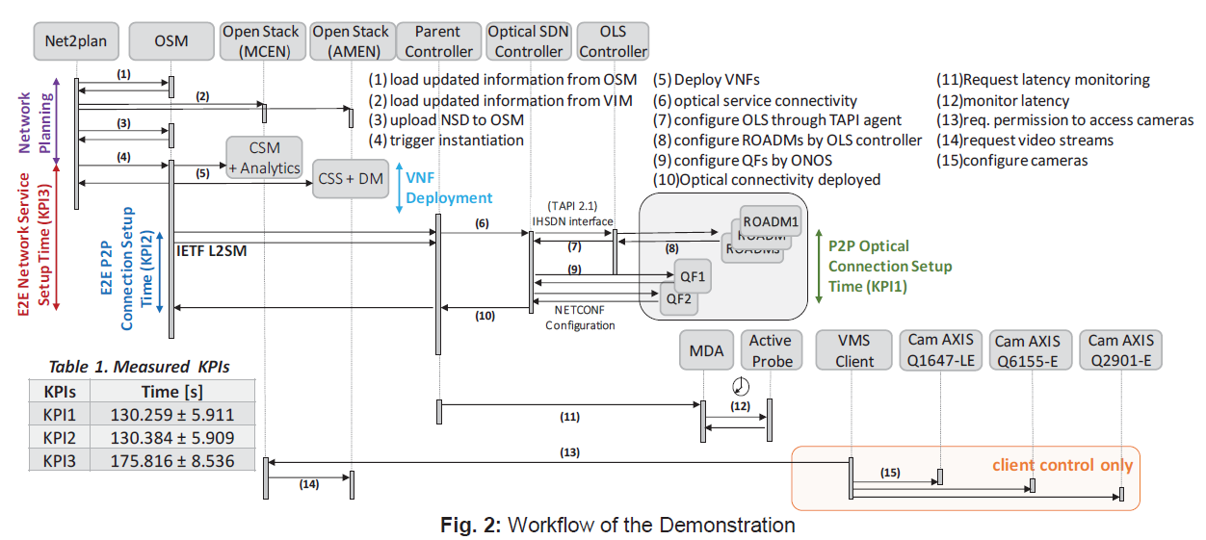
Similar work

Slide 4
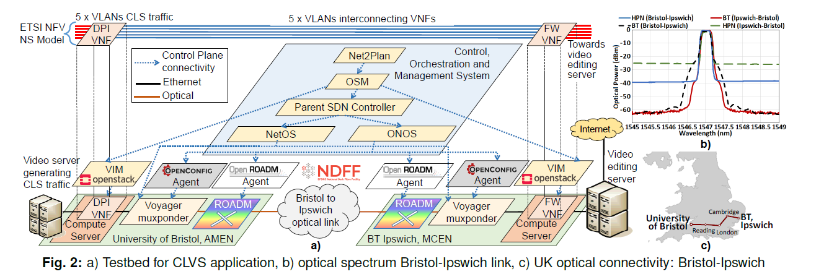
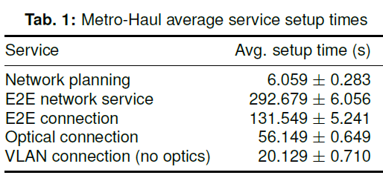
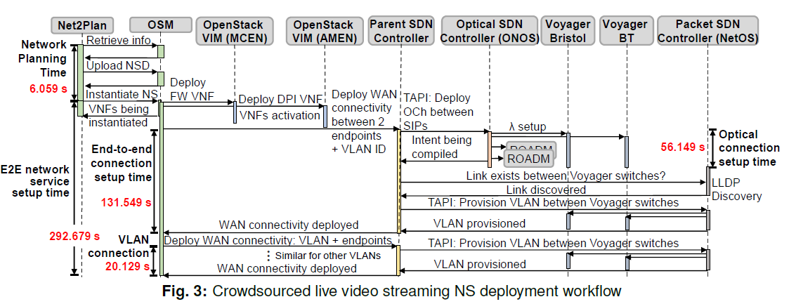
Similar Works

Slide 5
Main Figure/ Results
The Overall Proposed Architecture
Workflow Diagram
Optimization
Reference: Formula + pseudocode
Results
Average service chaining deployment time
Solver time
Function deployment
Placement
E2E Connection

Slide 6
Conferences
Netsys March 5th, 2022

