Slide 1
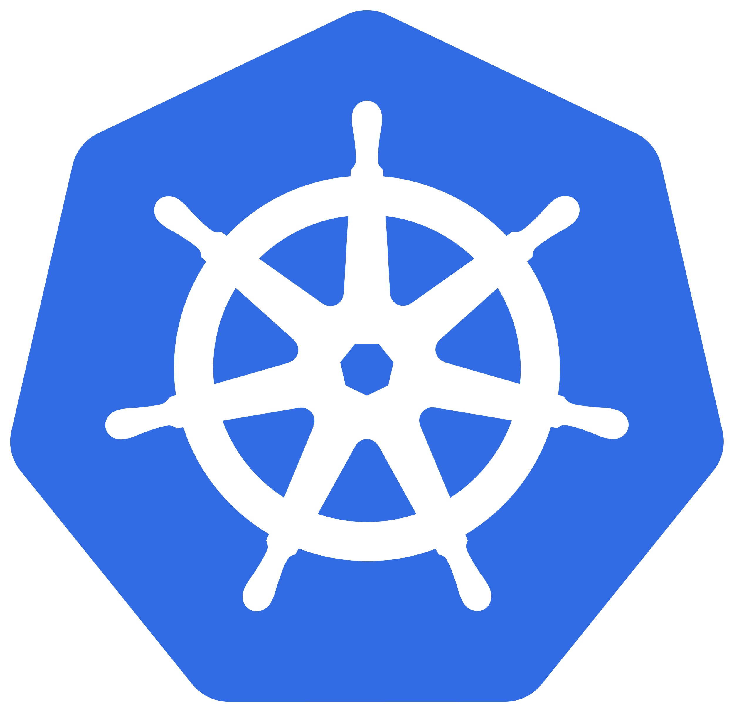

1

Slide 2
Table of Contents
Background
What is Kubernetes?
Container deployment
Kubernetes Components
Scheduling
Helm
2

Slide 3
Background
Kubernetes
Kubernetes, also known as K8s, is an open source system for managing containerized applications across multiple hosts.
Provides basic mechanisms for deployment, maintenance, and scaling of applications.
Kubernetes built upon Google’s running production workloads at scale using a system called Borg, combined with best-of-breed ideas and practices from the community.
Kubernetes is hosted by the Cloud Native Computing Foundation (CNCF).

Slide 4
What is Kubernetes?
Kubernetes is a portable, extensible, open-source platform for managing containerized workloads and services, that facilitates both declarative configuration and automation.
The name Kubernetes originates from Greek, meaning helmsman or pilot.

Slide 5
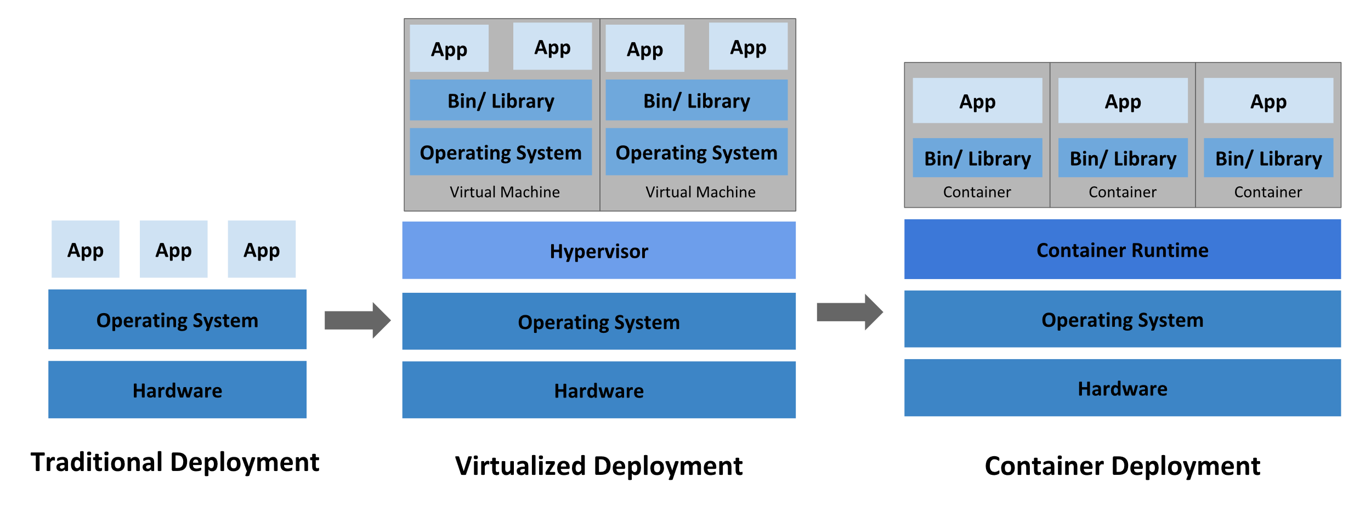
Container deployment

Slide 6
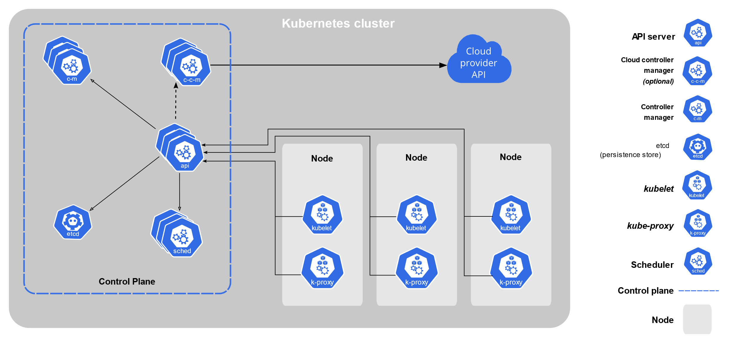
Kubernetes Components

Slide 7
Control Plane Components
kube-apiserver: The API server is a component of the Kubernetes control plane that exposes the Kubernetes API.
etcd: Consistent and highly-available key value store used as Kubernetes' backing store for all cluster data.
kube-scheduler: Control plane component that watches for newly created Pods with no assigned node, and selects a node for them to run on. Factors taken into account for scheduling decisions include: individual and collective resource requirements, hardware/software/ policy constraints, affinity and anti-affinity specifications, data locality, inter-workload interference, and deadlines.
kube-controller-manager: Control Plane component that runs controller processes.
cloud-controller-manager: A Kubernetes control plane component that embeds cloud-specific control logic.

Slide 8
Worker Node Components
kubelet: It makes sure that containers are running in a Pod.
kube-proxy: kube-proxy is a network proxy that runs on each node in your cluster, implementing part of the Kubernetes Service concept.
Container runtime: The container runtime is the software that is responsible for running containers

Slide 9
Scheduling
kube-scheduler
kube-scheduler is the default scheduler for Kubernetes and runs as part of the control plane.
kube-scheduler is designed so that, if you want and need to, you can write your own scheduling component and use that instead.
Nodes are first filtered to get feasible nodes
Once feasible nodes are found, scheduler then runs a set of functions to score the feasible nodes.
It then notifies API server about decision in a process called binding

Slide 10
Scheduling
kube-scheduler
kube-scheduler selects a node for the pod in a 2-step operation:
Filtering: The filtering step finds the set of Nodes where it's feasible to schedule the Pod
Scoring: In the scoring step, the scheduler ranks the remaining nodes to choose the most suitable Pod placement. The scheduler assigns a score to each Node that survived filtering, basing this score on the active scoring rules.

Slide 11
Scheduling
Supported ways to configure filtering and scoring
A scheduling Policy can be used to specify the predicates and priorities that the kube-scheduler runs to filter and score nodes, respectively. https://kubernetes.io/docs/reference/scheduling/policies/
A scheduling Profile allows you to configure the different stages of scheduling in the kube-scheduler. https://kubernetes.io/docs/reference/scheduling/config/#profiles

Slide 12
Scheduling
Schedule based on disk type
apiVersion: v1
kind: Pod
metadata:
name: nginx
labels:
env: test
spec:
containers:
- name: nginx
image: nginx
imagePullPolicy: IfNotPresent
nodeSelector:
disktype: ssd

Slide 13
Scheduling
Node affinity per scheduling profile
apiVersion: kubescheduler.config.k8s.io/v1beta1
kind: KubeSchedulerConfiguration
profiles:
- schedulerName: default-scheduler
- schedulerName: foo-scheduler
pluginConfig:
- name: NodeAffinity
args:
addedAffinity:
requiredDuringSchedulingIgnoredDuringExecution:
nodeSelectorTerms:
- matchExpressions:
- key: scheduler-profile
operator: In
values:
- foo

Slide 14
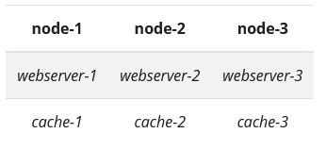
Scheduling
Schedule based on Inter-pod affinity and anti-affinity
Inter-pod affinity and anti-affinity allow you to constrain which nodes your pod is eligible to be scheduled based on labels on pods that are already running on the node rather than based on labels on nodes. The rules are of the form "this pod should (or, in the case of anti-affinity, should not) run in an X if that X is already running one or more pods that meet rule Y".

Slide 15
Scheduling
Schedule based on nodeName
apiVersion: v1
kind: Pod
metadata:
name: nginx
spec:
containers:
- name: nginx
image: nginx
nodeName: kube-01

Slide 16
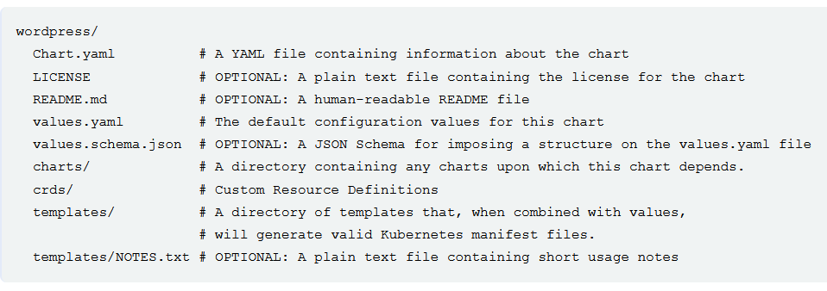
Helm Charts
Helm is the package manager for Kubernetes

Slide 17
Thank You

