Slide 1
Fuzzy Logic Based Light Intensity Controller
Guide → Prof. N.P. Padhy

Slide 2
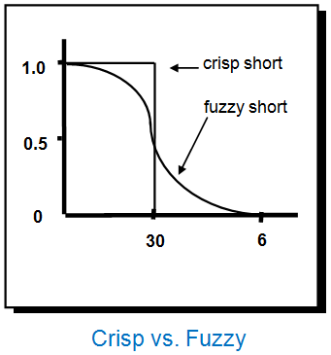
Why Fuzzy Logic?
Alternative to crisp logic
Many Valued Logic
Fluid Scaling
Handles ambiguity
Linguistic Variables

Slide 3


1. Subtasks
Fuzzy Logic Model
Designing Circuits
User interface

Slide 4

How to model Fuzzy Logic?
Matlab

Slide 5
Designing Circuits! From Scratch
Light Control at 220 V
Variable Intensity Circuit
Light Intensity Detection using Fuzzy Logic

Slide 6
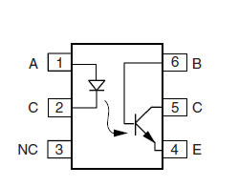
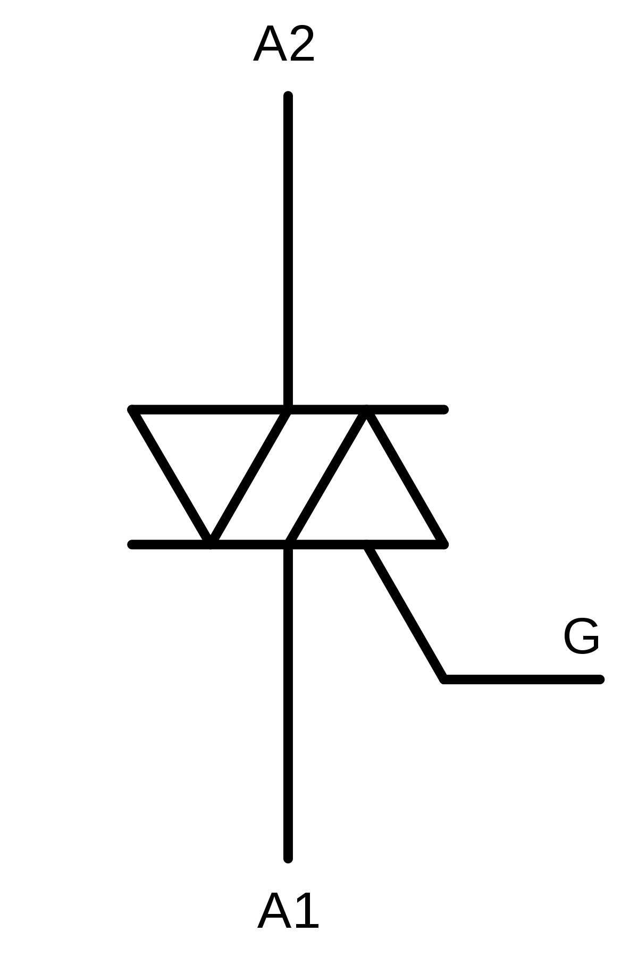
How to isolate 220 V Line from small arduino control voltages ?

Slide 7
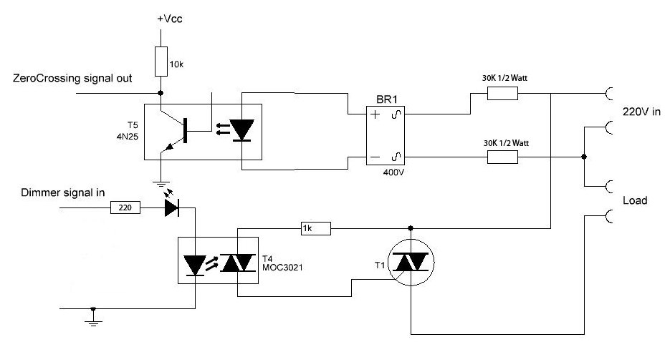
Intensity Controller Circuit
It is used for controlling light intensity using optocouplers and triac

Slide 8
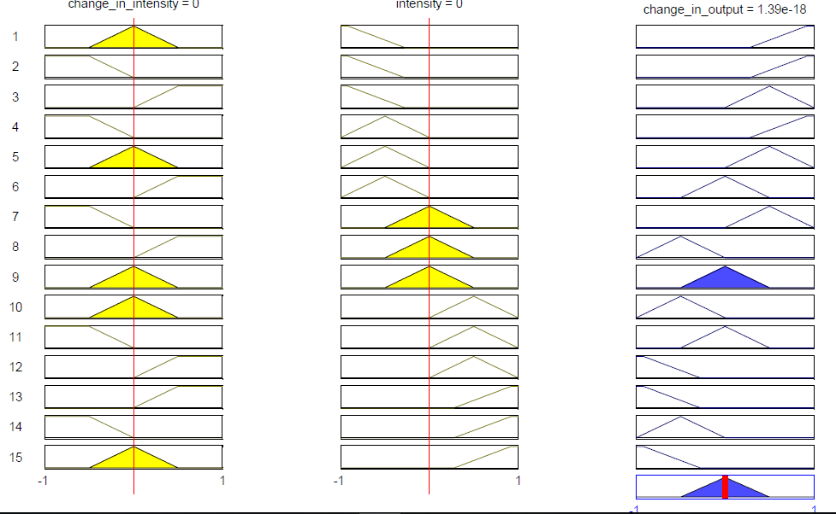
Fuzzy Logic Model
Rules

Slide 9


Incorporating User Input
Using mobile-based application BLYNK

Slide 10


Configuring Blynk using Internet based Server and Arduino UNO

Slide 11

Project Members →
Kakarla Uday Kanth Reddy Mudit Sharma Ankush Singh
Hardik Jain
Saket Gaur
Shubham Kumar

Slide 12
Thank You

