Slide 1
3-Phase to Sequence Decomposer
Hardware designing and Verification
By:​
Aishwarya Mittal (14115008)​
K. Uday Kanth Reddy (14115055)​
Shubham Chowdhary (14115115)

Slide 2
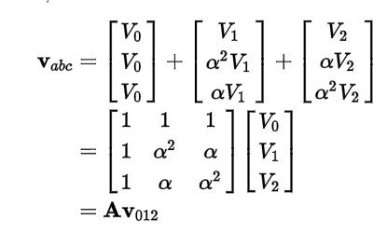

Decomposition
Fortescue Theorem
Use A⁻¹ to calculate V₀₁₂
Simple past time relation to calculate sequences
Susceptible to varied sensitivity at different samples

Slide 3

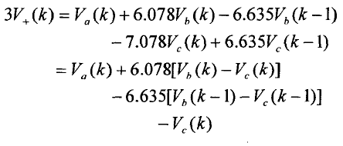
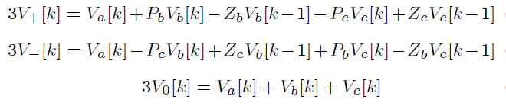
Fast Decomposition
Use of recursive relation to reduce the phase between samples
Our implementation goes from 120 deg. to 7.5 deg. reduction
Results in a difference relation
Will be implemented as a module in verilog

Slide 4
Component 1: Sequence Components Extractor
Calculate sequence components using fast recursion methods, rather than window based inaccurate Fortescue equation

Slide 5
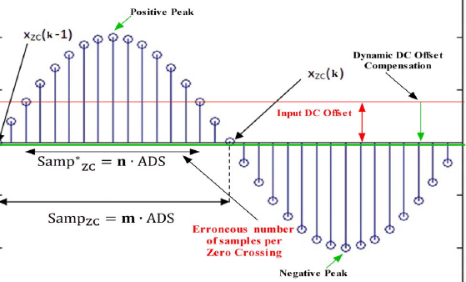
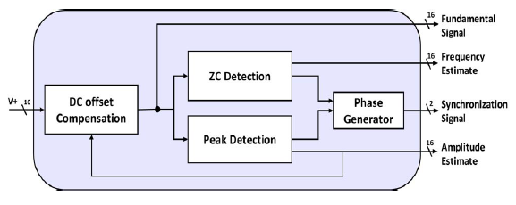
DZCPD Block
Zero crossing and peak detection
Zero crossing in a particular time detects signal frequency
Frequency allows phase calculation at any instant
Peak Detector calculates amplitude of phasor

Slide 6
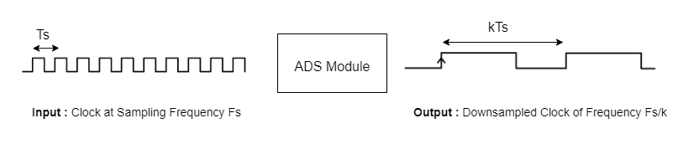
Adaptive Down Sampler
Input signal frequency can vary greatly
ADS module is implemented to give fixed number of samples per cycle to SCE and DZCPD module
$$k=\frac{Fs}{N∗Fin}$$
Fs = Sampling Frequency
Fin = Input Frequency
N = Number of Samples per cycle after downsampling

Slide 7
ADVANTAGES
It is frequency adaptive
Fast operation (gives output in just one sample delay)
It can be used for Data analysis later on by storing the measured values on a server
Faster than sequential microprocessor implementation.

Slide 8
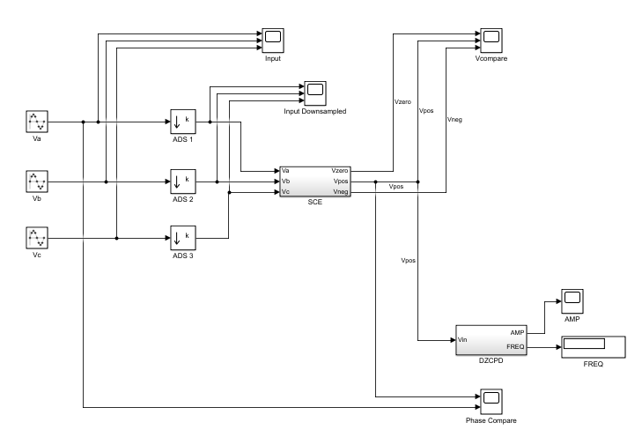
Work Done: Sequence Decomposer Simulink Model

Slide 9
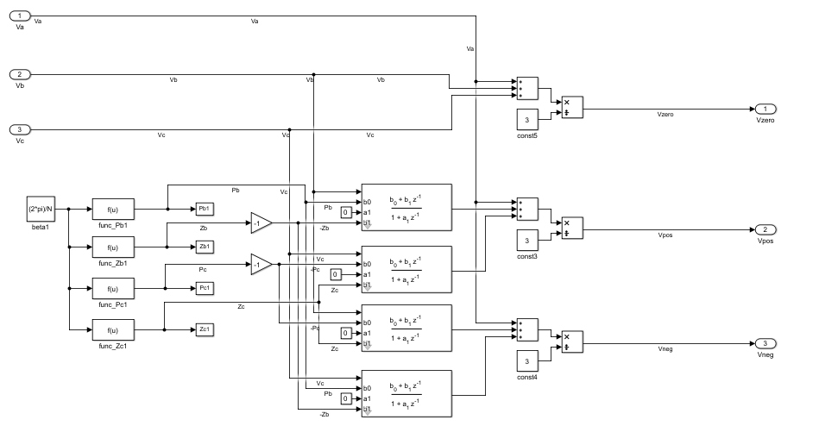
SCE (Seq. Extractor) Simulink Block
Implementing these:

Slide 10
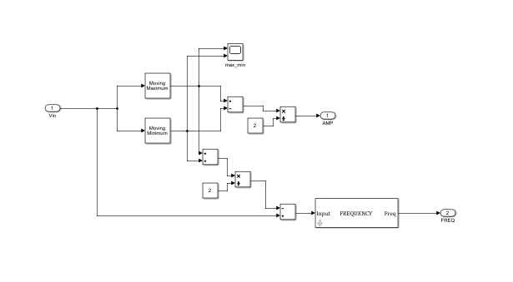
DZCPD Block Simulink
This block calculates:
Seq. component amplitude
Seq. component frequency

Slide 11
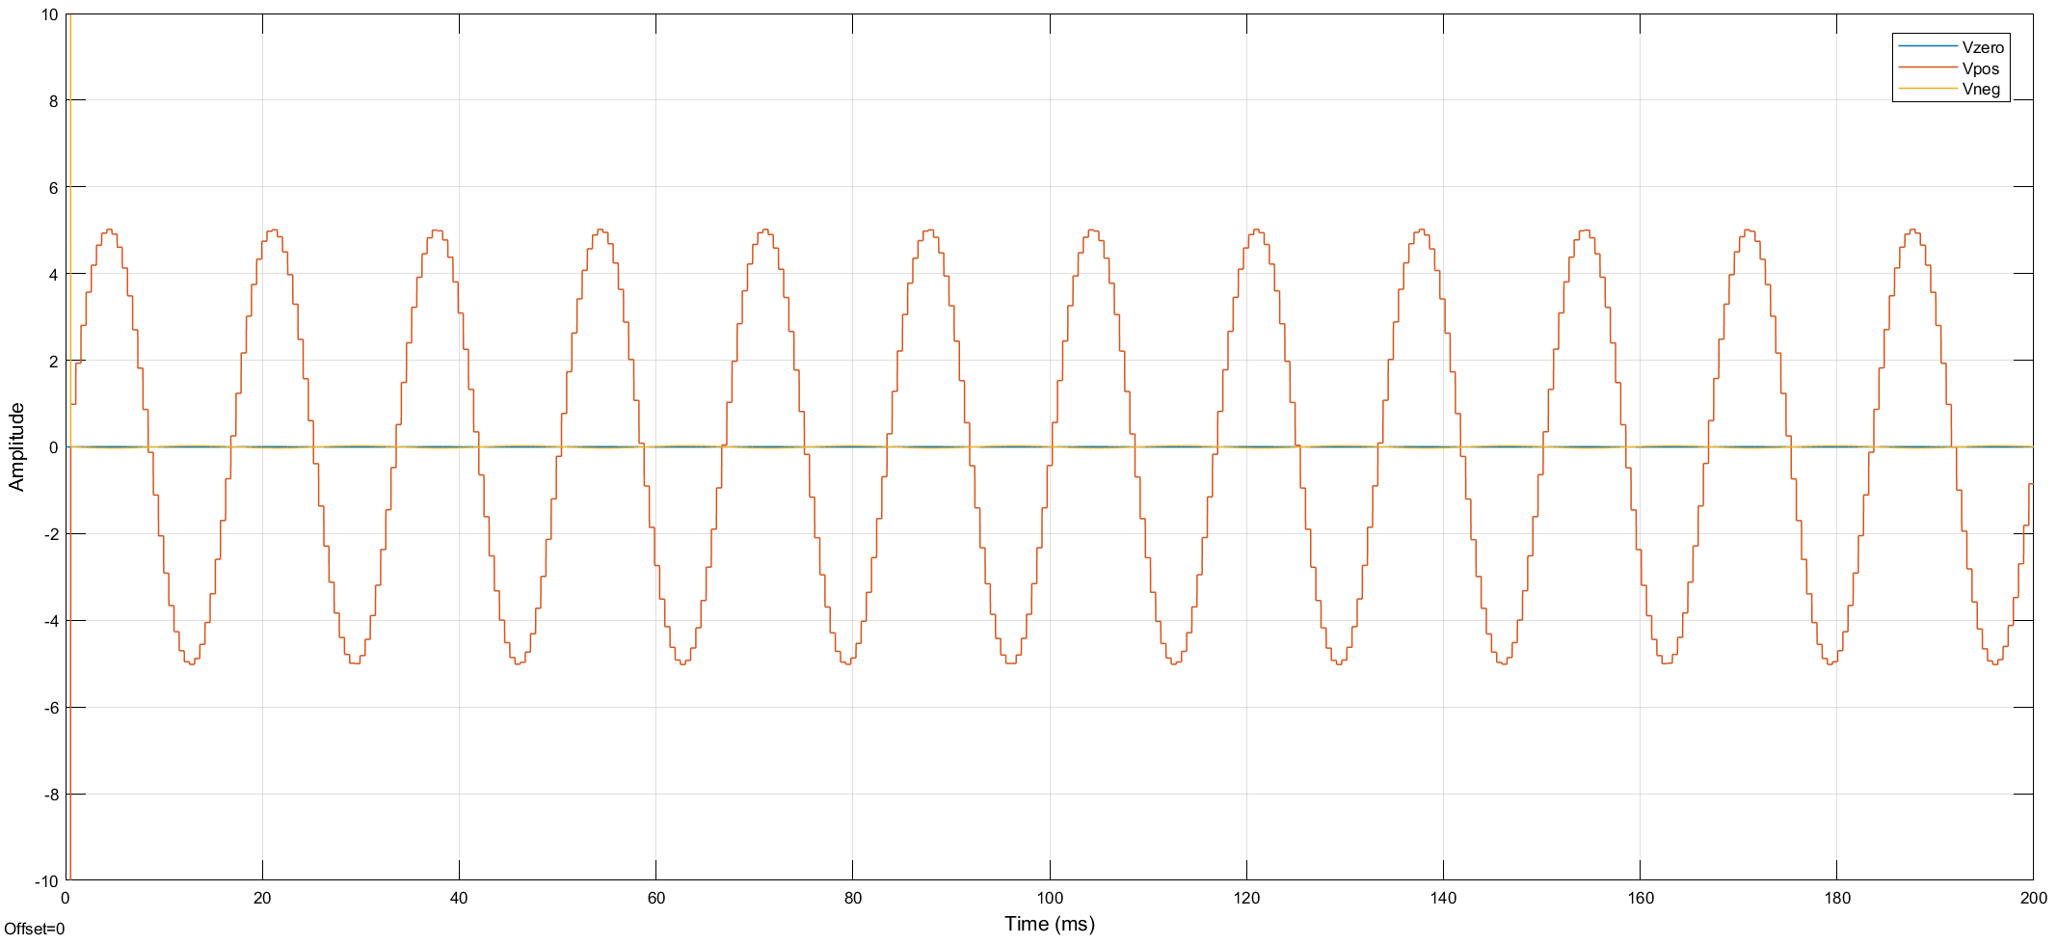
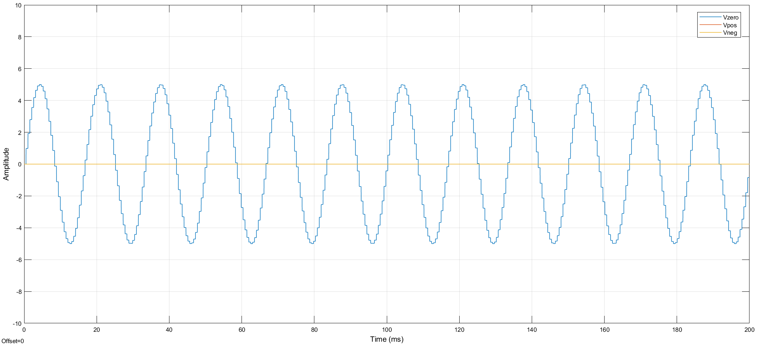
Simulink Model Verification
Balanced Phase
Phases: A->0, B->240, C->120
Equal Phase
Phases: A->0, B->240, C->120

Slide 12
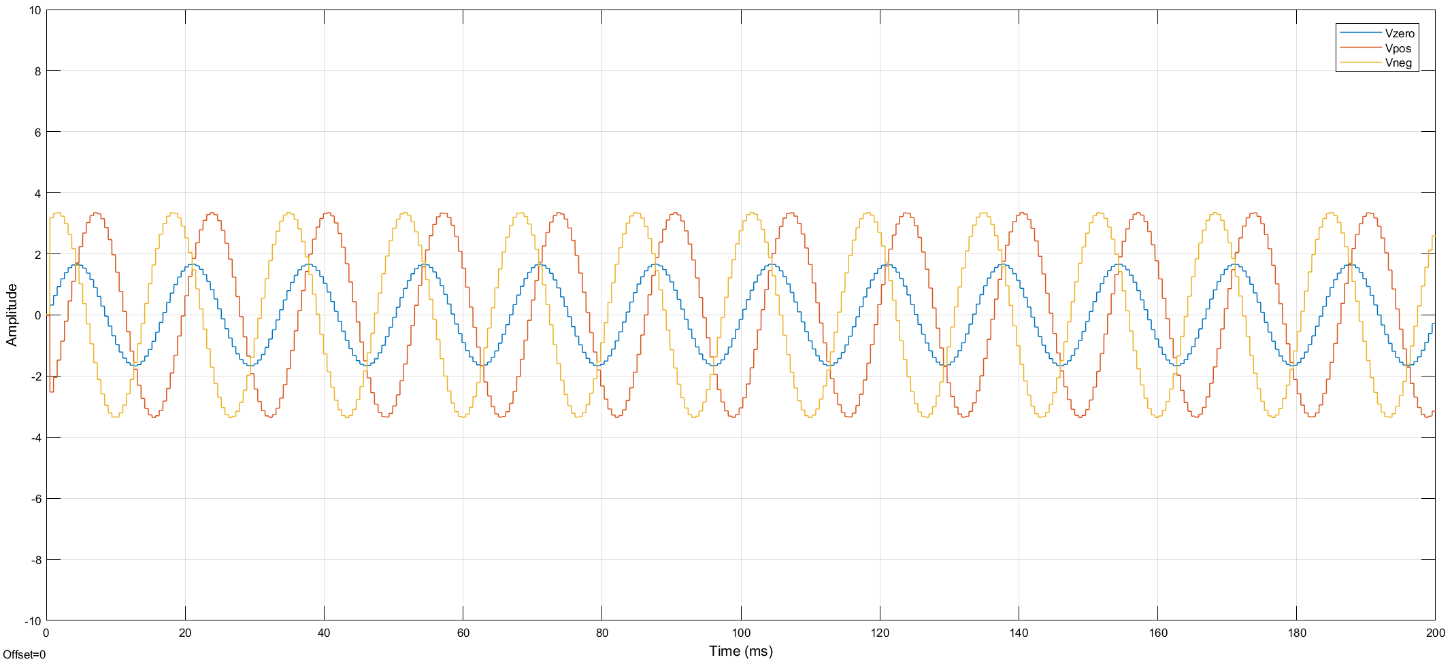
Simulink Model Verification
Unbalanced Phase
Phases: A->0, B->180, C->0

Slide 13
HDL Implementation of Sequence Decomposer
SEQ DECOMPOSER module HDL model implemented using Verilog HDL
Major Modules are
ADS Module
SCE Module
DZCPD Module
FREQ Measure Module
AMP Measure Module
PHASE Measure Module

Slide 14
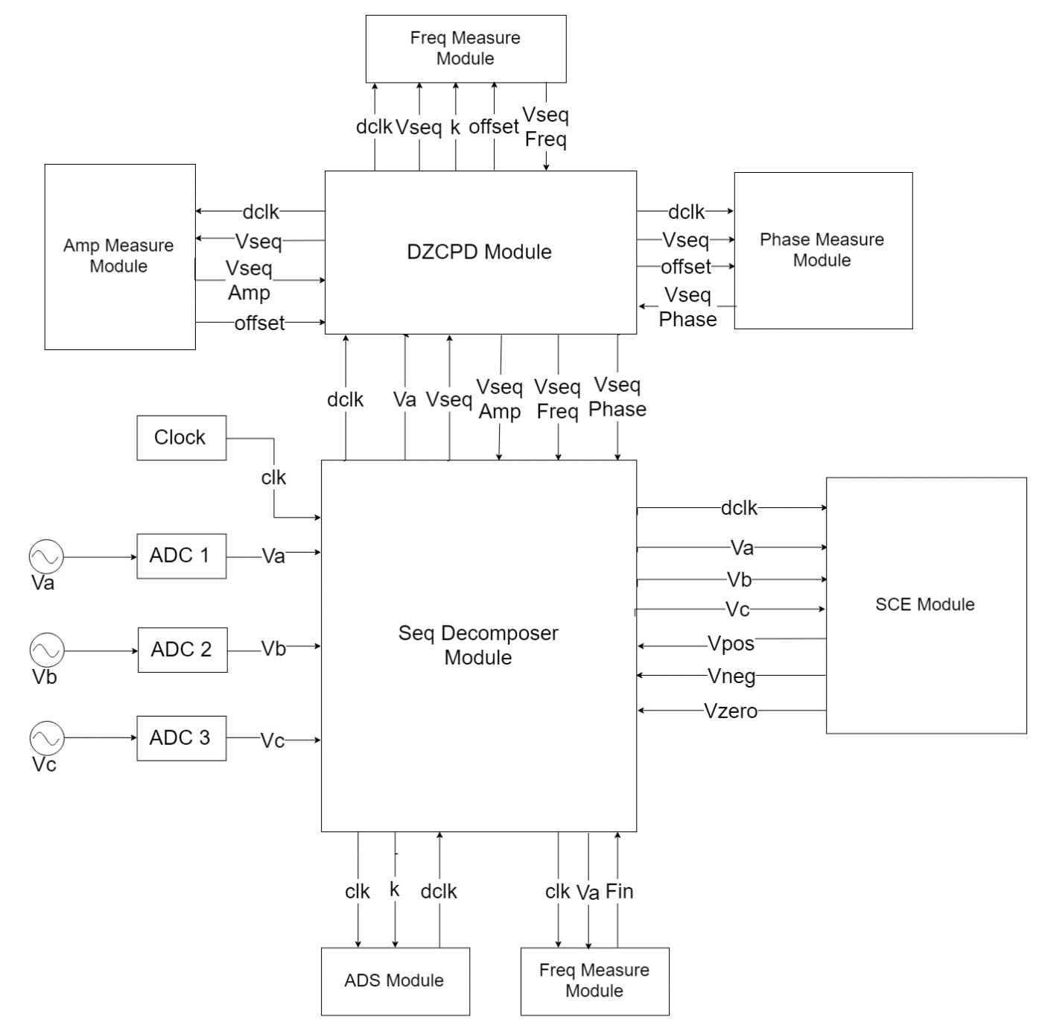
Fig: Schematic Diagram of Sequence Decomposer HDL Implementation

Slide 15
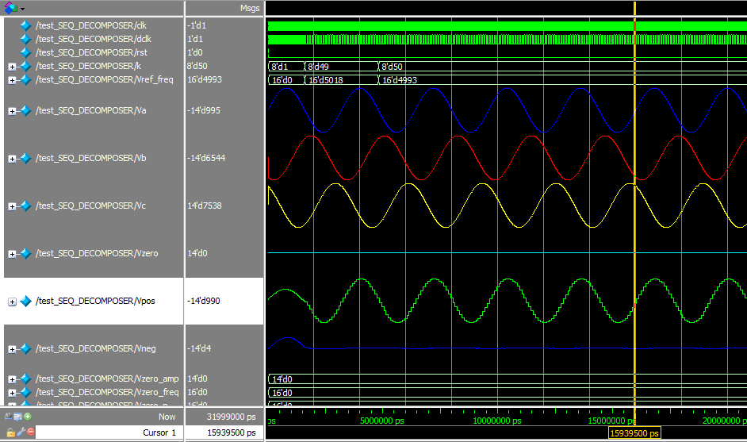
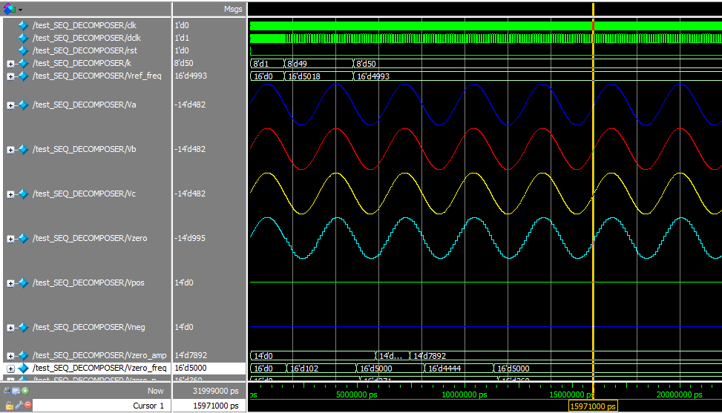
Verilog Module Results
Balanced Phase
Phases: A->0, B->240, C->120
Equal Phase
Phases: A->0, B->240, C->120

Slide 16
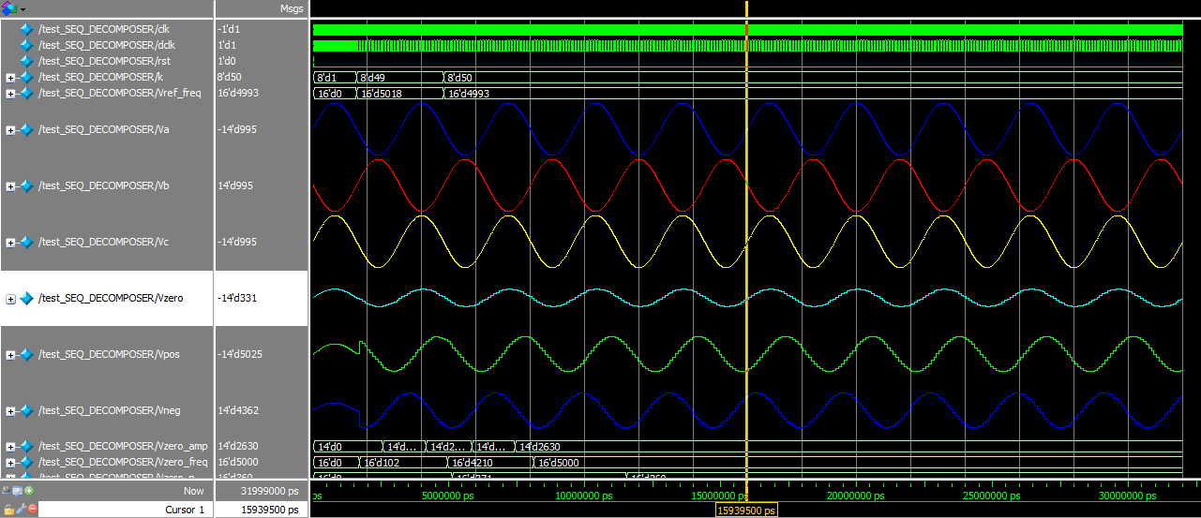
Verilog Module Results
Unbalanced Phase
Phases: A->0, B->180, C->0

Slide 17
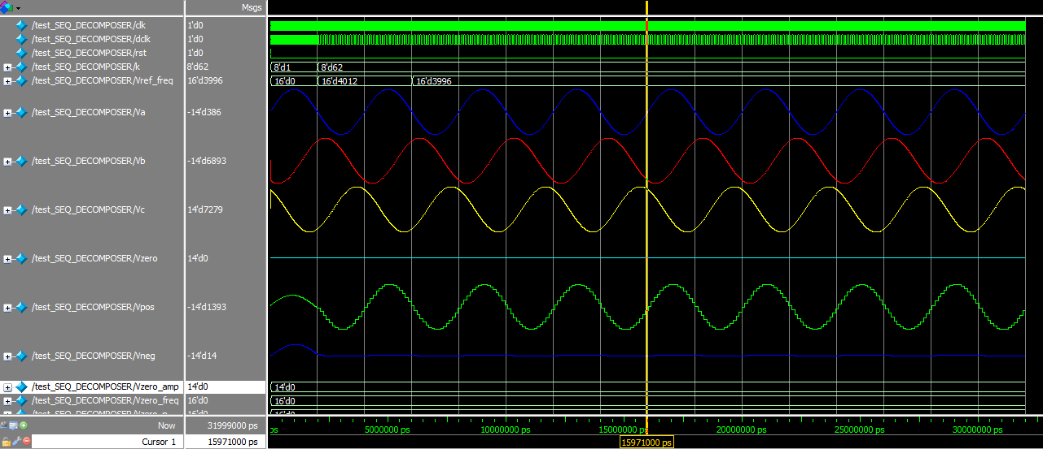
Verilog Module Results
Input Freq.=40Hz
Phases:
A->0
B->240
C->120

Slide 18
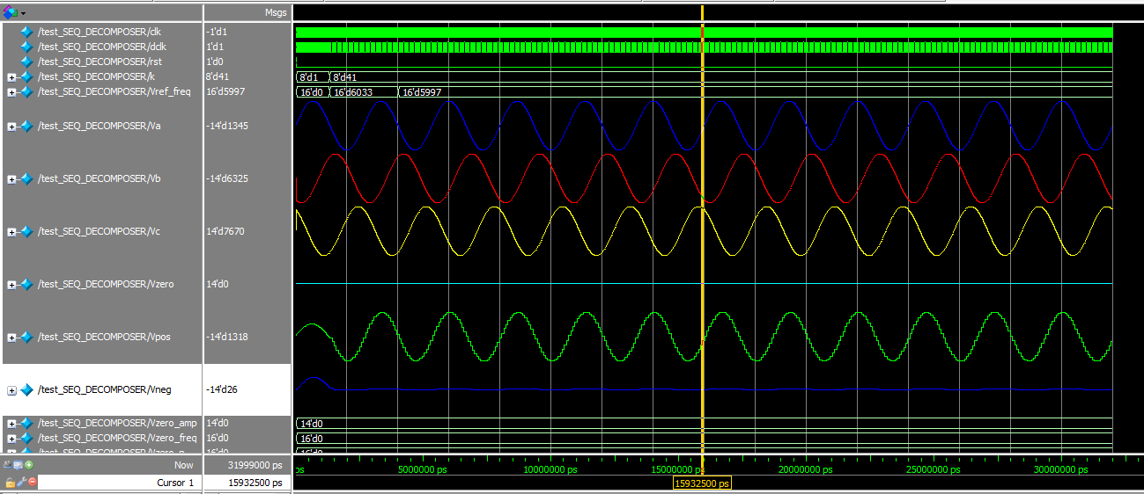
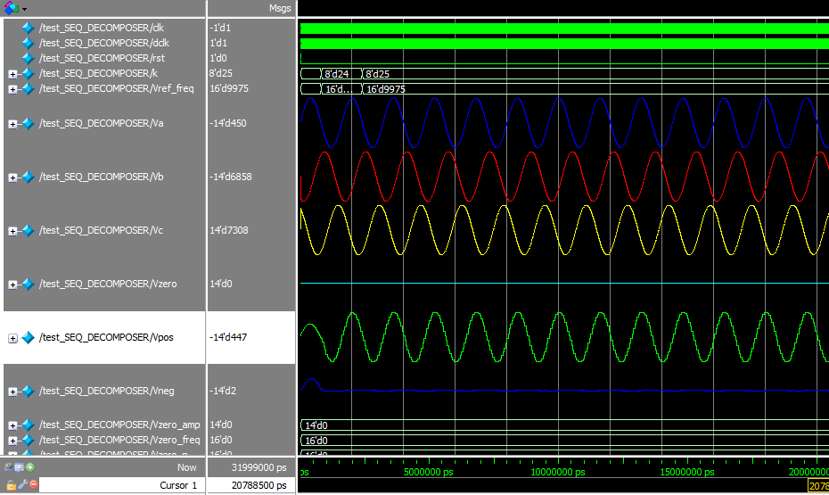
Verilog Module Results
Input Freq.=60Hz
Phases:
A->0, B->240, C->120
Input Freq.=100Hz
Phases:
A->0, B->240, C->120

Slide 19
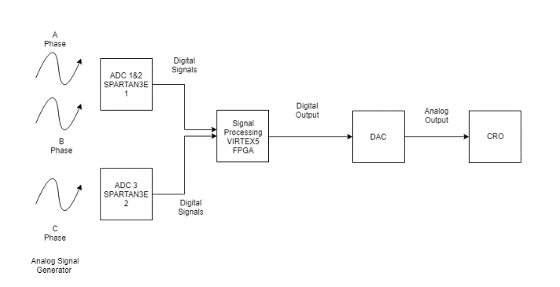
HIL Implementation

Slide 20
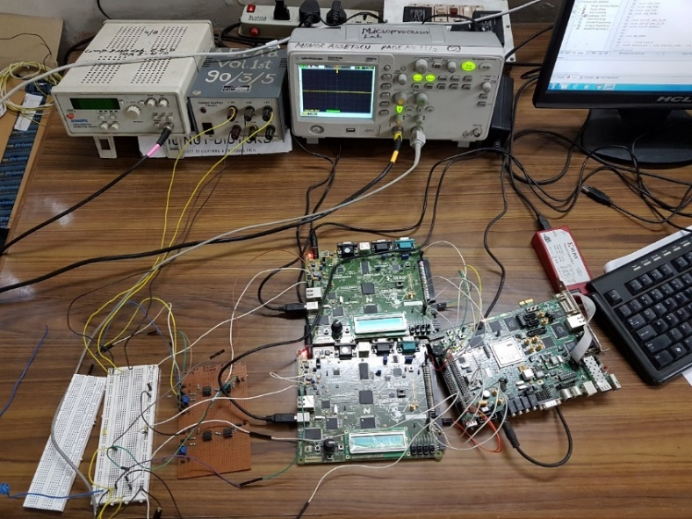
Hardware Setup
Fig: Hardware Setup

Slide 21
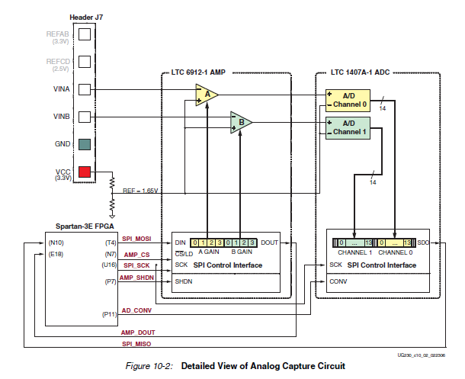
ADC Verification
Input | Output
+2.9V | (01 1111 1111 1111)₂ = +8191
+0.4V | (10 0000 0000 0000)₂ = -8192
+2.0V | (00 1000 1111 0101)₂ = +2293
+1.0V | (10 1111 0101 1101)₂ = -4259
ADC Output Verification
Fig: Analog Capture Circuit of Spartan3E

Slide 22
Further Work
DAC needs to be interfaced to VIRTEX-5 for output at CRO
Separate filter block to tackle harmonics
Xilinx ChipScope tool can be used in place of DAC in order to measure the hardware signal of the output directly.

Slide 23
References
J. Lewis Blackburn, "Symmetrical components for power system engineering", Marcel Dekker, Inc., 1993
C. Li, F.P. Dawson, ”A new algorithm for fast retrieval of sequence components in 3-phase networks”, Power Conv. Conf., vol.3, pp. 1357-1362, Osaka, 2002.
El Sahwi, Essam S., Adrian Z. Amanci, and Francis P. Dawson. "A frequency adaptive three-phase sequence detector synchronization system for power systems applications." Industry Applications Society Annual Meeting (IAS), 2012 IEEE. IEEE, 2012.
A.Z. Amanci, F.P. Dawson, ”Synchronization System with Zero-Crossing Peak Detection Algorithm for Power System Applications”, Int. Power Electron. Conf., pp. 2984-2991, Sapporo, 2010.

