Slide 1
AN IMPLEMENTATION CASE STUDY ON ANT BASED ENERGY EFFICIENT ROUTING IN WSNs
- By
Kavitha Kadarla
S.C Sharma
K. Uday Kanth Reddy

Slide 2
CONTENTS
Motivation
Understanding ACO
Implemented algorithm
Results
Conclusion

Slide 3
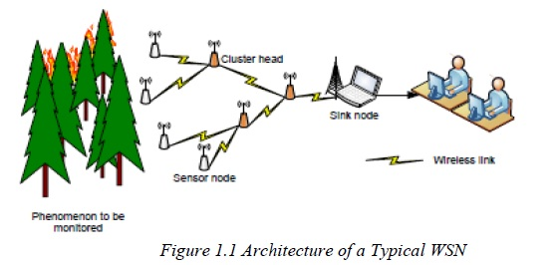
MOTIVATION
Wireless Sensor Networks
They are generally characterized by specific requirements such as
Limited energy availability
Low memory
Reduced processing power

Slide 4
MOTIVATION(Contd...)
Diverse applications and Flexibility in Network Deployment.
Monitor Network environment and report real time information about monitored phenomenon.
This paper presents an implementation case study using Ant Colony Optimization (ACO) heuristic for an energy efficient routing in WSNs.
Practical challenges like neighbor detection failure, Packet loss, interference from external objects were taken into consideration and ACO algorithm was modified accordingly to successfully solve those problems.

Slide 5
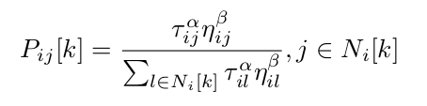
IMPLEMENTED ALGORITHM(TRANSITION PROBABILITY)
In ant colony optimization, each ant attempts to find the optimal path. In their journey from source node to destination node, ants move from node i to a neighbouring node j with a transition probability[2]
where P_{ij}[k] is the probability for ant k to move from node i to node j, τ_{ij} is the pheromone value deposited on link (i,j), η_{ij} a heuristic value assigned to the link, and (α, β) are weights used to control the importance given to the pheromone and the heuristic values, respectively.

Slide 6
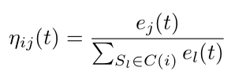
Contd...
The heuristic variable is calculated as follows[19]
where e_{j}(t) is the remaining amount of energy of neighbor j of node i.
When the forward ant gets to the destination node, the destination node generates a backward ant, and sends it back along the reverse path.
The backward ant in each visited node release a certain amount of pheromone △τ

Slide 7


PHERMONE ENHANCEMENT
Therefore, when node receives the response packet from the destination node by the n_{th} neighbor node, the node will update the pheromone concentration τ_{n,d} given by
where ρ is the pheromone evaporation coefficient,
The proposed algorithm considers both energy and distance.
Phermone minimum value-0.005, Phermone maximum value-0.9
Monitored phenomenon-temperature.

Slide 8
IMPLEMENTED ALGORITHM
The proposed protocol includes route discovery and route maintenance process.
In the route discovery process, the sensor nodes establish all valid paths to the destination node by sending a query packet (forward ant), if the ants find the destination node, then the destination node generates a response packet (backward ant).
The backward ant goes back to the sending node along the reverse path, and releases pheromone while it returns.
The concentration of pheromone is in inverse proportion to the distance to the destination node(Here, distance is measured in number of hops) and directly proportional to the average of remaining amount of energy level of the nodes on the path.
Once all the paths are set up, the source node begins to release the data packets and the packets transmit along the path with the highest pheromone concentration.
In route maintenance process, the sensor nodes send a certain number of forward ants to the destination node periodically to monitor the quality of the existing paths.

Slide 9
IMPLEMENTED ALGORITHM
The proposed protocol includes route discovery and route maintenance process.
Establish valid paths by sending forward ants.
Response packet from destination node.
Phermone Update.
Routing of Data packets.
Monitor the quality of existing paths.

Slide 10
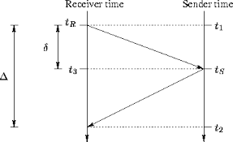
TIME SYNCHRONIZATION
The data and forward ants have been sent at specific intervals and entire network is made to operate at a single synchronized time for coordination between forward ants and data packets by using time synchronization protocol provided in isenseSDK.

Slide 11
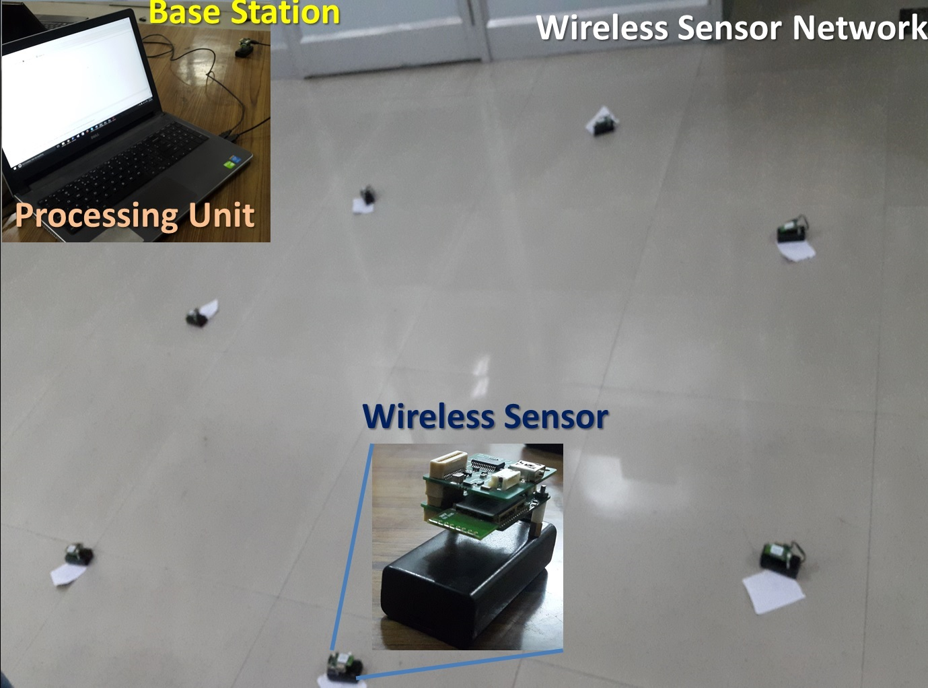
EXPERIMENTAL SETUP
The network was subjected to various disturbances such as
switching off nodes in the network dynamically.
hindrance from other objects which lead to variation in the signal strength between nodes.

Slide 12
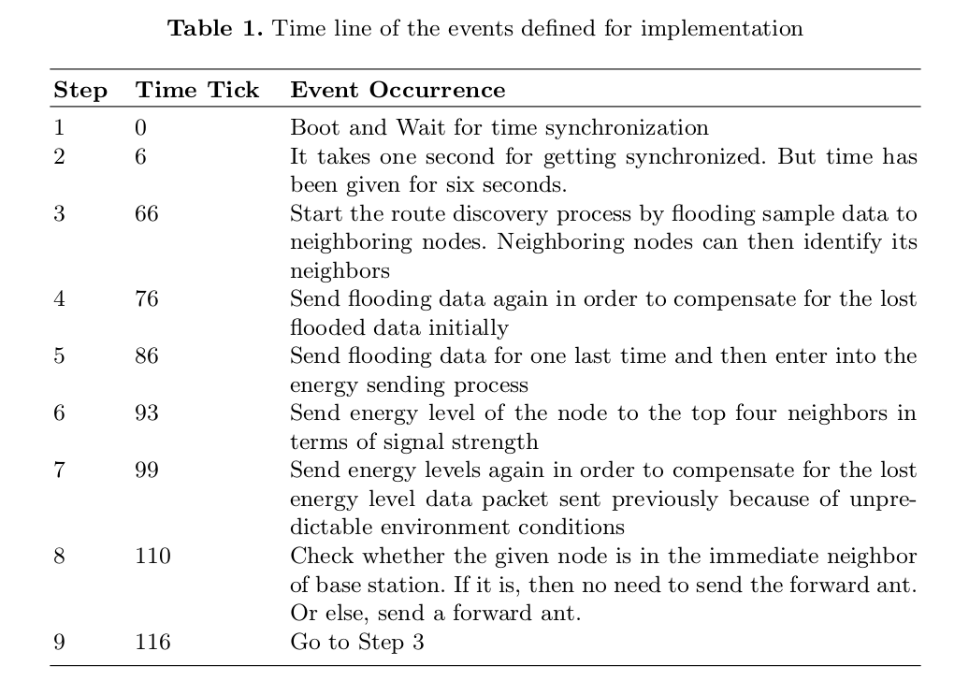
MODIFIED ACO ALGORITHM

Slide 13
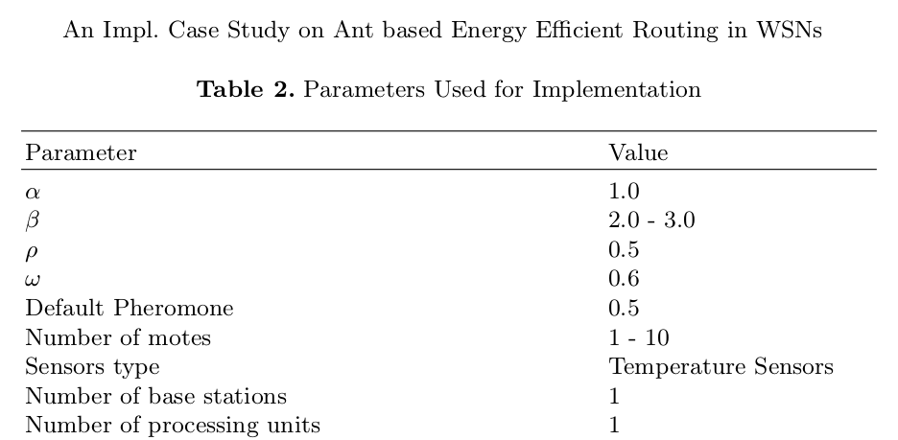
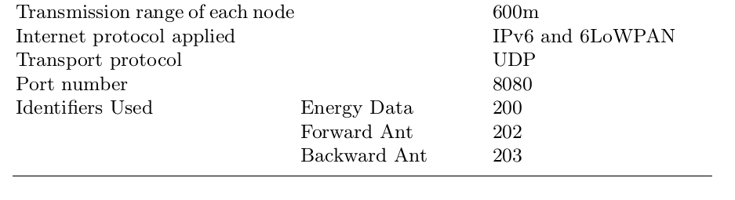
PARAMETERS USED

Slide 14
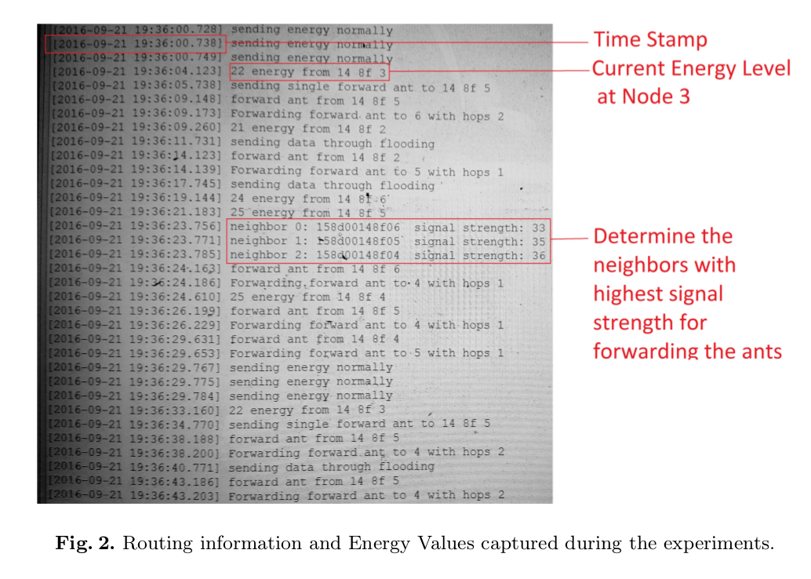
RESULTS

Slide 15
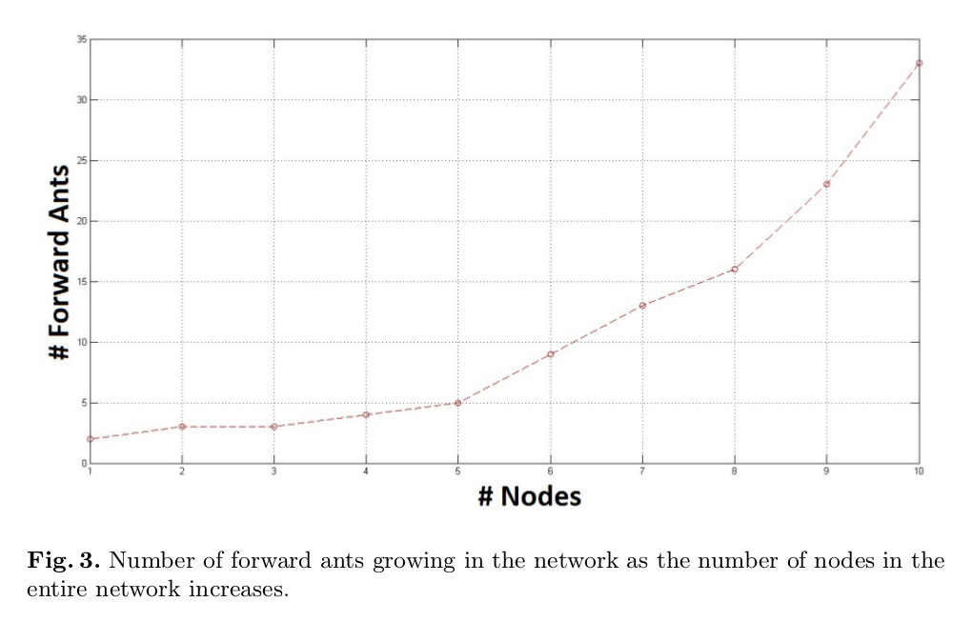
No. of FA vs No. Of Nodes

Slide 16
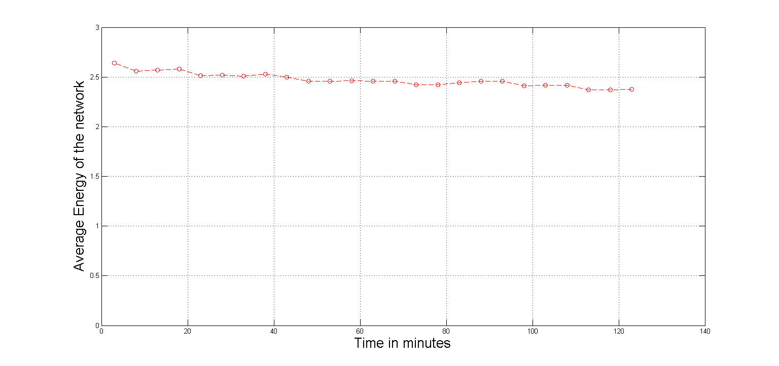
E_{avg} of Network Vs Time

Slide 17
CONCLUSION
Tried to demonstrate the real time implementation of ACO in WSNs
Design a couple of parameters and modify ACO algorithm accordingly.
Performance analysis

Slide 18
FUTURE WORK
The future work could be to reduce the total number of forward ants required to converge to optimal path along with improving the time frame proposed.
Implement clustering(such as LEACH) along with ACO to improve efficiency of the network.

Slide 19
Thank You

Slide 20
REFERENCES
Estrin D, Govindan R, Heidemann J, Kumar S (1999) Next century challenges: scalable coordination in sensor networks. Paper presented at the Proceedings of the 5th annual ACM/IEEE international conference on Mobile computing and networking, Seattle, Washington, USA.
Marco Dorigo and Thomas Sttzle. 2004. Ant Colony Optimization. Bradford Co., Scituate, MA, USA.
Ganesan D, Govindan R, Shenker S, Estrin D (2001) Highly-resilient, energy efficient multipath routing in wireless sensor networks. ACM SIGMOBILE Mobile Computing and Communications Review 5 (4):11-25.
Mann PS, Singh S (2016) Energy-Efficient Hierarchical Routing for Wireless Sensor Networks: A Swarm Intelligence Approach. Wireless Personal Communications. doi:10.1007/s11277-016-3577-1.
Muruganathan SD, Ma DC, Bhasin RI, Fapojuwo AO (2005) A centralized energy-efficient routing protocol for wireless sensor networks. IEEE Communications Magazine 43 (3):S8-13.
Razaque A, Abdulgader M, Joshi C, Amsaad F, Chauhan M P-LEACH: Energy efficient routing protocol for Wireless Sensor Networks. In: Long Island Systems, Applications and Technology Conference (LISAT), 2016 IEEE, 2016. IEEE, pp 1-5.

Slide 21
Razaque A, Mudigulam S, Gavini K, Amsaad F, Abdulgader M, Krishna GS HLEACH: Hybrid-low energy adaptive clustering hierarchy for wireless sensor networks. In: Long Island Systems, Applications and Technology Conference (LISAT), 2016 IEEE, 2016. IEEE, pp 1-4
Tabus V, Moltchanov D, Koucheryavy Y, Tabus I, Astola J (2015) Energy efficient wireless sensor networks using linear-programming optimization of the communication schedule. Journal of Communications and Networks 17 (2):184-197.
Schurgers C, Srivastava MB Energy efficient routing in wireless sensor networks. In: Military communications conference, 2001. MILCOM 2001. Communications for network-centric operations: Creating the information force. IEEE, 2001. IEEE, pp 357-361.
Kalantari M, Shayman M Energy efficient routing in wireless sensor networks. In: Proc. Conference on Information Sciences and Systems, 2004.
Gui T, Ma C, Wang F, Wilkins DE Survey on swarm intelligence based routing protocols for wireless sensor networks: An extensive study. In: 2016 IEEE International Conference on Industrial Technology (ICIT), 2016. IEEE, pp 1944-1949.
Farzana AF, Neduncheliyan S Ant based mobility aided routing in mobile Wireless Sensor Networks. In: Information Communication and Embedded Systems (ICICES), 2016 International Conference on, 2016. IEEE, pp 1-5.

Slide 22
Ghosh S, Mondal S, Biswas U A dominating set based modified LEACH using Ant Colony Optimization for data gathering in WSN. In: Advances in Electrical, Electronics, Information, Communication and Bio-Informatics (AEEICB), 2016 2nd International Conference on, 2016. IEEE, pp 390-396.
Ghosh S, Mondal S, Biswas U Enhanced PEGASIS using ant colony optimization for data gathering in WSN. In: Information Communication and Embedded Systems (ICICES), 2016 International Conference on, 2016. IEEE, pp 1-6.
Gupta AL, Shekokar N A novel approach to improve network lifetime in WSN by energy efficient packet optimization. In: Engineering and Technology (ICETECH), 2016 IEEE International Conference on, 2016. IEEE, pp 117-122.
Yao Y, Cao Q, Vasilakos AV (2015) EDAL: An energy-efficient, delay-aware, and lifetime-balancing data collection protocol for heterogeneous wireless sensor networks. IEEE/ACM Transactions on Networking 23 (3):810-823.
Zhong J-h, Zhang J (2012) Ant colony optimization algorithm for lifetime maximization in wireless sensor network with mobile sink. Paper presented at the Proceedings of the 14th annual conference on Genetic and evolutionary computation, Philadelphia, Pennsylvania, USA.
Liu X (2015) An optimal-distance-based transmission strategy for lifetime maximization of wireless sensor networks. IEEE Sensors Journal 15 (6):3484-3491.
Mohajerani A, Gharavian D (2015) An ant colony optimization based routing algorithm for extending network lifetime in wireless sensor networks. Wireless Networks:1-11.

