Slide 1
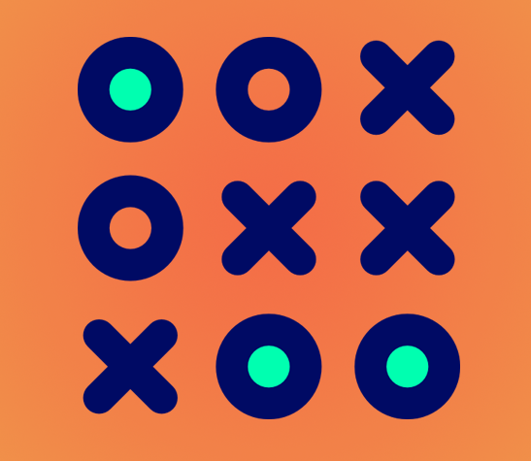
TIC-TAC-TOE
Name : PRANSHU KUKRETI
Student ID. : 19011907
Course : B. Tech (CSE)
Development Area : C/C++
Resource Person: Dr. Ashook Sahoo

Slide 2
Achievements and Learning
I achieved the objective of making a Tic-Tac-Toe game using C language through this project.
Even though tic-tac-toe is a very simple game to understand and play. But, to visualize it how it can be transformed into a code, what are the conditions to keep in mind during its development phase, etc. is challenging. This project has improved my knowledge in the subject and improved my thinking ability.
During all the time I have spent during the making of this small project of mine, I have learned few things that are:
Increased my knowledge in the subject.
Improved thinking ability.
Learned to apply theoretical knowledge to practical problems.
Learned to make Tic-Tac-Toe game.
Improved the knowledge of 1-D and 2-D array.

Slide 3
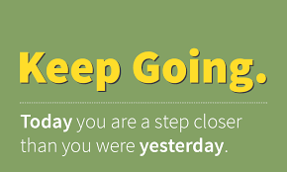
Goals and Motivations
The major goal of this project was to implement a pen and paper game i.e. tic-tac-toe into a computer game.
I saw many TIC-TAC-TOE on the internet and how they work that helped me in deciding my path.
I set a large goal and took some smaller steps in the process of making this project. The whole project is distributed in few short functions that after getting combined makes the full code. As this is my first project, so the enthusiasm was very high that kept me motivated me in this whole journey. In this project I used C language as it is the first language that I learned and moreover I am comfortable to write codes on C.

Slide 4
Challenges Faced in the Process
Project Planning and Figuring out how the game board layout should be made and what kind of C functions I should use in order to make a good Tic-Tac-Toe game.
Thinking about every corner of the problem was a challenging task.
Teaching yourself the concepts by your own was a difficult task. But, it teached me a lot about how to find your way to solutions and what should be the right way to approach a problem.

Slide 5
How I overcome those Challenges
As C language is an old programming language. So, it makes it easy to search any query/ problems on GOOGLE.
Read many articles on the internet about implementation and development of TIC-TIC-TOE.
Many websites like geeksforgeeks, tutorialspoints, etc. and Questions-Answer websites like Stack Overflow, Reddit, Quora, etc. came into help for selecting and guiding and clearing my doubts during the process.

Slide 6
Final Conclusion
After so much hard work, it resulted in successful completion of this project TIC-TIC-TOE.
I haven’t met my expectations yet. There’s a lot I need to improve and learn.

Slide 7
THANK YOU

