Slide 1
TRANSACTION ANALYSIS
Customer Shopping
Behavior Analysis
3,900 purchases across product categories
Implications for subscriptions, loyalty, discounts, merchandising and targeting
Notes:
This analysis reviews customer transactions to identify business questions across customer segments, product performance, loyalty, incentives and shipping behavior.

Slide 2
3,900 purchases provide a view of who buys and how.
3,900
18
6
ROWS
COLUMNS
BEHAVIOR DOMAINS
What the dataset covers
How to read it
Demographics, purchase details, discounts, purchase frequency, review ratings and shipping type.
A descriptive transaction analysis, not evidence of causality.
Analytical frame: the records support questions about behavior and value, not causal claims.
Customer Shopping Behavior Analysis
2
Notes:
Establish the evidence base first: 3,900 purchases and 18 columns give breadth across customer and transaction attributes, while the analysis remains descriptive.

Slide 3
The data was cleaned before business analysis.
01
02
03
Repair ratings
Standardize fields
Load for analysis
Thirty-seven missing Review Rating values were imputed using the median within each product category.
Columns were standardized to snake case; age groups and purchase-frequency days were engineered.
Promo Code Used was dropped after a redundancy check with Discount Applied; cleaned data was loaded into PostgreSQL.
Result: the business questions use a consistent transaction table.
Customer Shopping Behavior Analysis
3
Notes:
Explain that data preparation preceded the SQL work: ratings were imputed by product category, fields were standardized, useful derived fields were created, and redundant promotion information was removed.

Slide 4




Ten SQL questions connect transactions to decisions.
Four lenses organize the analysis without implying quantitative results that the source text does not provide.
REVENUE AND SEGMENTS
PRODUCTS AND RATINGS
Gender, age groups and revenue contribution.
Demand, review ratings and discounted purchases.
DISCOUNTS AND SUBSCRIPTIONS
SHIPPING AND PURCHASE BEHAVIOR
Spend, revenue, repeat buying and subscription behavior.
Discount use, purchase amount and service options.
Customer Shopping Behavior Analysis
4
Notes:
The SQL work is organized into four decision lenses. The slide maps what was asked, rather than claiming results not available in the source figures.

Slide 5
Revenue analysis spans gender and age groups.
TARGETING QUESTIONS
Gender
Age groups
SQL compared total revenue from male and female customers.
SQL calculated revenue contribution by age group.
Who contributes revenue across customer segments?
Exact rankings and values are not established by the available text.
Use: frame segment evidence for targeting questions, not as a confirmed ranking.
Customer Shopping Behavior Analysis
5
Notes:
This analysis compared revenue across gender and calculated contribution by age group. The appropriate business use is targeting exploration, because the source text does not establish segment rankings or amounts.

Slide 6



Product analysis joins demand, satisfaction and discount reliance.
SATISFACTION
DEMAND
DISCOUNT RELIANCE
Highest average review ratings
Most-purchased products
Highest discounted-purchase share
The analysis identified five products with the highest average review ratings.
The analysis identified the top three most-purchased products per category.
The analysis identified five products with the highest share of discounted purchases.
Interpretation guardrail: product names and percentages remain out until source figures can verify them.
Customer Shopping Behavior Analysis
6
Notes:
Bring together three product lenses: satisfaction, demand and discount reliance. The analysis identified products in each lens, but the available source text does not provide names or percentages.

Slide 7
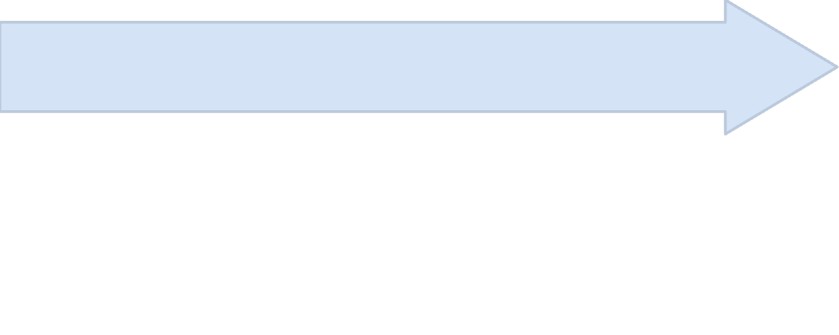
Subscriptions and repeat buying are a loyalty opportunity.
Test subscription relationship
Classify purchase history
Check whether customers with more than five purchases were more likely to subscribe.
Compare subscribers
Classify customers as New, Returning and Loyal using purchase history.
Compare average spend and total revenue for subscribers and non-subscribers.
Opportunity: use the analysis to shape loyalty offers without treating the tested relationship as a confirmed finding.
Customer Shopping Behavior Analysis
7
Notes:
The loyalty work connects subscriber economics, purchase-history segments and a test of whether more than five purchases relates to subscription. The source supports the question, not a confirmed answer.

Slide 8
Discount and shipping behavior deserve closer measurement.
DISCOUNT BEHAVIOR
SHIPPING BEHAVIOR
High-spending discount users
Standard versus Express
Customers whose discounted purchases exceeded average purchase amount were identified.
Average purchase amounts were compared between Standard and Express shipping.
MARGIN CONTROL
SERVICE OPTIONS
Business question: do incentives and service options support valuable orders without eroding margin?
Customer Shopping Behavior Analysis
8
Notes:
Discount and shipping are two levers that need joint measurement. The analysis identifies high-spending discount users and compares shipping types, while the decision question is order value versus margin.

Slide 9
The analysis culminates in an interactive dashboard.
A Power BI dashboard was built to present the findings visually.
REVENUE AND SEGMENTS
PRODUCTS AND RATINGS
Customer contribution
Demand and satisfaction
Gender and age-group revenue questions.
Purchase, rating and discount-reliance questions.
SUBSCRIPTIONS AND LOYALTY
DISCOUNTS AND SHIPPING
Repeat behavior
Order value questions
Subscriber comparisons and purchase-history segments.
Incentive and service-option comparisons.
Dashboard-inspired summary of the four analysis lenses; no metrics are shown because source figures are not available.
Customer Shopping Behavior Analysis
9
Notes:
The Power BI dashboard is the visual endpoint for the analysis. This summary represents the four lenses without fabricating dashboard values or recreating a fictional screenshot.

Slide 10
Five actions translate analysis into business decisions.
Boost subscriptions with exclusive benefits.
01
Reward repeat buyers to move them into the Loyal segment.
02
Review discount policy against margin control.
03
Feature top-rated and best-selling products in campaigns.
04
Target high-revenue age groups and express-shipping users.
05
Decision use: prioritize actions as figures become available from the analysis and dashboard.
Customer Shopping Behavior Analysis
10
Notes:
Close with the five actions directly supported by the report: subscription benefits, repeat-buyer rewards, discount review, product campaigns and segment targeting.

