Slide 1

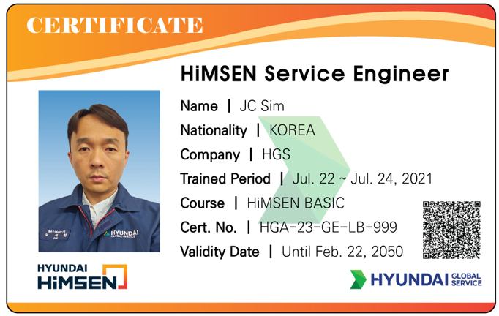


INTERMEDIATE
Cert. No. HGA-23-GE-LB-999
HiMSEN Service Engineer
Name | JC Sim
Nationality | KOREA
Company | HGS
Training Period | July. 22 ~ July. 24, 2021
Validity Date | Until Feb. 22, 2050

