Slide 1

IS-201 - Database Chapter 6 – Database Design Using the E-R Model
Part(3) of (4)
DAW MAY THU KYAW
LECTURER
Faculty of Information Science

Slide 2
Outlines
Primary Key
Removing Redundant Attributes in Entity Sets
Reduction to Relational Schemas

Slide 3
Primary Key
Primary keys provide a way to specify how entities and relations are distinguished. We will consider:
Entity sets
Relationship sets.
Weak entity sets

Slide 4
Primary Key for Entity Sets
By definition, individual entities are distinct.
From database perspective, the differences among them must be expressed in terms of their attributes.
The values of the attribute values of an entity must be such that they can uniquely identify the entity.
No two entities in an entity set are allowed to have exactly the same value for all attributes.
A key for an entity is a set of attributes that suffice to distinguish entities from each other

Slide 5
Primary Key for Relationship Sets
To distinguish among the various relationships of a relationship set we use the individual primary keys of the entities in the relationship set.
Let R be a relationship set involving entity sets E1, E2, .. En
The primary key for R is consists of the union of the primary keys of entity sets E1, E2, ..En
If the relationship set R has attributes a1, a2, .., am associated with it, then the primary key of R also includes the attributes a1, a2, .., am

Slide 6
Primary Key for Relationship Sets(Cont.)
Example: relationship set “advisor”.
The primary key consists of inrsructor.ID and student.ID
The choice of the primary key for a relationship set depends on the mapping cardinality of the relationship set.

Slide 7
Choice of Primary key for Binary Relationship
Many-to-Many relationships. The preceding union of the primary keys is a minimal superkey and is chosen as the primary key.
One-to-Many relationships . The primary key of the “Many” side is a minimal superkey and is used as the primary key.
Many-to-one relationships. The primary key of the “Many” side is a minimal superkey and is used as the primary key.
One-to-one relationships. The primary key of either one of the participating entity sets forms a minimal superkey, and either one can be chosen as the primary key.

Slide 8
Weak Entity Sets (Cont.)
A weak entity set is one whose existence is dependent on another entity, called its identifying entity
Instead of associating a primary key with a weak entity, we use the identifying entity, along with extra attributes called discriminator to uniquely identify a weak entity.
An entity set that is not a weak entity set is termed a strong entity set.

Slide 9
Weak Entity Sets (Cont.)
Every weak entity must be associated with an identifying entity; that is, the weak entity set is said to be existence dependent on the identifying entity set.
The identifying entity set is said to own the weak entity set that it identifies.
The relationship associating the weak entity set with the identifying entity set is called the identifying relationship.

Slide 10
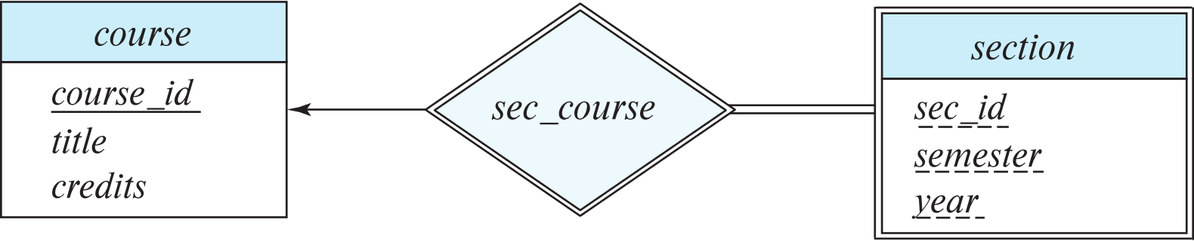
Expressing Weak Entity Sets
In E-R diagrams, a weak entity set is depicted via a double rectangle.
We underline the discriminator of a weak entity set with a dashed line.
The relationship set connecting the weak entity set to the identifying strong entity set is depicted by a double diamond.
Primary key for section – (course_id, sec_id, semester, year)

Slide 11
Redundant Attributes
Suppose we have entity sets:
student, with attributes: ID, name, tot_cred, dept_name
department, with attributes: dept_name, building, budget
We model the fact that each student has an associated department using a relationship set stud_dept
The attribute dept_name in student replicates information present in the relationship and is therefore redundant
and needs to be removed.

Slide 12
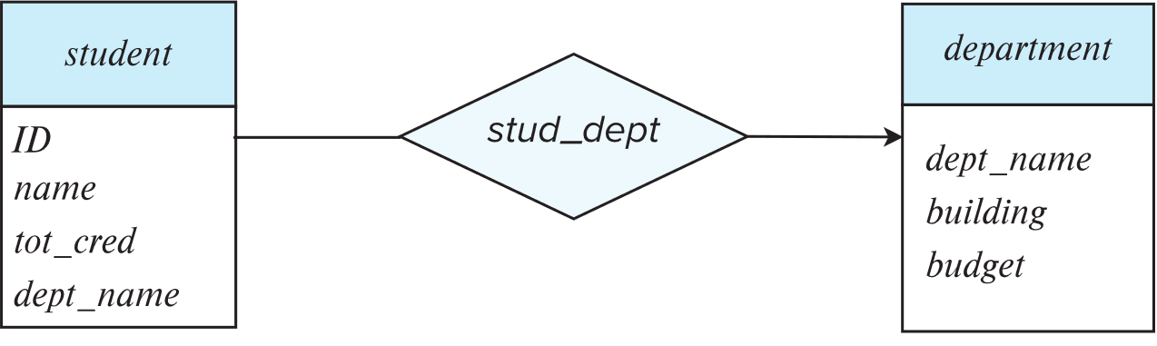
Redundant Attributes(Cont.)
BUT: when converting back to tables, in some cases the attribute gets reintroduced, as we will see later.

Slide 13
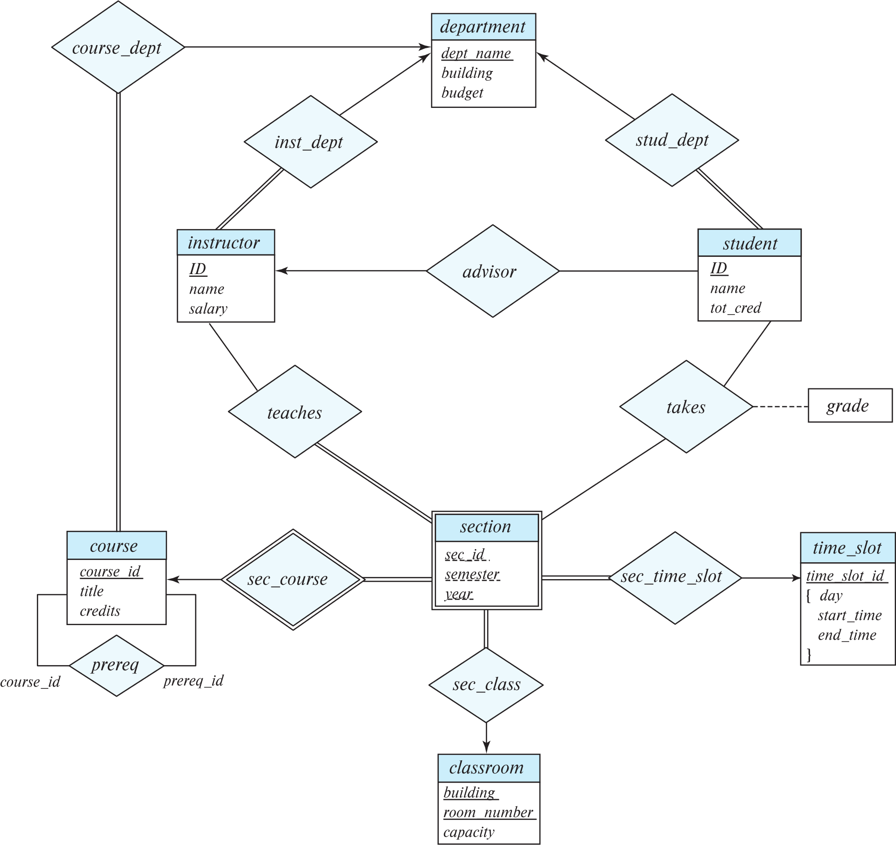
E-R Diagram for a University Enterprise

Slide 14
Reduction to Relation Schemas
Entity sets and relationship sets can be expressed uniformly as relation schemas that represent the contents of the database.
A database which conforms to an E-R diagram can be represented by a collection of schemas.
For each entity set and relationship set there is a unique schema that is assigned the name of the corresponding entity set or relationship set.
Each schema has a number of columns (generally corresponding to attributes), which have unique names.

Slide 15
Representing Entity Sets
A strong entity set reduces to a schema with the same attributes
student(ID, name, tot_cred)
A weak entity set becomes a table that includes a column for the primary key of the identifying strong entity set
section ( course_id, sec_id, sem, year )
Example

Slide 16
Representation of Entity Sets with Composite Attributes
Composite attributes are flattened out by creating a separate attribute for each component attribute
Example: given entity set instructor with composite attribute name with component attributes first_name and last_name the schema corresponding to the entity set has two attributes name_first_name and name_last_name
Prefix omitted if there is no ambiguity (name_first_name could be first_name)

Slide 17
Representation of Entity Sets with Composite Attributes(Cont.)
Ignoring multivalued attributes, extended instructor schema is
instructor(ID, first_name, middle_initial, last_name, street_number, street_name, apt_number, city, state, zip_code, date_of_birth)

Slide 18
Representation of Entity Sets with Multivalued Attributes
A multivalued attribute M of an entity E is represented by a separate schema EM
Schema EM has attributes corresponding to the primary key of E and an attribute corresponding to multivalued attribute M
Example: Multivalued attribute phone_number of instructor is represented by a schema: inst_phone= ( ID, phone_number)
Each value of the multivalued attribute maps to a separate tuple of the relation on schema EM
For example, an instructor entity with primary key 22222 and phone numbers 456-7890 and 123-4567 maps to two tuples: (22222, 456-7890) and (22222, 123-4567)

Slide 19
Representing Relationship Sets
A many-to-many relationship set is represented as a schema with attributes for the primary keys of the two participating entity sets, and any descriptive attributes of the relationship set.
Example: schema for relationship set advisor
advisor = (s_id, i_id)

Slide 20
Redundancy of Schemas
Many-to-one and one-to-many relationship sets that are total on the many-side can be represented by adding an extra attribute to the “many” side, containing the primary key of the “one” side
Example: Instead of creating a schema for relationship set inst_dept, add an attribute dept_name to the schema arising from entity set instructor
Example

Slide 21
Redundancy of Schemas (Cont.)
For one-to-one relationship sets, either side can be chosen to act as the “many” side
That is, an extra attribute can be added to either of the tables corresponding to the two entity sets
If participation is partial on the “many” side, replacing a schema by an extra attribute in the schema corresponding to the “many” side could result in null values

Slide 22
Redundancy of Schemas (Cont.)
The schema corresponding to a relationship set linking a weak entity set to its identifying strong entity set is redundant.
Example: The section schema already contains the attributes that would appear in the sec_course schema

Slide 23
Next Lecture
Extended E-R Features
Entity-Relationship Design Issues
Alternative Notations for Modeling Data
Other Aspects of Database Design

