Slide 1
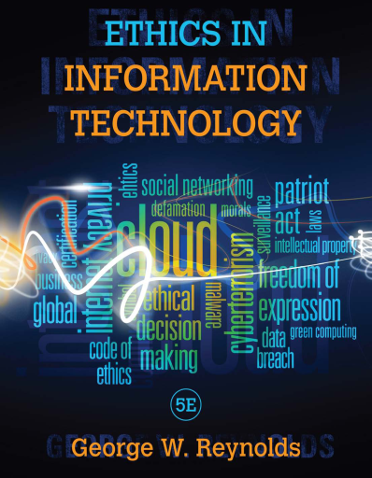
Ethics in Information Technology
01
An Overview of Ethics
02
Ethics for IT Workers and IT Users
Table of Contents
03
Computer and Internet Crime
04
Privacy
Reference Book
Ethics in Information Technology
Fifth Edition
George W. Reynolds
06
Intellectual Property

Slide 2
Chapter 4 Privacy
Ethics in Information Technology

Slide 3
Contents
Privacy Protection and the Law
Information privacy
Privacy Laws, Applications, and Court Rulings
Key Privacy and Anonymity Issues
Data Breaches
Electronic Discovery
Consumer Profiling
Workplace Monitoring
Advanced Surveillance Technology

Slide 4
Objectives
As you read this chapter, consider the following questions:
What is the right of privacy, and what is the basis for protecting personal privacy under the law?
What are some of the laws that provide protection for the privacy of personal data, and what are some of the associated ethical issues?
What are the various strategies for consumer profiling, and what are the associated ethical issues?
Why and how are employers increasingly using workplace monitoring?
What are the capabilities of advanced surveillance technologies, and what ethical issues do they raise?

Slide 5
Privacy Protection and the Law
Systems collect and store key data from every interaction with customers to make better decisions
Many object to data collection policies of government and business
Reasonable limits must be set
Privacy
Key concern of Internet users
Top reason why nonusers still avoid the Internet
Bill of Rights: Ten amendments that were ratified to protect the privacy of individuals
The concept of privacy is protected by the Bill of Rights

Slide 6
Privacy Protection and the Law (cont’d)
Right of privacy: “The right to be left alone the most comprehensive of rights, and the right most valued by a free people”
Information privacy is a combination of:
Communications privacy: Ability to communicate with others without being monitored by other persons or organizations
Data privacy: Ability to limit access to one’s personal data in order to exercise a substantial degree of control over that data and its use

Slide 7
Privacy Laws, Applications, and Court Rulings
Legislative acts
Most address invasion of privacy by the government
No protection of data privacy abuses by corporations
No single, overarching national data privacy policy

Slide 8
Privacy Laws, Applications, and Court Rulings (cont’d)
Financial data: individuals must reveal much of their personal financial data in order to take advantage of the wide range of financial products and services available.
Fair Credit Reporting Act (1970)
Regulates operations of credit-reporting bureaus including how they collect, store, and use credit information.
2. Fair and Accurate Credit Transactions Act (2003)​
Allows consumers to request and obtain a free credit report once each year from each of the three primary consumer credit reporting companies
3. Right to Financial Privacy Act (1978)
Protects the financial records of financial institution customers from unauthorized scrutiny by the federal government

Slide 9
Privacy Laws, Applications, and Court Rulings (cont’d)
4. Gramm-Leach-Bliley Act (1999)
Bank deregulation that enabled institutions to offer investment, commercial banking, and insurance services
Three key rules affecting personal privacy
(1) Financial Privacy Rule: established mandatory guidelines for the collection and disclosure of personal financial information by financial organizations.
Opt-out policy: Customers’ refusal to give the institution the right to share personal data with third parties
Opt-in policy: Customers give financial institutions the right to share their personal data to other financial institutions

Slide 10
Privacy Laws, Applications, and Court Rulings (cont’d)
(2) Safeguards Rule: requires each financial institution to document a data security plan describing the company’s preparation and plans for the ongoing protection of clients’ personal data.
(3) Pretexting Rule: addresses attempts by people to access personal information without proper authority by such means as impersonating an account holder or phishing.

Slide 11
Privacy Laws, Applications, and Court Rulings (cont’d)
Health information: The use of electronic medical records and the subsequent interlinking and transferring of this electronic information among different organizations has become widespread.
Health Insurance Portability and Accountability Act (1996)
Improves the portability and continuity of health insurance coverage
Reduces fraud, waste, and abuse
Simplifies the administration of health insurance
2. American Recovery and Reinvestment Act (2009)
Included strong privacy provisions for electronic health records
Offers protection for victims of data breaches
Bans the sale of health information, promotes the use of audit trails and encryption, and provides rights of access for patients

Slide 12
Privacy Laws, Applications, and Court Rulings (cont’d)
Children’s personal data: only a few laws have been implemented to protect children online, and most of these have been ruled unconstitutional under the First Amendment and its protection of freedom of expression.
1. Children’s Online Privacy Protection Act (1998)
Aims to give parents control over the collection, use, and disclosure of their children’s personal information over the Internet
2. Family Education Rights and Privacy Act (1974)
Assigns rights to parents regarding their children’s education records
Rights transfer to student once student becomes 18

Slide 13
Privacy Laws, Applications, and Court Rulings (cont’d)
Electronic surveillance: laws that address government surveillance, including various forms of electronic surveillance. New laws have been added and old laws amended in recent years
1. Communications Act (1934)
Established the Federal Communications Commission
Regulates all non-federal-government use of radio and television plus all interstate communications
2. Title III of the Omnibus Crime Control and Safe Streets Act Wiretap Act (1968 amended 1986)
Regulates interception of telephone and oral communications
Has been amended by new laws

Slide 14
Privacy Laws, Applications, and Court Rulings (cont’d)
3. Foreign Intelligence Surveillance Act (FISA) (1978)
Describes procedures for electronic surveillance and collection of foreign intelligence information in communications between foreign powers and agents of foreign powers
4. Foreign Intelligence Surveillance Act (FISA) Amendments Act (2008)
Granted NSA expanded authority to collect international communications as they flow through U.S. telecom network equipment and facilities

Slide 15
Privacy Laws, Applications, and Court Rulings (cont’d)
5. Electronic Communications Privacy Act (ECPA) (1986 )
Protects communications in transfer from sender to receiver
Protects communications held in electronic storage
Prohibits recording dialing, routing, addressing, and signaling information without a search warrant
Pen register records: electronic impulses to identify numbers dialed for outgoing calls
Trap and trace records: originating number of incoming calls

Slide 16
Privacy Laws, Applications, and Court Rulings (cont’d)
6. Communications Assistance for Law Enforcement Act (CALEA) (1994)
Amended both the Wiretap Act and ECPA
Required the telecommunications industry to build tools into its products so federal investigators could eavesdrop and intercept electronic communications.
Covered emerging technologies, such as:
Wireless modems
Radio-based electronic mail
Cellular data networks
7. USA Patriot Act (2001)
Increased ability of law enforcement agencies to search telephone, email, medical, financial, and other records

Slide 17
Privacy Laws, Applications, and Court Rulings (cont’d)
Fair Information Practices: is a term for a set of guidelines that govern the collection and use of personal data.
Transborder data flow: Flow of personal data across national boundaries
Organization for Economic Co-operation and Development Fair Information Practices (OECD) (1980)
Set of eight principles
Model of ethical treatment of consumer data

Slide 18
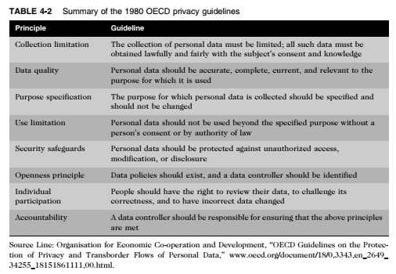
Privacy Laws, Applications, and Court Rulings (cont’d)

Slide 19
Privacy Laws, Applications, and Court Rulings (cont’d)
European Union Data Protection Directive (1995)
Requires companies doing business within the borders of 15 European nations to implement a set of privacy directives on the fair and appropriate use of information
Goal: to ensure data transferred to non-European countries is protected
European Data Protection Regulation (2012)
Enforces a single set of rules for data protection across the EU, eliminating the need for costly administrative processes

Slide 20
Privacy Laws, Applications, and Court Rulings (cont’d)
Access to government records
1. Freedom of Information Act (1966 amended 1974)
Grants citizens the right to access certain information and records of the federal government upon request
Request must:
Not require wide-ranging, unreasonable, or burdensome searches for records
Be made according to procedural regulations published in the Federal Register
Exemptions bar disclosure of information that could:
Compromise national security
Interfere with active law enforcement investigation
Invade someone’s privacy

Slide 21
Privacy Laws, Applications, and Court Rulings (cont’d.)
2. The Privacy Act (1974)
Sets rules for the collection, maintenance, use, and dissemination of personal data kept in systems of records by federal agencies
Prohibits government agencies from concealing the existence of any personal data record-keeping system
Outlines 12 requirements that each record-keeping agency must meet
CIA and law enforcement agencies are excluded from this act
Does not cover actions of private industry

Slide 22
Key Privacy and Anonymity Issues
Data Breaches
Advanced Surveillance Technology
Electronic Discovery
Workplace Monitoring
Consumer profiling

Slide 23
Key Privacy and Anonymity Issues (cont’d)
1. Data Breaches
May be caused by:
Hackers breaking into a database
Failure to follow proper security procedures
Health Information Technology for Economic and Clinical Health Act
Mandates that within 60 days after discovery of a data breach, each individual whose health information has been exposed must be notified

Slide 24
Key Privacy and Anonymity Issues (cont’d)
1. Data Breaches (cont’d)
Purchase of personal data
Black market for:
Credit card numbers in bulk—$.40 each
Logon name and PIN for bank account—$10
Identity information—including DOB, address, SSN, and telephone number—$1 to $15
Estimates nearly $200 for each record lost

Slide 25
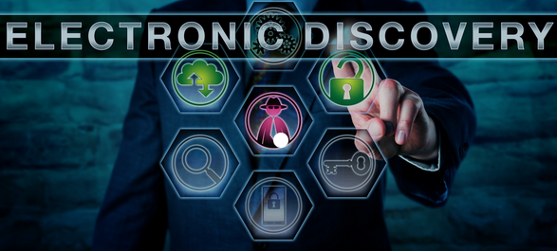
Key Privacy and Anonymity Issues (cont’d)
2. Electronic discovery
Collection, preparation, review, and production of electronically stored information for use in criminal and civil actions
Electronically stored information (ESI): Any form of digital information stored on any form of electronic storage device
Quite likely that information of a private or personal nature will be disclosed during e-discovery
Federal Rules of Procedure define e-discovery processes
E-discovery is complicated and requires extensive time to collect, prepare, and review data

Slide 26
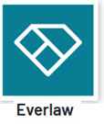

Key Privacy and Anonymity Issues (cont’d)
2. Electronic discovery (cont’d)
E-discovery software helps:
Analyze large volumes of ESI quickly
Simplify and streamline data collection
Identify all participants in an investigation to determine who knew what and when
Raises many ethical issues
Should an organization attempt to destroy or conceal incriminating evidence?
To what degree must an organization be proactive and thorough in providing evidence?
Should an organization attempt to “bury” incriminating evidence in a mountain of trivial, routine data?

Slide 27
Key Privacy and Anonymity Issues (cont’d)
3. Consumer Profiling
Companies openly collect personal information about Internet users
Cookies: text files that can be downloaded to the hard drives of users who visit a Web site so that it can identify visitors
Tracking software: analyzes browsing habits
Criticism: Personal data may be gathered and sold to other companies without the permission of consumers who provide the data

Slide 28
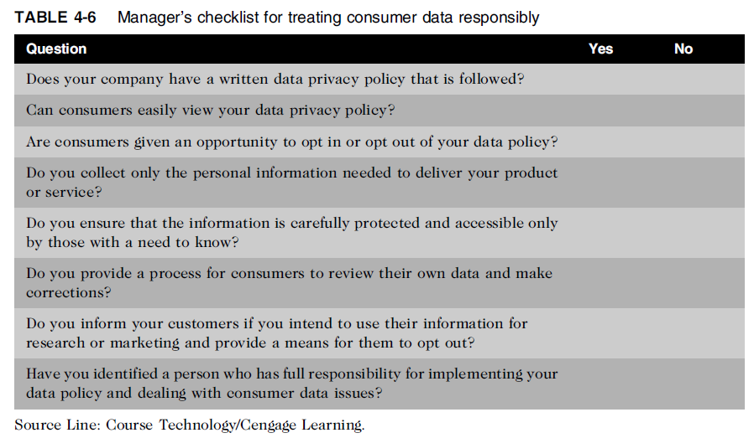
Key Privacy and Anonymity Issues (cont’d)

Slide 29
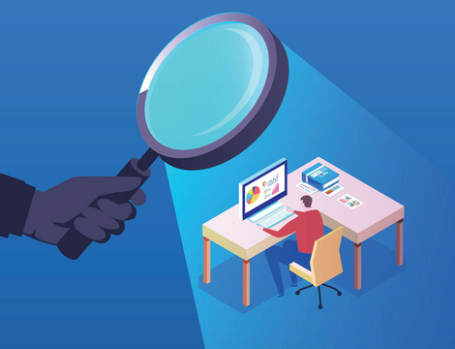
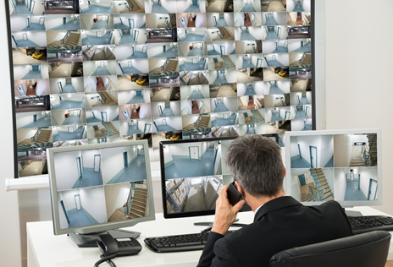
Key Privacy and Anonymity Issues (cont’d)
4. Workplace Monitoring
Employers monitor workers
Protect against employee abuses that reduce worker productivity or expose employer to harassment lawsuits
State privacy statutes tend to favor employers over employees
Fourth Amendment cannot be used to limit how a private employer treats its employees
Privacy advocates want federal legislation
To keep employers from infringing upon privacy rights of employees

Slide 30
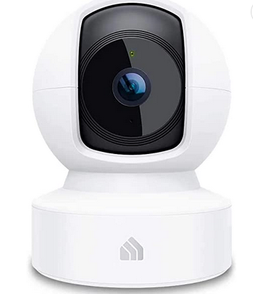
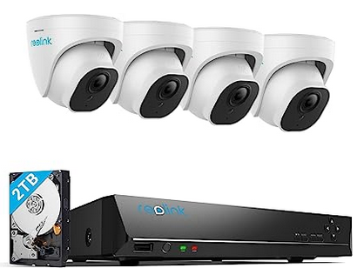
Key Privacy and Anonymity Issues (cont’d)
5. Advanced Surveillance Technology: surveillance cameras and satellite-based systems that can pinpoint a person’s physical location—provide amazing new data-gathering capabilities.
Camera surveillance
Goal: Deter crime and terrorist activities
Criticism: May provide leeway for abuse and blackmail
Domain Awareness system
Joint effort of the New York Police Department and Microsoft
Goal is to combat terrorist activities and reduce the time required to respond to an incident

Slide 31
Key Privacy and Anonymity Issues (cont’d)
5. Advanced Surveillance Technology (cont’d)
Vehicle event data recorder (EDR) : is a device that records vehicle and occupant data for a few seconds before, during, and after any vehicle crash that is severe enough to deploy the vehicle’s air bags.
Purpose of the EDR
To capture and record data that can be used by the manufacturer to make future changes
To improve vehicle performance in the event of a crash.
For use in a court of law to determine what happened during a vehicle accident

Slide 32
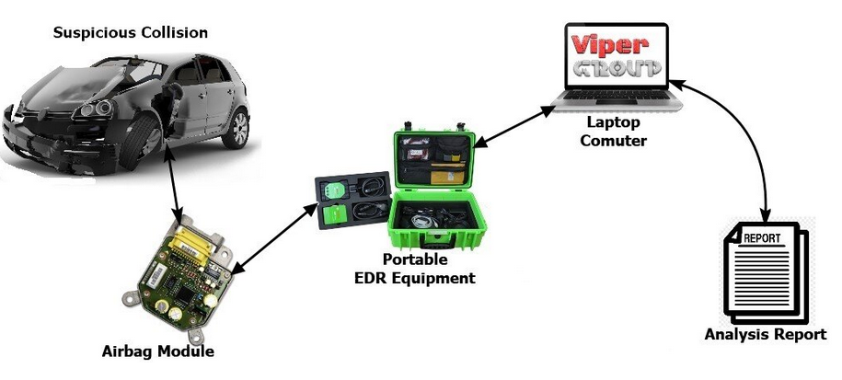
Vehicle event data recorder (EDR)

Slide 33
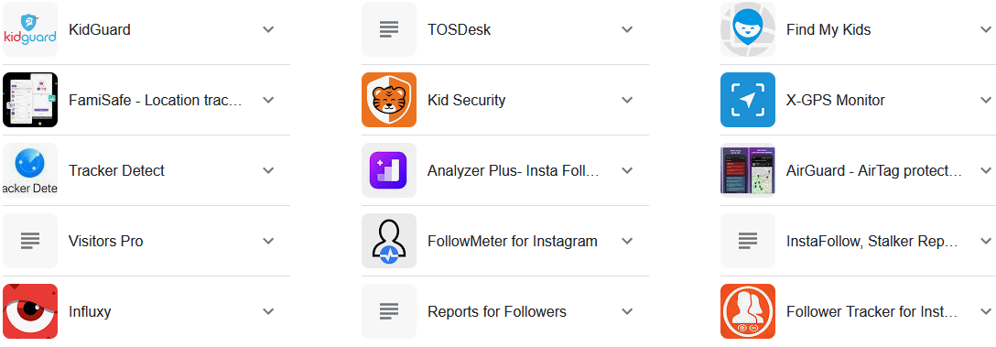
Key Privacy and Anonymity Issues (cont’d)
5. Advanced Surveillance Technology (cont’d)
Stalking app: Cell phone spy software that can be loaded onto someone’s cell phone or smartphone
Perform location tracking, record calls, view every text message or picture sent or received, and record the URLs of any Web site visited on the phone.
Illegal to install the software on a phone without the permission of the phone owner

Slide 34
Summary
Laws, technical solutions, and privacy policies are required to balance needs of business against rights of consumers
A number of laws have been enacted that affect a person’s privacy particularly in the areas of financial and health records, protection following a security breach, children’s personal data, electronic surveillance, export of personal data, and access to government records

Slide 35
Summary (cont’d)
Identity theft is fastest-growing form of fraud
E-discovery can be expensive, can reveal data of a private or personal data, and raises many ethical issues
Web sites collect personal data about visitors
Consumer data privacy has become a major marketing issue
Code of Fair Information Practices and 1980 OECD privacy guidelines provide an approach to treating consumer data responsibly

Slide 36
Summary (cont’d)
Employers monitor employees to maintain employee productivity and limit exposure to harassment lawsuits
Advances in information technology provide new data-gathering capabilities but also diminish individual privacy

Slide 37
Additional Resources
To learn more about the Gramm-Leach-Bliley Act, visit: http://business.ftc.gov/privacy-and-security/gramm-leach-bliley-act
To learn more about the American Recovery and Reinvestment Act of 2009, visit: http://www.recovery.gov/arra/About/Pages/About.aspx
Identity theft: http://www.consumer.ftc.gov/features/feature-0014-identity-theft
Consumer profiling: http://epic.org/privacy/profiling/
CNN article on workplace monitoring: http://edition.cnn.com/2001/CAREER/trends/01/02/surveillence/index.html?iref=allsearch
NPR articles on the USA Patriot Act in depth http://www.npr.org/templates/story/story.phpstoryId=4759727&sourceCode=gw

Slide 38
Additional Resources (cont’d)
https://www.g2.com/categories/sensitive-data-discovery
https://www.g2.com/categories/cookie-tracking
https://www.enster.com/
https://skybrary.aero/portals
https://www.frotcom.com/blog/2022/11/event-data-recorders-mandatory-all-vehicles-2024
https://freeappsforme.com/best-stalking-apps/

Slide 39
Additional Projects
Write a paper comparing and contrasting privacy policies in Germany and privacy policies in the United States.
Write a paper analyzing the legality of the NSA program to collect and analyze pen register and tap-and-trace data, and the NSA program to listen to the overseas phone calls of U.S. citizens without a court order. (For an overview, see
http://www.usatoday.com/news/washington/2006-05-10-nsa_x.htm)
3. Write a paper discussing the ethics and consequences (including effects on productivity and morale) of different types of workplace monitoring.

Slide 40
Reference
Ethics in Information Technology, George W. Reynolds, Fifth Edition
Pictures source from Internet

