Slide 1
Introduction to CSS (Cascading Style Sheet)

Slide 2
Cascading Style Sheets (CSS)
Cascading style sheets are used to format the layout of Web pages.
They can be used to define text styles, table sizes, and other aspects of Web pages that previously could only be defined in a page's HTML.
CSS helps Web developers create a uniform look across several pages of a Web site.
Once the style is defined in cascading style sheet, it can be used by any page that references the CSS file.
CSS makes it easy to change styles across several pages at once.

Slide 3
Configuring CSS
Inline styles are coded in the body page as an attribute of HTML tag and apply only to specific element that contains it as an attribute.
Embedded styles are defined in the header of web page and apply to entire web page document.
External styles are coded in separate text file and is associated with the web page by using link element in head section.
Imported styles are similar to external styles in that they can connect styles coded in separate text file with a web page document. An external style sheet can be imported into embedded styles or into another style sheet by using the @import directive.

Slide 4
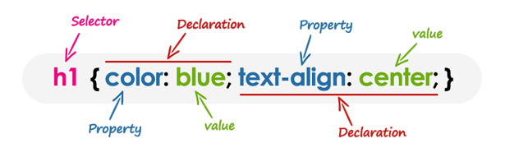
CSS-Syntax
A CSS rule have two main parts, a selector and one or more declarations:
Selector − The selector specifies which element or elements in the HTML page the CSS rule applies to.
Declaration- Whereas, the declarations within the block determines how the elements are formatted on a webpage. Each declaration consists of a property and a value separated by a colon (:) and ending with a semicolon (;), and the declaration groups are surrounded by curly braces {}.
Property − A property is a type of attribute of HTML tag. All the HTML attributes are converted into CSS properties. They could be color, border etc.
Value − Values are assigned to properties. For example, color property can have value either red or #F1F1F1 etc.

Slide 5
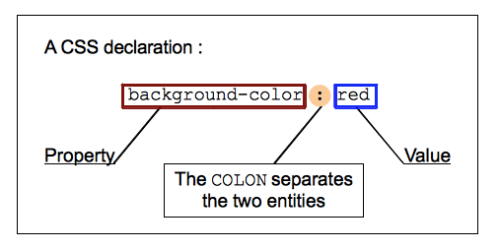
The CSS declarations
Setting CSS properties to specific values is the core function of the CSS language.

Slide 6
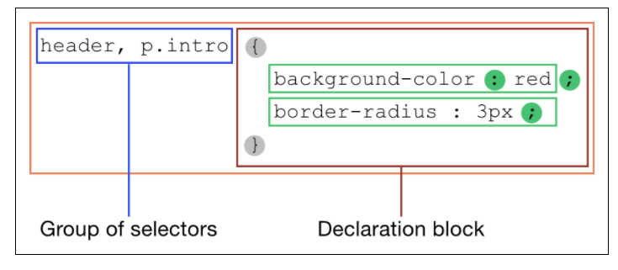
The CSS rulesets
CSS allows this by associating conditions with declarations blocks.
Each (valid) declaration block is preceded by one or more comma-separated selectors, which are conditions selecting some elements of the page.
A selector group and an associated declarations block, together, are called a ruleset, or often simply a rule.
A CSS ruleset (or rule) is visualized in the diagram below.

Slide 7
The CSS Element Selector
The element selector selects HTML elements based on the element name.
Syntax:
Example:
All <p> elements on the page will be center-aligned, with a red text color:
p { text-align: center; color: red; }
element{ CSS-Property: value; ........................ }

Slide 8
Eg. Element Selector
<!DOCTYPE html>
<html>
<head>
<title>CSS</title>
<style type="text/css">
p{
text-align: center;
color: green;
}
</style>
</head>
<body>
<h1>Happy<h1>
<p>Hello CSS</p>
</body>
</html>

Slide 9
The CSS id Selector
The id selector uses the id attribute of an HTML element to select a specific element.
The id of an element is unique within a page, so the id selector is used to select one unique element.
To select an element with a specific id, write a hash (#) character, followed by the id of the element.
Syntax:
Example:
The CSS rule below will be applied to the HTML element with id="para1":
#para1 { text-align: center; color: red; }
#id { CSS-Property: value; ........................ }

Slide 10
Eg
<!DOCTYPE html>
<html>
<head>
<title>CSS</title>
<style type="text/css">
#para1{
text-align: center;
color: green;
}
#para2{
text-align: center;
color: green;
}
</style>
</head>
<body>
<h1 id="para1">Happy<h1>
<p id="para2">Hello CSS</p>
</body>
</html>

Slide 11
The CSS Class Selectors
Define style rules based on the class attribute of the elements.
All the elements having that class will be formatted according to the defined rule.
To select all elements with a specific class, write a dot (.) character, followed by the class of the element.
Syntax:
Example:
.black {
color: #000000;
}
.class { CSS-Property: value; ........................ }

Slide 12
Eg
<!DOCTYPE html>
<html>
<head>
<title>CSS</title>
<style type="text/css">
.center{text-align: center;
text-underline-position: under;}
.color{
color: yellow;
}
</style>
</head>
<body>
<h1 class="center">Happy<h1>
<p class="color center">Hello CSS</p>
</body>
</html>

Slide 13
The CSS Universal Selectors
CSS universal selectors select any type of elements in an HTML page. It matches a single element.
An asterisk ( i.e. "*" ) is used to denote a CSS universal selector.
An asterisk can also be followed by a selector.
This is useful when you want to set a style for of all the elements of an HTML page or for all of the elements within an element of an HTML page.
Syntax:
Example:
* {
color: #000000;
}
* { CSS-Property: value; ........................ }

Slide 14
Eg
<!DOCTYPE html>
<html>
<head>
<title>CSS</title>
<style type="text/css">
*{
text-align: center;
color: green;
}
</style>
</head>
<body>
<h1>Happy<h1>
<p>Hello CSS</p><h1>Happy<h1>
<p>Hello CSS</p><h1>Happy<h1>
<p>Hello CSS</p><h1>Happy<h1>
<p>Hello CSS</p><h1>Happy<h1>
<p>Hello CSS</p><h1>Happy<h1>
<p>Hello CSS</p>
</body>
</html>

Slide 15
Inline CSS Style
An inline style may be used to apply a unique style for a single element.
To use inline styles, add the style attribute to the relevant element. The style attribute can contain any CSS property.
Inline styles are defined within the "style" attribute of the relevant element:
<!DOCTYPE html> <html> <body> <h1 style="color:blue; text-align:center;">This is a heading</h1> <p style="color:red;">This is a paragraph.</p> </body> </html>

Slide 16
Internal CSS Style
An internal style sheet may be used if one single HTML page has a unique style.
The internal style is defined inside the <style> element, inside the head section.
Internal styles are defined within the <style> element, inside the <head> section of an HTML page:
<!DOCTYPE html> <html> <head> <style> body { background-color: linen; } h1 { color: maroon; margin-left: 40px; } </style> </head>
<body> <h1>This is first heading</h1>
<p>This is a paragraph.</p>
<h1>This is second heading</h1> </body> </html>

Slide 17
External CSS Style
With an external style sheet, you can change the look of an entire website by changing just one file!
Each HTML page must include a reference to the external style sheet file inside the <link> element, inside the head section.
External styles are defined within the <link> element, inside the <head> section of an HTML page:
An external style sheet can be written in any text editor, and must be saved with a .css extension.
The external .css file should not contain any HTML tags.
"mystyle.css"
<!DOCTYPE html> <html> <head> <link rel="stylesheet" type="text/css" href="mystyle.css"> </head> <body> <h1>This is a heading</h1> <p>This is a paragraph.</p> </body> </html>
body { background-color: lightblue; } h1 { color: navy; margin-left: 20px; }

Slide 18
@import CSS Style
CSS @import Rule
The @import rule is used to import one style sheet into another style sheet.
This rule also support media queries so that the user can import the media-dependent style sheet.
The @import rule must be declared at the top of the document after any @charset declaration.
Syntax: @import url | string list-of-mediaqueries;
url|string: A url or a string represents the location of the resource to be imported. The url may be relative or absolute
list-of-mediaqueries: The list of media queries condition the application of the CSS rules defined in the linked URL
i1css.css
h1 { text-decoration: underline; font-size:60px; }
p { padding-left: 20px; font-size: 60px; }
icss.css
@import url("i1css.css");
h1 { color: #00ff00; }

Slide 19

Link the first CSS file icss.css in the below HTML file and see the output.
<!DOCTYPE html>
<html>
<head>
<title>WebPage</title>
<link href="icss.css" rel="stylesheet">
</head>
<body>
<h1>University of Computer Studies, Yangon</h1>
<p> The University of Computer Studies, Yangon, located in the outskirts of Yangon, is the leading IT and computer science university of Myanmar. </p>
</body>
</html>
Output:

Slide 20
The CSS Basic Properties
There are some basic CSS properties to work with.
Text Properties
List Properties
Border Properties
Font Properties

Slide 21
Text Properties
Property | Description | Values
color | Sets the color of a text | RGB, hex, keyword
line-height | Sets the distance between lines | normal, number, length, %
letter-spacing | Increase or decrease the space between characters | normal, length
text-align | Aligns the text in an element | left, right, center, justify
text-decoration | Adds decoration to text | none, underline, overline, line-through
text-indent | Indents the first line of text in an element | length, %
text-transform | Controls the letters in an element | none, capitalize, uppercase, lowercase

Slide 22
List Properties
Property | Description | Values
list-style | Sets all the properties for a list in one declaration | list-style-type, list-style-position, list-style-image,inherit
list-style-image | Specifies an image as the list-item marker | URL, none, inherit
list-style-position | Specifies where to place the list-item marker | inside, outside, inherit
list-style-type | Specifies the type of list-item marker | none, disc, circle, square, decimal, decimal-leading-zero, armenian, georgian, lower-alpha, upper-alpha, lower-greek, lower-latin, upper-latin, lower-roman, upper-roman, inherit

Slide 23
Border Properties
Property | Description | Values
border | Sets all the border properties in one declaration | border-width, border-style, border-color
border-bottom | Sets all the bottom border properties in one declaration | border-bottom-width, border-bottom-style, border-bottom-color
border-bottom-color | Sets the color of the bottom border | border-color
border-bottom-style | Sets the style of the bottom border | border-style
border-bottom-width | Sets the width of the bottom border | border-width
border-color | Sets the color of the four borders | color_name, hex_number, rgb_number, transparent, inherit
border-left | Sets all the left border properties in one declaration | border-left-width, border-left-style, border-left-color
border-left-color | Sets the color of the left border | border-color
border-left-style | Sets the style of the left border | border-style
border-left-width | Sets the width of the left border | border-width

Slide 24
Border Properties Cont’s
Property | Description | Values
border-right | Sets all the right border properties in one declaration | border-right-width, border-right-style, border-right-color
border-right-color | Sets the color of the right border | border-color
border-right-style | Sets the style of the right border | border-style
border-right-width | Sets the width of the right border | border-width
border-style | Sets the style of the four borders | none, hidden, dotted, dashed, solid, double, groove, ridge, inset, outset, inherit
border-top | Sets all the top border properties in one declaration | border-top-width, border-top-style, border-top-color
border-top-color | Sets the color of the top border | border-color
border-top-style | Sets the style of the top border | border-style
border-top-width | Sets the width of the top border | border-width
border-width | Sets the width of the four borders | thin, medium, thick, length, inherit

Slide 25
Font Properties
Property | Description | Values
font | Sets all the font properties in one declaration | font-style, font-variant, font-weight, font-size/line-height, font-family, caption, icon, menu, message-box, small-caption, status-bar, inherit
font-family | Specifies the font family for text | family-name, generic-family, inherit
font-size | Specifies the font size of text | xx-small, x-small, small, medium, large, x-large, xx-large, smaller, larger, length, %, inherit
font-style | Specifies the font style for text | normal, italic, oblique, inherit
font-variant | Specifies whether or not a text should be displayed in a small-caps font | normal, small-caps, inherit
font-weight | Specifies the weight of a font | normal, bold, bolder, lighter, 100, 200, 300, 400, 500, 600, 700, 800, 900, inherit Careful, many of these are not supported!

