Slide 1
Java Programming
Chapter 5
Selection Statements

Slide 2
Objectives
After you have read and studied this chapter, you should be able to
    Implement a selection control using if statements
    Implement a selection control using switch statements
    Write boolean expressions using relational and boolean expressions
    Evaluate given boolean expressions correctly
    Nest an if statement inside another if statement
    Describe how objects are compared
    Choose the appropriate selection control statement for a given task
    Define and use enumerated constants
Chapter 5 - <number>
Notes:
Intro to OOP with Java, C. Thomas Wu
©The McGraw-Hill Companies, Inc.
We will study two forms of if statements in this lesson. They are called if-then-else and if-then. Although the compiler does not care how we format the if statements, we will present the recommended style.

Slide 3
The if Statement
int testScore;
testScore = //get test score input
if (testScore < 70)
System.out.println("You did not pass" );
else
System.out.println("You did pass" );
This statement is executed if the testScore is less than 70.
This statement is executed if the testScore is 70 or higher.
Chapter 5 - <number>
Notes:
Intro to OOP with Java, C. Thomas Wu
©The McGraw-Hill Companies, Inc.
We assume there’s some kind of input routine to input test score value and assign it to ‘testScore’.
This sample shows how to make a decision on the input value by using an if test.

Slide 4
Syntax for the if Statement
if ( <boolean expression> )
<then block>
else
<else block>
Boolean Expression
if ( testScore < 70 )
System.out.println("You did not pass");
else
System.out.println("You did pass ");
Then Block
Else Block
Chapter 5 - <number>
Notes:
Intro to OOP with Java, C. Thomas Wu
©The McGraw-Hill Companies, Inc.

Slide 5
Control Flow
false
true
testScore < 70 ?
System.out.println
("You did pass");
System.out.println
("You did not pass");
Chapter 5 - <number>
Notes:
Intro to OOP with Java, C. Thomas Wu
©The McGraw-Hill Companies, Inc.
This shows how the control logic flows. When the test is true, the true block is executed. When the test is false, the else block is executed.

Slide 6
Relational Operators
< //less than
<= //less than or equal to
== //equal to
!= //not equal to
> //greater than
>= //greater than or equal to
testScore < 80
testScore * 2 >= 350
30 < w / (h * h)
x + y != 2 * (a + b)
2 * Math.PI * radius <= 359.99
Chapter 5 - <number>
Notes:
Intro to OOP with Java, C. Thomas Wu
©The McGraw-Hill Companies, Inc.
The list shows six relational operators for comparing values. The result is a boolean value, i.e., either true or false.
One very common error in writing programs is mixing up the assignment and equality operators. We frequently make a mistake of writing
if (x = 5) ...
when we actually wanted to say
if (x == 5) ...

Slide 7
Compound Statements
Use braces if the <then> or <else> block has multiple statements.
if (testScore < 70)
{
System.out.println("You did not pass“ );
System.out.println(“Try harder next time“ );
}
else
{
System.out.println(“You did pass“ );
System.out.println(“Keep up the good work“ );
}
Then Block
Else Block
Chapter 5 - <number>
Notes:
Intro to OOP with Java, C. Thomas Wu
©The McGraw-Hill Companies, Inc.
When there are more than one statement in the then or else block, then we put the braces as this example illustrates.
Rules for writing the then and else blocks:
- Left and right braces are necessary to surround the statements if the then or else block contains multiple statements.
- Braces are not necessary if the then or else block contains only one statement.
- A semicolon is not necessary after a right brace.

Slide 8
Style Guide
if ( <boolean expression> ) {
…
} else {
…
}
Style 1
if ( <boolean expression> )
{
…
}
else
{
…
}
Style 2
Chapter 5 - <number>
Notes:
Intro to OOP with Java, C. Thomas Wu
©The McGraw-Hill Companies, Inc.
Here are two most common format styles. In this course, we will use Style 1, mainly because this style is more common among programmers, and it follows the recommended style guide for Java. If you prefer Style 2, then go ahead and use it. Whichever style you choose, be consistent, because consistent look and feel are very important to make your code readable.

Slide 9
The if-then Statement
if ( <boolean expression> )
<then block>
Boolean Expression
if ( testScore >= 95 )
System.out.println("You are an honor student");
Then Block
Chapter 5 - <number>
Notes:
Intro to OOP with Java, C. Thomas Wu
©The McGraw-Hill Companies, Inc.
Here's the second form of the if statement. We call this form if-then.
Notice that the if–then statement is not necessary, because we can write any if–then statement using if–then–else by including no statement in the else block. For instance, the sample if–then statement can be written as
if (testScore >= 95) {
messageBox.show("You are an honor student");
}
else { }
In this book, we use if-then statements whenever appropriate.

Slide 10
Control Flow of if-then
true
testScore >= 95?
System.out.println (
"You are an honor student");
false
Chapter 5 - <number>
Notes:
Intro to OOP with Java, C. Thomas Wu
©The McGraw-Hill Companies, Inc.
This shows how the control logic of the if-then statement flows. When the test is true, the true block is executed. When the test is false, the statement that follows this if-then statement is executed.

Slide 11
The Nested-if Statement
The then and else block of an if statement can contain any valid statements, including other if statements. An if statement containing another if statement is called a nested-if statement.
if (testScore >= 70) {
if (studentAge < 10) {
System.out.println("You did a great job");
} else {
System.out.println("You did pass"); //test score >= 70
} //and age >= 10
} else { //test score < 70
System.out.println("You did not pass");
}
Chapter 5 - <number>
Notes:
Intro to OOP with Java, C. Thomas Wu
©The McGraw-Hill Companies, Inc.
It is possible to write if tests in different ways to achieve the same result. For example, the above code can also be expressed as
if (testScore >= 70 && studentAge < 10) {
messageBox.show("You did a great job");
} else {
//either testScore < 70 OR studentAge >= 10
if (testScore >= 70) {
messageBox.show("You did pass");
} else {
messageBox.show("You did not pass");
}
}

Slide 12
if – else if Control
if (score >= 90)
System.out.print("Your grade is A");
else if (score >= 80)
System.out.print("Your grade is B");
else if (score >= 70)
System.out.print("Your grade is C");
else if (score >= 60)
System.out.print("Your grade is D");
else
System.out.print("Your grade is F");
Test Score | Grade
90 ≤ score | A
80 ≤ score < 90 | B
70 ≤ score < 80 | C
60 ≤ score < 70 | D
score < 60 | F
Chapter 5 - <number>
Notes:
Intro to OOP with Java, C. Thomas Wu
©The McGraw-Hill Companies, Inc.
This is the style we format the nested-if statement that has empty then blocks. We will call such nested-if statements if-else if.
If we follow the general rule , the above if-else if will be written as below, but the style shown in the slide is the standard notation.
if (score >= 90)
System.out.print("Your grade is A");
else
if (score >= 80)
System.out.print("Your grade is B");
else
if (score >= 70)
System.out.print("Your grade is C");
else
if (score >= 60)
System.out.print("Your grade is D");
else
messageBox.show("Your grade is F");

Slide 13
Boolean Operators
A boolean operator takes boolean values as its operands and returns a boolean value.
The three boolean operators are
  and: &&
  or: ||
  not !
if (temperature >= 65 && distanceToDestination < 2) {
System.out.println("Let's walk");
} else {
System.out.println("Let's drive");
}
Chapter 5 - <number>
Notes:
Intro to OOP with Java, C. Thomas Wu
©The McGraw-Hill Companies, Inc.
The result of relational comparison such as score > 80 is a boolean value. Relational comparisons can be connected by boolean operators &&, ||, or !. The sample boolean expression is true if BOTH relational comparisons are true.

Slide 14
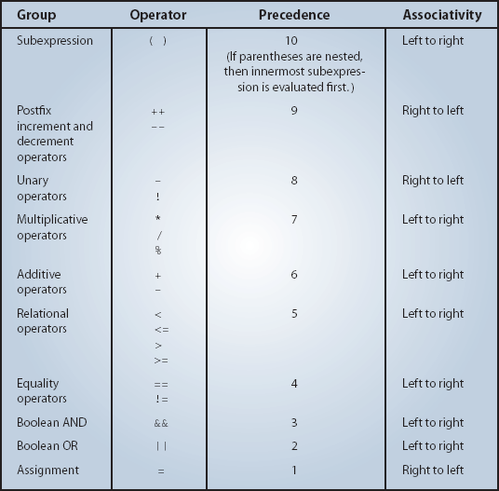
Operator Precedence Rules
Chapter 5 - <number>
Notes:
Intro to OOP with Java, C. Thomas Wu
©The McGraw-Hill Companies, Inc.
The precedence table shows the order of operator evaluation. Instead of memorizing this table, it is more convenient and the code more readable if you use the parentheses judiciously.

Slide 15
Boolean Variables
The result of a boolean expression is either true or false. These are the two values of data type boolean.
We can declare a variable of data type boolean and assign a boolean value to it.
boolean pass, done;
pass = 70 < x;
done = true;
if (pass) {
…
} else {
…
}
Chapter 5 - <number>
Notes:
Intro to OOP with Java, C. Thomas Wu
©The McGraw-Hill Companies, Inc.
The result of a boolean expression is one of the values of data type boolean. As we can assign an int value to an int variable, we can assign a boolean value to a boolean variable.

Slide 16
Boolean Methods
A method that returns a boolean value, such as
private boolean isValid(int value) {
if (value < MAX_ALLOWED)
return true;
} else {
return false;
}
}
if (isValid(30)) {
…
} else {
…
}
Can be used as
Chapter 5 - <number>
Notes:
Intro to OOP with Java, C. Thomas Wu
©The McGraw-Hill Companies, Inc.
This example shows an effective use of a boolean method. We will be seeing this style of using boolean methods frequently, so make sure you are comfortable with this.

Slide 17
Comparing Objects
With primitive data types, we have only one way to compare them, but with objects (reference data type), we have two ways to compare them.
  We can test whether two variables point to the same object (use ==), or
  We can test whether two distinct objects have the same contents.
Chapter 5 - <number>
Notes:
Intro to OOP with Java, C. Thomas Wu
©The McGraw-Hill Companies, Inc.
Comparing primitive data types is straightforward because there's only one way to compare them. Comparing objects is a little trickier because we can compare them in two different ways.

Slide 18
Using == With Objects (Sample 1)
String str1 = new String("Java");
String str2 = new String("Java");
if (str1 == str2) {
System.out.println("They are equal");
} else {
System.out.println("They are not equal");
}
They are not equal
Not equal because str1 and str2 point to different String objects.
Chapter 5 - <number>
Notes:
Intro to OOP with Java, C. Thomas Wu
©The McGraw-Hill Companies, Inc.
When we use the equality operator (==), we can comparing the contents of the variables str1 and str2. So str1 == str2 being true means the contents are the same, which in turn, means they are pointing to the same object because the content of a reference data type is an address. Therefore, if there are two distinct objects, even the values hold by these objects are the same, the equality testing by the equality operator will always result in false.

Slide 19
Using == With Objects (Sample 2)
String str1 = new String("Java");
String str2 = str1;
if (str1 == str2) {
System.out.println("They are equal");
} else {
System.out.println("They are not equal");
}
They are equal
It's equal here because str1 and str2 point to the same object.
Chapter 5 - <number>
Notes:
Intro to OOP with Java, C. Thomas Wu
©The McGraw-Hill Companies, Inc.

Slide 20
Using equals with String
String str1 = new String("Java");
String str2 = new String("Java");
if (str1.equals(str2)) {
System.out.println("They are equal");
} else {
System.out.println("They are not equal");
}
They are equal
It's equal here because str1 and str2 have the same sequence of characters.
Chapter 5 - <number>
Notes:
Intro to OOP with Java, C. Thomas Wu
©The McGraw-Hill Companies, Inc.
To compare whether two String objects have the same sequence of characters, we use the equals method. This method checks for the case. If we want to compare String objects case-insensitively, then we use the equalsIgnoreCase method.

Slide 21
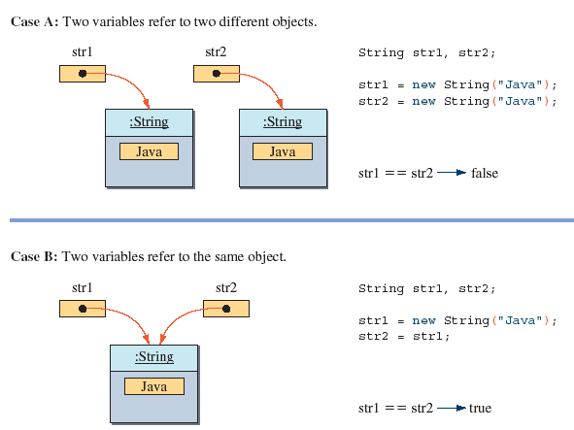
The Semantics of ==
Chapter 5 - <number>
Notes:
Intro to OOP with Java, C. Thomas Wu
©The McGraw-Hill Companies, Inc.

Slide 22
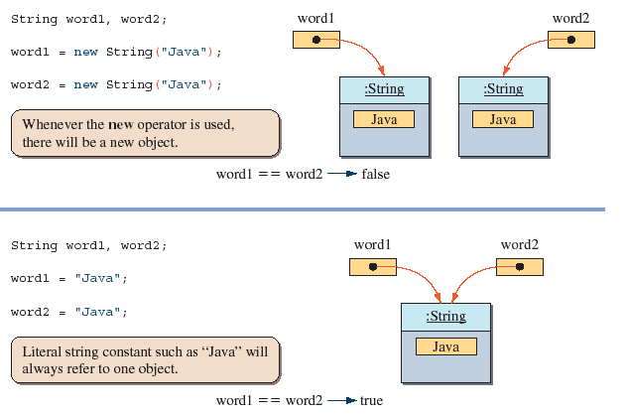
In Creating String Objects
Chapter 5 - <number>
Notes:
Intro to OOP with Java, C. Thomas Wu
©The McGraw-Hill Companies, Inc.

Slide 23
The switch Statement
Scanner scanner = new Scanner(System.in);
System.out.println( "Grade (Frosh-1,Soph-2,...):“);
int gradeLevel = scanner.nextInt();
switch (gradeLevel) {
case 1: System.out.print("Go to the Gymnasium");
break;
case 2: System.out.print("Go to the Science Auditorium");
break;
case 3: System.out.print("Go to Harris Hall Rm A3");
break;
case 4: System.out.print("Go to Bolt Hall Rm 101");
break;
}
This statement is executed if the gradeLevel is equal to 1.
This statement is executed if the gradeLevel is equal to 4.
Chapter 5 - <number>
Notes:
Intro to OOP with Java, C. Thomas Wu
©The McGraw-Hill Companies, Inc.
This is an example of a switch statement. The variable gradeLevel is called a switch control. The data type for a switch control must be one of the integer data types or a char.

Slide 24
Syntax for the switch Statement
switch ( <arithmetic expression> ) {
<case label 1> : <case body 1>
…
<case label n> : <case body n>
}
Arithmetic Expression
switch ( gradeLevel ) {
case 1: System.out.print( "Go to the Gymnasium" );
break;
case 2: System.out.print( "Go to the Science Auditorium" );
break;
case 3: System.out.print( "Go to Harris Hall Rm A3" );
break;
case 4: System.out.print( "Go to Bolt Hall Rm 101" );
break;
}
Case Label
Case Body
Chapter 5 - <number>
Notes:
Intro to OOP with Java, C. Thomas Wu
©The McGraw-Hill Companies, Inc.
This is the general syntax rule for a switch statement. The case body may contain zero or more statements.

Slide 25
switch With the default Block
switch (ranking) {
case 10:
case 9:
case 8: System.out.print("Master");
break;
case 7:
case 6: System.out.print("Journeyman");
break;
case 5:
case 4: System.out.print("Apprentice");
break;
default: System.out.print("Input error: Invalid Data");
break;
}
Chapter 5 - <number>
Notes:
Intro to OOP with Java, C. Thomas Wu
©The McGraw-Hill Companies, Inc.
If the ranking is 10, 9, or 8, then the text “Master” is displayed. If the ranking is 7 or 6, “Journeyman” is displayed. If the ranking is 5 or 4, “Apprentice” is displayed. If there’s no matching case, the default case is executed and an error message is displayed. If a default case is included, then it is executed when there are no matching cases. You can define at most one default case.
A default case is often used to detect an erroneous value in the control variable.
Although not required, it is a standard to place the default case at the end.

Slide 26
Enumerated Constants
In Chapter 3, we introduced numerical constants.
Additional type of constants available in Java are called enumerated constants.
Enumerated constants when used properly will support more reliable and robust programs.
Enumerated constants are defined by using the reserved word enum.
Chapter 5 - <number>
Notes:
Intro to OOP with Java, C. Thomas Wu
©The McGraw-Hill Companies, Inc.

Slide 27
Defining an Enumerated Type
Consider the following example. Instead of defining numerical constants as
class Student {
public static final int FRESHMAN = 0;
public static final int SOPHOMORE = 1;
public static final int JUNIOR = 2;
public static final int SENIOR = 3;
}
We can define an enumerated type as
class Student {
public static enum GradeLevel
{FRESHMAN, SOPHOMORE , JUNIOR , SENIOR}
}
Chapter 5 - <number>
Notes:
Intro to OOP with Java, C. Thomas Wu
©The McGraw-Hill Companies, Inc.

Slide 28
Using Enumerated Types
enum Fruit {APPLE, ORANGE , BANANA}
Fruit f1, f2, f3;
f1 = Fruit.APPLE;
f2 = f1;
System.out.println( “Favorite Fruit is “ + f2);
Fruit favoriteFruit = …;
switch (favoriteFruit) {
case Fruit.APPLE: …
break;
case Fruit.ORANGE: …
break;
case Fruit.BANANA: …
break;
}
Favorite Fruit is APPLE
Chapter 5 - <number>
Notes:
Intro to OOP with Java, C. Thomas Wu
©The McGraw-Hill Companies, Inc.

Slide 29

Exercises 1 to 5, 7,8,9,12,13,15
Lets Do Exercises!!!

