Slide 1
Chapter (8)
Exception Handling

Slide 2
Exception Handling
What is Exception?
  An Exception is an unwanted event that interrupts the normal flow of the program. It is an object which is thrown at runtime.
Why an exception occurs?
  Opening a non-existing file in your program, Network connection problem, wrong input data provided by user, database server down etc.
What is Exception Handling?
  It is mechanism to handle the runtime errors such as ArithmeticException, ClassNotFoundException,IOException,SQLException, IndexOutOfBoundException so that normal flow of the application can be maintained.

Slide 3
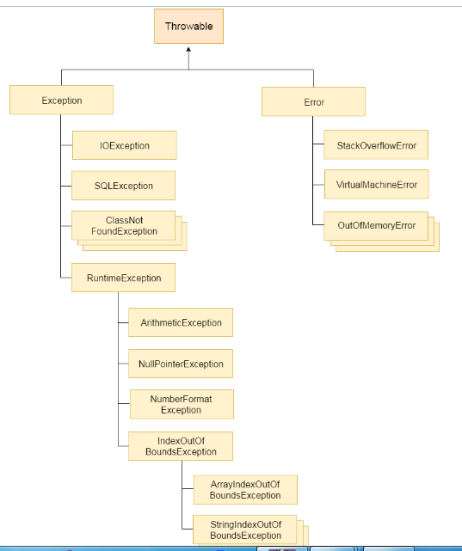
Hierarchy of Java Exception classes
Checked Exception (checked at compile-time)
Unchecked Exception (not checked at compile-time, but they are checked at runtime)

Slide 4
Unchecked Exception (Run Time Exception)
ArithmeticException
int num = 100 / 0;
NullPointerException
    String s=null;
    System.out.println(s.charAt(0));
NumberFormatException
String str="hello";
    int i=Integer.parseInt(str);
ArrayIndexOutOfBoundsException
int array[] = new int[100];
    array[100] = 100;

Slide 5
Checked Exception (Compile Time)
import java.io.FileInputStream;
public class checked_eg {
  public static void main(String[] args) {
  openfile("text.txt");
  }
  public static void openfile(String filename) {
    try {
      FileInputStream f = new FileInputStream(filename);
    } catch (Exception e) {
      System.out.println(e);
    }
    System.out.println("File not found example");
  }
}
java.io.FileNotFoundException: text.txt (The system cannot find the file specified)
File not found example

Slide 6
Java Exception Keywords
Keyword | Description
try | Specify a block where we should place exception code. It must be followed by either catch or finally. We can't use try block alone.
catch | It is used to handle the exception. It must be preceded by try block We can't use catch block alone. It can be followed by finally block later.
finally | It is used to execute the important code of the program. It is executed whether an exception is handled or not.
throw | It is used to throw an exception.
throws | It is used to declare exceptions. It doesn't throw an exception. It specifies that there may occur an exception in the method. It is always used with method signature.

Slide 7
Exception Handling
Exception Handling
  Throwing Exception
  Try, catch and finally
Exception as objects
  Creating new exception classes

Slide 8
Handling Exceptions in two ways
Implicit Exception Handling
  To let Java handle such errors automatically
  use throws construct
Explicit Exception Handling
  To let programmer to provide code dealing with errors
  use try-catch-finally construct

Slide 9
public static void main(String[] args)
{
int num = 100/0;
System.out.println("Java Exception Example");
}
Exception in thread "main" java.lang.ArithmeticException: / by zero
at ExceptionHandlingTest.Test1.main(Test1.java:7)

Slide 10
Example
public static void main(String[] args)
{
try {
int num = 100 / 0;
}
catch (ArithmeticException e) {
System.out.println(e);
}
System.out.println("Java Exception Example");
}

Slide 11
Not Catching Exceptions
Scanner scanner = new Scanner(System.in);
System.out.println(“Enter integer:");
int number = scanner.nextInt();
Error message for invalid input
Exception in thread “main” java.lang.InputMismatchException
at java.util.Scanner.throwFor(Scanner.java:819)
at java.util.Scanner.next(Scanner.java:1431)
at java.util.Scanner.nextInt(Scanner.java:2040)
at java.util.Scanner.nextInt(Scanner.java:2000)
at Ch8Sample1.main(Ch8Sample1.java:35)
Notes:
Consider the given example. What would happen if the user enters a value such as the text 'ten' instead of 10? The parseInt method cannot convert such an input to an internal numerical format. This type of error is called an exception, and it will result in displaying an error message such as the one shown here. We say the parseInt method has thrown a NumberFormatException.

Slide 12
Catching an Exception
Scanner scanner = new Scanner(System.in);
System.out.println(“Enter Age:");
int age;
try {
age = scanner.nextInt( );
} catch (InputMismatchException e){
System.out.println("Invalid Entry.Please enter digits only");
}
try
catch
Notes:
This example shows a way to handle a thrown exception in our code, instead of letting the system handle it, as in the previous example. If any statement inside the try block throws an exception, then the statements in the matching catch block are executed. And the program continues the execution from the statement that follows this try-catch statement.

Slide 13
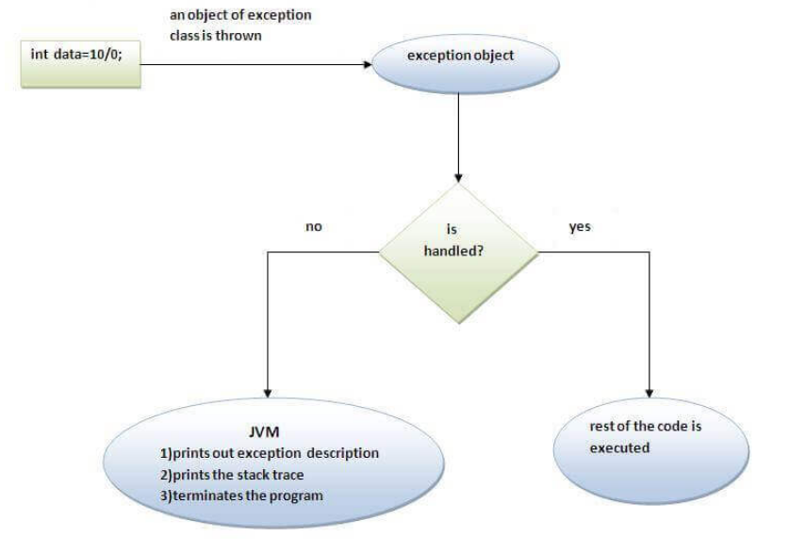
Internal working of java try-catch block
Picture Source : https://www.javatpoint.com/try-catch-block

Slide 14
Getting Information
There are two methods we can call to get information about the thrown exception:
  getMessage
  printStackTrace
try {
. . .
} catch (InputMismatchException e){
System.out.println(e.getMessage()); (OR)
e.printStackTrace();
}
Notes:
In the previous example, we simply displayed a fixed error message. We can get display a more generic error message by using the getMessage or printStrackTrace methods. We will experiment with these methods in the lab.

Slide 15
try-catch Control Flow
Exception
No Exception
try {
<t-stmt-1>
<t-stmt-2>
<t-stmt-3>
<t-stmt-4>
. . .
<t-stmt-n>
} catch (Exception e) {
<c-stmt-1>
. . .
<c-stmt-m>
}
<next stmt>
try {
<t-stmt-1>
<t-stmt-2>
<t-stmt-3>
<t-stmt-4>
. . .
<t-stmt-n>
} catch (Exception e) {
<c-stmt-1>
. . .
<c-stmt-m>
}
<next stmt>
Assume <t-stmt-3>
throws an exception.
All statements in the try block are executed.
Remaining statements in the try block is skipped.
Statements in the catch block are executed.
Statements in the catch block are skipped.
And the execution continues to the next statement
Notes:
This illustrates how the control flows when there is an exception and when there is no exception.
In the case when no statements in the try block throw an exception, then the catch block is skipped and execution continues with the next statement following the try-catch statement.
If any one of the statements throws an exception, the statements in the catch block are executed. Execution then continues to the statement following the try-catch statement, ignoring any remaining statements in the try block.

Slide 16
Multiple Exception (Multi Catch)
A try block can be followed by one or more catch blocks.
Each catch block must contain a different exception handler.
To perform different tasks at the occurrence of different exceptions, use java multi-catch block
At a time only one exception occurs and at a time only one catch block is executed.
All catch blocks must be ordered from most specific to most general, i.e. catch for ArrayIndexOutOfBoundException must come before catch for Exception.

Slide 17
Multi catch Example
try{
int array[]=new int[5];
array[3]=20/0;
}
catch(ArithmeticException e1)
{ System.out.println(e1); }
catch(ArrayIndexOutOfBoundsException e2)
{ System.out.println(e2); }
catch( Exception e)
{
System.out.println(e);
System.out.println("Other Exception");
}
System.out.println("MultipleCatchExample");

Slide 18
Multiple catch Control Flow
Exception
No Exception
Assume <t-stmt-3>
throws an exception and <catch-block-3> is the matching block.
try {
<t-stmt-1>
<t-stmt-2>
<t-stmt-3>
<t-stmt-4>
. . .
<t-stmt-n>
}
<catch-block-1>
<catch-block-2>
<catch-block-3>
. . .
<catch-block-m>
}
<next stmt>
try {
<t-stmt-1>
<t-stmt-2>
<t-stmt-3>
<t-stmt-4>
. . .
<t-stmt-n>
}
<catch-block-1>
<catch-block-2>
<catch-block-3>
. . .
<catch-block-m>
}
<next stmt>
All statements in the try block are executed and throw no exceptions.
Remaining statements in the try block is skipped.
Statements in the matching catch block are executed.
All catch blocks are skipped.
Notes:
Here's how the control flows when there are multiple catch blocks.
In the case when no statements in the try block throw an exception, then all catch blocks are skipped and execution continues with the next statement following the try-catch statement.
If any one of the statements throws an exception, the statements in the matching catch block are executed. Execution then continues to the statement following the try-catch statement, ignoring any remaining statements in the try block.

Slide 19
Nested Try Block
Sometimes a situation may arise where a part of a block may cause one error and the entire block itself may cause another error.
In such cases, exception handlers have to be nested.

Slide 20
Syntax
try
{
statement 1;
statement 2;
try
{
statement 3;
statement 4;
}
catch(Exception e)
{
}
}
catch(Exception e)
{
}

Slide 21
Example
public static void main(String[] args) {
try
{
System.out.println("Nested Try Example ");
try
{ int num=10/0; }
catch(ArithmeticException e1)
{ System.out.println(e1); }
try
{
String str="";
    System.out.println(str.charAt(8));
}
catch(StringIndexOutOfBoundsException e2)
    { System.out.println(e2); }
String st=null;
System.out.println(st.length());
}
catch(Exception e)
{
System.out.println(e);
}
}
Nested Try Example
java.lang.ArithmeticException: / by zero
java.lang.StringIndexOutOfBoundsException: String index out of range: 8
java.lang.NullPointerException: Cannot invoke "String.length()" because "st" is null

Slide 22
Java Finally Block
is used to execute important code such as closing connection, closing a file, etc.
is always executed whether exception is handled or not.
follows try or catch block.
  try
  {
  int num=10/0;
  }
  catch (ArithmeticException e)
  {
  System.out.println(e);
  }
  finally
  {
  System.out.println("Finally Executed ");
  }

Slide 23
Java Exception propagation
void method3() {
  String string = "hello";
  System.out.println(string.charAt(10));
}
void method2() {
  method3();
}
void method1() {
  try {
    method2();
  } catch (Exception e) {
    System.out.println(e);
  }
}
public static void main(String[] args) {
Propagation p = new Propagation();
p.method1(); }
( By default Unchecked Exceptions are forwarded in calling chain (propagated))
java.lang.StringIndexOutOfBoundsException: String index out of range: 10

Slide 24
Java throw keyword
The Java throw keyword is used to explicitly throw an exception.
We can throw either checked or uncheked exception in java by throw keyword
Syntax
  throw new IOException("sorry IO exception occurs);
  Example
    int num=34;
    if(num<50)
    throw new ArithmeticException("not pass");
    else
    System.out.println("Pass");

Slide 25
Java throws keyword (Why throws keyword is used)
The Java throws keyword is used to declare an exception.
myMethod() that has statements that can throw either ArithmeticException or NullPointerException, in this case you can use try-catch as shown below:
  public void myMethod()
  { try { // Statements that might throw an exception }
  catch (ArithmeticException e)
  { // Exception handling statements }
  catch (NullPointerException e)
  { // Exception handling statements } }
But suppose you have several such methods that can cause exceptions, in that case it would be tedious to write these try-catch for each method.
The code will become unnecessary long and will be less-readable.

Slide 26
public void myMethod() throws ArithmeticException, NullPointerException
{
// Statements that might throw an exception
}
public static void main(String args[])
{
try{
myMethod();
}
catch (ArithmeticException e)
{ // Exception handling statements }
catch (NullPointerException e)
{ // Exception handling statements } }
}

Slide 27
Java throws keyword
import java.io.*;
class File1{
public static void main(String[] args) throws IOException{
FileWriter file = new FileWriter("D:\\Data1.txt");
file.write("Hello");
file.close();
}
}

Slide 28
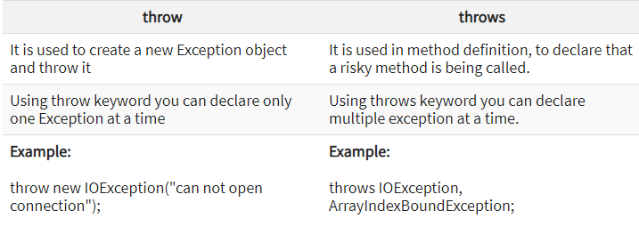
Difference between throw and throws

Slide 29
Exercises: No.1,2

