Slide 1
Chapter 9
Character and String

Slide 2
Objectives
After you have read and studied this chapter, you should be able to
Declare and manipulate data of the char data type.
Write string processing program, applicable in areas such as bioinformatics, using String, StringBuilder, and StringBuffer objects.
Specify regular expressions for searching a pattern in a string.
Use the Pattern and Matcher classes.
Compare the String objects correctly.

Slide 3
Characters
In Java, single characters are represented using the data type char.
Character constants are written as symbols enclosed in single quotes.
Characters are stored in a computer memory using some form of encoding.
ASCII, which stands for American Standard Code for Information Interchange, is one of the document coding schemes widely used today.
ASCII, using 8 bits, 265 symbols can represent
To accommodate the character symbols of non-English languages, Java uses Unicode, which includes ASCII, for representing char constants, as a total of 34,168 distinct characters (2 bytes)

Slide 4
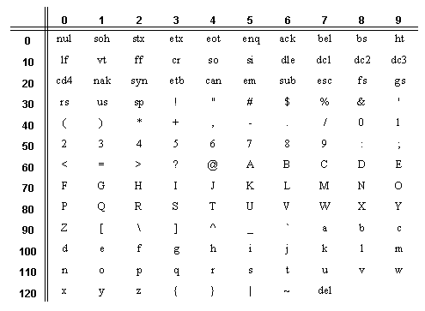
ASCII Encoding
9
For example, character 'O' is 79 (row value 70 + col value 9 = 79).
70
O

Slide 5
Unicode Encoding
The Unicode Worldwide Character Standard (Unicode) supports the interchange, processing, and display of the written texts of diverse languages.
Java uses the Unicode standard for representing char constants.
char ch1 = 'X';
System.out.println(ch1);
System.out.println( (int) ch1);

Slide 6
Character Processing
Declaration and initialization
char ch1, ch2 = ‘X’;
System.out.print("ASCII code of character X is " + (int) 'X' );
System.out.print("Character with ASCII code 88 is " + (char)88 );
Type conversion between int and char.
This comparison returns true because ASCII value of 'A' is 65 while that of 'c' is 99.
‘A’ < ‘c’

Slide 7
String
String is basically an object that represents sequence of char values.
An array of characters works same as Java string.
char[] ch={‘w',’e’,’l',’c’,’o’,’m',’e’};
String s=new String(ch);
Or
String s=“welcome”;

Slide 8
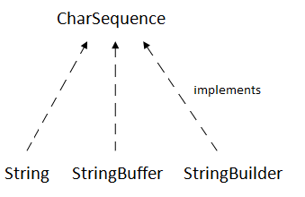
CharSequence Interface
The CharSequence interface is used to represent the sequence of characters.
String, StringBuffer and StringBuilder classes implement it.
It means, we can create strings in java by using these three classes.
Java String is immutable which means it cannot be changed.
StringBuffer and StringBuilder is mutable.

Slide 9

Example
public static void main(String[] args) {
String s1="Hello"; // using literal
String s2= new String("Welcome");// using new keyword
char [] ch= {'j','a','v','a'};
String s3= new String(ch); // convert char array to string
System.out.println(s1);
System.out.println(s2);
System.out.println(s3);
}

Slide 10
Example : String, StringBuffer and StringBuilder
public class string_eg {
public static void concat1(String s1)
{
s1 = s1 + " of Computer Studies";
}
public static void concat2(StringBuilder s2)
{
s2.append(" of Computer Studies");
}
public static void concat3(StringBuffer s3)
{
s3.append(" of Computer Studies");
}
public static void main(String[] args)
{
String s1 = "University";
concat1(s1);
System.out.println("String: " + s1);
StringBuilder s2 = new StringBuilder("University");
concat2(s2);
System.out.println("StringBuilder: " + s2);
StringBuffer s3 = new StringBuffer("University");
concat3(s3);
System.out.println("StringBuffer: " + s3);
}
}
String: University
StringBuilder: University of Computer Studies
StringBuffer: University of Computer Studies

Slide 11
Some useful methods of java.lang.String class
NO | Methods | Descriptions
1 | char charAt(int index) | returns char value for the particular index
2 | int length() | returns string length
3 | String substring(int beginIndex) | returns substring for given begin index.
4 | String substring(int beginIndex, int endIndex) | returns substring for given begin index and end index.
5 | boolean contains(CharSequence s) | returns true or false after matching the sequence of char value.
6 | boolean isEmpty() | checks if string is empty.
7 | String concat(String str) | concatenates the specified string.
8 | String replace(char oldChar, char newChar) | replaces all occurrences of the specified char value.
9 | String replace(CharSequence target, CharSequence replacement) | replaces all occurrences of the specified CharSequence.
10 | equalsIgnoreCase | compares another string. It doesn't check case.
11 | equal | checks the equality of string with the given object.

Slide 12
Example
import java.util.*;
public class CountJava {
public static void main (String[] args) {
Scanner scanner = new Scanner(System.in);
int javaCount = 0;
String word;
System.out.print("Enter sentence: ");
while (true) {
word = scanner.next( );
if (word.equals("STOP")) {
break;
} else if (word.equalsIgnoreCase("Java")){
javaCount++;
}
}
System.out.println("'Java' count: " + javaCount );
}
}

Slide 13


Example
String s1="Java Programming";
System.out.println("character = " +s1.charAt(3));
System.out.println("length = " +s1.length());
String s2="welcome";
System.out.println(s2.substring(2, 5));
System.out.println(s2.substring(2));
System.out.println(s2.substring(0));

Slide 14

String s3="Are you studying?";
System.out.println(s3.contains("Are you"));
System.out.println(s3.contains("study"));
System.out.println(s3.contains("going"));
true if sequence of char value exists, otherwise false
System.out.println(s3.isEmpty());
isEmpty() method checks if this string is empty or not.
It returns true, if length of string is 0 otherwise false..

Slide 15

String s5="Object Oriented ";
s5.concat("Programming");
System.out.println(s5);
s5=s5.concat("Programming");
System.out.println(s5);
String str1="Object";
String str2=" Oriented";
String str3=" Programming";
String str4=str1.concat(str2).concat(str3);
System.out.println(str4);
concat() method combines specified string at the end of this string. It append another string.
public String concat(String anotherString)

Slide 16


There are two type of replace methods in java string.
(1) public String replace(char oldChar, char newChar)
(2) public String replace(CharSequence target, CharSequence replacement)
(1) String s6="Java programming";
String s=s6.replace('a', 'A’);
System.out.println(s);
(2) String s7="I am Su Su. I am reading";
String ss=s7.replace("am", "was");
System.out.println(ss);
String s1="Java";
String s2="JAVA";
System.out.println(s1.equalsIgnoreCase(s2));
System.out.println(s1.equals(s2));

Slide 17
(3) String replaceAll(String regex, String replacement): It replaces all the substrings that fits the given regular expression with the replacement String.
String s8="Java Programming";
System.out.println(s8.replaceAll("a", "b")); //Jbvb Progrbmming
String s13="My .com is java.com";
String s14=s13.replaceAll(".com", ".net");
System.out.println(s14); //My .net is java.net
String s11="University of Computer Studies , Yangon";
String s12=s11.replaceAll("(.*)Computer(.*)", "Computer University");
System.out.println(s12); // Computer University

Slide 18
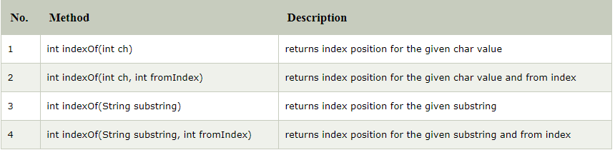
indexOf() method
There are 4 types of indexOf method in java.
indexOf() method returns index of given character value or substring

Slide 19
indexOf() and lastIndexOf()
String s6= "University of Computer Studies, Yangon : Computer Science";
System.out.println(s6.indexOf('o’)); //11
System.out.println(s6.indexOf('o', 12)); //15
System.out.println(s6.indexOf("Computer")); //14
System.out.println(s6.indexOf("Computer", 20)); //41
System.out.println(s6.lastIndexOf('i')); //52
System.out.println(s6.lastIndexOf('i',50));//27

Slide 20

trim()
trim() is a built-in function that eliminates leading and trailing spaces.
The trim() method in java checks this Unicode value before and after the string, if it exists then removes the spaces and returns the omitted string.
String st=" Java Programming";
System.out.println(st.trim());
String s4="JAVA PROGRAMMINg";
System.out.println(s4.toLowerCase());
System.out.println(s4.toUpperCase());

Slide 21

valueOf()
The java string valueOf() method converts different types of values into string.
By the help of string valueOf() method, you can convert int to string, long to string, boolean to string, character to string, float to string, double to string, object to string and char array to string.
int value=10; char ch='A’;
boolean flag=true; float f = 10.05f; double d = 10.02;
System.out.println(String.valueOf(value));
System.out.println(String.valueOf(ch));
System.out.println(String.valueOf(flag));
System.out.println(String.valueOf(f));
System.out.println(String.valueOf(d));

Slide 22

startsWith()/ endsWith()
The java string startsWith() method checks if this string starts with given prefix.
It returns true if this string starts with given prefix else returns false.
The java string endsWith() method checks if this string ends with given suffix.
It returns true if this string ends with given suffix else returns false.
String s1="java string example";
System.out.println(s1.startsWith("ja"));
System.out.println(s1.startsWith("java string"));
System.out.println(s1.endsWith("le"));
System.out.println(s1.endsWith("exam"));
Notes:
Class Types
a class can be defined in 3 ways:
in a separate .java file
top-level class
can be public
it can be used everywhere
within the same file as a top-level class
local
can be used only by classes defined in the same file
nested within another class
local
can be used within the same scope
within the declaration where it's defined
within nested declarations

Slide 23

String compareTo()
is used for comparing two strings lexicographically.
Each character of both the strings is converted into a Unicode value for comparison.
If both the strings are equal then this method returns 0 else it returns positive or negative value.
The result is positive if the first string is lexicographically greater than the second string else the result would be negative.
String st1="java";
String st2="programming";
String st3="java";
System.out.println(st1.compareTo(st3));
System.out.println(st1.compareTo(st2));
How about st2.comparteTo(st1)?
Notes:
alphabetical order

Slide 24
The String Class is Immutable
In Java, a String object is immutable
This means once a String object is created, it cannot be changed, such as replacing a character with another character or removing a character
The String methods we have used so far do not change the original string. They created a new string from the original. For example, substring creates a new string from a given string.
The String class is defined in this manner for efficiency reason

Slide 25
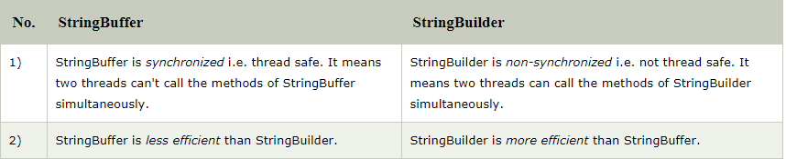
StringBuffer and String Builder
Since String is immutable in Java, whenever we do String manipulation like concatenation, substring etc, it generates a new String and discards the older String for garbage collection.
These are heavy operations and generate a lot of garbage in heap.
So Java has provided StringBuffer and StringBuilder class that should be used for String manipulation
Notes:
The Java heap is the area of memory used to store objects instantiated by applications running on the JVM. When the JVM is started, heap memory is created and any objects in the heap can be shared between threads as long as the application is running.

Slide 26
Example
StringBuffer st=new StringBuffer("Good");
st.append(" Morning");
System.out.println(st);
StringBuilder str=new StringBuilder("Welcome");
str.append(" UCSY");
System.out.println(str);

Slide 27
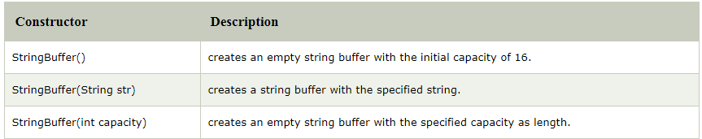
Constructor of StringBuffer Class

Slide 28
Some useful methods of StringBuffer class
Methods | Descriptions
append(String s) | is used to append the specified string with this string. append(char), append(boolean), append(int), append(float), append(double) etc.
insert(int offset, String s) | is used to insert the specified string with this string at the specified position. insert(int, char), insert(int, boolean), insert(int, int), insert(int, float), insert(int, double)
replace(int startIndex, int endIndex, String str) | is used to replace the string from specified startIndex and endIndex.
delete(int startIndex, int endIndex) | is used to delete the string from specified startIndex and endIndex.
reverse() | is used to reverse the string.
charAt(int index) | is used to return the character at the specified position.
length() | is used to return the length of the string i.e. total number of characters.
substring(int beginIndex) | is used to return the substring from the specified beginIndex.
substring(int beginIndex, int endIndex) | is used to return the substring from the specified beginIndex and endIndex.

Slide 29
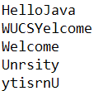
Example
StringBuffer s1=new StringBuffer("Hello");
System.out.println(s1.append("Java"));
StringBuffer s2=new StringBuffer("Welcome");
System.out.println(s2.insert(1, "UCSY"));
System.out.println(s2.replace(1, 5, ""));
StringBuffer s3=new StringBuffer("University");
System.out.println(s3.delete(2, 5));
System.out.println(s3.reverse());

Slide 30
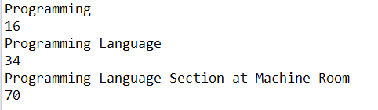

Example
StringBuffer s4=new StringBuffer();
System.out.println(s4.capacity());
System.out.println(s4.append("Programming"));
System.out.println(s4.capacity());
System.out.println(s4.append(" Language"));
System.out.println(s4.capacity());
System.out.println(s4.append(" Section at Machine Room"));
System.out.println(s4.capacity());
StringBuffer s5=new StringBuffer("Java");
System.out.println(s5.charAt(2));
s5.setCharAt(1, 'A');
s5.setCharAt(3, 'A');
System.out.println(s5);
The default capacity of the buffer is 16. If the number of character increases from its current capacity, it increases the capacity by (oldcapacity*2)+2.

Slide 31
Example
import java.util.*;
class ReplaceVowelsWithX {
public static void main (String[] args) {
Scanner scanner = new Scanner(System.in);
scanner.useDelimiter(System.getProperty("line.separator"));
StringBuffer tempStringBuffer;
String inSentence;
char letter;
System.out.println("Sentence: ");
inSentence = scanner.next();
tempStringBuffer = new StringBuffer(inSentence);
for (int index = 0; index < tempStringBuffer.length(); index++) {
letter = tempStringBuffer.charAt(index);
if (letter == 'a' || letter == 'A' ||
letter == 'e' || letter == 'E' ||
letter == 'i' || letter == 'I' ||
letter == 'o' || letter == 'O' ||
letter == 'u' || letter == 'U' ) {
tempStringBuffer.setCharAt(index,'X');
}
}
System.out.println("Input: " + inSentence);
System.out.println("Output: " + tempStringBuffer);
}
}

Slide 32
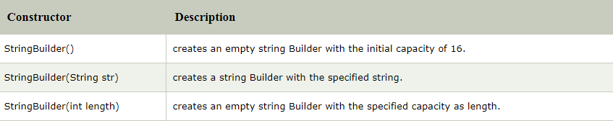
Constructor of StringBuilder Class
is used to create mutable (modifiable) string.
StringBuffer and StringBuilder support exactly the same set of methods, so they are interchangeable.
same as StringBuffer class except that it is non-synchronized.
It is available since JDK 1.5.

Slide 33
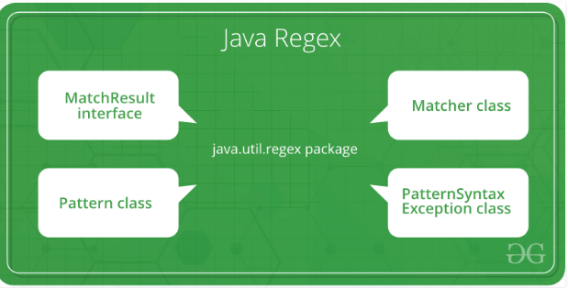
Regular Expression
Java Regex or Regular Expression is an API to define a pattern for searching or manipulating strings.
Used to define the constraint on strings such as password and email validation.
Java Regex API provides 1 interface and 3 classes in java.util.regex package.
java.util.regex.Pattern – Used for defining patterns
java.util.regex.Matcher – Used for performing match operations on text using patterns
Picture : https://www.geeksforgeeks.org

Slide 34
Regular Expression
Some Rules
The brackets [ ] represent choices
The asterisk symbol * means zero or more occurrences.
The plus symbol + means one or more occurrences.
The hat symbol ^ means negation.
The hyphen – means ranges.
The parentheses ( ) and the vertical bar | mean a range of choices for multiple characters.

Slide 35
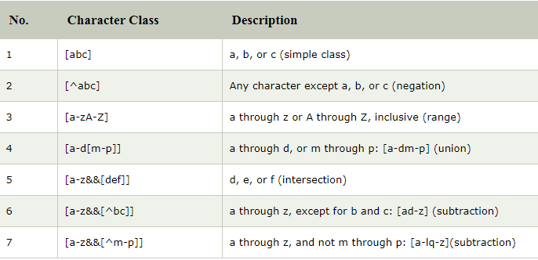
Regex Character Class
The Java regular expression syntax has a few predefined character classes

Slide 36
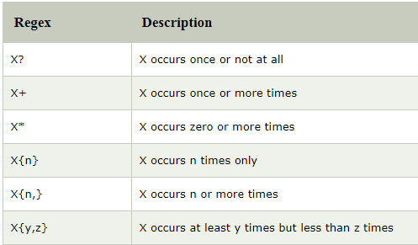
Regex Quantifiers
The quantifiers specify the number of occurrences of a character.

Slide 37
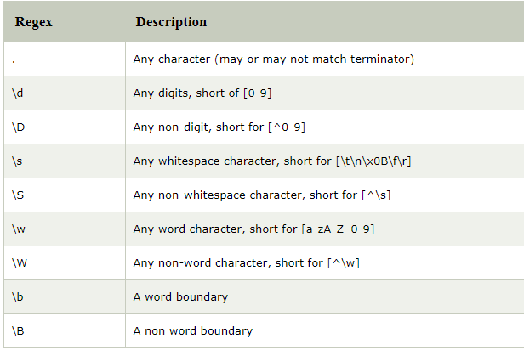
Predefined Character Class (Regex Metacharacters)
The predefined character classes do not have to be enclosed in square brackets, but you can if you want to combine them.
\b matches any digit character
[\b\s] matches any digit or any white space character.

Slide 38
Regular Expression Examples
Expression | Description
[013] | A single digit 0, 1, or 3.
[0-9][0-9] | Any two-digit number from 00 to 99.
[0-9&&[^4567]] | A single digit that is 0, 1, 2, 3, 8, or 9.
[a-z0-9] | A single character that is either a lowercase letter or a digit.
[a-zA-z][a-zA-Z0-9_$]* | A valid Java identifier consisting of alphanumeric characters, underscores, and dollar signs, with the first character being an alphabet.
[wb](ad|eed) | Matches wad, weed, bad, and beed.
(AZ|CA|CO)[0-9][0-9] | Matches AZxx,CAxx, and COxx, where x is a single digit.

Slide 39
Regular Expression Examples
Expression | Description
[wb](ad|eed) | Matches wad,weed,bad, and beed.
(pro|anti)-OO? | Matches pro-OOP and anti-OOP.
(AZ|CA|CO)[0–9]{4} | Matches AZxxxx,CAxxxx, and COxxxx, where x is a single digit.

Slide 40
Example
import java.util.*;
class MatchJavaIdentifier {
private static final String STOP = "STOP";
private static final String VALID = "Valid Java identifier";
private static final String INVALID = "Not a valid Java identifier";
private static final String VALID_IDENTIFIER_PATTERN = "[a-zA-Z][a-zA-Z0-9_$]*";
public static void main (String[] args) {
Scanner scanner = new Scanner (System.in);
String str, reply;
while (true) {
System.out.print ("Identifier: ");
str = scanner.next( );
if (str.equals(STOP)) break;
if (str.matches(VALID_IDENTIFIER_PATTERN)) {
reply = VALID;
} else {
reply = INVALID;
}
System.out.println(str + ": " + reply + "\n");
} }
}

Slide 41
The replaceAll Method
The replaceAll method replaces all occurrences of a substring that matches a given regular expression with a given replacement string.
`
Replace all vowels with the symbol @
String originalText, modifiedText;
originalText = ...; //assign string
modifiedText =
originalText.replaceAll("[aeiou]","@");

Slide 42
The Pattern and Matcher Classes
The matches and replaceAll methods of the String class are shorthand for using the Pattern and Matcher classes from the java.util.regex package.
If str and regex are String objects, then
str.matches(regex);
is equivalent to
Pattern pattern = Pattern.compile(regex);
Matcher matcher = pattern.matcher(str);
matcher.matches();

Slide 43
The compile Method
The compile method of the Pattern class converts the stated regular expression to an internal format to carry out the pattern-matching operation.
This conversion is carried out every time the matches method of the String class is executed, so it is more efficient to use the compile method when we search for the same pattern multiple times.
See the sample programs Ch9MatchJavaIdentifierPM on Page 539 and Ch9CountJavaPM on Page 540
Notes:
private static final String VALID_IDENTIFIER_PATTERN = "[a-zA-Z][a-zA-Z0-9_$]*";
Matcher matcher;
Pattern pattern = Pattern.compile(VALID_IDENTIFIER_PATTERN);
matcher = pattern.matcher(str);
if (matcher.matches()) {
reply = VALID;
} else {
reply = INVALID;
}

Slide 44
Example
import java.util.*;
import java.util.regex.*;
class MatchJavaIdentifierPM {
private static final String STOP = "STOP";
private static final String VALID = "Valid Java identifier";
private static final String INVALID = "Not a valid Java identifier";
private static final String VALID_IDENTIFIER_PATTERN = "[a-zA-Z][a-zA-Z0-9_$]*";
Scanner scanner = new Scanner(System.in);
String str, reply;
Matcher matcher;
Pattern pattern = Pattern.compile(VALID_IDENTIFIER_PATTERN);
while (true) {
System.out.print("Identifier: ");
str = scanner.next();
if (str.equals(STOP)) break;
matcher = pattern.matcher(str);
if (matcher.matches()) {
reply = VALID;
} else {
reply = INVALID;
}
System.out.println(str + ": " + reply + "\n");
}}

Slide 45
Three ways to write Java Regex
(1) Pattern p= Pattern.compile(".b"); // . Means one character
Matcher m=p.matcher("ab");
boolean result = m.matches();
System.out.println(result); // true
(2) boolean result1= Pattern.compile(".b").matcher("ab").matches();
System.out.println(result1); // true
(3) boolean result2= Pattern.matches(".b", "ab");
System.out.println(result2); // true

Slide 46
Split() method Example (Pattern class)
To split a text into multiple strings based on a delimiter, we can use Pattern.split() method
String text3="redisyellowIsgreenisblue";
Pattern p1=Pattern.compile("is", Pattern.CASE_INSENSITIVE);
String [] result=p1.split(text3);
for(String s: result)
{
System.out.print(s);
} red yellow green blue

Slide 47
Find out multiple occurrences of Pattern (Pattern and Matcher Class)
String text4="AABBCAAADEEAA";
Pattern p2=Pattern.compile("AA");
Matcher m2=p2.matcher(text4);
while(m2.find())
{
System.out.println("Found at : "+m2.start()+" - "+m2.end());
}
Found at : 0 - 2
Found at : 5 - 7
Found at : 11 - 13

Slide 48
replaceAll (String replacement) (Matcher Class)
Replacing multiple spaces into single space.
It covers tab, new line, any kind of spaces replaces with single space.
Pattern p3=Pattern.compile("\\s+");
Matcher m3=p3.matcher("This is my first time");
String newString=m3.replaceAll(" ");
System.out.println("New String ="+newString);
New String = This is my first time

Slide 49
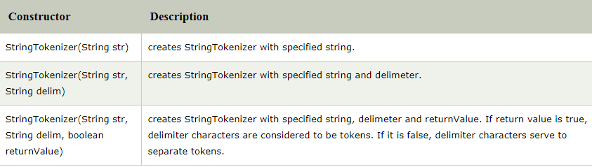
StringTokenizer
java.util.StringTokenizer class allows you to break a string into tokens
There are 3 constructors defined in the StringTokenizer class

Slide 50
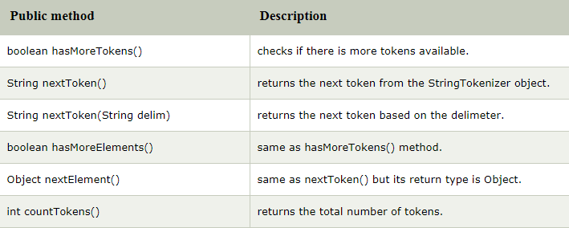
Methods of StringTokenizer class

Slide 51

Examples
StringTokenizer st = new StringTokenizer("University of Computer Studies"," ");
while (st.hasMoreTokens()) {
System.out.println(st.nextToken());
}

Slide 52
Exercises 4, 10, 11, 12, 19, 20

