Slide 1
Chapter 14
GUI and Event-Driven Programming
Notes:
Introduction to OOP with Java 4th Ed, C. Thomas Wu
© The McGraw-Hill Companies, Inc.

Slide 2
Objectives
After you have read and studied this chapter, you should be able to
  Define a subclass of JFrame to implement a customized frame window.
  Write event-driven programs using Java's delegation-based event model
  Arrange GUI objects on a window using layout managers and nested panels
  Write GUI application programs using JButton, JLabel, ImageIcon, JTextField, JTextArea, JCheckBox, JRadioButton, JComboBox, JList, and JSlider objects from the javax.swing package
  Write GUI application programs with menus
  Write GUI application programs that process mouse events
Chapter 14 - <number>
Notes:
Intro to OOP with Java, C. Thomas Wu
©The McGraw-Hill Companies, Inc.
We will learn how to create a customized frame window by defining a subclass of the JFrame class. Among the many different types of GUI objects, arguably the buttons are most common. We will learn how to create and place buttons on a frame in this lesson.

Slide 3
Graphical User Interface
In Java, GUI-based programs are implemented by using classes from the javax.swing and java.awt packages.
Chapter 14 - <number>
Notes:
Intro to OOP with Java, C. Thomas Wu
©The McGraw-Hill Companies, Inc.
Classes we use to develop GUI-based programs are located in two packages javax.swing and java.awt. Many of the classes in the java.awt package are replaced by Swing counterparts, and for the most part, using the Swing classes over the AWT classes is the preferred approach because the newer Swing classes are better implementation. We still have to refer to java.awt package because there are some classes that are defined only in the java.awt package.

Slide 4
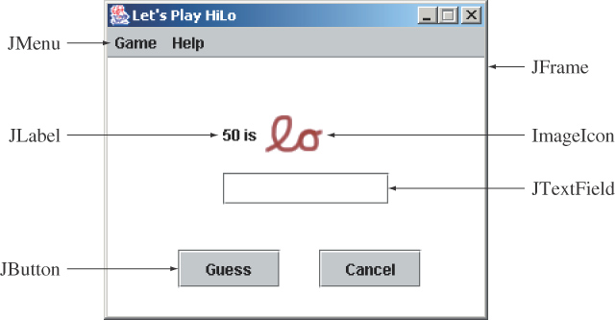
Sample GUI Objects
Various GUI objects from the javax.swing package.
Chapter 14 - <number>
Notes:
Intro to OOP with Java, C. Thomas Wu
©The McGraw-Hill Companies, Inc.
Here's a sample frame that includes a number of common Swing components. We will see examples using JFrame and JButton in this lesson. We will see other components in the later lessons of this module.

Slide 5
JOptionPane
Using the JOptionPane class is a simple way to display the result of a computation to the user or receive an input from the user.
We use the showMessageDialog class method for output.
We use the showInputDialog class method for input. This method returns the input as a String value so we need to perform type conversion for input of other data types
Chapter 14 - <number>
Notes:
Intro to OOP with Java, C. Thomas Wu
©The McGraw-Hill Companies, Inc.

Slide 6
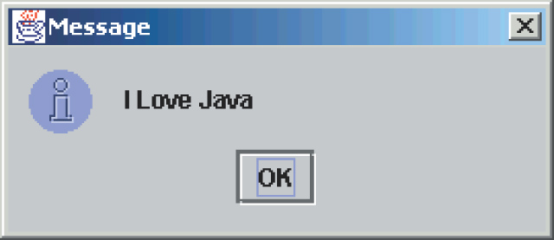
Using JOptionPane for Output
import javax.swing.*;
. . .
JOptionPane.showMessageDialog( null, “I Love Java” );
Chapter 14 - <number>
Notes:
Intro to OOP with Java, C. Thomas Wu
©The McGraw-Hill Companies, Inc.

Slide 7
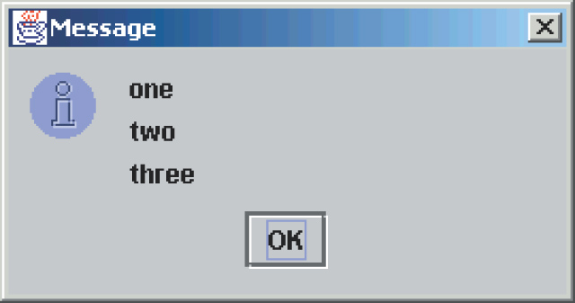
Using JOptionPane for Output - 2
import javax.swing.*;
. . .
JOptionPane.showMessageDialog( null, “one\ntwo\nthree” );
//place newline \n to display multiple lines of output
Chapter 14 - <number>
Notes:
Intro to OOP with Java, C. Thomas Wu
©The McGraw-Hill Companies, Inc.

Slide 8
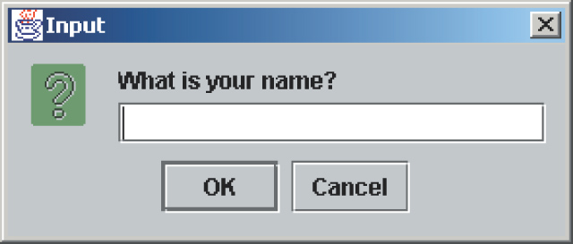
JOptionPane for Input
import javax.swing.*;
. . .
String inputstr =
JOptionPane.showInputDialog( null, “What is your name?” );
(oR)
JOptionPane.showInputDialog(“What is your name?” );
Chapter 14 - <number>
Notes:
Intro to OOP with Java, C. Thomas Wu
©The McGraw-Hill Companies, Inc.

Slide 9
Subclassing JFrame
To create a customized frame window, we define a subclass of the JFrame class.
The JFrame class contains rudimentary functionalities to support features found in any frame window.
Chapter 14 - <number>
Notes:
Intro to OOP with Java, C. Thomas Wu
©The McGraw-Hill Companies, Inc.
The standard JFrame class includes only most basic functionalities. When we need a frame window in our application, it is typical for us to define a subclass of JFrame to create a frame window that is customized to our needs. We will study the basics of this customization.

Slide 10

Creating a Plain JFrame
import javax.swing.*;
class Ch7DefaultJFrame {
public static void main( String[] args ) {
JFrame defaultJFrame;
defaultJFrame = new JFrame();
defaultJFrame.setVisible(true);
}
}
Chapter 14 - <number>
Notes:
Intro to OOP with Java, C. Thomas Wu
©The McGraw-Hill Companies, Inc.
Before we start to explore how to customize a frame window, let's see the behavior of a plain standard JFrame object. This sample program creates a default JFrame object. When you run this program, a very tiny window appears at the top left corner of the screen.

Slide 11
Creating a Subclass of JFrame
To define a subclass of another class, we declare the subclass with the reserved word extends.
import javax.swing.*;
class Ch7JFrameSubclass1 extends JFrame {
. . .
}
Chapter 14 - <number>
Notes:
Intro to OOP with Java, C. Thomas Wu
©The McGraw-Hill Companies, Inc.
A subclass of any class is declared by including the keyword 'extends' the class definition header. The example here defines a subclass of JFrame named Ch7JFrameSubclass1.

Slide 12
Customizing Ch14JFrameSubclass1
An instance of Ch14JFrameSubclass1 will have the following default characteristics:
  The title is set to My First Subclass.
  The size of the frame is 300 pixels wide by 200 pixels high.
  The frame is positioned at screen coordinate (150, 250).
  The program terminates when the close box is clicked.
  These properties are set inside the default constructor.
Source File: Ch14JFrameSubclass1.java
Chapter 14 - <number>
Notes:
Intro to OOP with Java, C. Thomas Wu
©The McGraw-Hill Companies, Inc.
Open the sample Ch7JFrameSubclass1 class and see how the constructor includes a number of statements such as setTitle and setLocation to set the properties. These methods are all inherited from the superclass JFrame. The last statement is setDefaultCloseOperation that defines the frame's behavior when the close box of the frame is clicked. Passing the class constant EXIT_ON_CLOSE specifies to stop the application when the close box of a frame is clicked. Remove this statement and see what happens.

Slide 13
Example
import javax.swing.*;
public class JFrameSubclass extends JFrame {
public JFrameSubclass() {
    setTitle("First GUI Program");
    setSize(300, 200);
    setLocation(150, 250);
    setDefaultCloseOperation(JFrame.EXIT_ON_CLOSE);
}
public static void main(String[] args) {
JFrameSubclass jf = new JFrameSubclass();
    jf.setVisible(true);
}
}
Chapter 14 - <number>

Slide 14
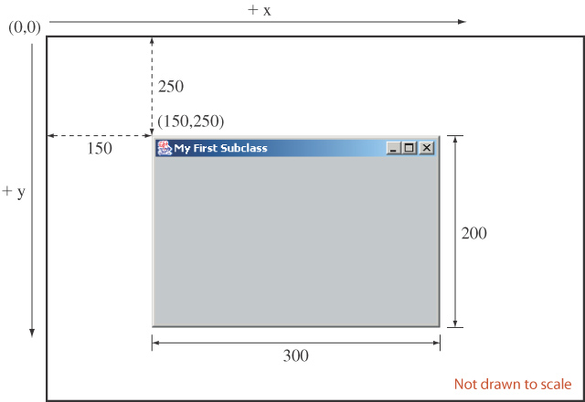
Displaying Ch14JFrameSubclass1
Here's how a Ch14JFrameSubclass1 frame window will appear on the screen.
Chapter 14 - <number>
Notes:
Intro to OOP with Java, C. Thomas Wu
©The McGraw-Hill Companies, Inc.
This diagram illustrates how the arguments to the setSize and setLocation methods affect the frame window appearance on the screen. The top left corner of the screen has coordinate (0,0). The value of x increases as you move toward right and the value of y increases as you move down. Notice that the screen coordinate is different from the coordinate system of a mathematical 2-D graph.

Slide 15
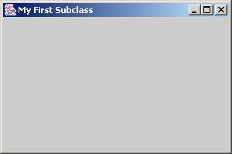
The Content Pane of a Frame
The content pane is where we put GUI objects such as buttons, labels, testboxes, scroll bars, and others.
We access the content pane by calling the frame’s getContentPane method.
This gray area is the content pane of this frame.
Chapter 14 - <number>
Notes:
Intro to OOP with Java, C. Thomas Wu
©The McGraw-Hill Companies, Inc.
A frame window is composed of four borders, a title bar, and a content area. The content area is called a content pane in Java, and this is the area we can use to place GUI components.

Slide 16
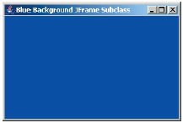
Changing the Background Color
Here's how we can change the background color of a content pane to blue:
Container contentPane = getContentPane();
contentPane.setBackground(Color.BLUE);
Source File:
Ch14JFrameSubclass2.java
Chapter 14 - <number>
Notes:
Intro to OOP with Java, C. Thomas Wu
©The McGraw-Hill Companies, Inc.
We access the content pane of a frame by calling the JFrame method called getContentPane. We declare the data type for the object returned by the getContentPane method to Container. Once we get the content pane object, we can call its methods. The example here calls the setBackground method to change the default background color of gray to white. The complete sample code can be found in the file Ch7JFrameSubclass2.java.

Slide 17
Placing GUI Objects on a Frame
There are two ways to put GUI objects on the content pane of a frame:
  Use a layout manager
    FlowLayout
    BorderLayout
    GridLayout
  Use absolute positioning
    null layout manager
Chapter 14 - <number>
Notes:
Intro to OOP with Java, C. Thomas Wu
©The McGraw-Hill Companies, Inc.
The content pane of a frame is where we can place GUI components. Among the approaches available to us to place components, we will study the easier one here. The easier absolute positioning is not a recommended approach for practical applications, but our objective here is to learn the basic handling of events and placement of GUI objects, we will use the easier approach. Chapter 12 of the textbook discusses different layout managers.

Slide 18
Layout Managers
The layout manager determines how the GUI components are added to the container (such as the content pane of a frame)
Among the many different layout managers, the common ones are
  FlowLayout (see Ch14FlowLayoutSample.java)
  BorderLayout (see Ch14BorderLayoutSample.java)
  GridLayout (see Ch14GridLayoutSample.java)
4th Ed Chapter 14 - <number>

Slide 19
FlowLayout
In using this layout, GUI componentsare placed in left-to-right order.
  When the component does not fit on the same line, left-to-right placement continues on the next line.
As a default, components on each line are centered.
When the frame containing the component is resized, the placement of components is adjusted accordingly.
Chapter 14 - <number>
Notes:
Intro to OOP with Java, C. Thomas Wu
©The McGraw-Hill Companies, Inc.

Slide 20
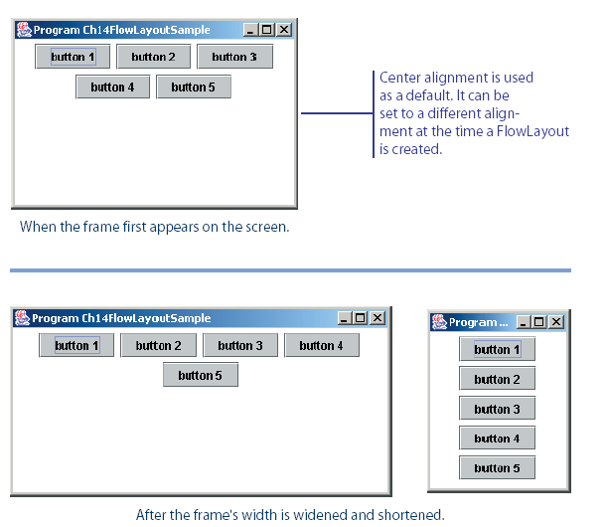
FlowLayout Sample
This shows the placement of five buttons by using FlowLayout.
Chapter 14 - <number>
Notes:
Intro to OOP with Java, C. Thomas Wu
©The McGraw-Hill Companies, Inc.

Slide 21
BorderLayout
This layout manager divides the container into five regions: center, north, south, east, and west.
The north and south regions expand or shrink in height only
The east and west regions expand or shrink in width only
The center region expands or shrinks on both height and width.
Not all regions have to be occupied.
Chapter 14 - <number>
Notes:
Intro to OOP with Java, C. Thomas Wu
©The McGraw-Hill Companies, Inc.

Slide 22
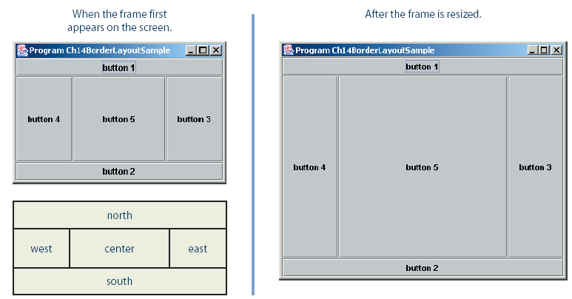
BorderLayout Sample
Chapter 14 - <number>
Notes:
Intro to OOP with Java, C. Thomas Wu
©The McGraw-Hill Companies, Inc.
contentPane.setLayout(new BorderLayout());
contentPane.add(button1, BorderLayout.NORTH);
contentPane.add(button2, BorderLayout.SOUTH);
contentPane.add(button3, BorderLayout.EAST);
contentPane.add(button4, BorderLayout.WEST);
contentPane.add(button5, BorderLayout.CENTER);

Slide 23
GridLayout
This layout manager placesGUI components on equal-size N by M grids.
Components are placed in top-to-bottom, left-to-right order.
The number of rows and columns remains the same after the frame is resized, but the width and height of each region will change.
Chapter 14 - <number>
Notes:
Intro to OOP with Java, C. Thomas Wu
©The McGraw-Hill Companies, Inc.

Slide 24
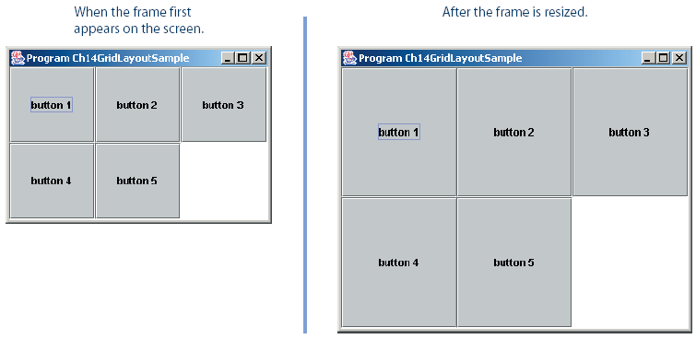
GridLayout Sample
Chapter 14 - <number>
Notes:
Intro to OOP with Java, C. Thomas Wu
©The McGraw-Hill Companies, Inc.

Slide 25
Nesting Panels
It is possible, but very difficult, to place all GUI components on a single JPanel or other types of containers.
A better approach is to use multiple panels, placing panels inside other panels.
Ch14NestedPanels2.java provides the user interface for playing HiLo.
Chapter 14 - 25

Slide 26
Absolute Positioning
It is possible not to use any layout manager. If we do not use one, then we place GUI objects on the frame’s content pane by explicitly specifying their position and size.
We call this approach absolute positioning.
Chapter 14 - <number>

Slide 27
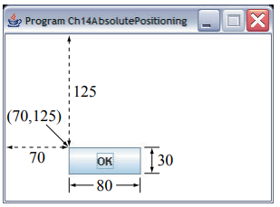
Absolute Positioning Sample
Container contentPane = getContentPane();
JButton okButton = new JButton("OK");
contentPane.setLayout(null);
okButton.setBounds(70, 125, 80, 30); ); //(x, y, width, height)
contentPane.add(okButton);
Chapter 14 - <number>

Slide 28
Event Handling
An action involving a GUI object, such as clicking a button, is called an event(Pressing a button, Entering a character in Textbox, Clicking or Dragging a mouse, etc.).
The mechanism to process events is called event handling.
Event handling is implemented by two types of objects:
  event source objects
  event listener objects
Chapter 14 - <number>
Notes:
Intro to OOP with Java, C. Thomas Wu
©The McGraw-Hill Companies, Inc.
JButton and other GUI objects are event source objects. Any object can be designated as event listener objects.

Slide 29
Event Source Objects
An event source is a GUI object where an event occurs. We say an event source generates events.
Buttons, text boxes, list boxes, and menus are common event sources in GUI-based applications.
Although possible, we do not, under normal circumstances, define our own event sources when writing GUI-based applications.
Chapter 14 - <number>
Notes:
Intro to OOP with Java, C. Thomas Wu
©The McGraw-Hill Companies, Inc.
A single event source can generate more than one type of events. When an event is generated, a corresponding event listener is notified. Whether there is a designated listener or not, event sources generates events. If there's a no matching listeners, generated events are simply ignored.

Slide 30
Event Listener Objects
An event listener object is an object that includes a method that gets executed in response to the generated events.
A listener must be associated, or registered, to a source, so it can be notified when the source generates events.
Chapter 14 - <number>
Notes:
Intro to OOP with Java, C. Thomas Wu
©The McGraw-Hill Companies, Inc.
A listener can listen to a single type of events. If an event source generates two types of events, then we need two different listeners if we want process both types of events. A single listener, however, can be set to listen to single type of events from more than one event source.

Slide 31
Connecting Source and Listener
event source
event listener
notify
JButton
Handler
register
A listener must be registered to a event source. Once
registered, it will get notified when the event source
generates events.
Chapter 14 - <number>
Notes:
Intro to OOP with Java, C. Thomas Wu
©The McGraw-Hill Companies, Inc.
This diagram shows the relationship between the event source and listener. First we register a listener to an event source. Once registered, whenever an event is generated, the event source will notify the listener.

Slide 32
Example
import java.awt.*;
import java.awt.event.*;
import javax.swing.*;
public class EventHandling1 extends JFrame implements ActionListener {
  JButton ok;
  JButton cancel;
  Container contentPane;
public EventHandling1() {
  setTitle("GUI Program");
  setSize(500, 300);
  setLocation(150, 200);
  setDefaultCloseOperation(JFrame.EXIT_ON_CLOSE);
  contentPane = getContentPane();
  contentPane.setLayout(new FlowLayout());
  ok = new JButton("OK");
  cancel = new JButton("Cancel");
  ok.addActionListener(this);
  cancel.addActionListener(this);
  contentPane.add(ok);
  contentPane.add(cancel);
}
Chapter 14 - <number>

Slide 33
public static void main(String[] args) {
  EventHandling1 ev = new EventHandling1();
  ev.setVisible(true);
}
@Override
public void actionPerformed(ActionEvent e1) {
  if (e1.getSource().equals(ok)) {
  JOptionPane.showMessageDialog( null, "Ok button is clicked.");
  }
  if (e1.getSource().equals(cancel)) {
  JOptionPane.showMessageDialog( null, "Cancel button is clicked.");
  }
  }
}
Chapter 14 - <number>

Slide 34
Important Event Classes and Interface
Event Class | Description | Listener Interface
ActionEvent | generated when button is pressed, menu-item is selected, list-item is double clicked | ActionListener
MouseEvent | generated when mouse is dragged, moved,clicked,pressed or released and also when it enters or exit a component | MouseListener
ItemEvent | generated when check-box or list item is clicked | ItemListener
….. | …. | …
Chapter 14 - <number>

Slide 35
JButton
Button
  Component user clicks to trigger an action
  Several types of buttons
    Command buttons, toggle buttons, check boxes, radio buttons
Command button
  Generates ActionEvent when clicked
  Created with class JButton
    Inherits from class AbstractButton
    Defines many features of Swing buttons
JButton
  JButton myButton = new JButton( "Label" );
  myButton.addActionListener(this);
Chapter 14 - <number>

Slide 36
Several types of buttons are subclasses of AbstractButton
javax.swing.JComponent
javax.swing.AbstractButton
javax.swing.JButton
javax.swing.ToggleButton
javax.swing.JCheckBox
javax.swing.JRadioButton
Chapter 14 - <number>

Slide 37
GUI Classes for Handling Text
The Swing GUI classes JLabel, JTextField, and JTextArea deal with text.
A JLabel object displays uneditable text (or image).
A JTextField object allows the user to enter a single line of text.
A JTextArea object allows the user to enter multiple lines of text. It can also be used for displaying multiple lines of uneditable text.
Chapter 14 - <number>

Slide 38
JTextField
We use a JTextField object to accept a single line to text from a user. An action event is generated when the user presses the ENTER key.
The getText method of JTextField is used to retrieve the text that the user entered.
JTextField input = new JTextField( );
input.addActionListener(eventListener);
contentPane.add(input);
Chapter 14 - <number>
Notes:
Intro to OOP with Java, C. Thomas Wu
©The McGraw-Hill Companies, Inc.
The getText method is most commonly used inside the actionPerformed method of an action listener.

Slide 39
JLabel
We use a JLabel object to display a label.
A label can be a text or an image.
When creating an image label, we pass ImageIcon object instead of a string.
JLabel textLabel = new JLabel("Please enter your name");
contentPane.add(textLabel);
JLabel imgLabel = new JLabel(new ImageIcon("cat.gif"));
contentPane.add(imgLabel);
4th Ed Chapter 14 - <number>
Notes:
Intro to OOP with Java, C. Thomas Wu
©The McGraw-Hill Companies, Inc.
A JLabel is strictly for displaying noneditable text or image. A JLabel object does not generate any events.

Slide 40
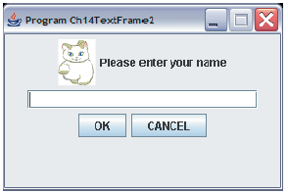
Ch14TextFrame2
JLabel
(with a text)
JLabel
(with an image)
JTextField
Source File: Ch14TextFrame2.java
Chapter 14 - <number>
Notes:
Intro to OOP with Java, C. Thomas Wu
©The McGraw-Hill Companies, Inc.
The sample Ch7TextFrame2 class includes five GUI components: two JLabel objects, one JTextField object, and two JButton objects.
Page No. 835

Slide 41
JTextArea
We use a JTextArea object to display or allow the user to enter multiple lines of text.
The setText method assigns the text to a JTextArea, replacing the current content.
The append method appends the text to the current text.
JTextArea textArea
= new JTextArea(5,10 );
. . .
textArea.setText("Hello\n");
textArea.append("the lost ");
textArea.append("world");
Hello
the lost world
JTextArea
Chapter 14 - <number>

Slide 42
Adding Scroll Bars to JTextArea
By default a JTextArea does not have any scroll bars. To add scroll bars, we place a JTextArea in a JScrollPane object
JTextArea textArea = new JTextArea();
. . .
JScrollPane scrollText = new JScrollPane(textArea);
. . .
contentPane.add(scrollText);
Chapter 14 - <number>

Slide 43
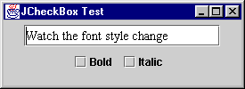
JCheckBox
State buttons
  JToggleButton
    Subclasses JCheckBox, JRadioButton
  Have on/off (true/false) values
Class JCheckBox
  Text appears to right of checkbox
  Constructor
  JCheckBox myBox = new JCheckBox( “Bold" );
Chapter 14 - <number>

Slide 44
JCheckBox
When JCheckBox changes
  ItemEvent generated
    Handled by an ItemListener, which must define itemStateChanged
  Register handlers with with addItemListener
private class CheckBoxHandler implements ItemListener
{
public void itemStateChanged( ItemEvent e )
{
….
}
}

Slide 45
JCheckBox
Some Constructors and Methods
JCheckBox(String label)
JCheckBox(String label, boolean state)
JCheckBox(String label, Icon icon)
boolean isSelected()
void setSelected()
String getText();
void append();
Chapter 14 - <number>

Slide 46
JRadioButton
Radio buttons look just like checkboxes, but they are grouped and only one radio button in a group can be checked at any given time.
In many cases, we want to require the user to check only one of several boxes. When another box is checked, the previous box is automatically unchecked.
Such a group of boxes is called a radio button group because the buttons works like the station selector buttons on a radio.
Chapter 14 - <number>

Slide 47
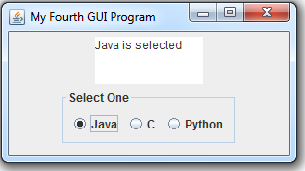
JRadioButton
Some Constructors and Methods of JRadioButton
JRadioButton ()
JRadioButton (Icon icon)
JRadioButton (Icon icon, boolean selected)
JRadioButton (String text)
JRadioButton (String text, boolean selected)
JRadioButton (String text, Icon icon)
JRadioButton (String text, Icon icon, boolean selected)
void isSelected();
String getText();
Javax.swing. ButtonGroup
void add(AbstractButton b)
adds the button to the group
Chapter 14 - <number>

Slide 48
JComboBox
The JComboBox class presents a combo box. This class is similar to the JRadioButton class in that it also allows the user to select one item from a list of possible choices.
A JComboBox object generates both action events and item events.
To find out the currently selected item, we call the getSelectedItem method of JComboBox.
Chapter 14 - <number>

Slide 49
JComboBox
Some Constructor and Methods of JComboBox
JComboBox()
JComboBox(Object[] items)
void addItem(Object anObject)
int getSelectedIndex( )
Object getSelectedItem ( )
void addActionListener(ActionListener listener)
void addItemListener(ItemListener listener)
Chapter 14 - <number>

Slide 50
JComboBox
String[] comboBoxItem = {"Java", "C", “Python"};
JComboBox comboBox = new JComboBox(comboBoxItem);
String selection = (String) comboBox.getSelectedItem();
Chapter 14 - <number>

Slide 51
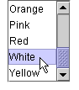
JList
The JList class is useful when we need to display a list of items, for example, a list of students, a list of files, and so forth
We can construct a JList object in a manner identical to the way we construct a JComboBox object, that is, by passing an array of String
String[] listItem = {“Orange", “Pink", “Red“, “White”,”Yellow”};
JList list = new JList (listITem);
Chapter 14 - <number>

Slide 52
JList
JList methods
  int getSelectedIndex()
  int[] getSelectedIndices()
  Object getSelectedValue()
  Object [] getSelectedValues()
  void setListData(Object[] listData)
  void setSelectionMode (int selectionMode)
  void setVisibleRowCount(int count)
Chapter 14 - <number>

Slide 53
JList
Event handlers
  Implement interface ListSelectionListener (javax.swing.event)
  Define method valueChanged
  Register handler with addListSelectionListener
Chapter 14 - <number>

Slide 54
Common GUI Components
JCheckBox
  see Ch14JCheckBoxSample1.java and Ch14JCheckBoxSample2.java
JRadioButton
  see Ch14JRadioButtonSample.java
JComboBox
  see Ch14JComboBoxSample.java
JList
  see Ch14JListSample.java
4th Ed Chapter 14 - <number>
Notes:
Intro to OOP with Java, C. Thomas Wu
©The McGraw-Hill Companies, Inc.

Slide 55
Menus
The javax.swing package contains three menu-related classes: JMenuBar, JMenu, and JMenuItem.
JMenuBar is a bar where the menus are placed. There is one menu bar per frame.
JMenu (such as File or Edit) is a group of menu choices. JMenuBar may include many JMenu objects.
JMenuItem (such as Copy, Cut, or Paste) is an individual menu choice in a JMenu object.
Only the JMenuItem objects generate events.
Chapter 14 - <number>
Notes:
Intro to OOP with Java, C. Thomas Wu
©The McGraw-Hill Companies, Inc.
Almost all nontrivial GUI programs support menus. By using these three menu-related classes, we can easily add menus to our Java programs.

Slide 56
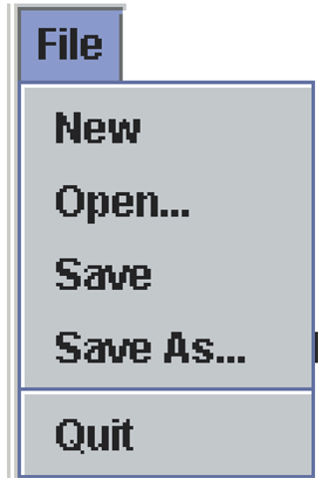
Menu Components
Edit
View
Help
JMenuBar
File
Edit
View
Help
JMenu
JMenuItem
separator
Chapter 14 - <number>
Notes:
Intro to OOP with Java, C. Thomas Wu
©The McGraw-Hill Companies, Inc.
The diagram shows how the menu-related objects correspond to the actual menus.

Slide 57
Sequence for Creating Menus
Create a JMenuBar object and attach it to a frame.
Create a JMenu object.
Create JMenuItem objects and add them to the JMenu object.
Attach the JMenu object to the JMenuBar object.
Source: Ch14JMenuFrame.java
Chapter 14 - <number>
Notes:
Intro to OOP with Java, C. Thomas Wu
©The McGraw-Hill Companies, Inc.
This is not the only valid sequence. Other sequences are possible. We list this sequence as one possible sequence you can follow in creating menus.

Slide 58
Handling Mouse Events
Mouse events include such user interactions as
  moving the mouse
  dragging the mouse (moving the mouse while the mouse button is being pressed)
  clicking the mouse buttons.
The MouseListener interface handles mouse button
  mouseClicked, mouseEntered, mouseExited, mousePressed, and mouseReleased
The MouseMotionListener interface handles mouse movement
  mouseDragged and mouseMoved.
Chapter 14 - <number>

Slide 59
References
An introduction to object-oriented programming with Java (Fifth Edition), C. Thomas Wu
Java 8 Programming Black Book (2015 Edition), DT Editorial Services, Comprehensive Problem Solver.
Chapter 14 - <number>

Slide 60
Exercises No. 11, 29
Chapter 14 - <number>

