Slide 1

IS-201 - Database Chapter 6 – Database Design Using the E-R Model
Part(1) of (4)
DAW MAY THU KYAW
LECTURER
Faculty of Information Science

Slide 2
Outline
Overview of the Design Process
Design Phases
Design Alternatives
The Entity-Relationship Model
Entity Sets
Relationship Sets

Slide 3
Design Phases
Initial phase -- characterize fully the data needs of the prospective database users.
Second phase -- choosing a data model
Applying the concepts of the chosen data model
Translating these requirements into a conceptual schema of the database.
A fully developed conceptual schema indicates the functional requirements of the enterprise.
Describe the kinds of operations (or transactions) that will be performed on the data.

Slide 4
Design Phases (Cont.)
Final Phase -- Moving from an abstract data model to the implementation of the database
Logical Design – Deciding on the database schema. Database design requires that we find a “good” collection of relation schemas.
Business decision – What attributes should we record in the database?
Computer Science decision – What relation schemas should we have and how should the attributes be distributed among the various relation schemas?
Physical Design – Deciding on the physical layout of the database

Slide 5
Design Alternatives
In designing a database schema, we must ensure that we avoid two major pitfalls:
Redundancy: a bad design may result in repeat information.
Redundant representation of information may lead to data inconsistency among the various copies of information
Incompleteness: a bad design may make certain aspects of the enterprise difficult or impossible to model.
Avoiding bad designs is not enough. There may be a large number of good designs from which we must choose.

Slide 6
Design Approaches
Entity Relationship Model (covered in this chapter)
Models an enterprise as a collection of entities and relationships
Entity: a “thing” or “object” in the enterprise that is distinguishable from other objects
Described by a set of attributes
Relationship: an association among several entities
Represented diagrammatically by an entity-relationship diagram:
Normalization Theory (Chapter 7)
Formalize what designs are bad, and test for them

Slide 7
The Entity-Relationship Model
The ER data mode was developed to facilitate database design by allowing specification of an enterprise schema that represents the overall logical structure of a database.
The ER data model employs three basic concepts:
entity sets,
relationship sets,
attributes.
The ER model also has an associated diagrammatic representation, the ER diagram, which can express the overall logical structure of a database graphically.

Slide 8
Entity Sets
An entity is an object that exists and is distinguishable from other objects.
Example: specific person, company, event, plant
An entity set is a set of entities of the same type that share the same properties.
Example: set of all persons, companies, trees, holidays

Slide 9
Entity Sets(Cont.)
An entity is represented by a set of attributes; i.e., descriptive properties possessed by all members of an entity set.
Example:
instructor = (ID, name, salary ) course= (course_id, title, credits)
A subset of the attributes form a primary key of the entity set; i.e., uniquely identifying each member of the set.

Slide 10
Entity Sets -- instructor and student

Slide 11
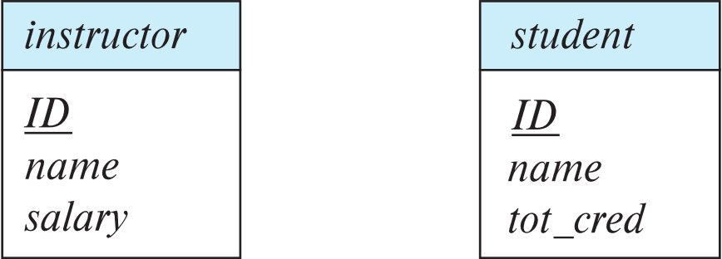
Representing Entity sets in ER Diagram
Entity sets can be represented graphically as follows:
Rectangles represent entity sets.
Attributes listed inside entity rectangle
Underline indicates primary key attributes

Slide 12
Relationship Sets
A relationship is an association among several entities
Example: 44553 (Peltier) advisor 22222 (Einstein) student entity relationship set instructor entity
A relationship set is a mathematical relation among n ≥ 2 entities, each taken from entity sets
{(e₁, e₂, … e_{n}) | e₁ ∈ E₁, e₂ ∈ E₂, …, e_{n} ∈ E_{n}} where (e₁, e₂, …, e_{n}) is a relationship
Example:
(44553,22222) ∈ advisor

Slide 13
Relationship Sets (Cont.)
Example: we define the relationship set advisor to denote the associations between students and the instructors who act as their advisors.
Pictorially, we draw a line between related entities.

Slide 14
Representing Relationship Sets via ER Diagrams
Diamonds represent relationship sets.

Slide 15
Relationship Sets (Cont.)
An attribute can also be associated with a relationship set.
For instance, the advisor relationship set between entity sets instructor and student may have the attribute date which tracks when the student started being associated with the advisor

Slide 16
Relationship Sets with Attributes

Slide 17
Roles
Entity sets of a relationship need not be distinct
Each occurrence of an entity set plays a “role” in the relationship
The labels “course_id” and “prereq_id” are called roles.

Slide 18
Degree of a Relationship Set
Binary relationship
involve two entity sets (or degree two).
most relationship sets in a database system are binary.
Relationships between more than two entity sets are rare. Most relationships are binary. (More on this later.)
Example: students work on research projects under the guidance of an instructor.
relationship proj_guide is a ternary relationship between instructor, student, and project

Slide 19
Non-binary Relationship Sets
Most relationship sets are binary
There are occasions when it is more convenient to represent relationships as non-binary.
E-R Diagram with a Ternary Relationship

Slide 20
Next Lecture
Complex Attributes
Mapping Cardinalities

